Slide 1
Welcome to Mrs Footer’s Class

Slide 2
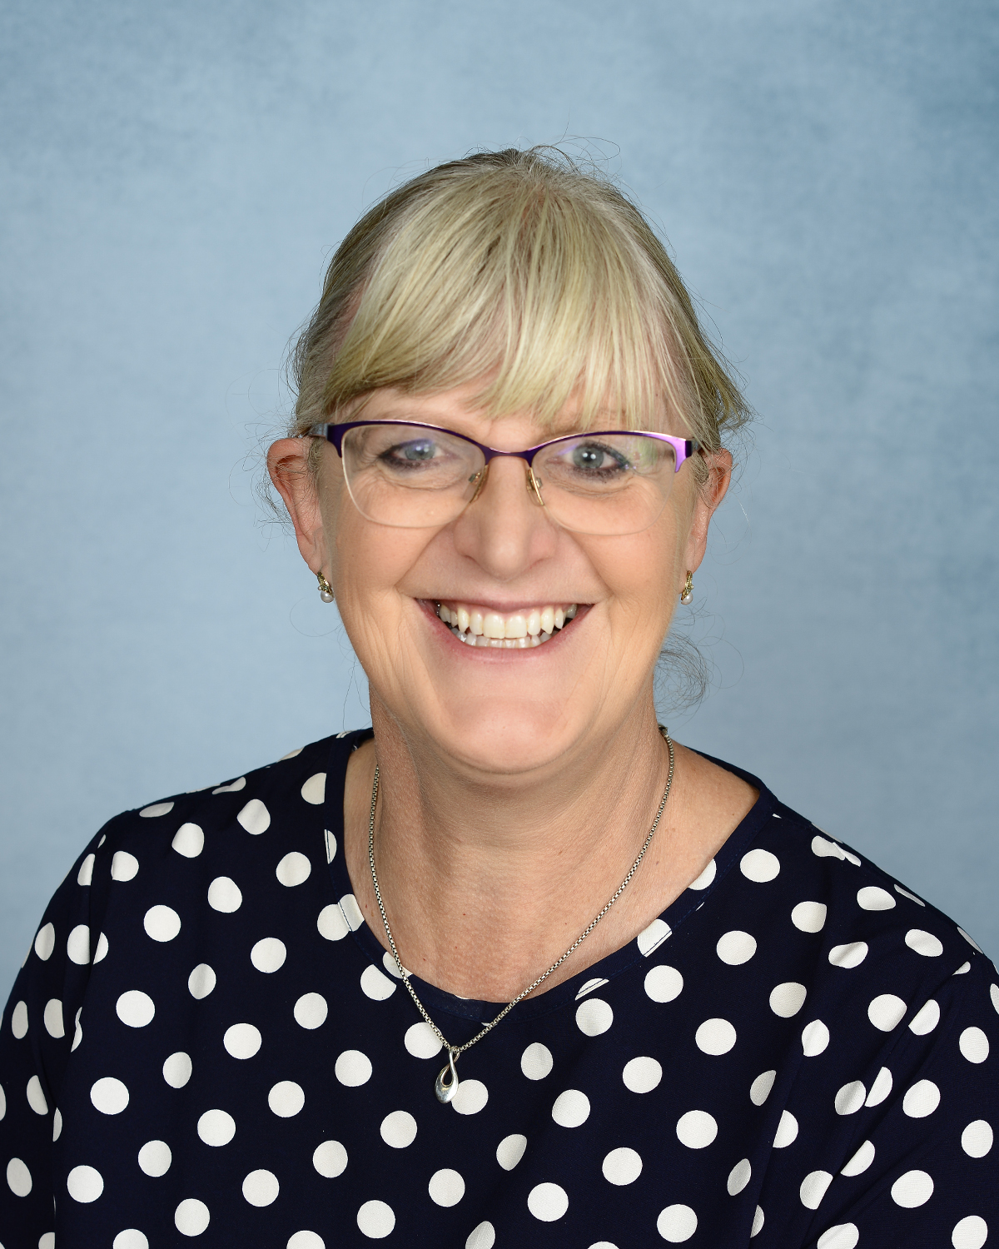
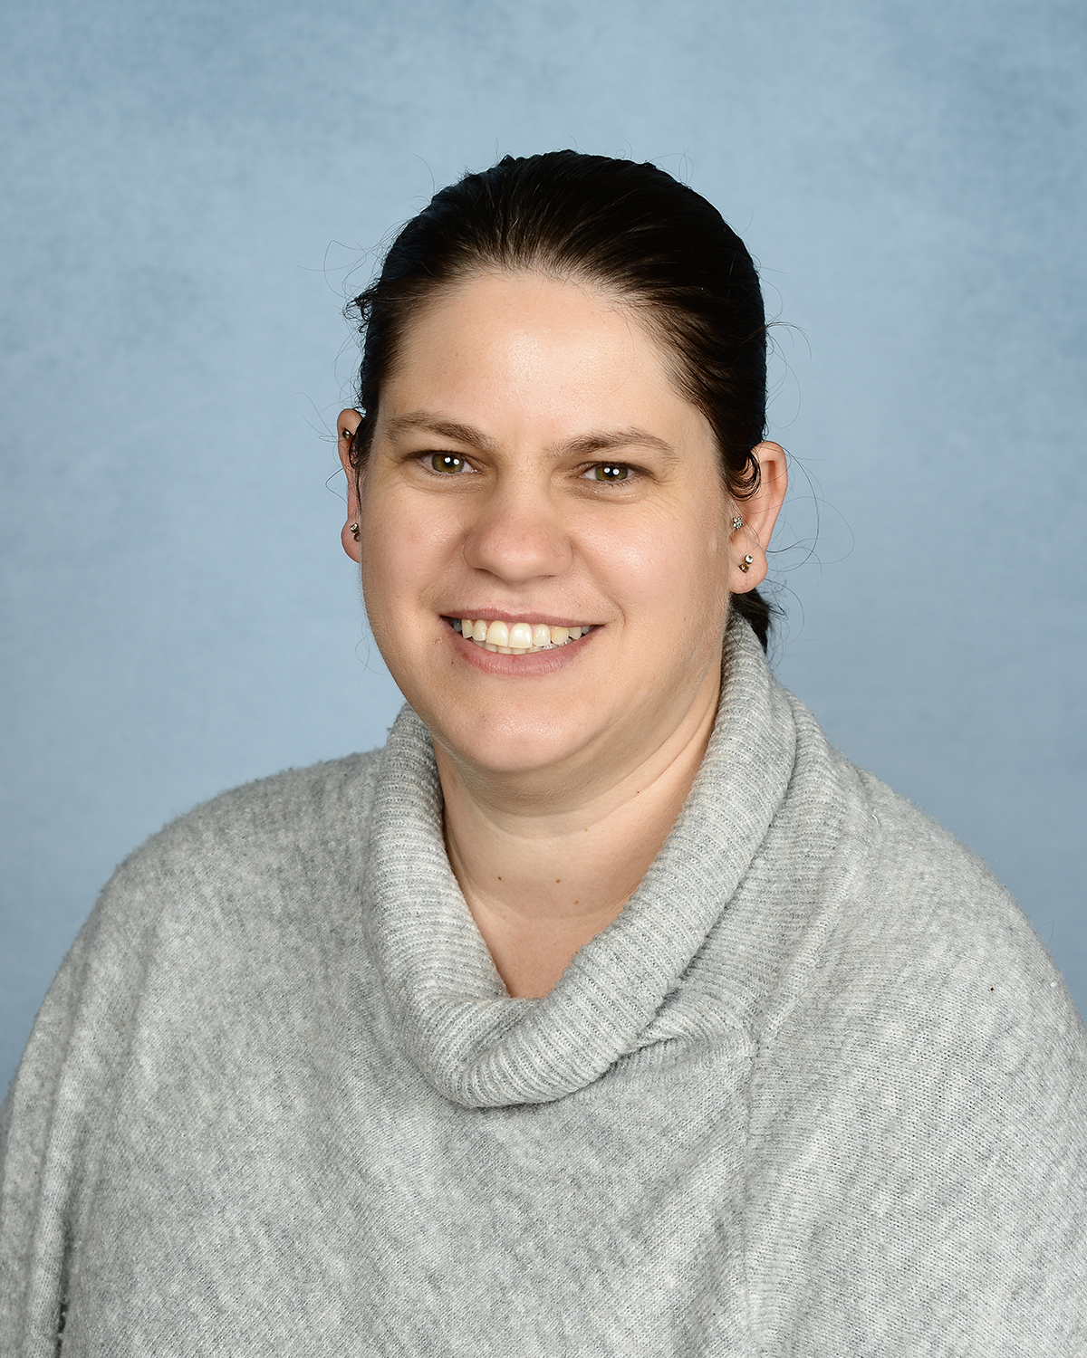
These are the adults that will be working
in your classroom.
Mrs Footer
Class Teacher
Mrs Van Jaarsveld
Teaching assistant

Slide 3
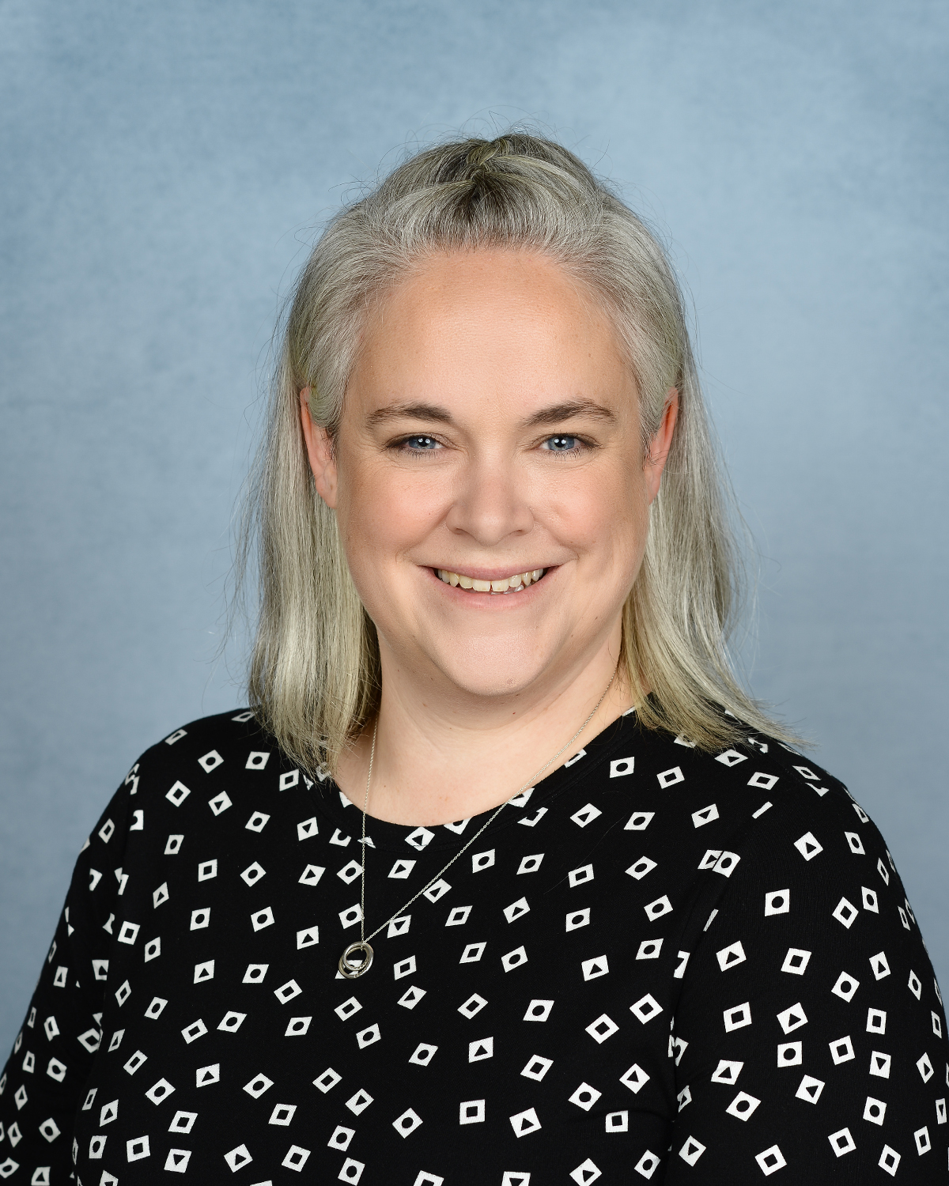
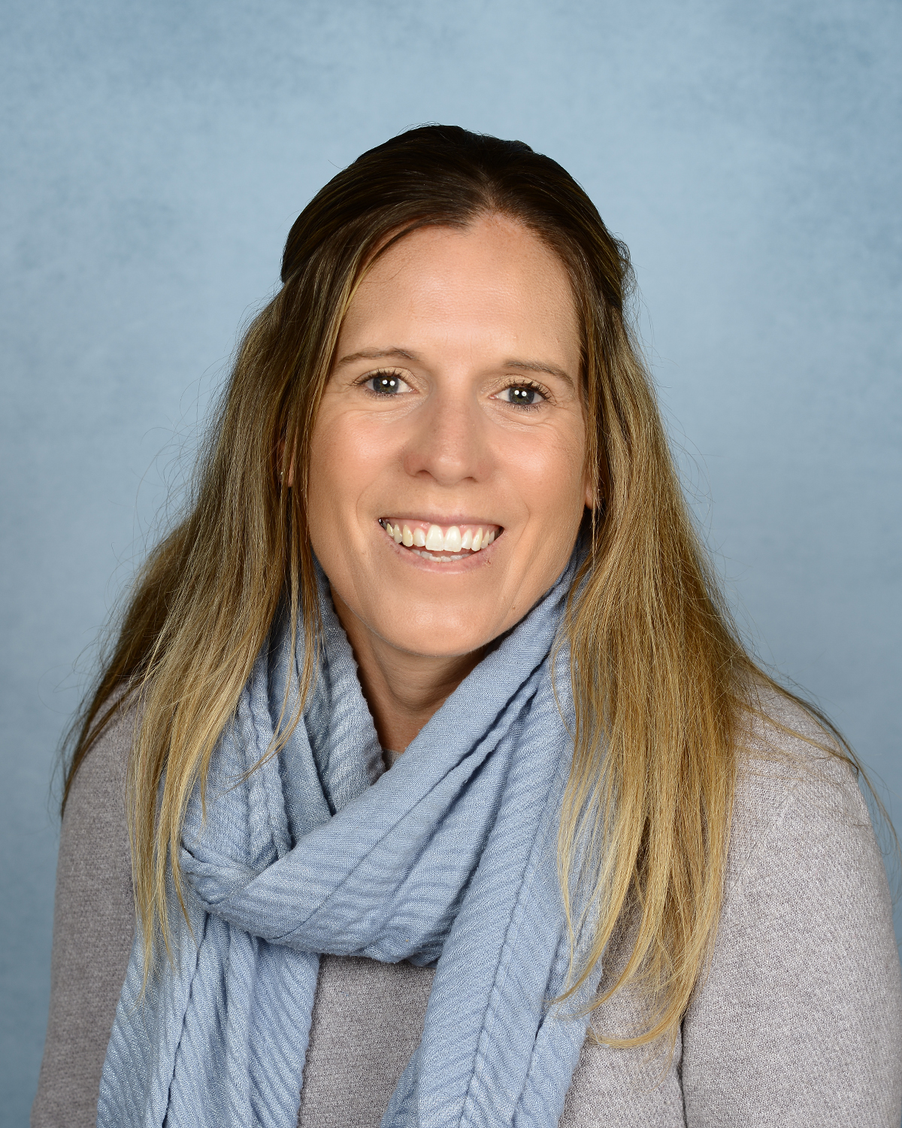
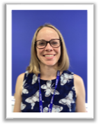
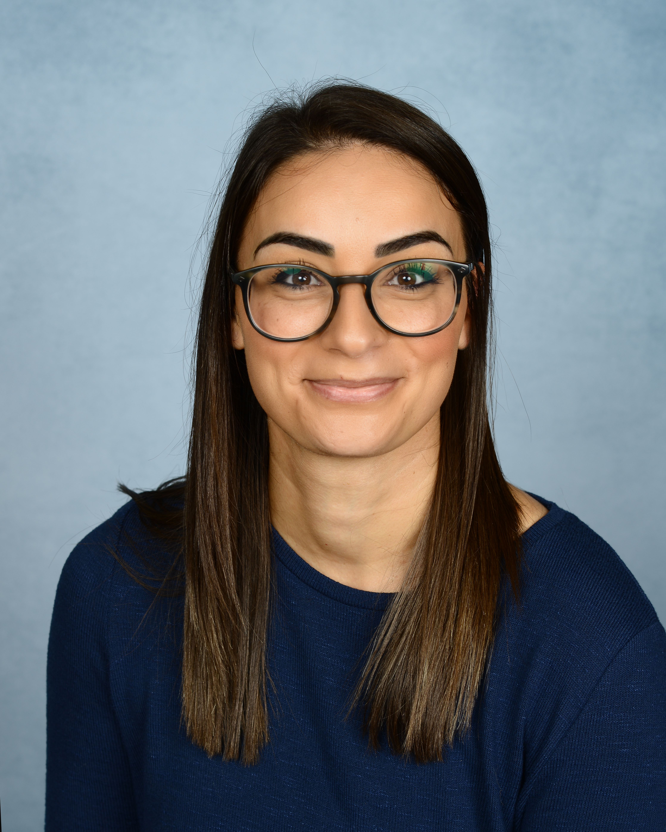
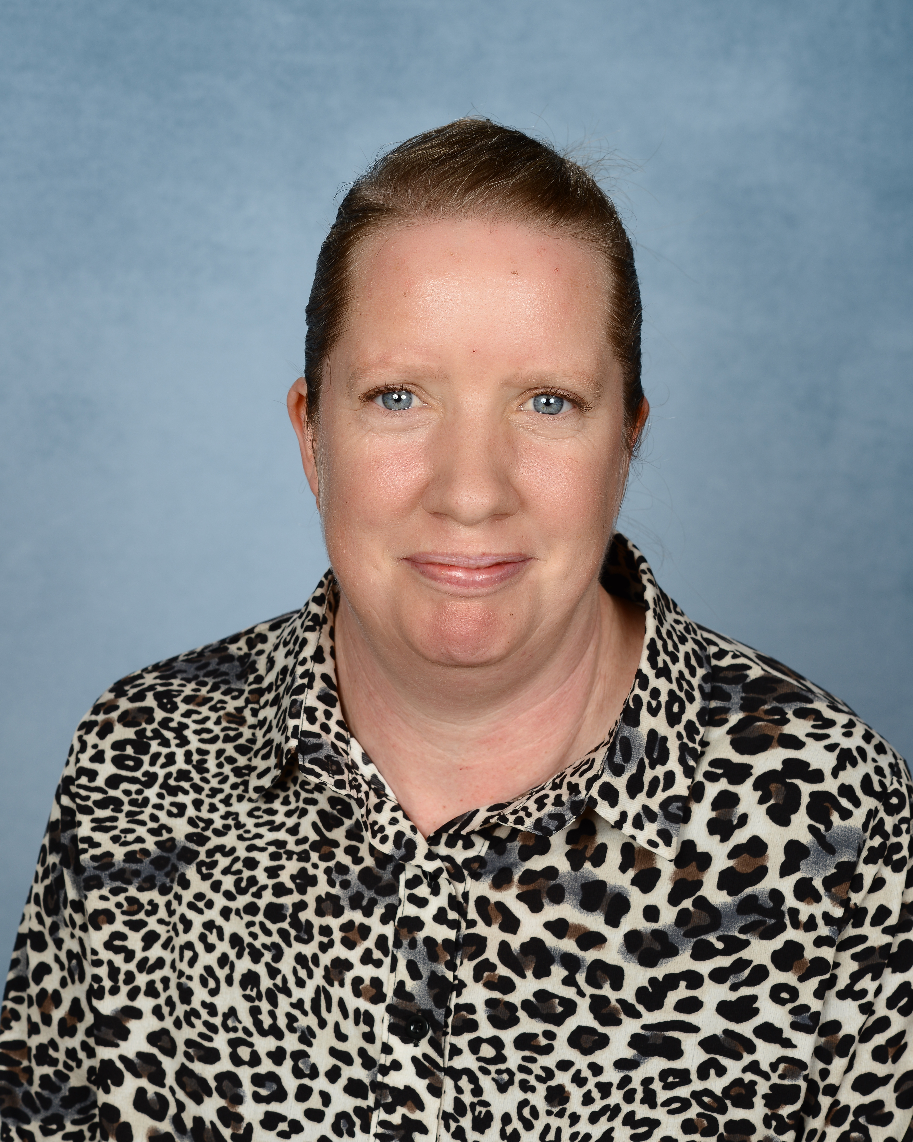
These are the adults that will be working
in Early Years
Mrs Walker
Class Teacher
Mrs Hunt
Class Teacher
Mrs Langley
Class Teacher
Mrs Woods
Teaching assistant
Mrs Palmer
Teaching assistant

Slide 4
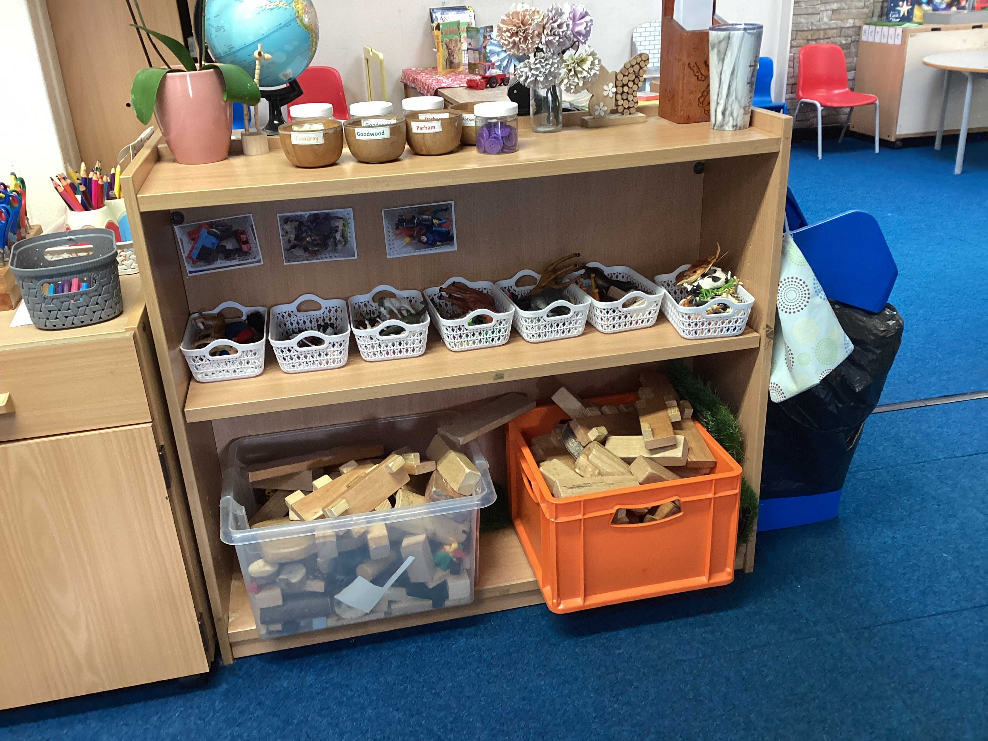
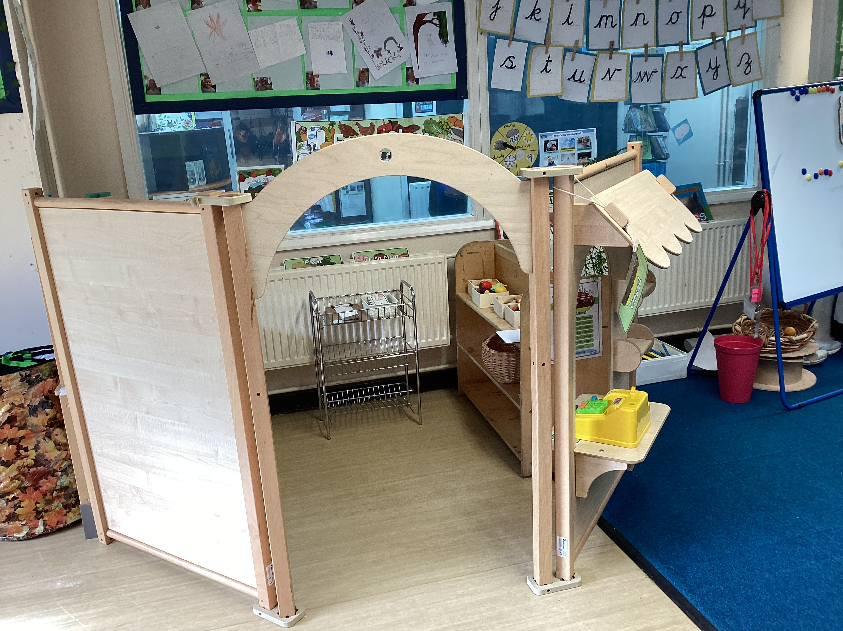
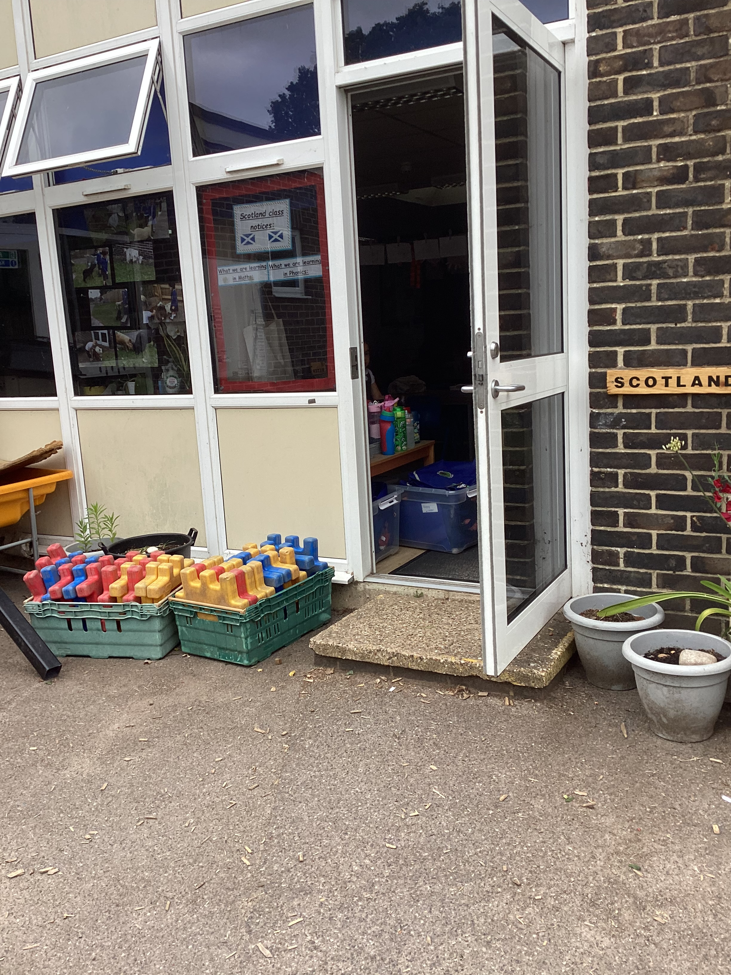
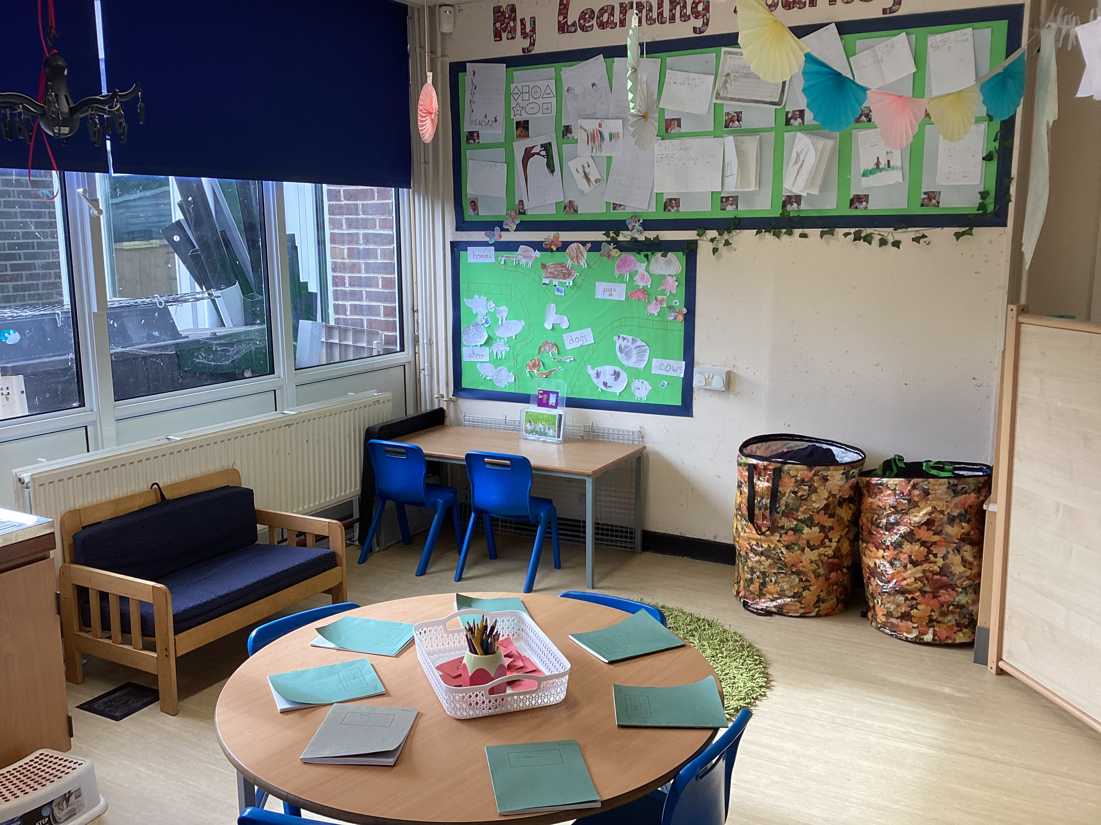
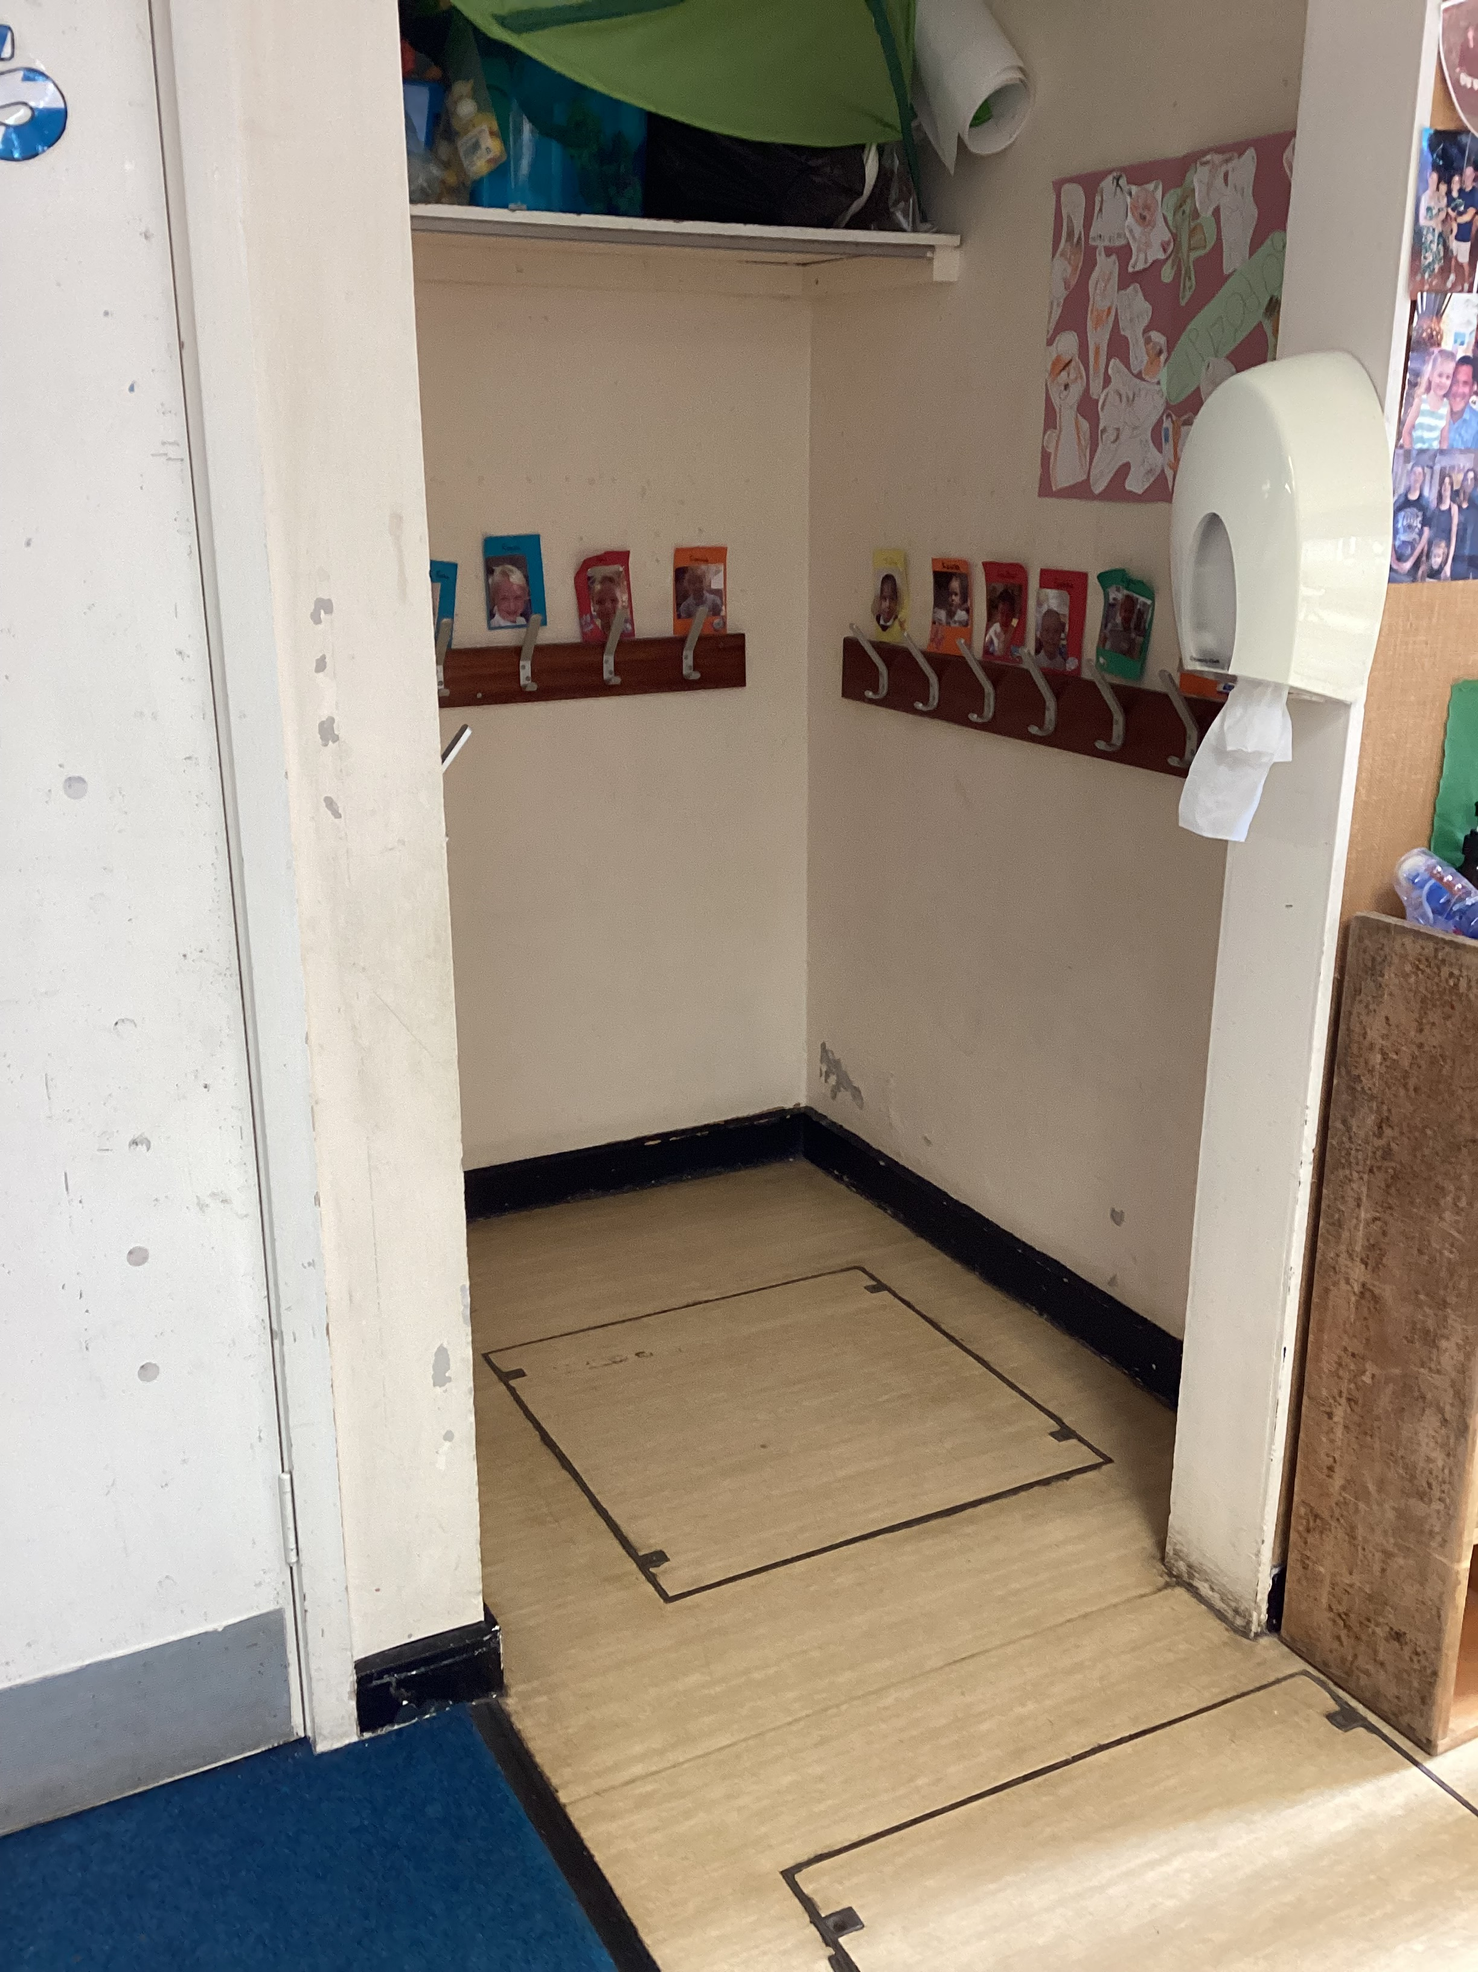
This is your classroom.
This is where you will enter the school and your classroom.
This is where you will hang your coat and book bag.

Slide 5
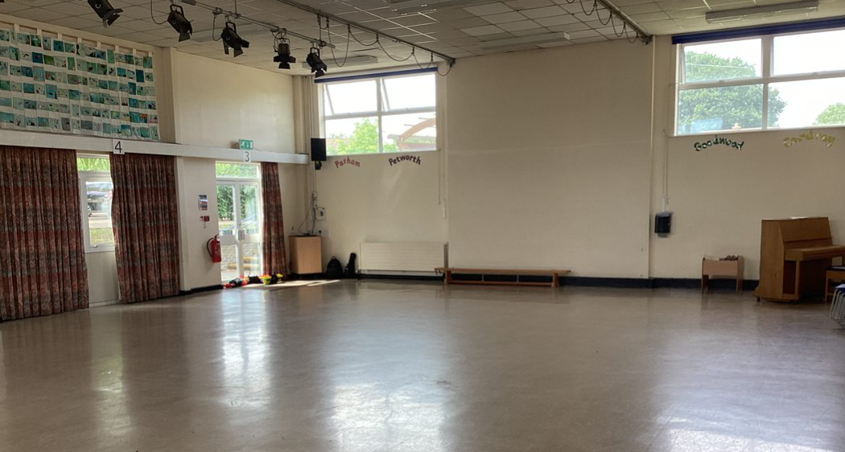
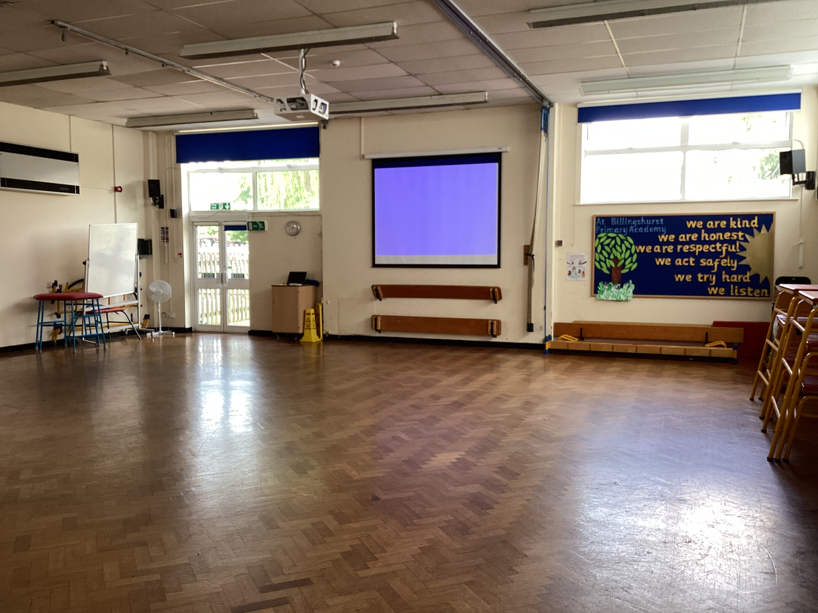
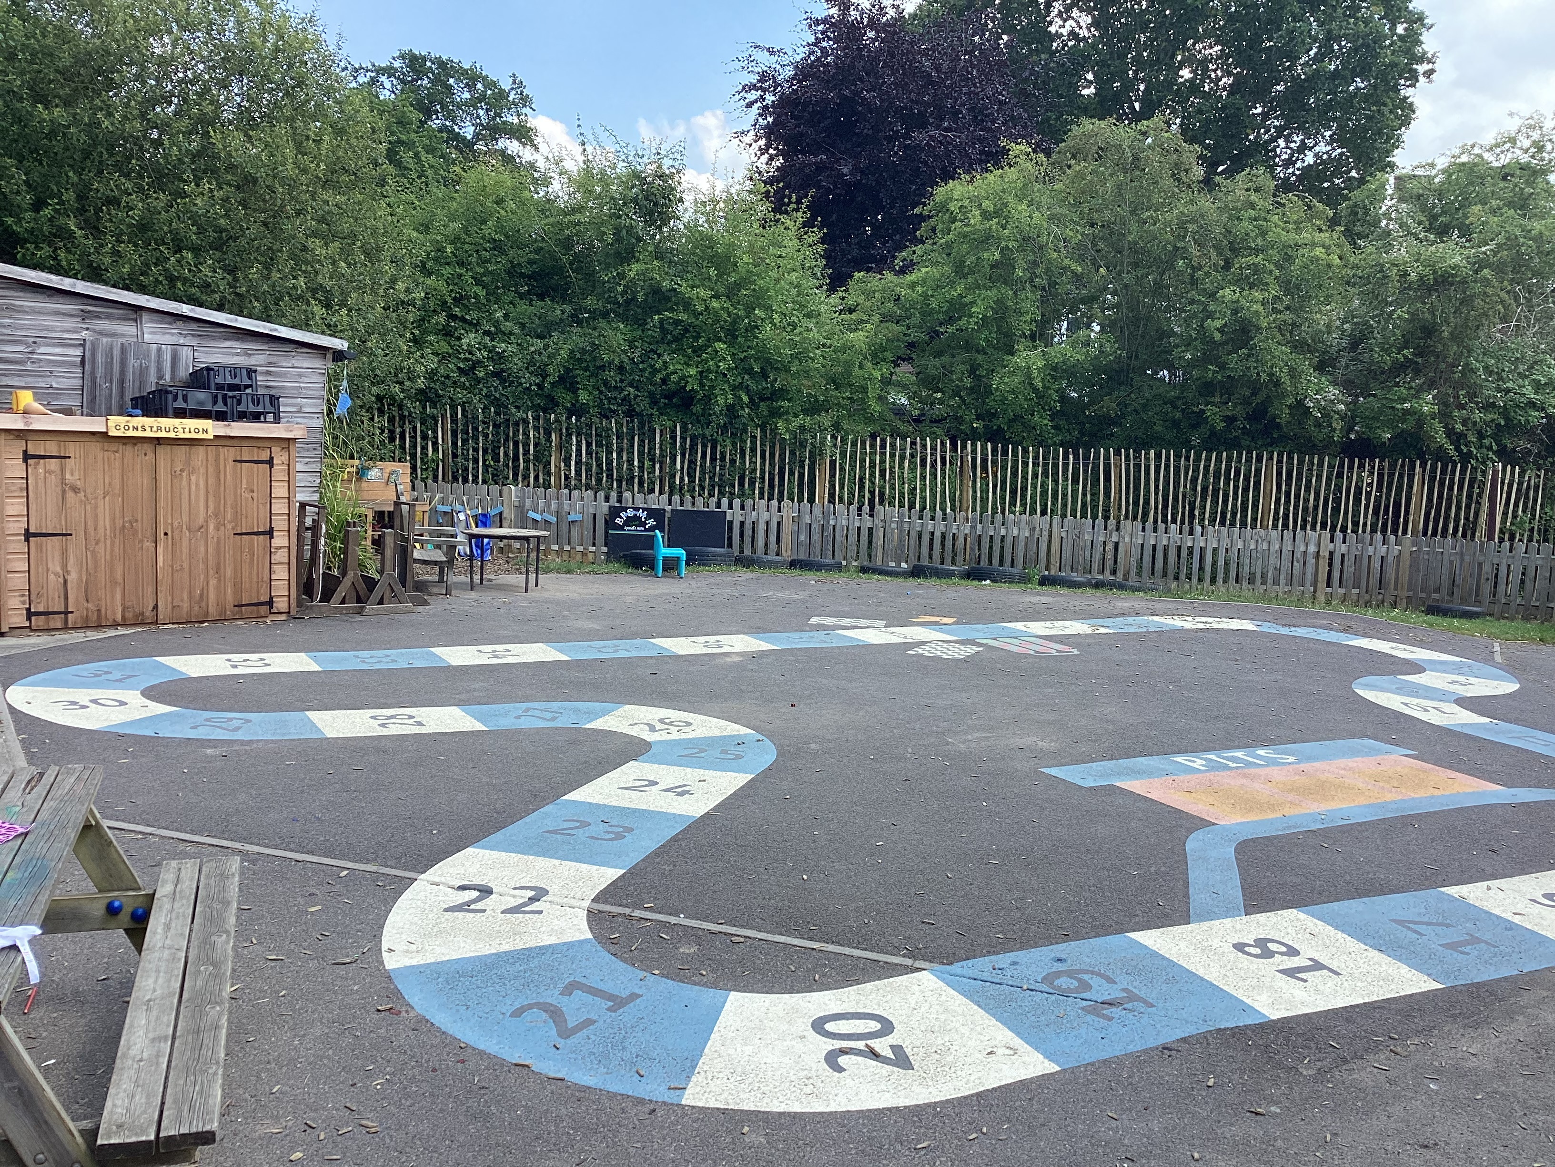
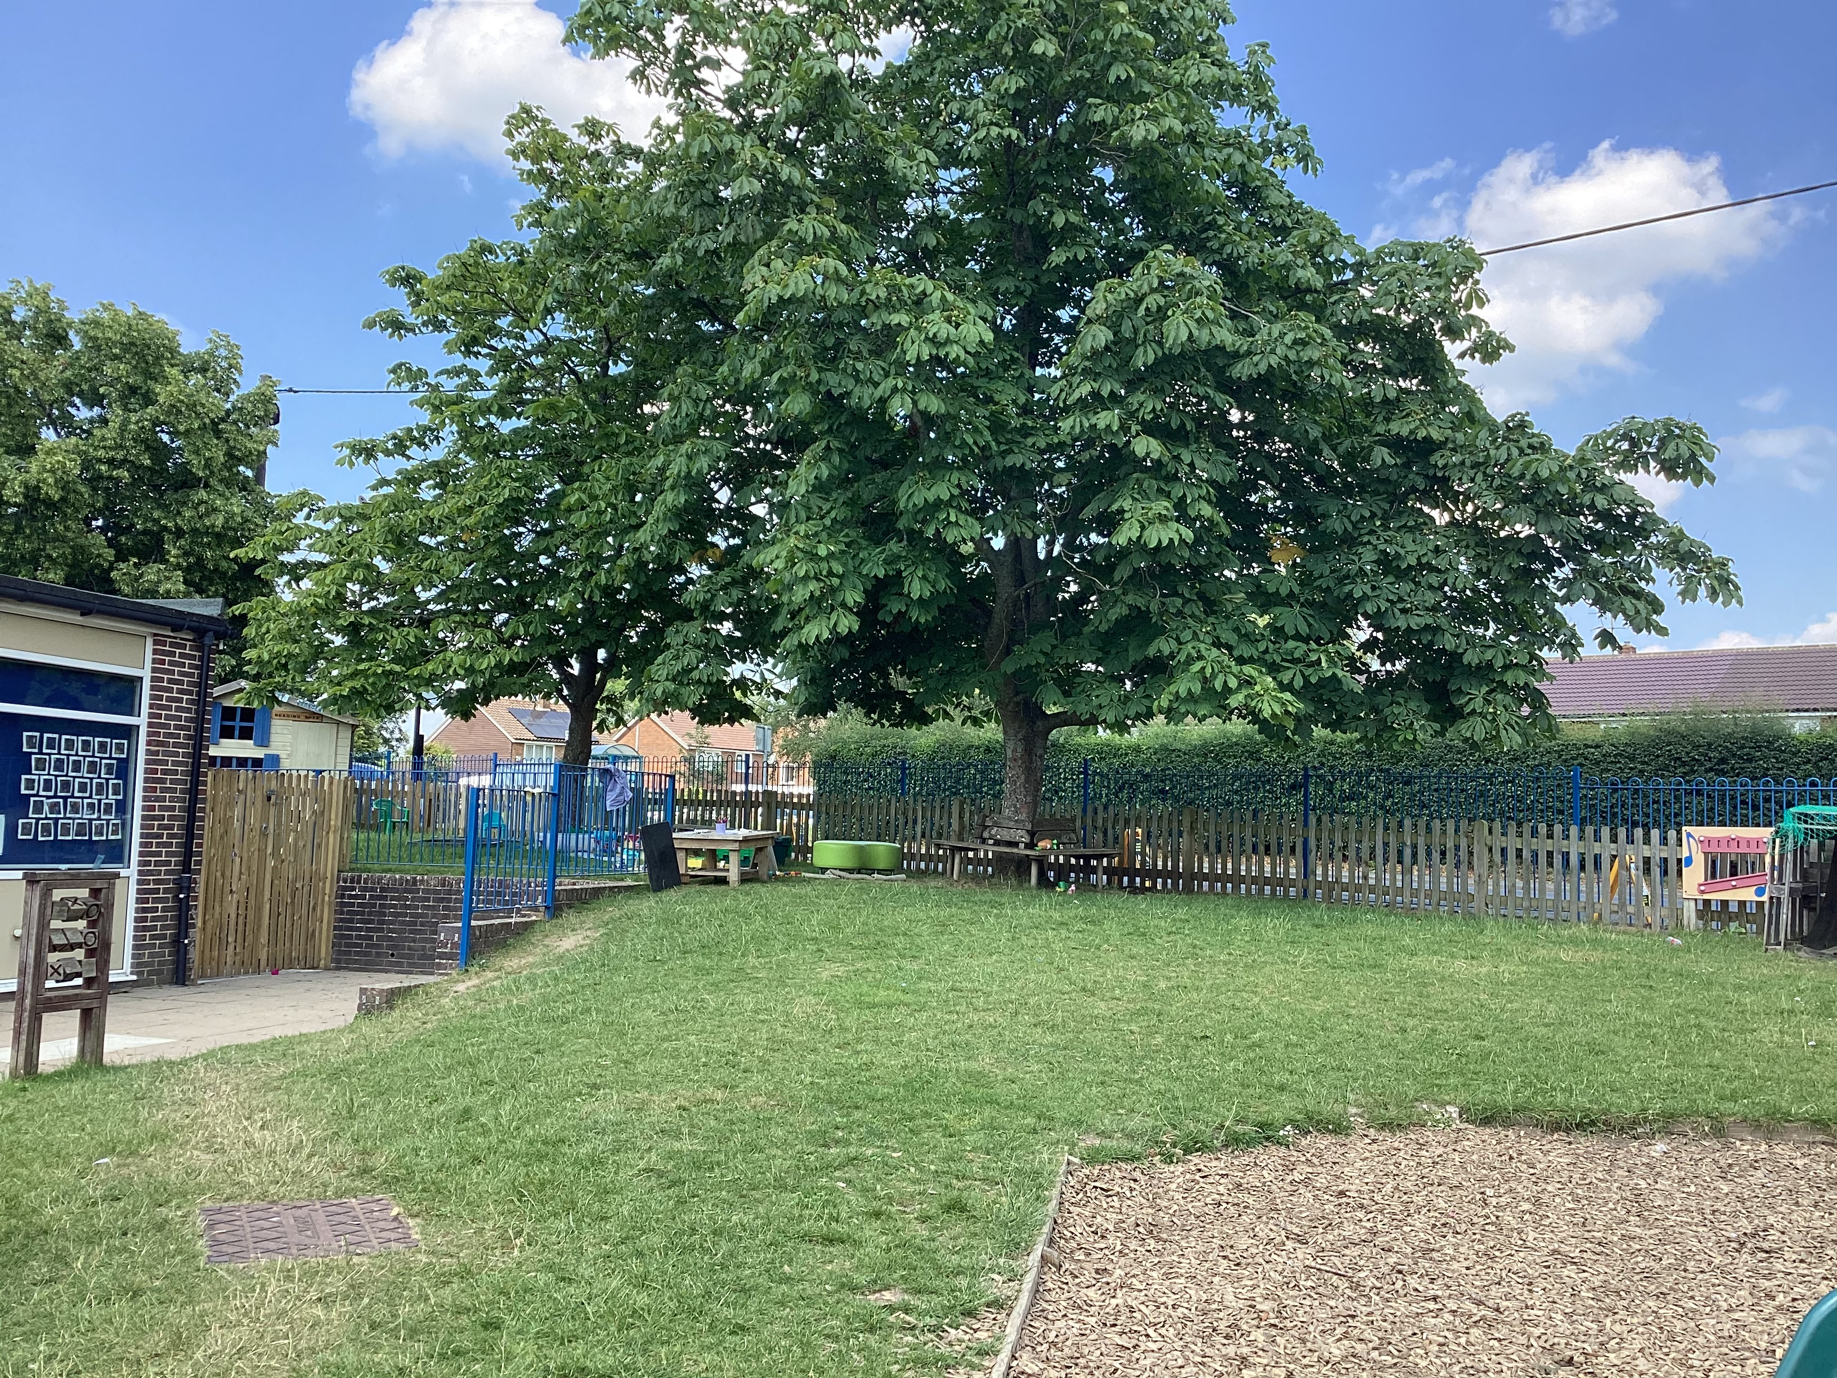
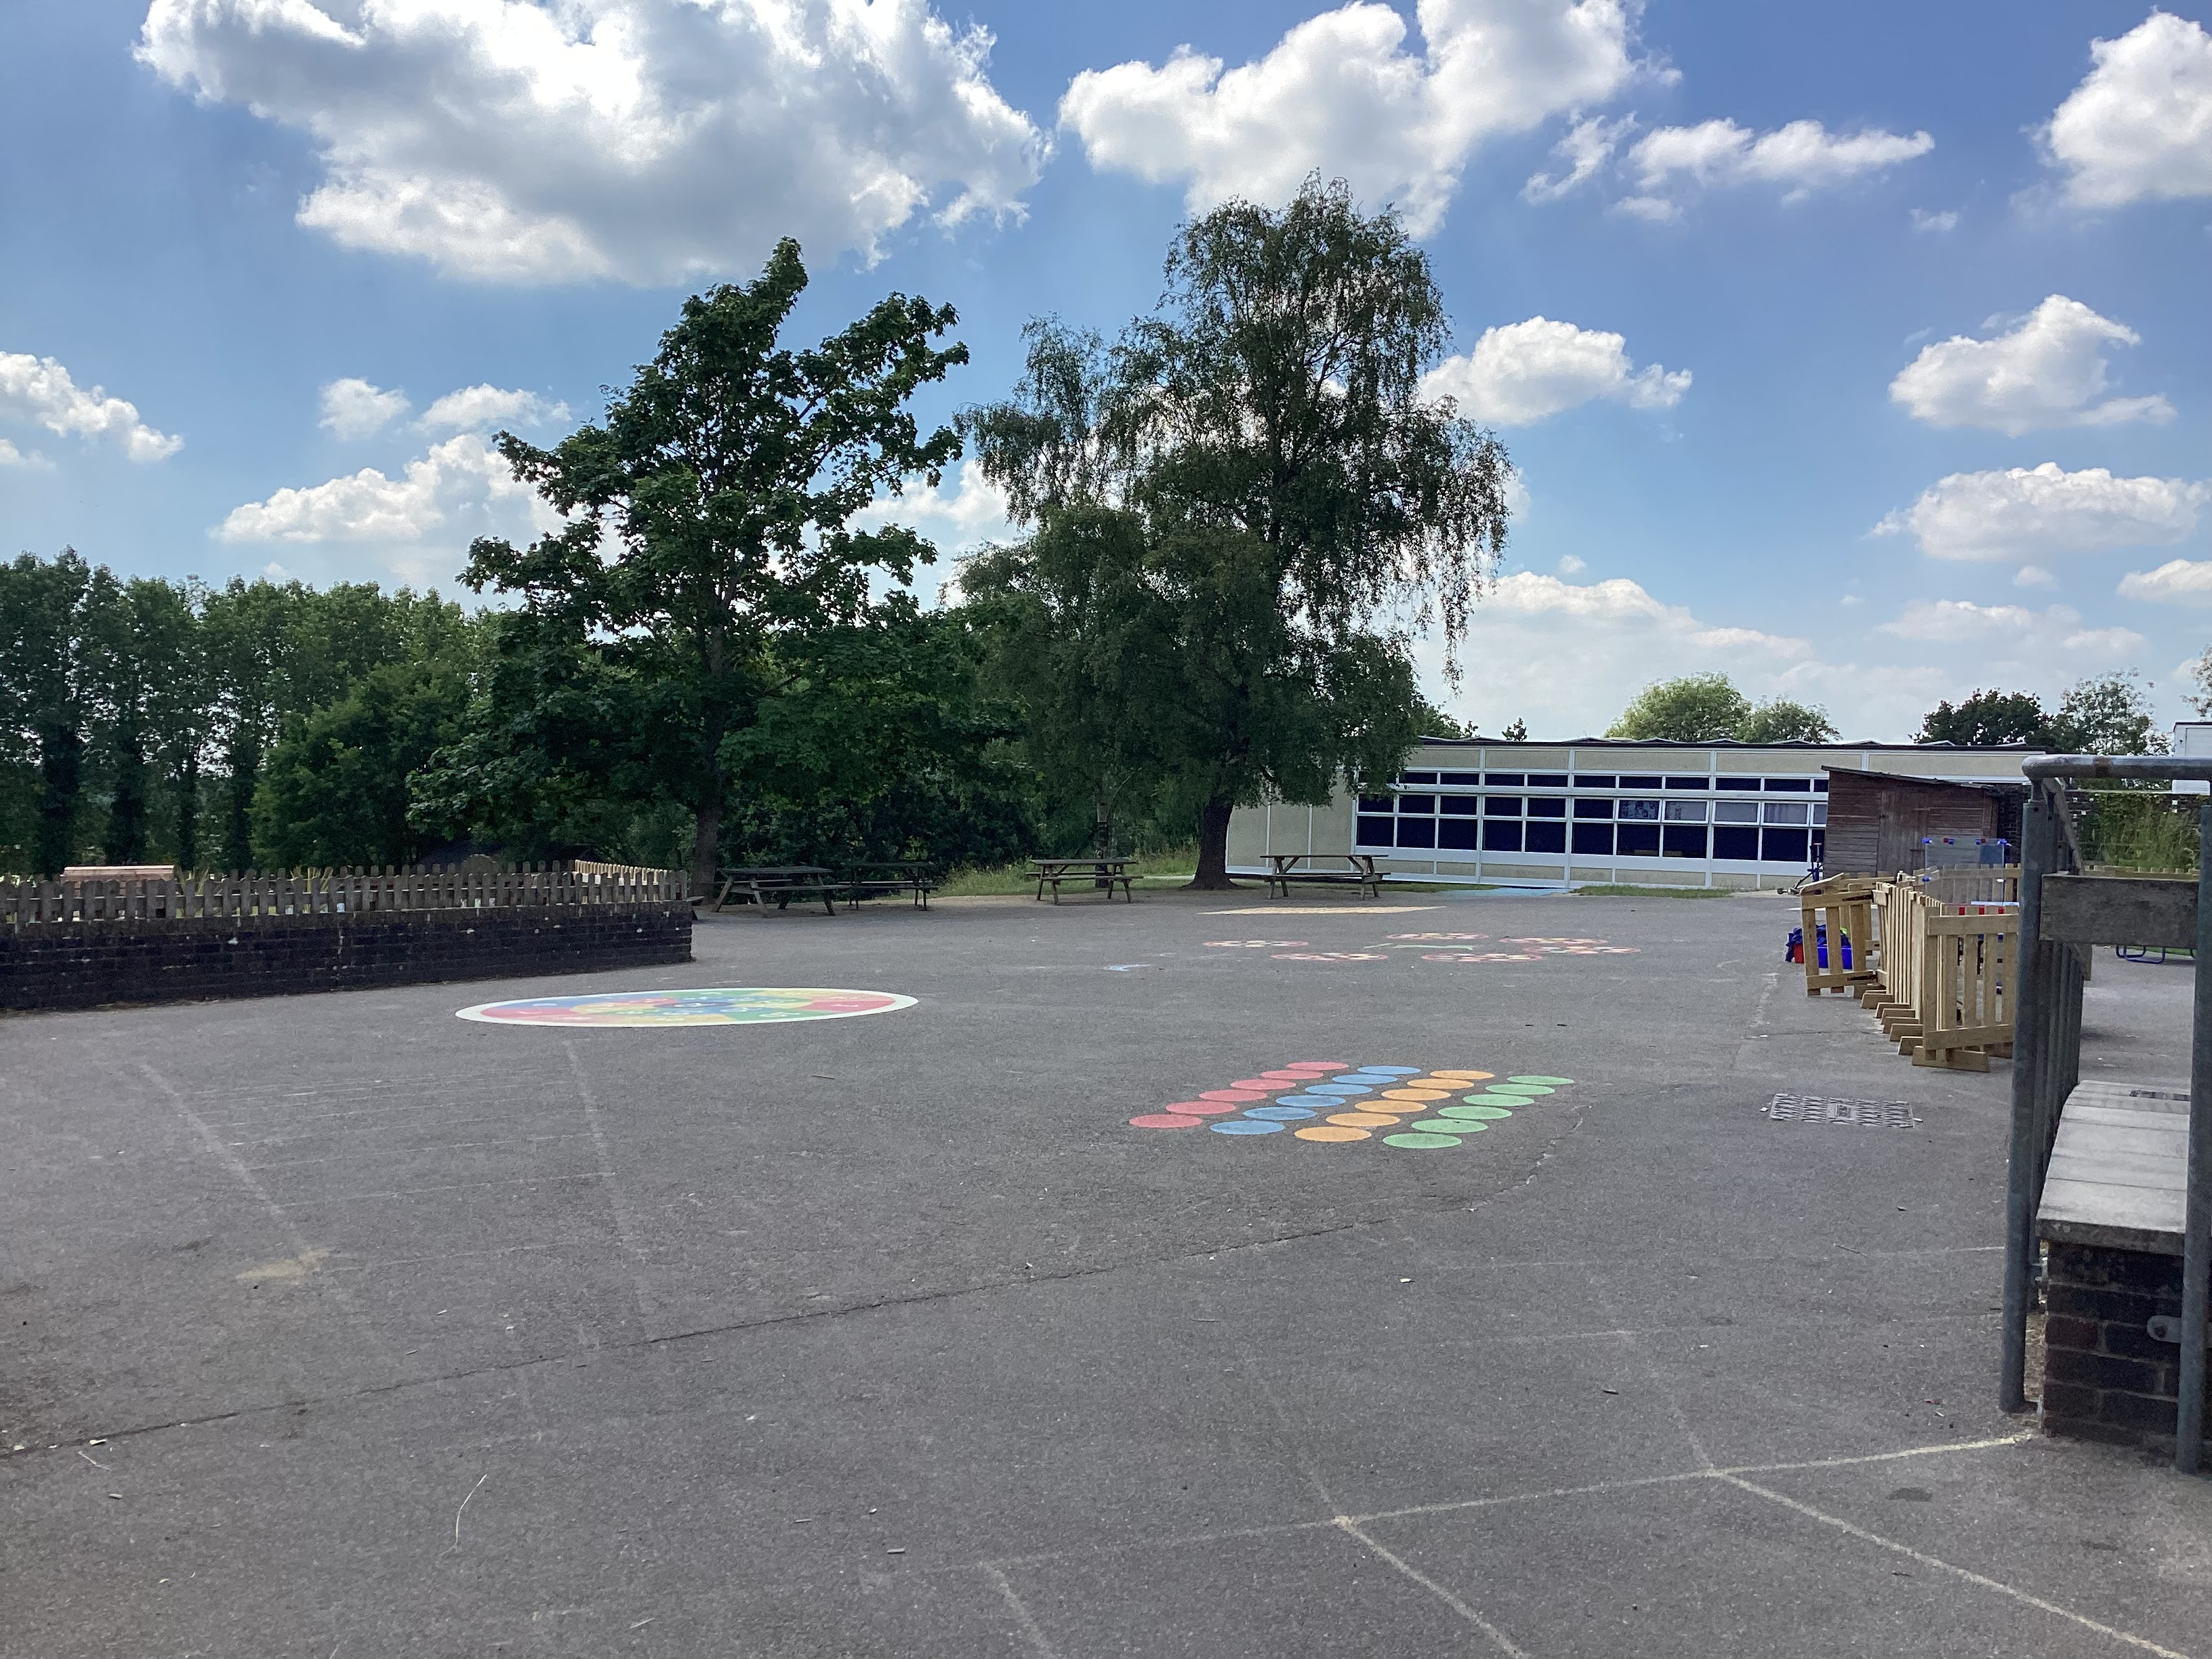
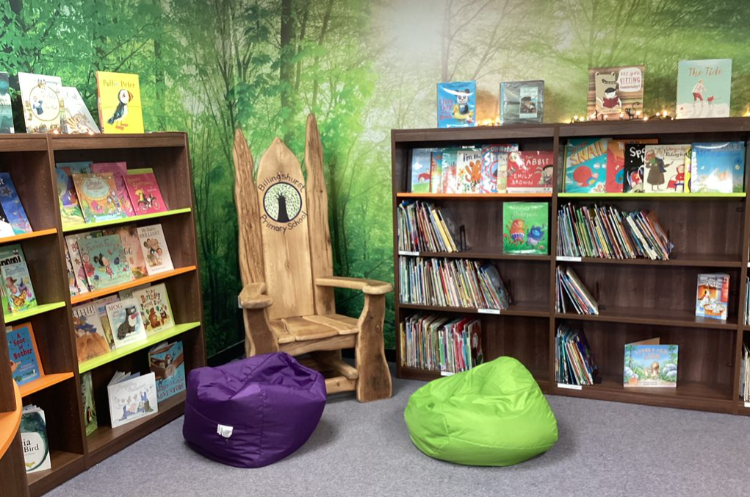
These are the KS1 & KS2 Halls where you will have lunch and assemblies.
This is our outside Learning Garden, you will be able to use this everyday.
This is the KS1 playground that you will use at lunchtimes
This is the KS1 library

Slide 6
When you start school we will be learning how to use our new classrooms and our outside classroom. We will also be developing new friendships.

Slide 7
We are really looking forward to seeing you in September.

