Slide 1
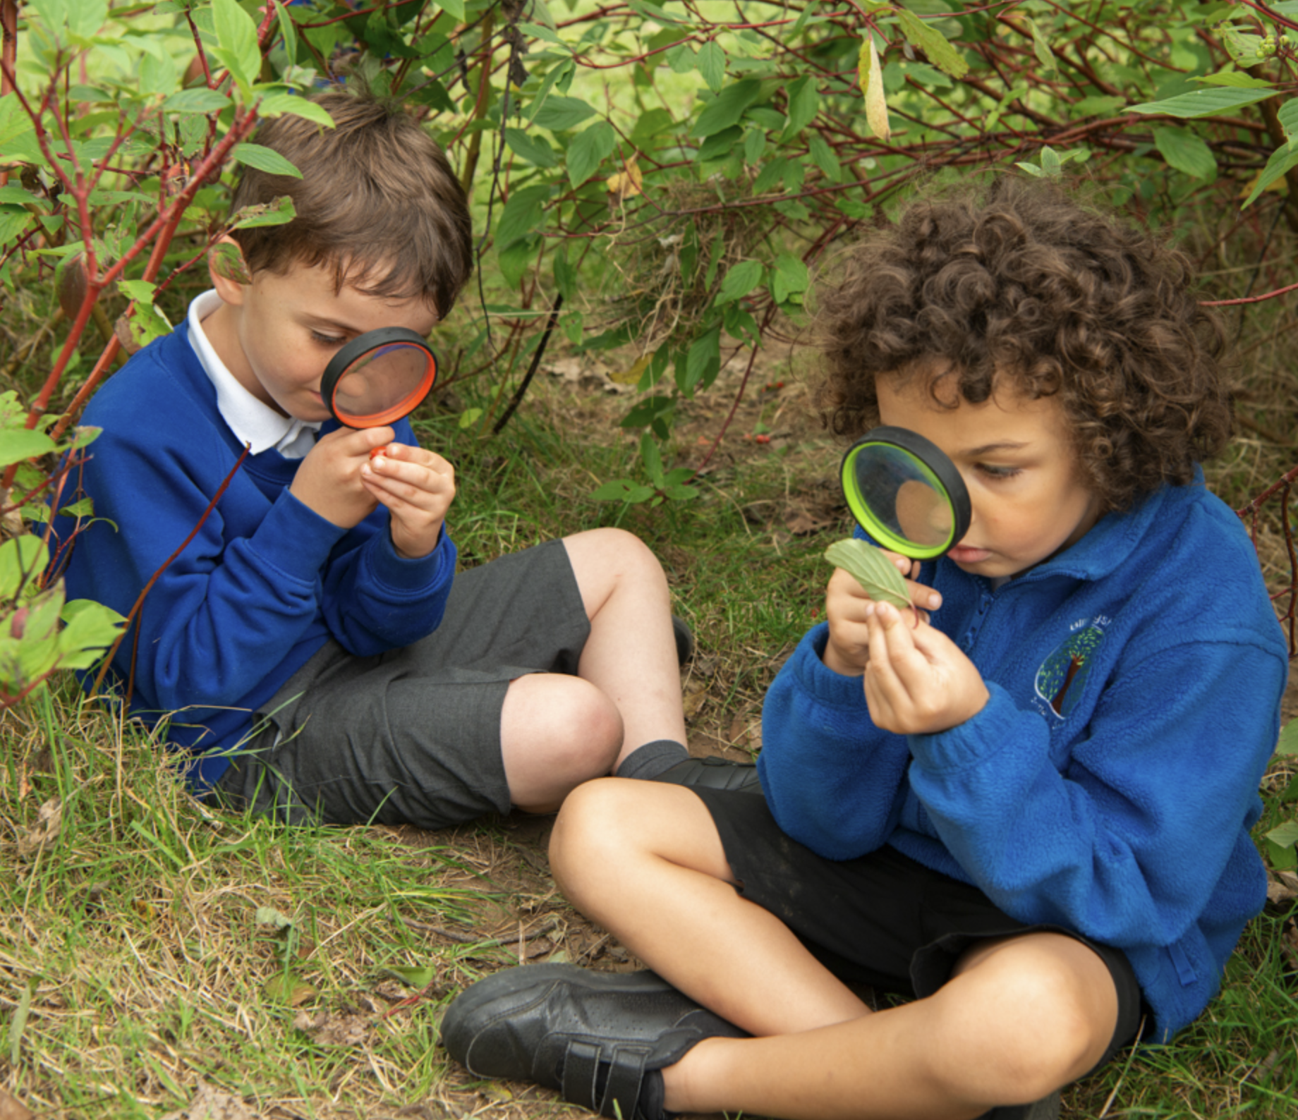
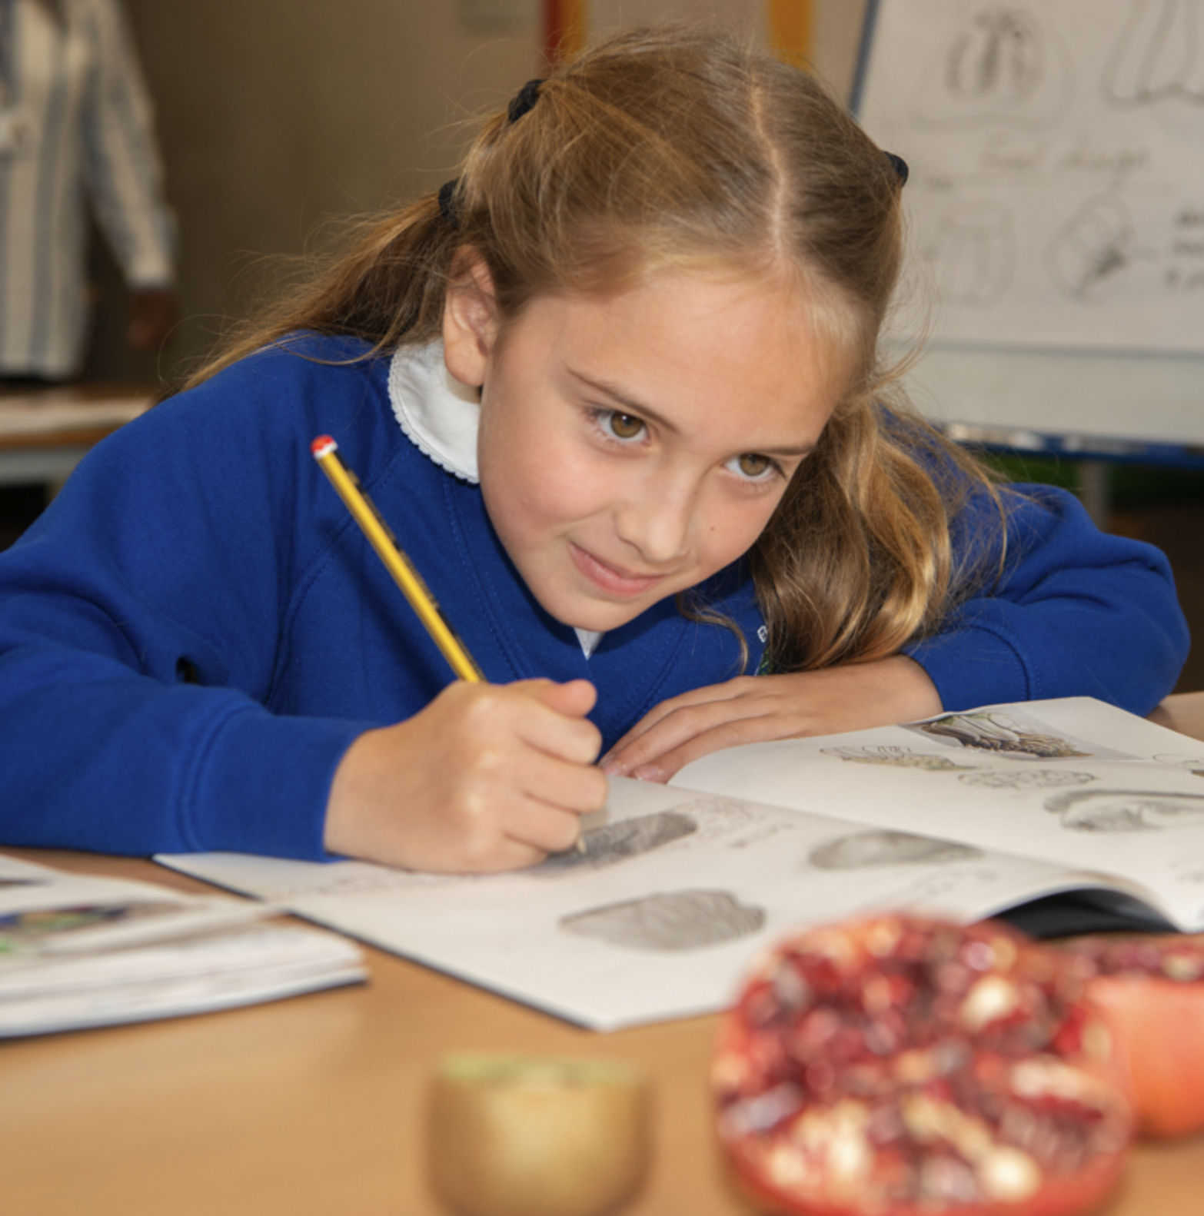
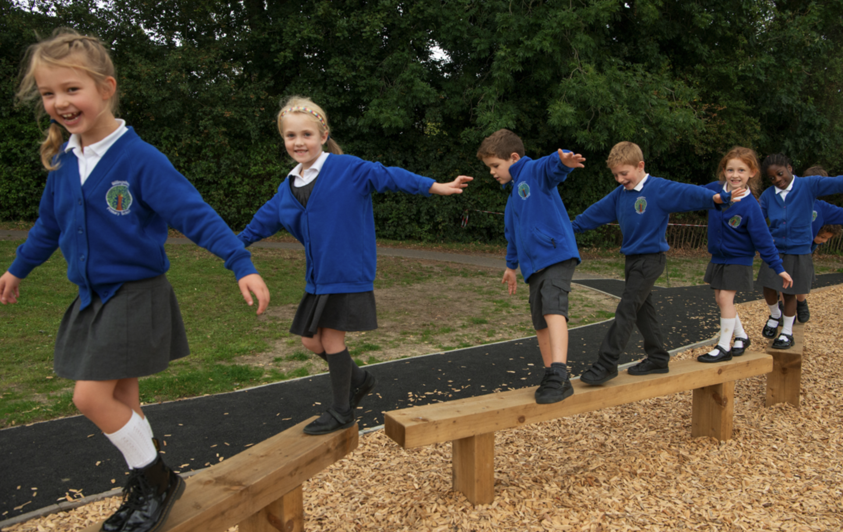
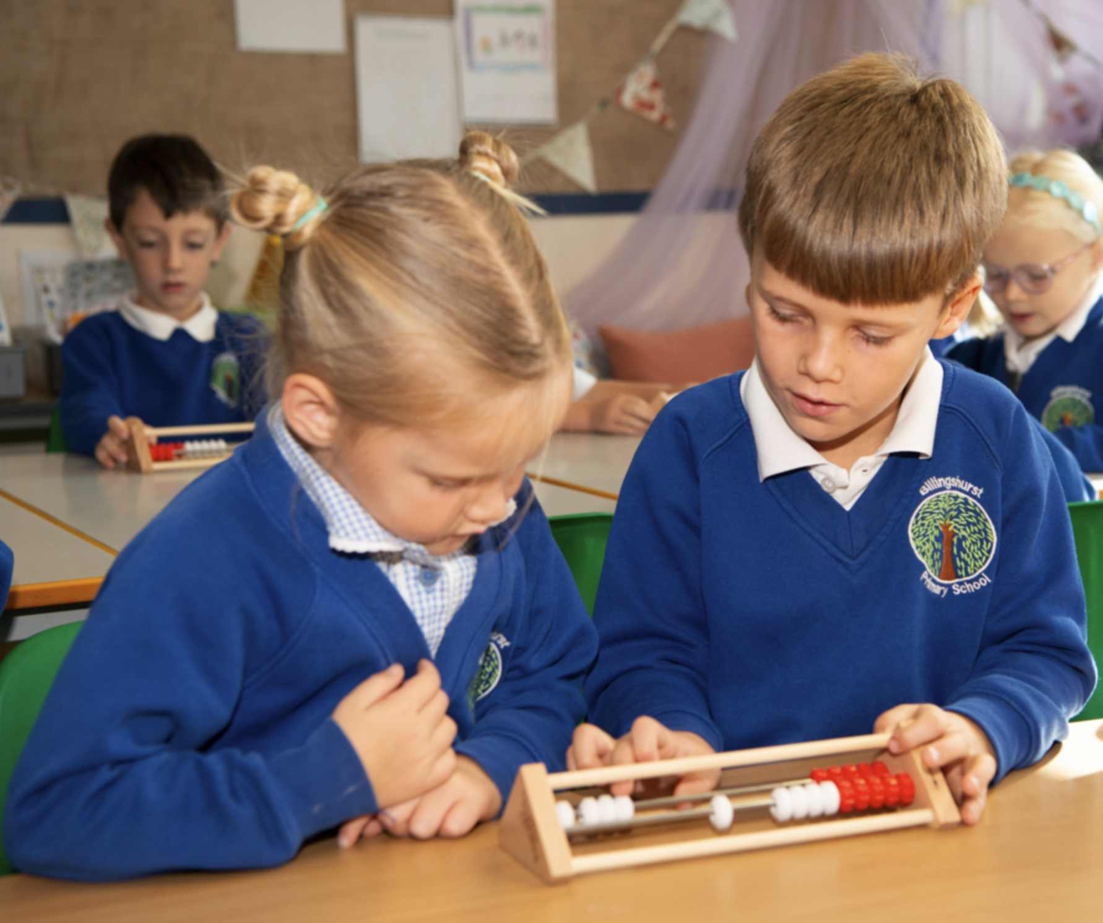
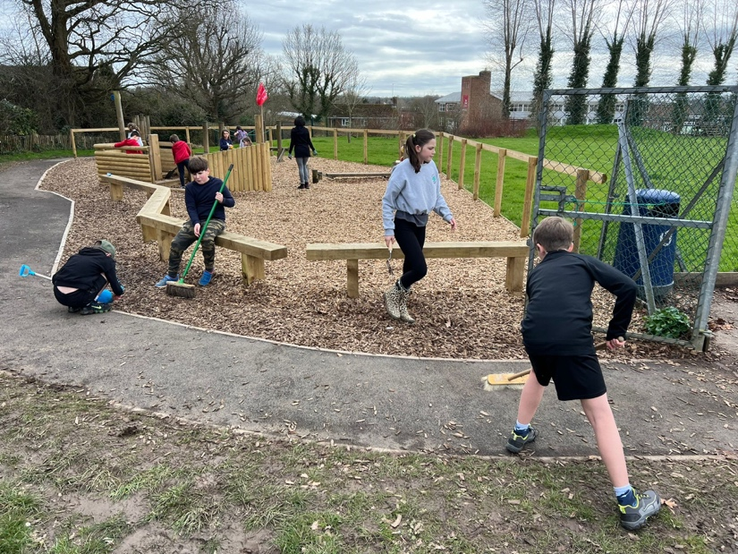
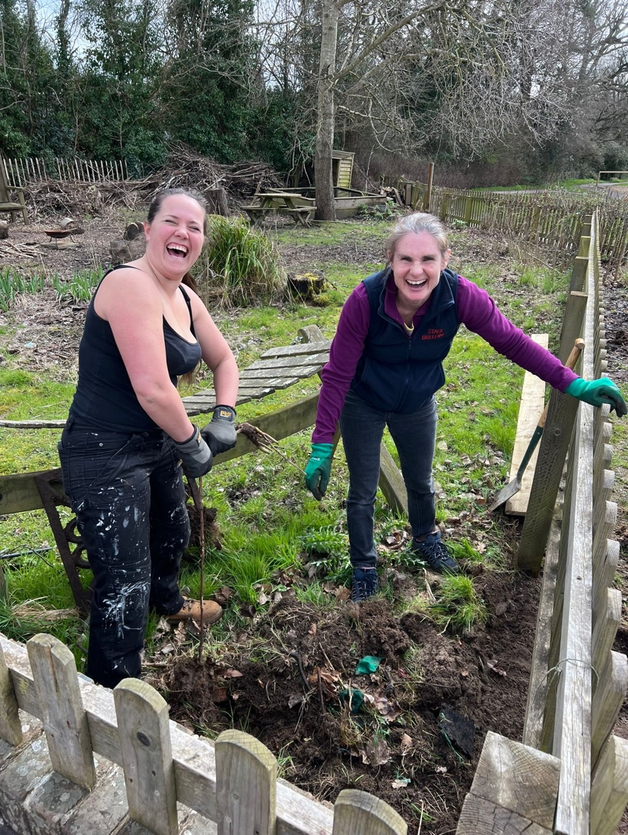
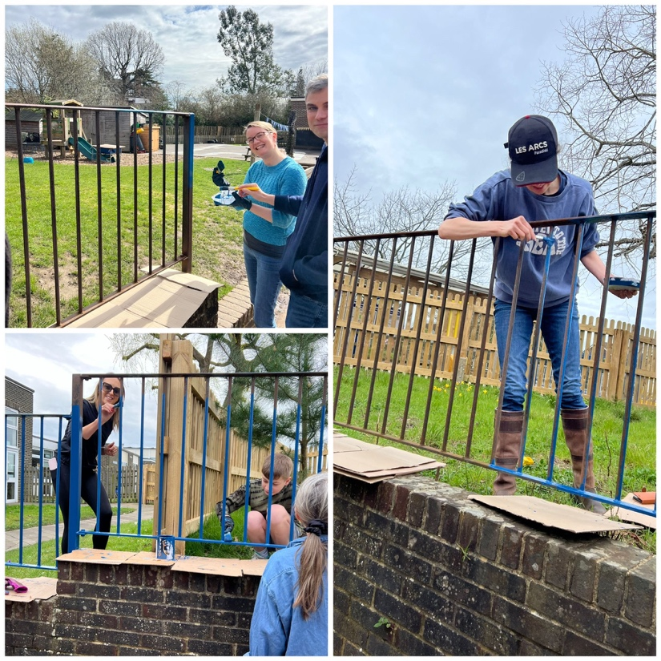
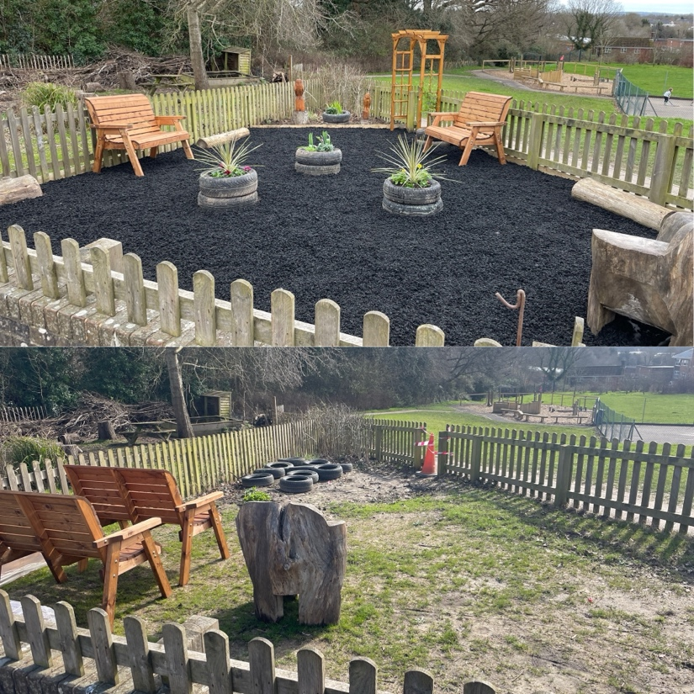
Newsletter 17th May
Learning, growing and achieving excellence together
Dear Parents and Carers,

Slide 2
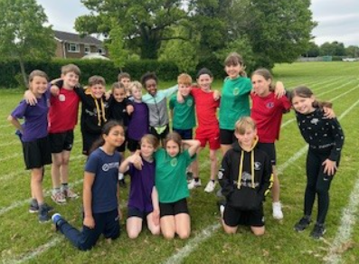
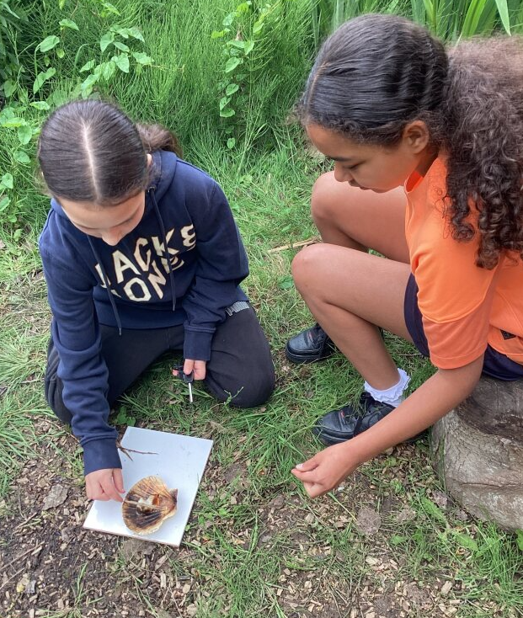
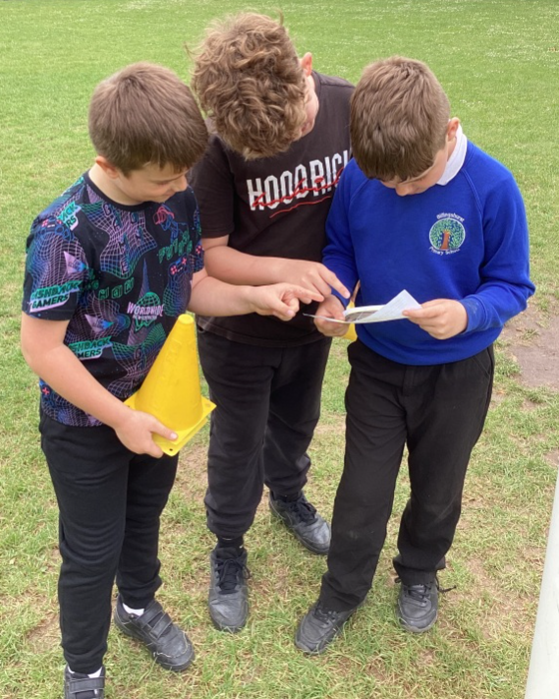
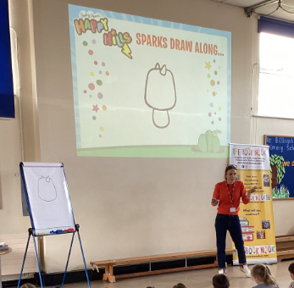
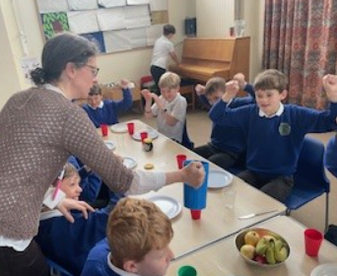
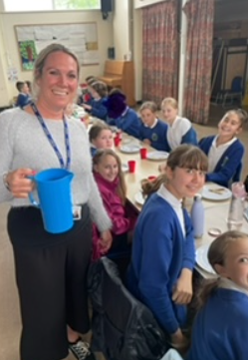
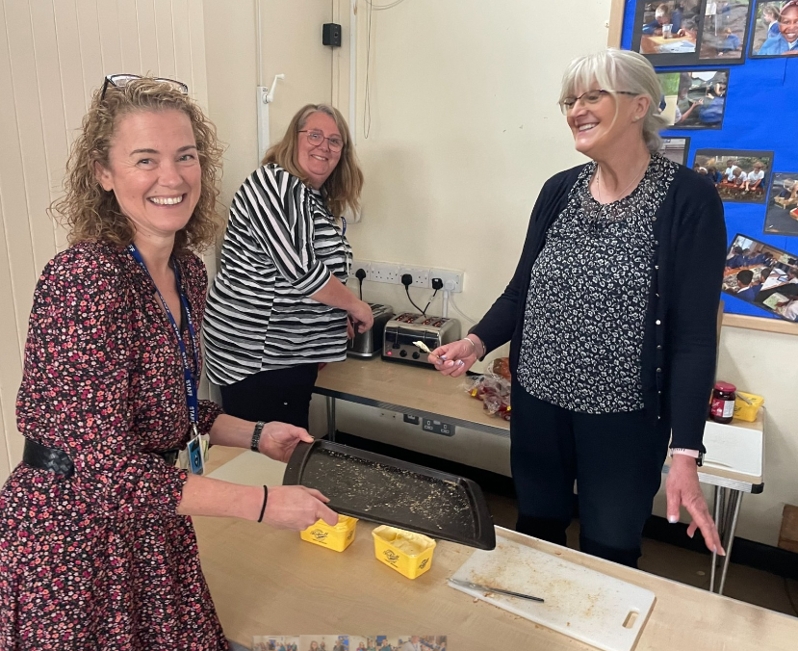
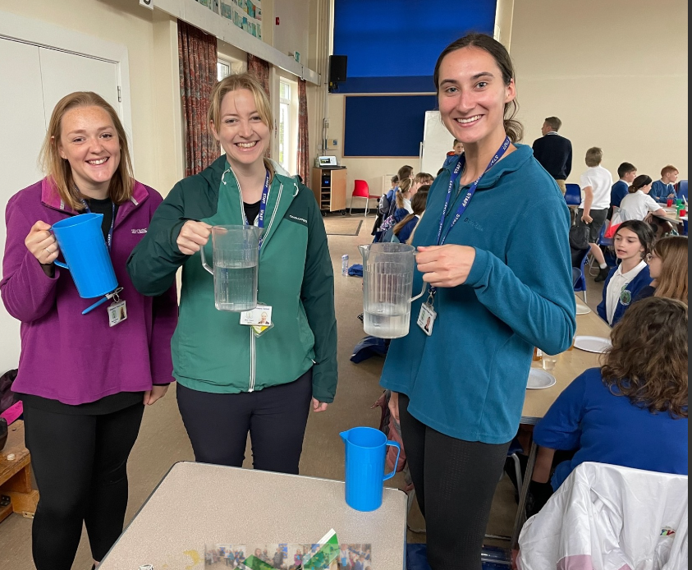
Quad Kids Athletics Event
On Monday, fifteen children across Years 5 and 6 took part in the Quad Kids Athletics event at the Weald. The children showed some fantastic teamwork, taking part in events on both the track and field. Particular mention must go to Lina K (Japan class) for her impressive long jump efforts, and Amy M (Russia class) for her fantastic finishing sprint in the 600m race.
We are so pleased with the final results:
Billingshurst Girls: 1st Place
Billingshurst Boys: 3rd Place
Overall: 3rd Place
Well done to all those involved!
Year 5 – Survival Experience!
On Tuesday afternoon, Year 5 took part in a 'survival experience'. They enjoyed fire-lighting, knot tying and orienteering activities and learnt lots of valuable skills for surviving in the wilderness!
Sophy Henn Author Visit!
Last Friday afternoon, we were excited to welcome back Sophy Henn for a visit. She spoke to Years 2, 3 and 4 about her new graphic novel – Happy Hills. The children also took part in a draw along where they were able to create their own characters! It was wonderful to see so many children getting their copies of Sophy's book; we can't wait to hear their reviews!
Year 6 SATs assessments
A huge well done to all Year 6 children who took part in assessments this week! We are so incredibly proud of all your hard work, determination and perseverance. Enjoy a lovely weekend relaxing!
A big thank you goes to the wonderful BPSCA who provided all of the items for the SATs breakfast and celebration ice-lollies!

Slide 3
BPSCA
Summer Fun Day – Saturday 6th July 11am-2pm.
We need your help! Donations of cuddly toys and tomboys prizes for both children and adults can be left in the main office. Volunteers to set up or run a table for an hour; sign up will be circulated soon!
Having a party?
Hire our eco-friendly party pack of 30 place settings and serving equipment. Email bpsca@billingshurstprimary.org.uk
House Point Results
Winning House -
Thank you to our sponsors for their support!
Cowdray
Parham
Goodwood
Petworth
Gil Parham Woodside Sculpture
www.woodlouseindustries.com
Upcoming dates:
Friday 17th May – Year 6 Tile Barn parent meeting 3.30pm KS2 Hall
Wednesday 22nd May – Open Classrooms 2.45pm EYFS & KS1, 3.05pm KS2
Thursday 23rd May – KS1 Little Big Sing 9:00am-11:30am
Thursday 23rd May – Year 1 trip to Tilgate Park
Letters home this week: No additional letters
Best quality Blast-frozen Family run
www.tomthefish.co.uk
@BPSEYFS
@BPSYearOne
@BPSYearTwo
@BPSYearThree
@BPSYearFour
@BPSYearFive
@BPSYearSix
Year groups regularly post photos of children and learning on their X account. Please follow your child’s Year Group using the handles above.
www.professionalrubbersurfaces.com
The Budding Foundation
Follow us on Facebook for all the latest updates:
www.facebook.com/BillingshurstPrimary

