Slide 1
Welcome to Miss Milner's Class

Slide 2
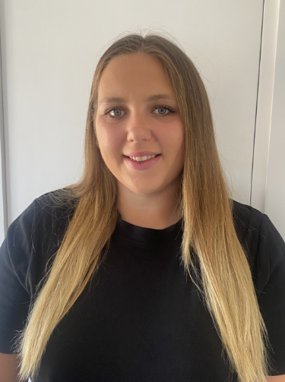
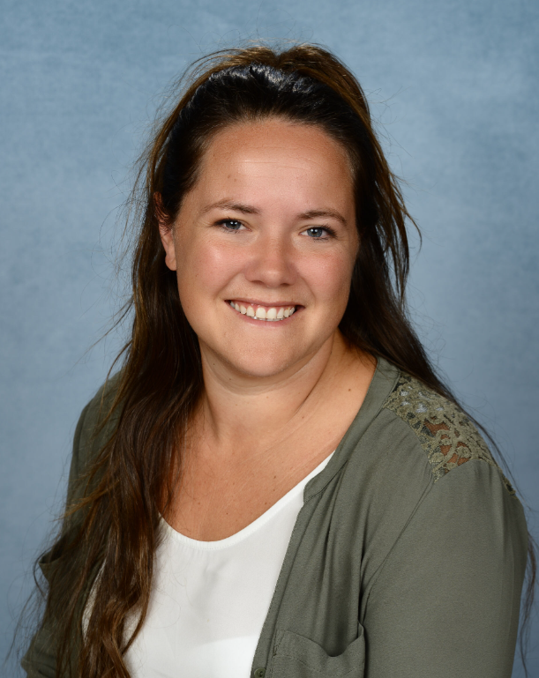
These are the adults that will be working in your classroom.
Miss Milner
Your Class Teacher
Mrs Dewell
Learning Support Assistant (LSA)

Slide 3
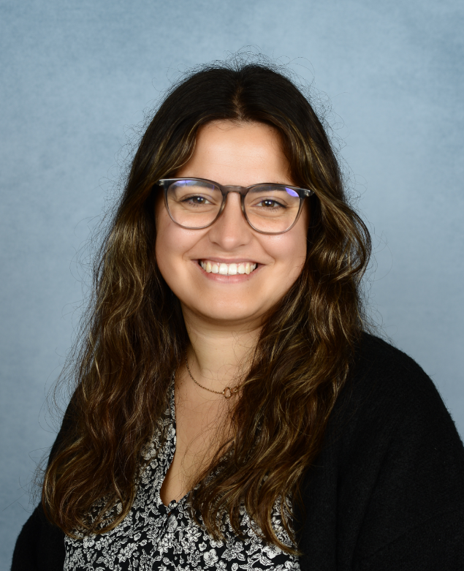
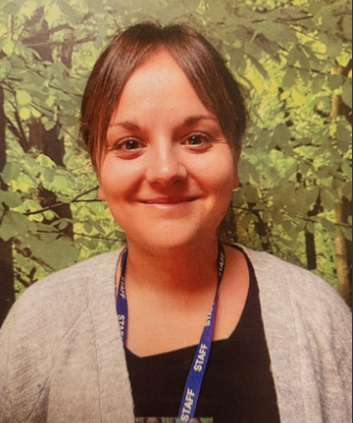
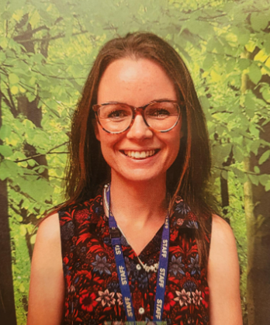
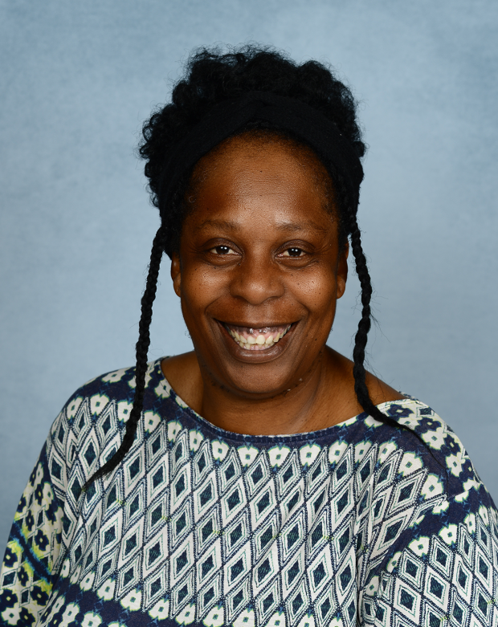
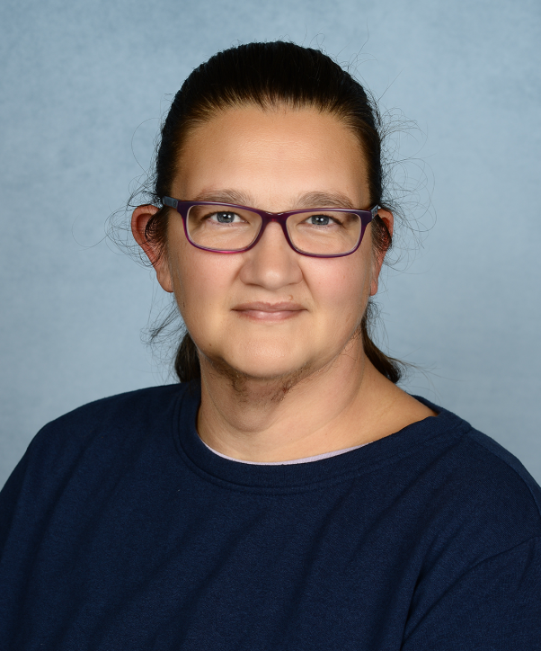
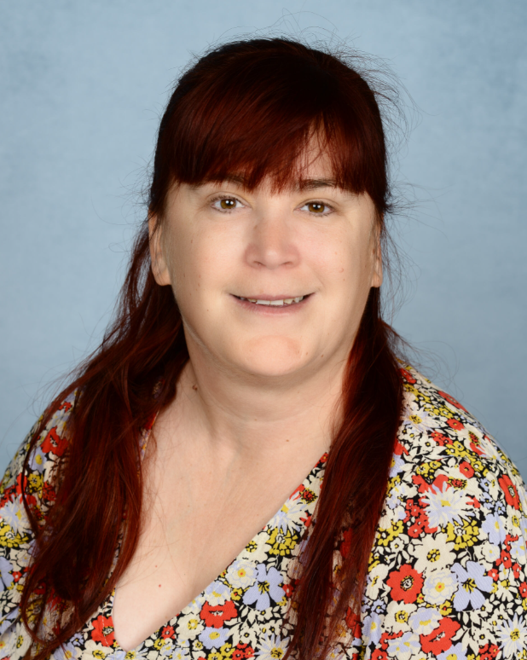
These are the adults that will be working in Year 2.
Miss Spoard
Year 1 Teacher
Mrs Mason
Year 1 Teacher
Miss Jolley
Year 1 Teacher
Miss Milner
Year 1 Teacher
Mrs Dewell
Year 1 Learning Support Assistant (LSA)
Ms Alexis
Year 1 Learning Support Assistant (LSA)
Mrs Casagrande
Year 1 Learning Support Assistant (LSA)
Mrs Richardson
1:1 Learning Support Assistant (LSA)

Slide 4
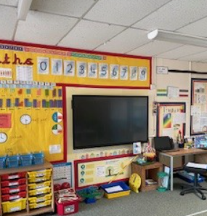
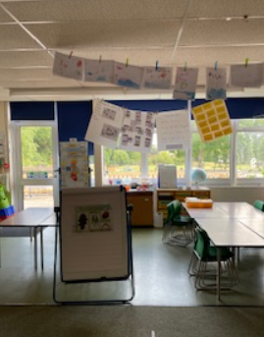
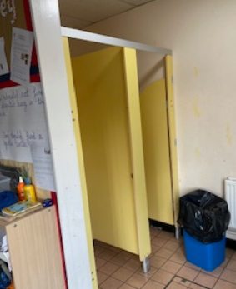
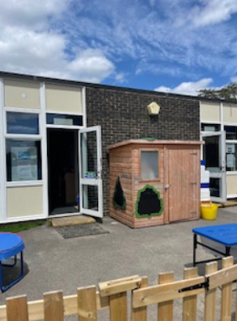
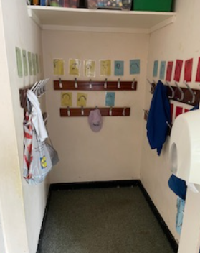
This is your classroom.
This is where you will go to the toilet, in the classroom.
This is where you will enter the school and your classroom.
This is where you will hang your coat and book bag.

Slide 5
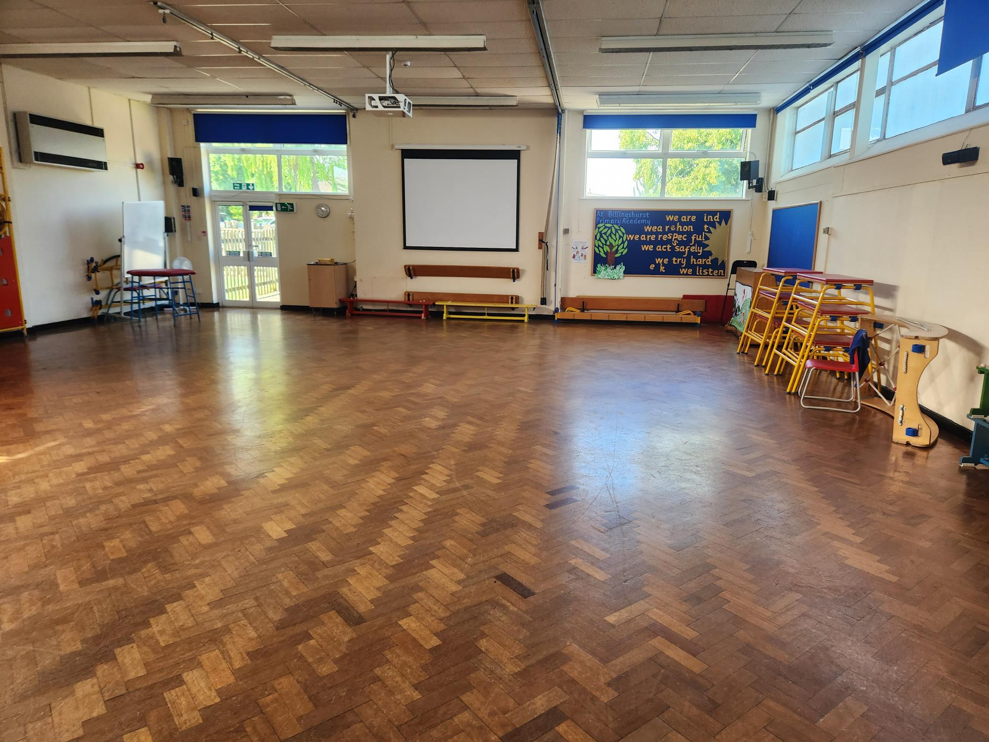
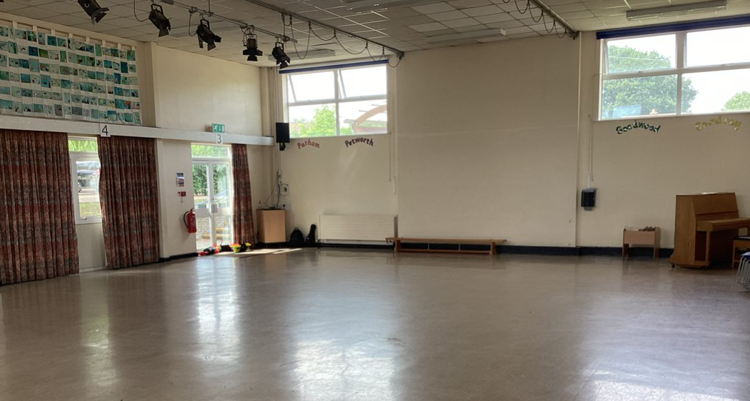
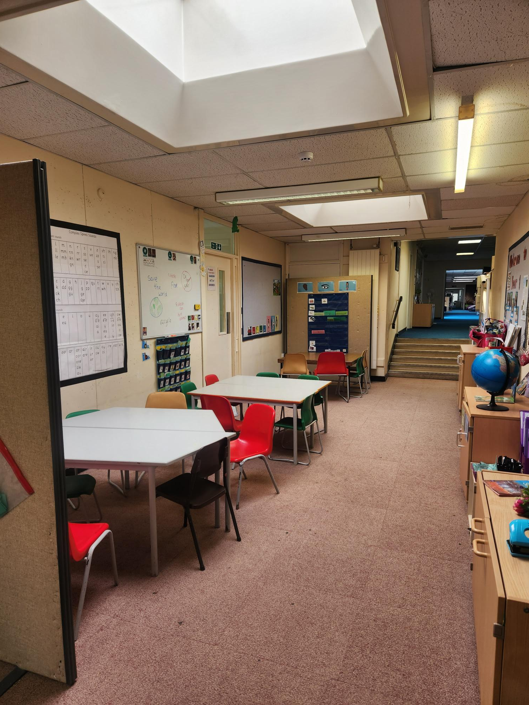
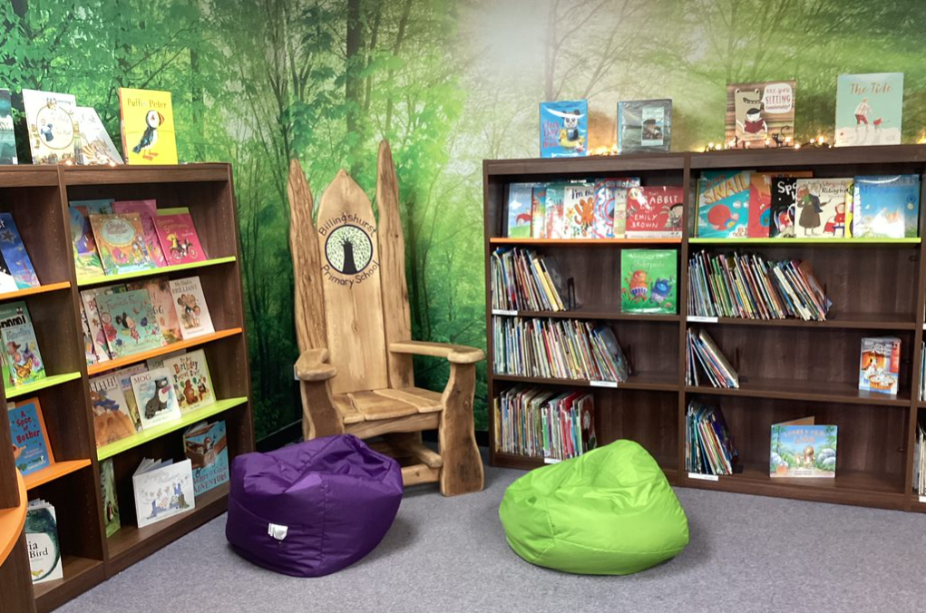
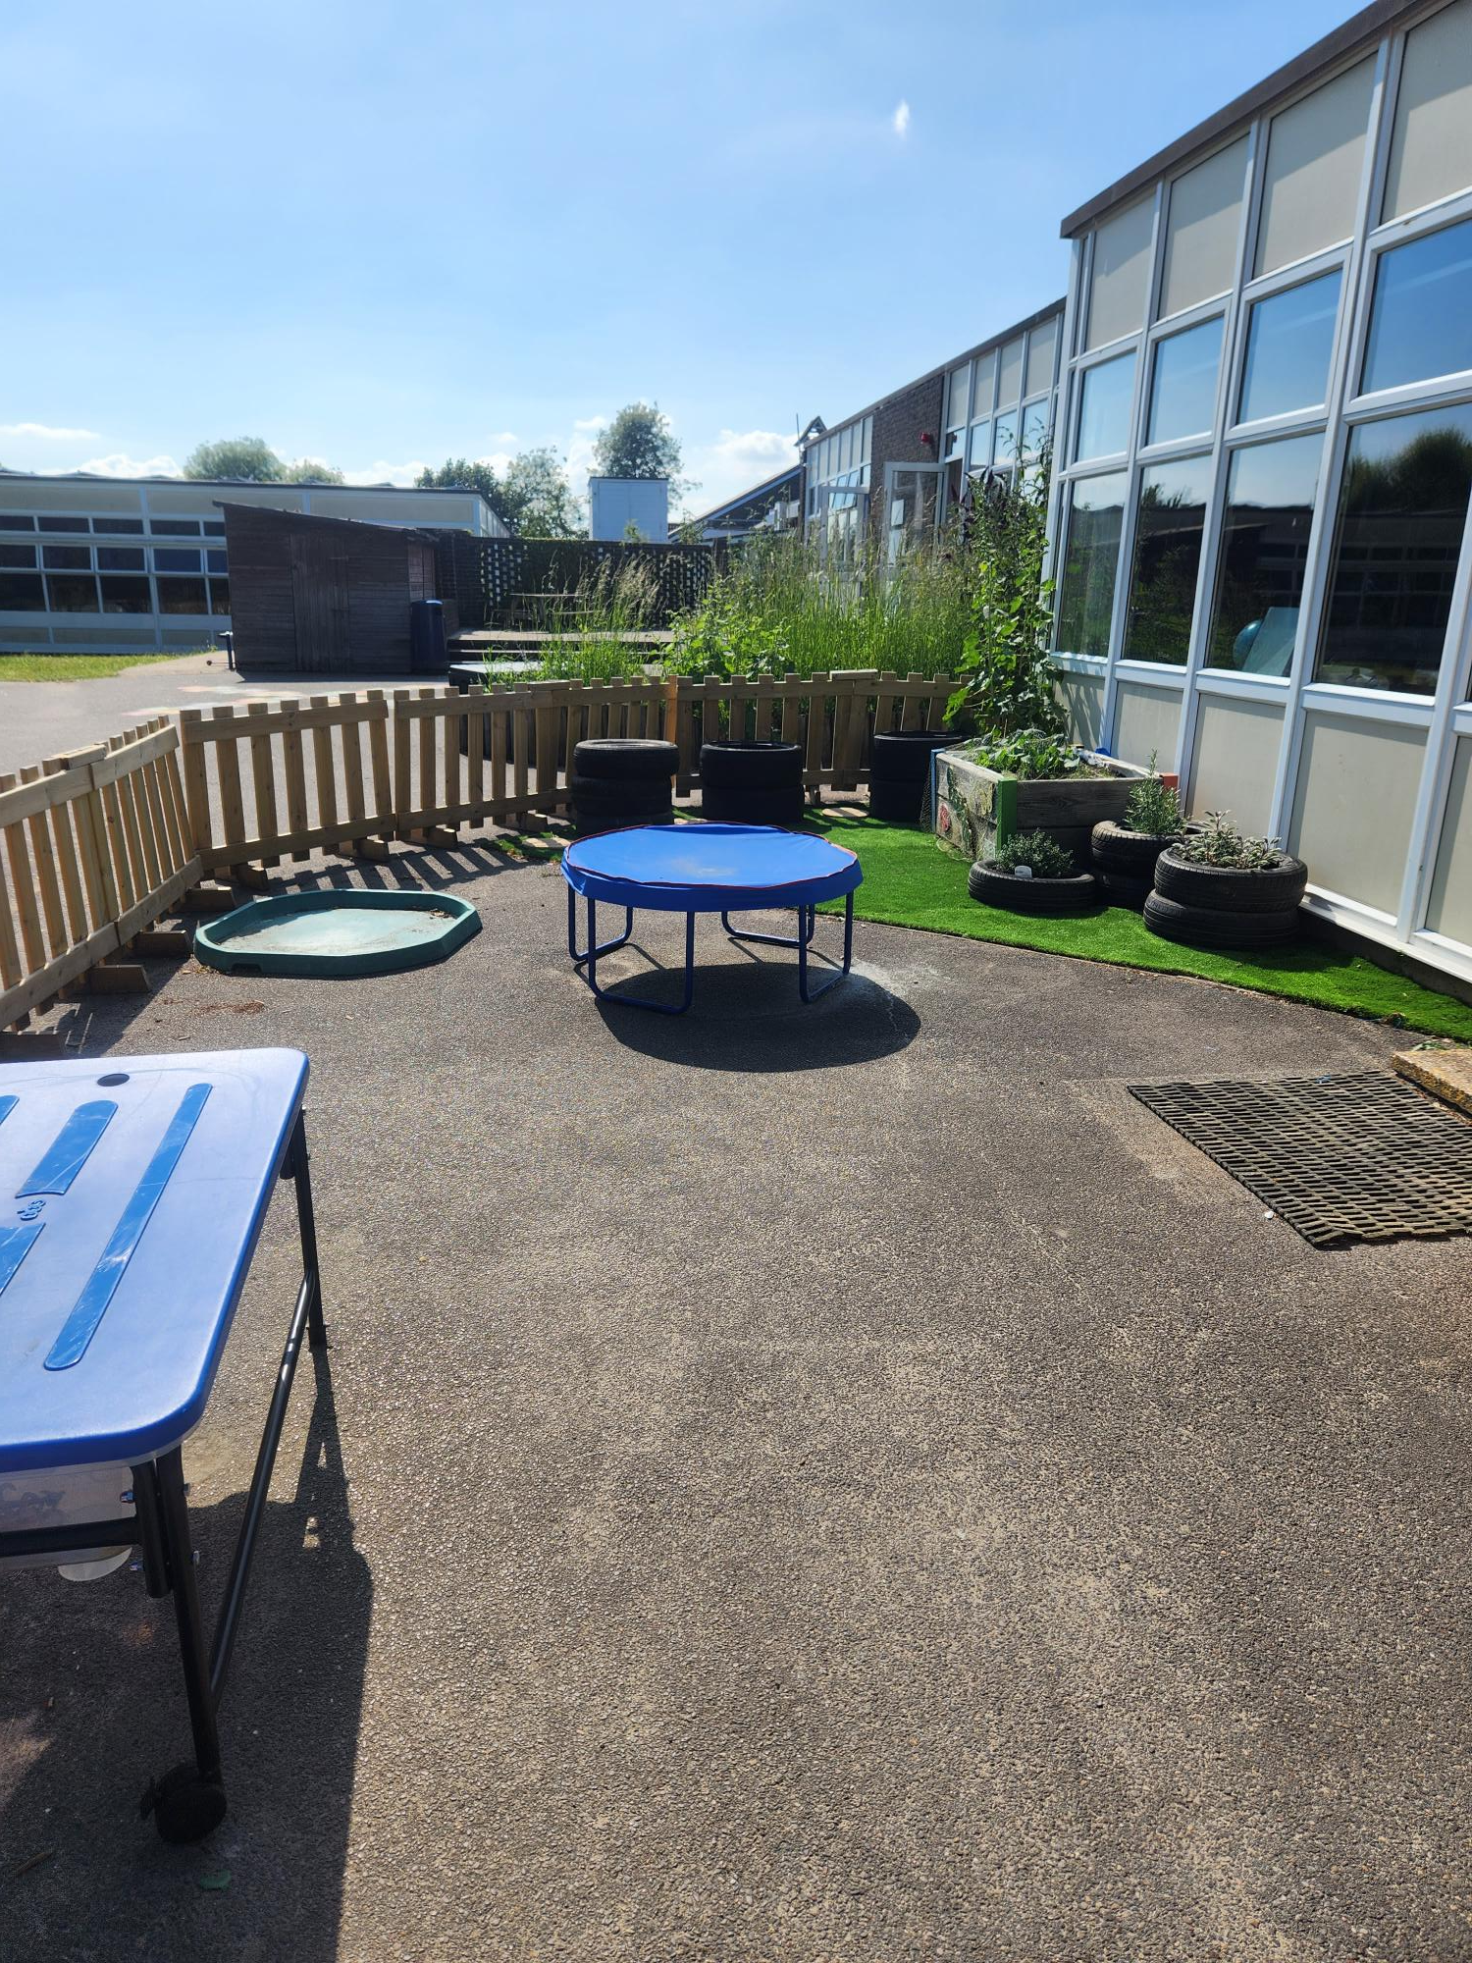
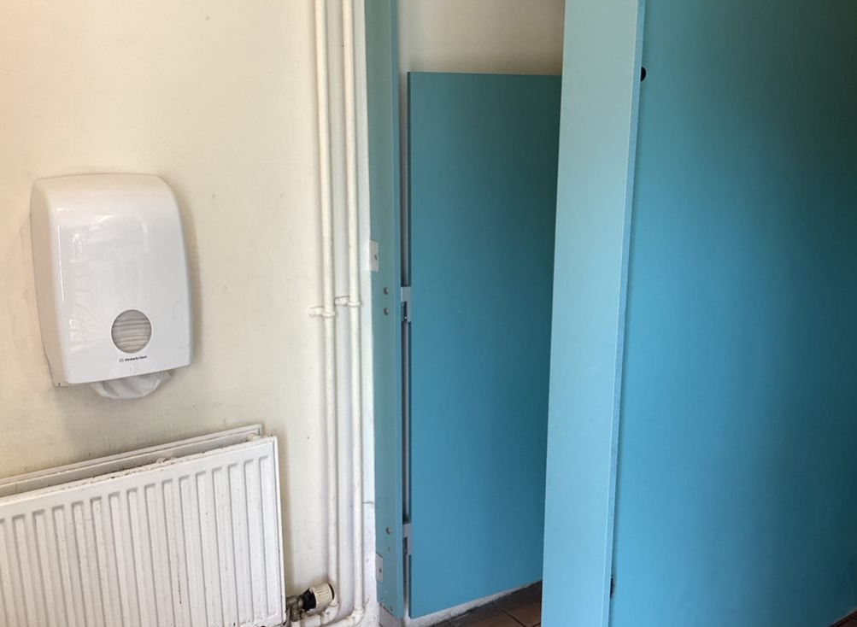
This is the area outside of Year 1 where you may sometimes work.
These are the KS1 & KS2 Halls where you will have lunch and assemblies.
These are the class toilets.
This is the KS1 library
This is the Year 1 outside area.

Slide 6
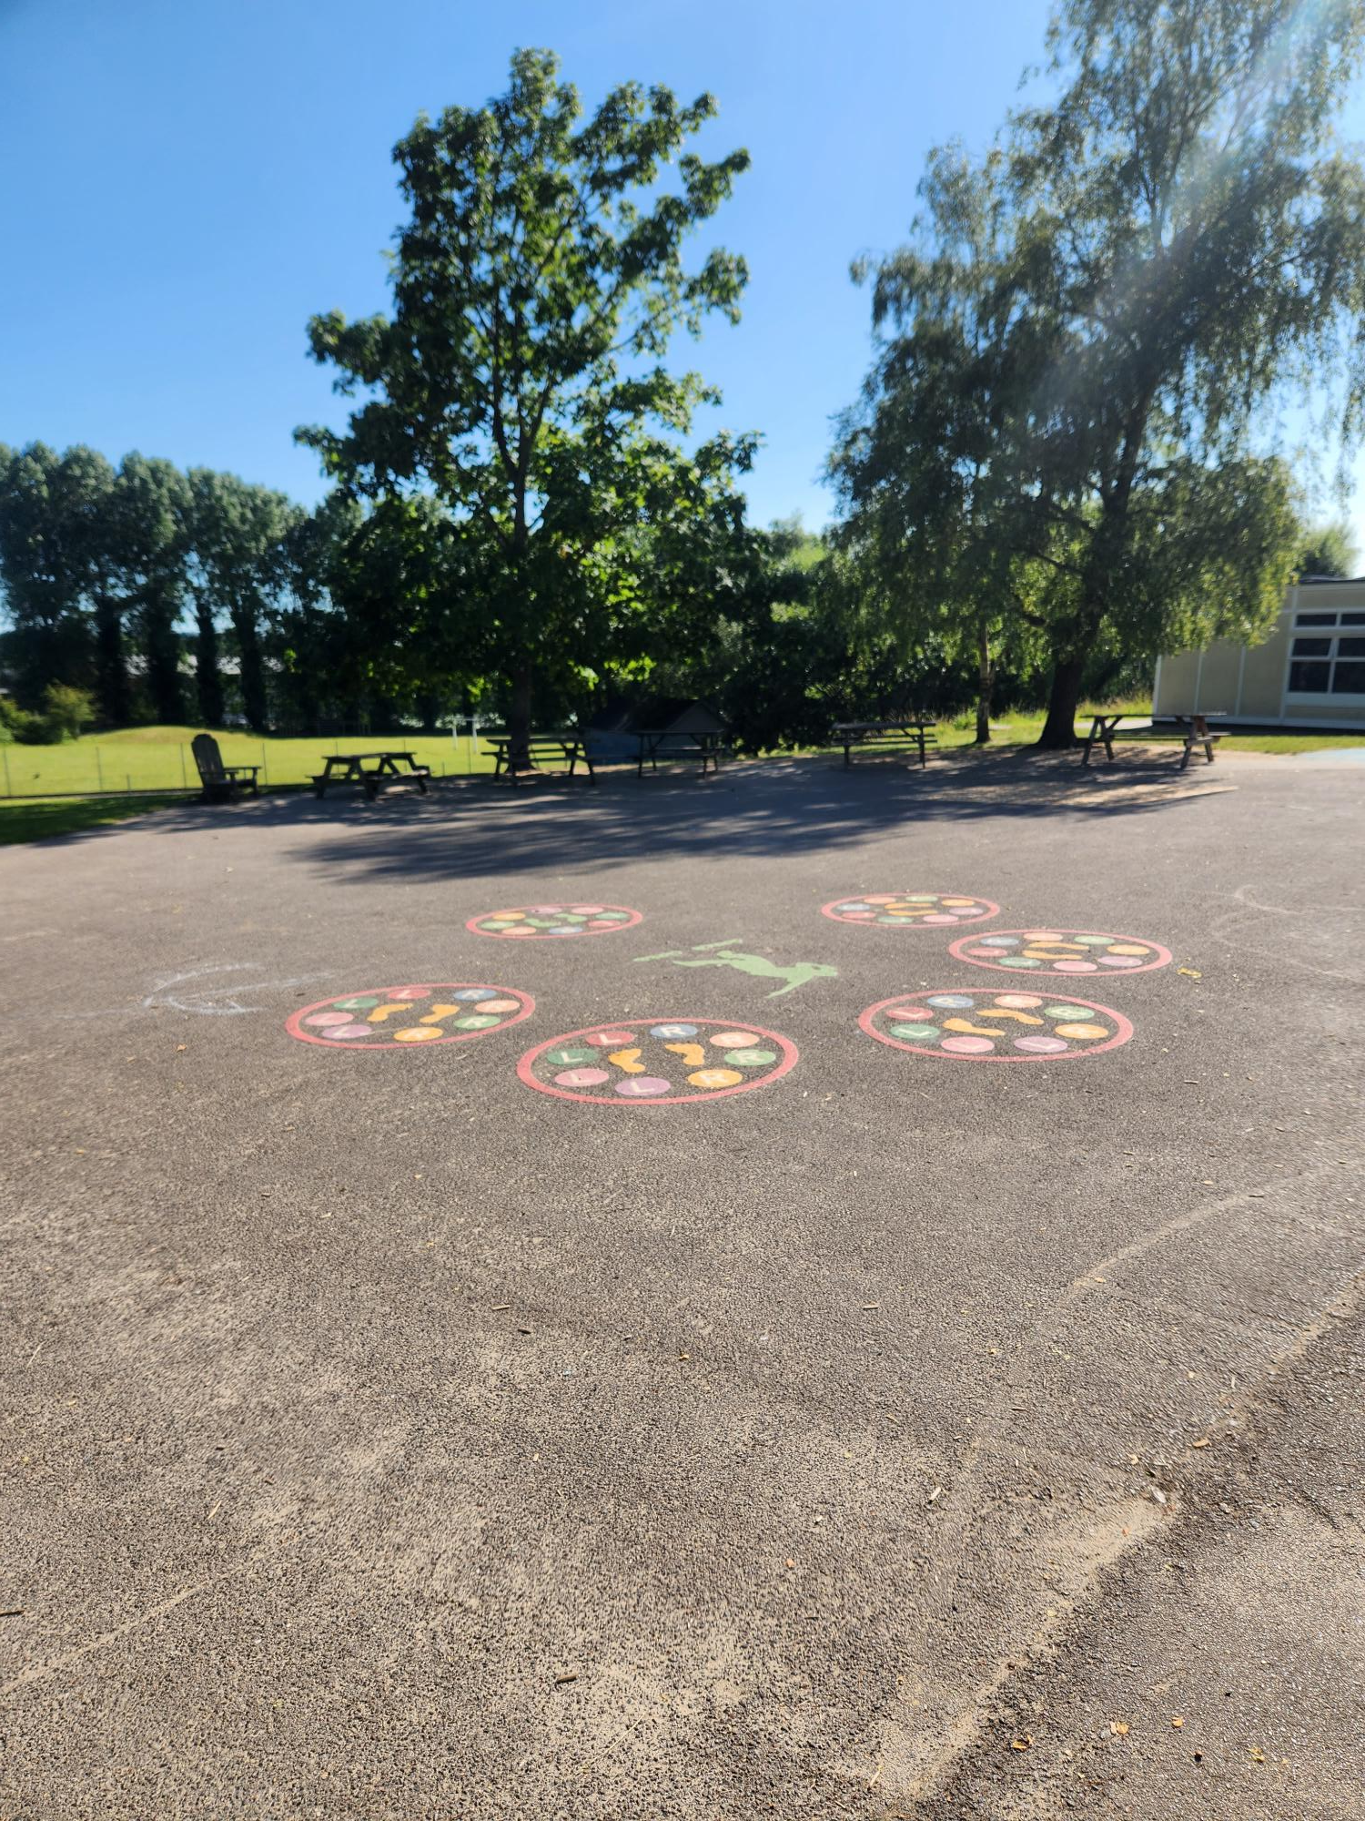
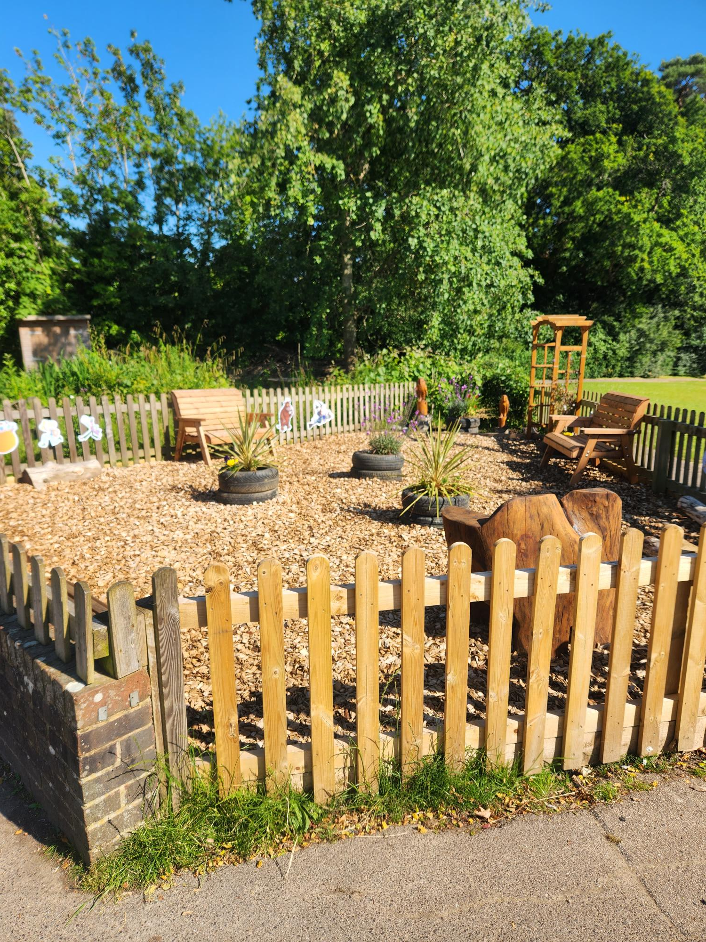
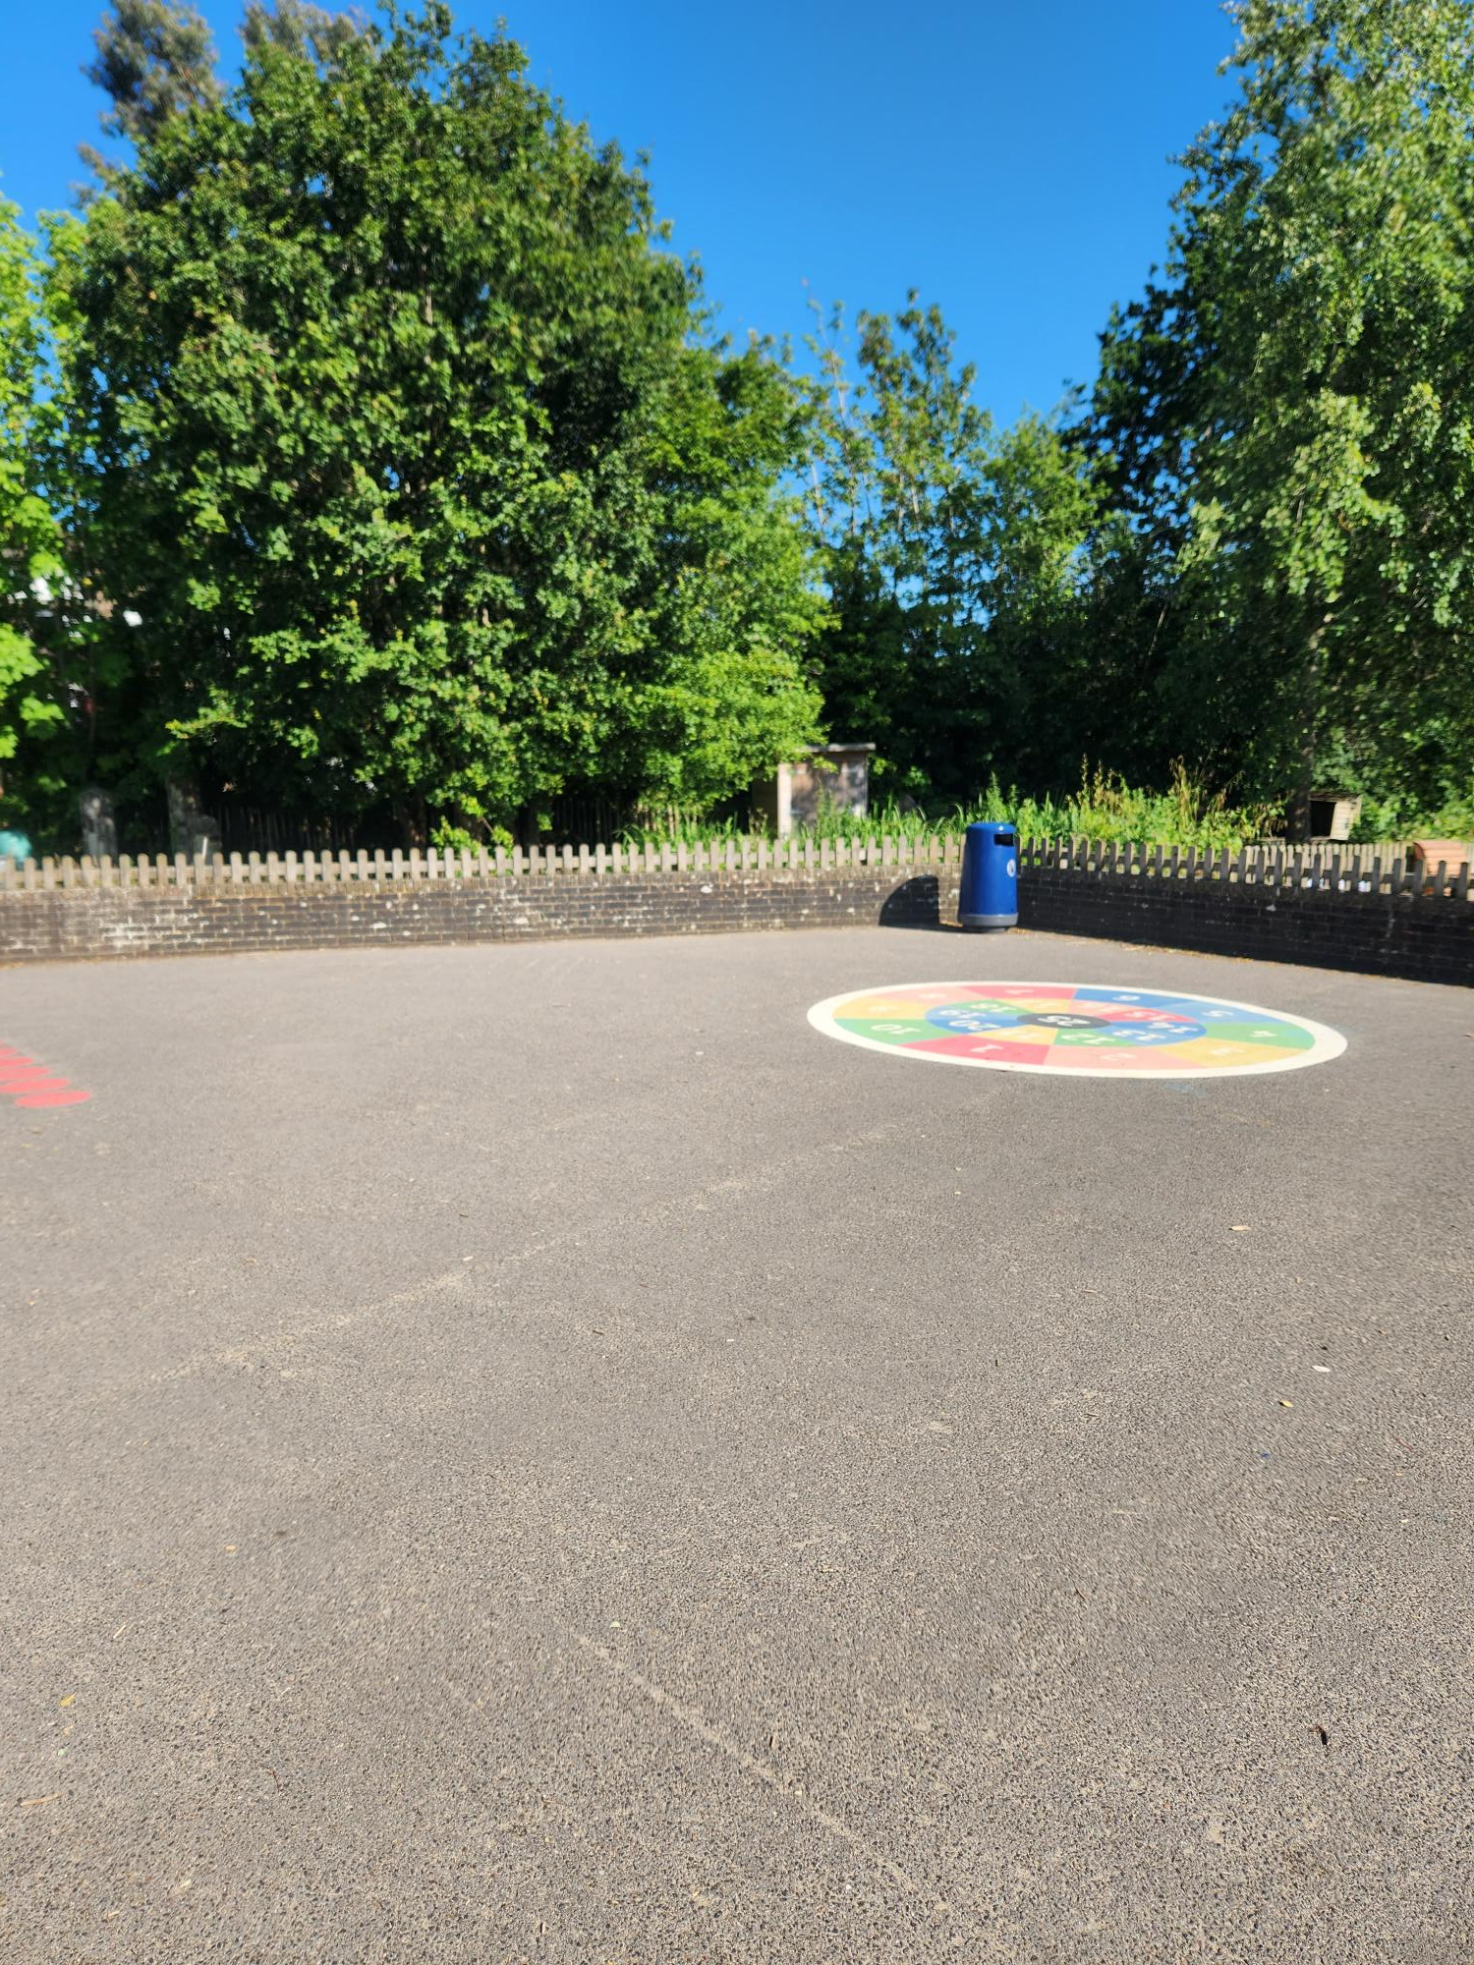
This is your playground

Slide 7
When you return to school your topic theme will be ‘Why am I super?’
You might like to start exploring some of these books during the summer holidays.

Slide 8
We are really looking forward to seeing you in September.

