Slide 1
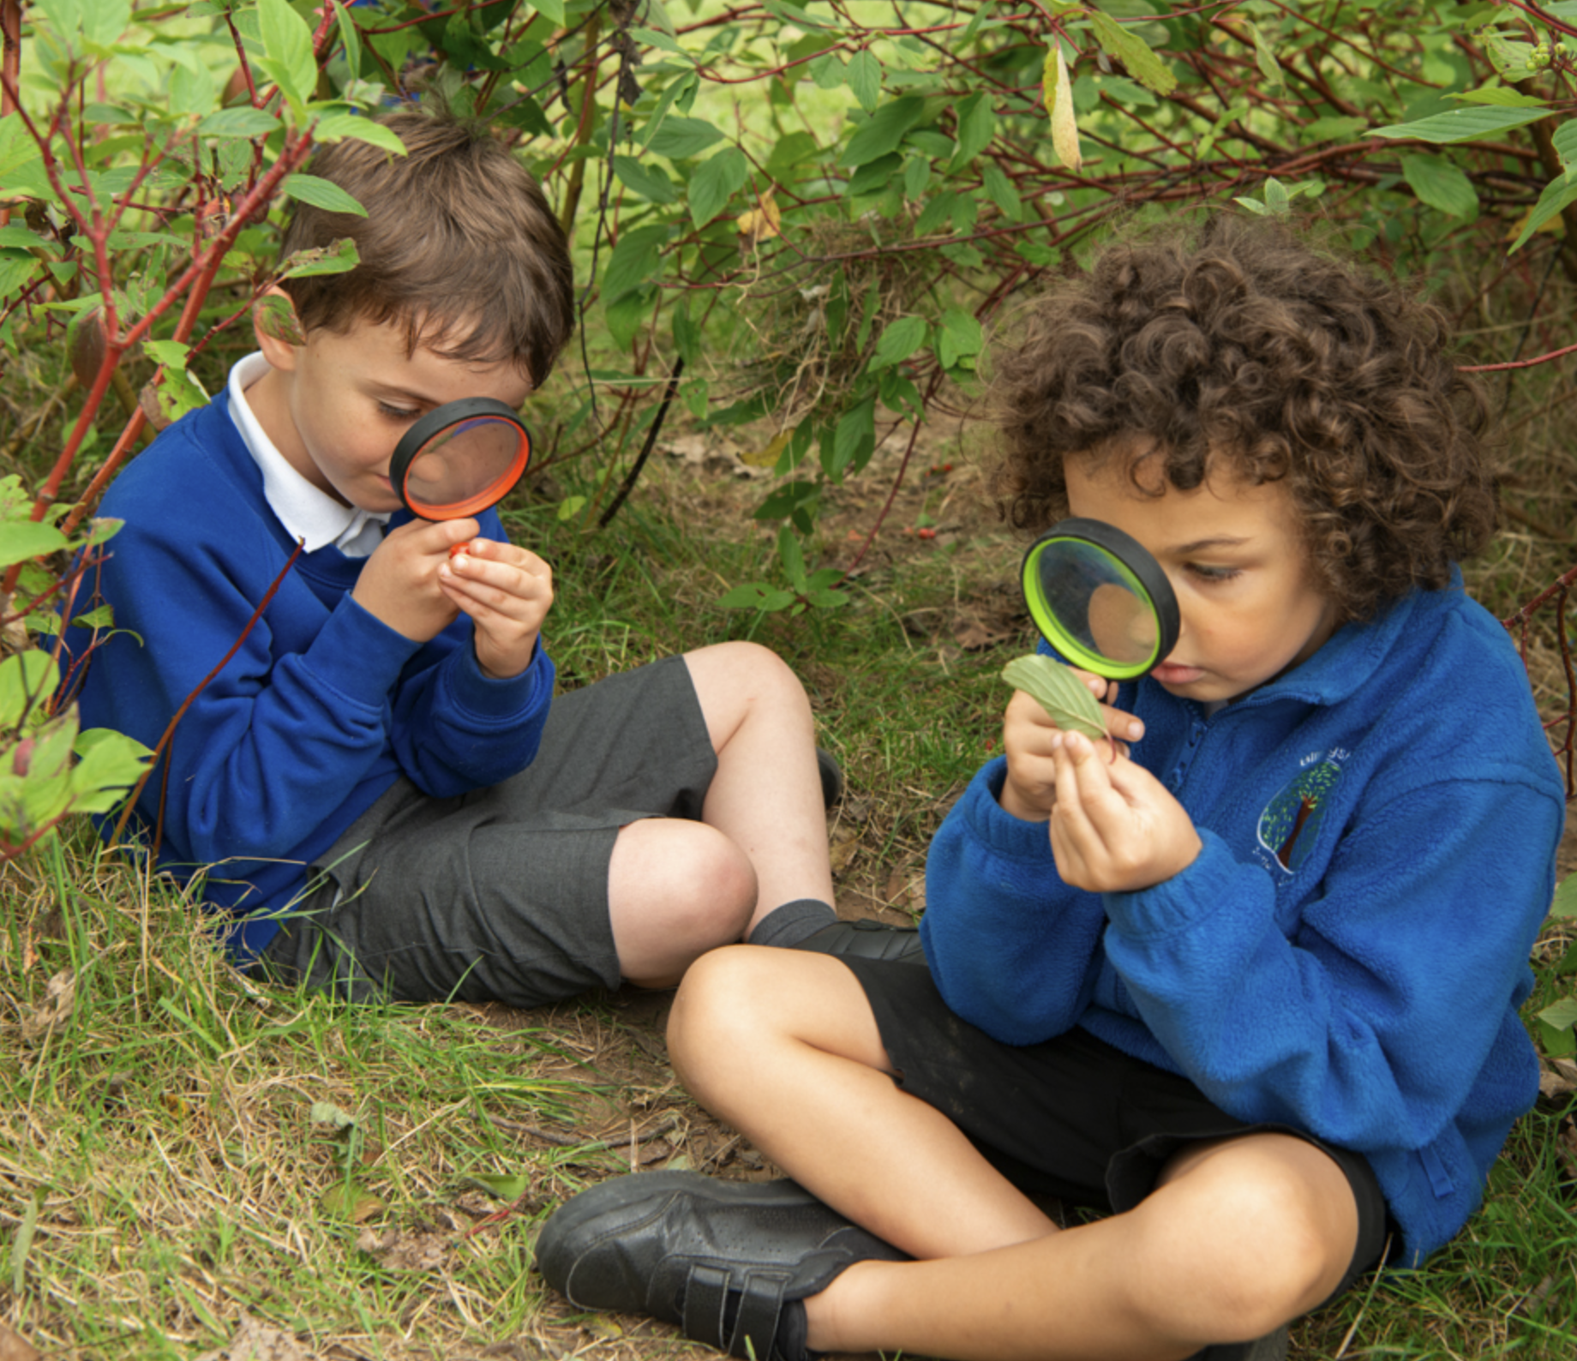
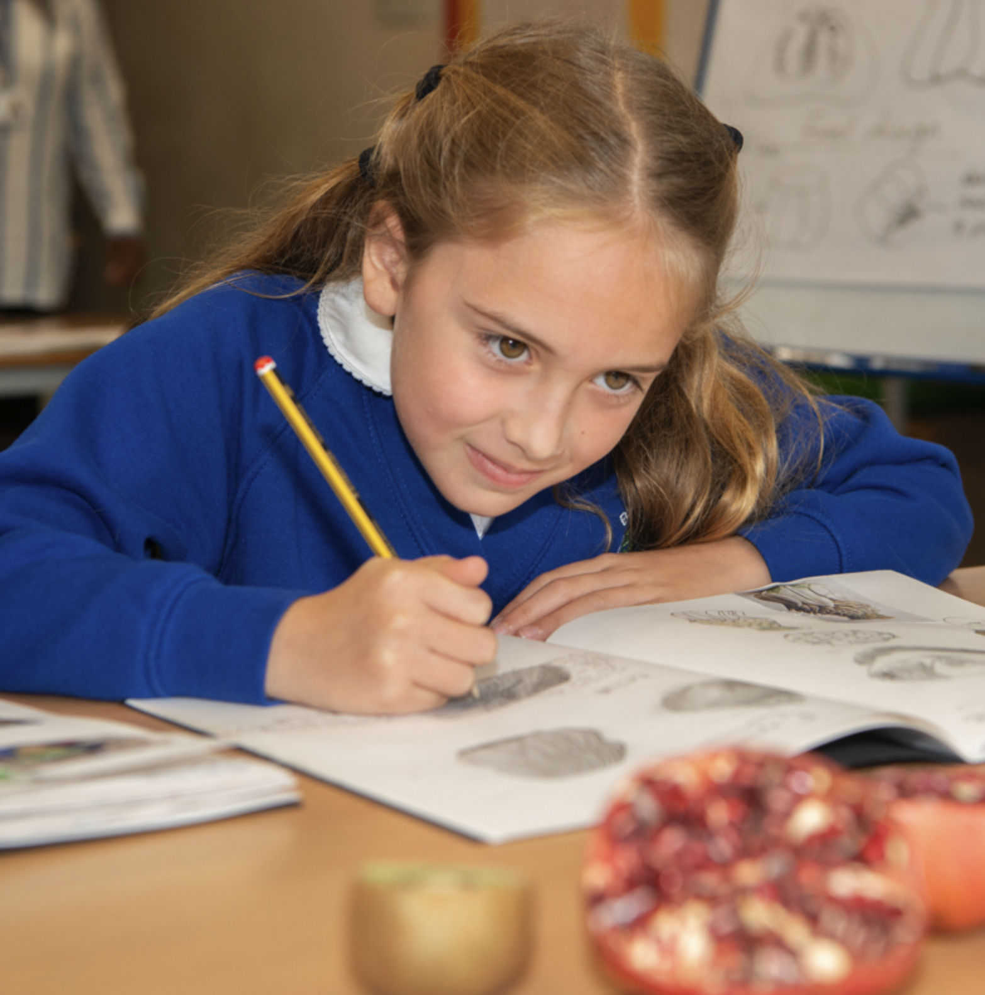
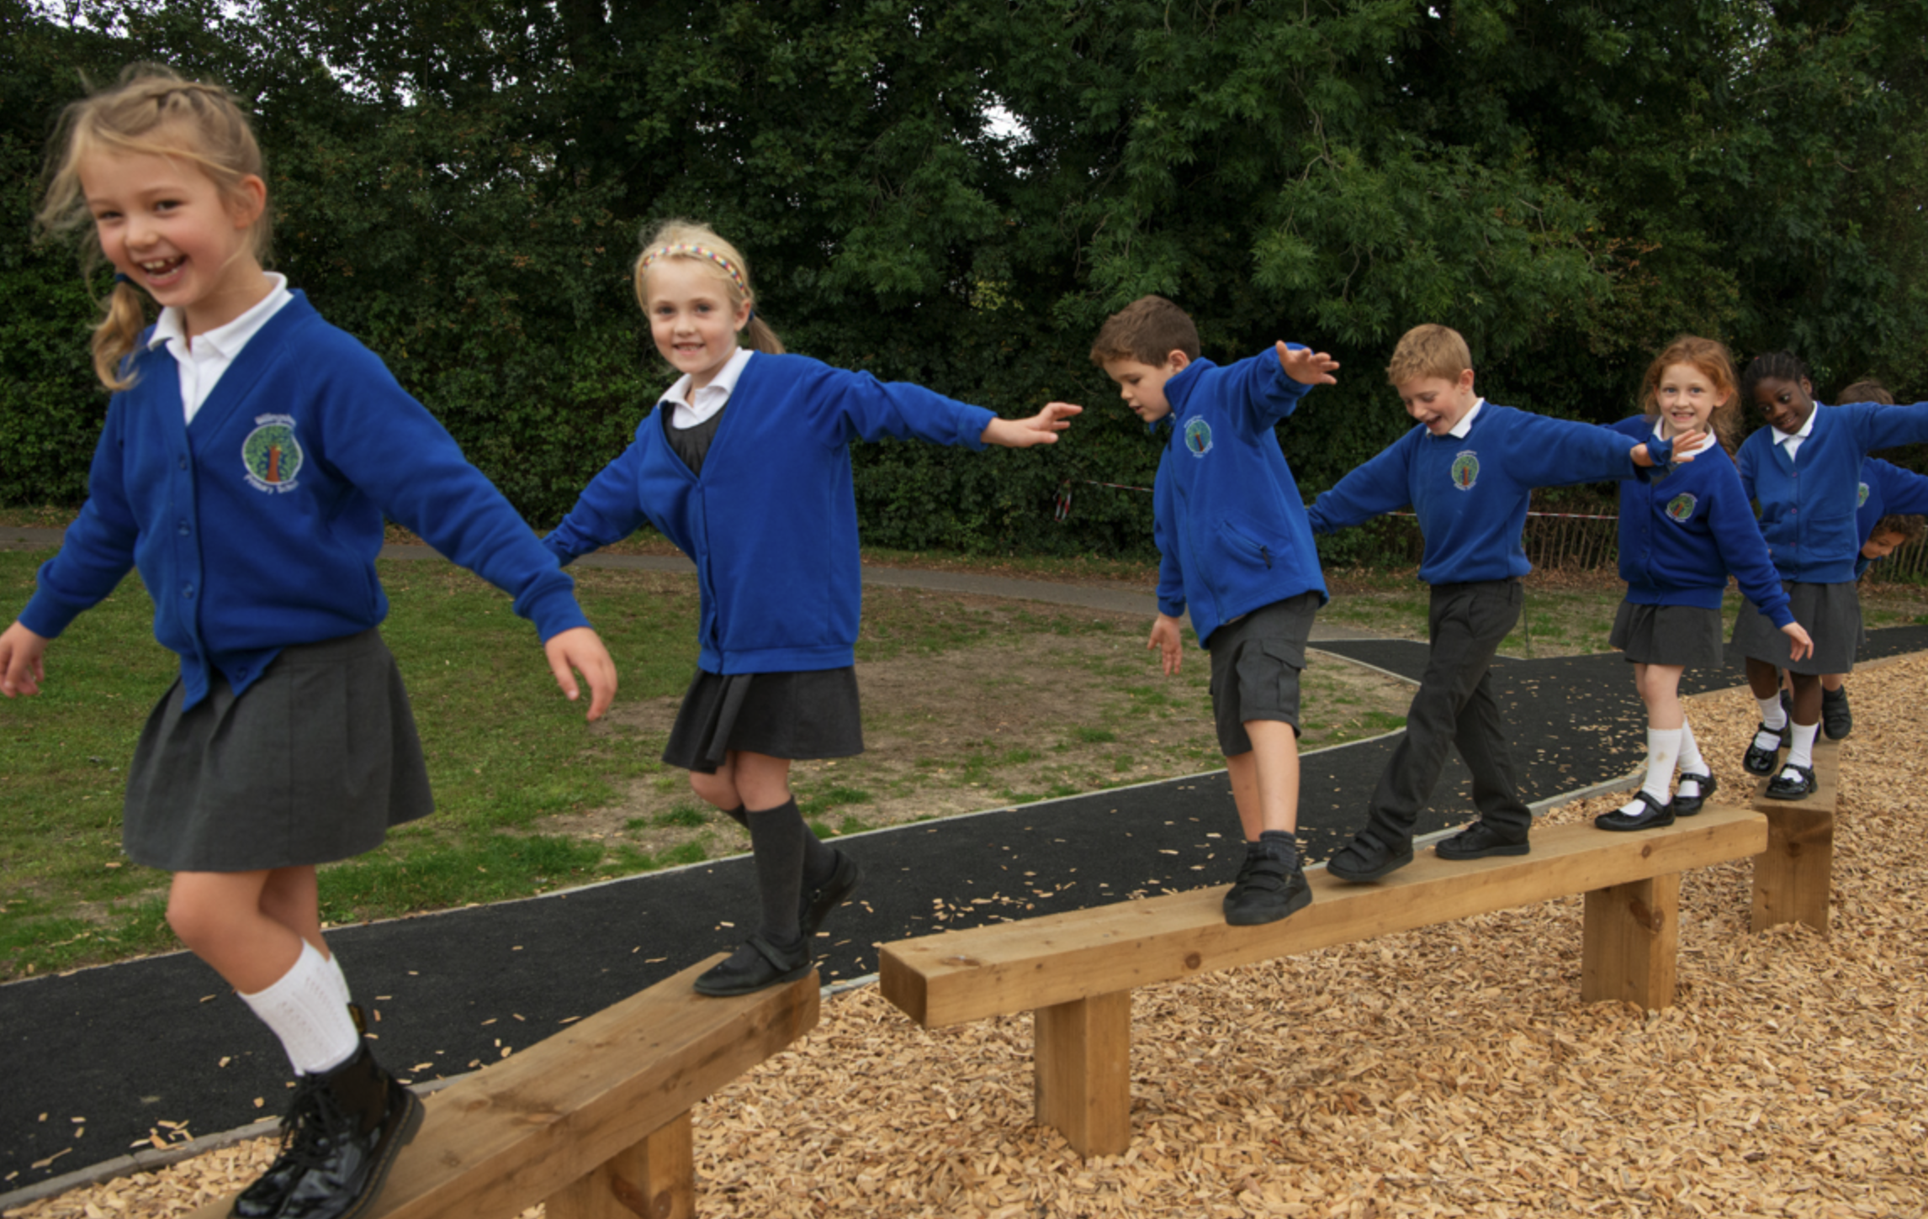
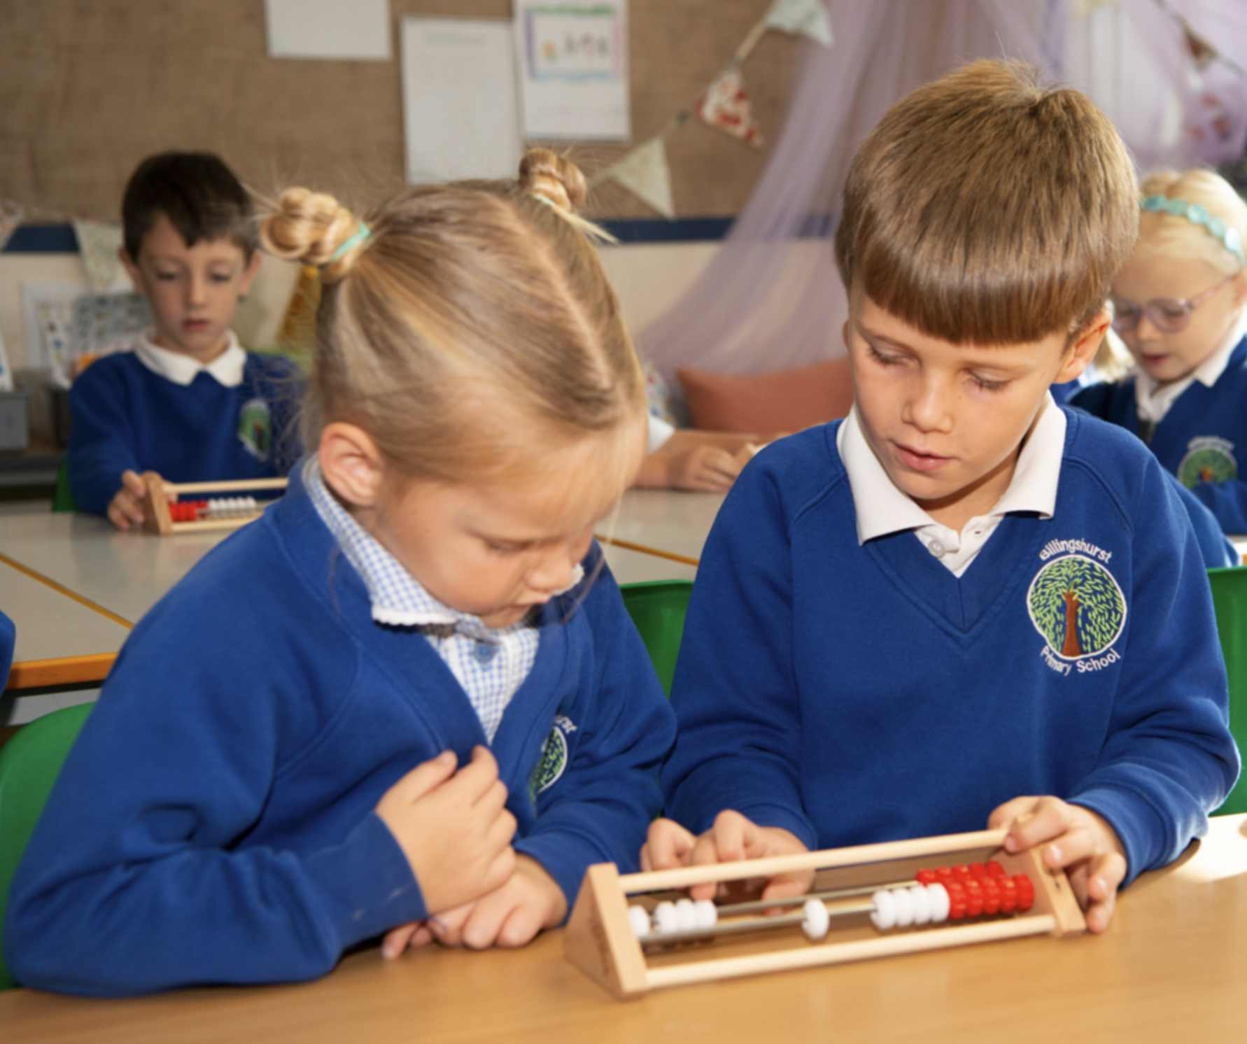
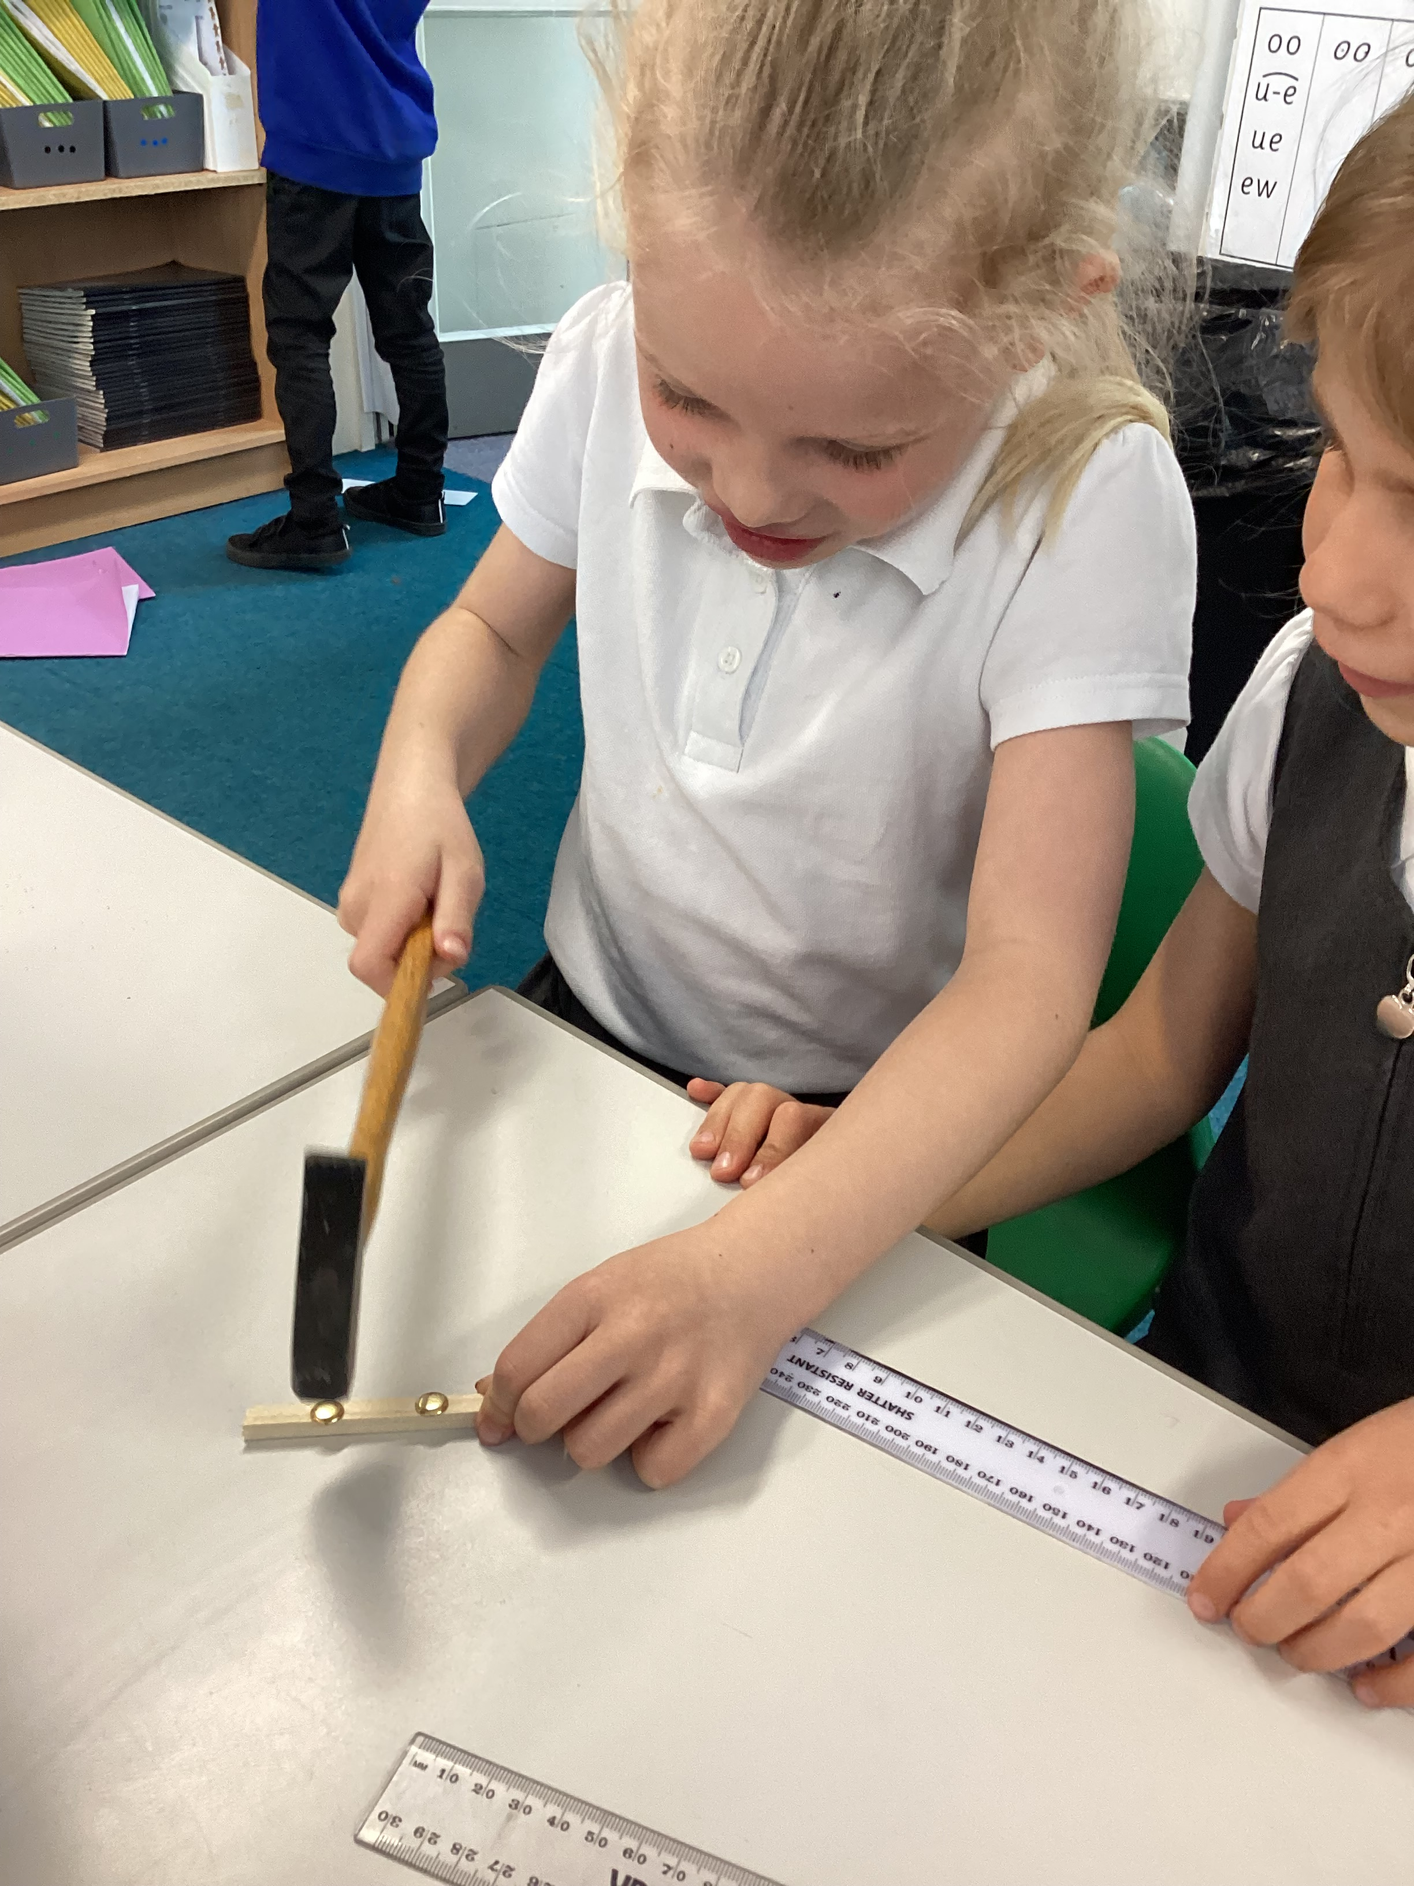
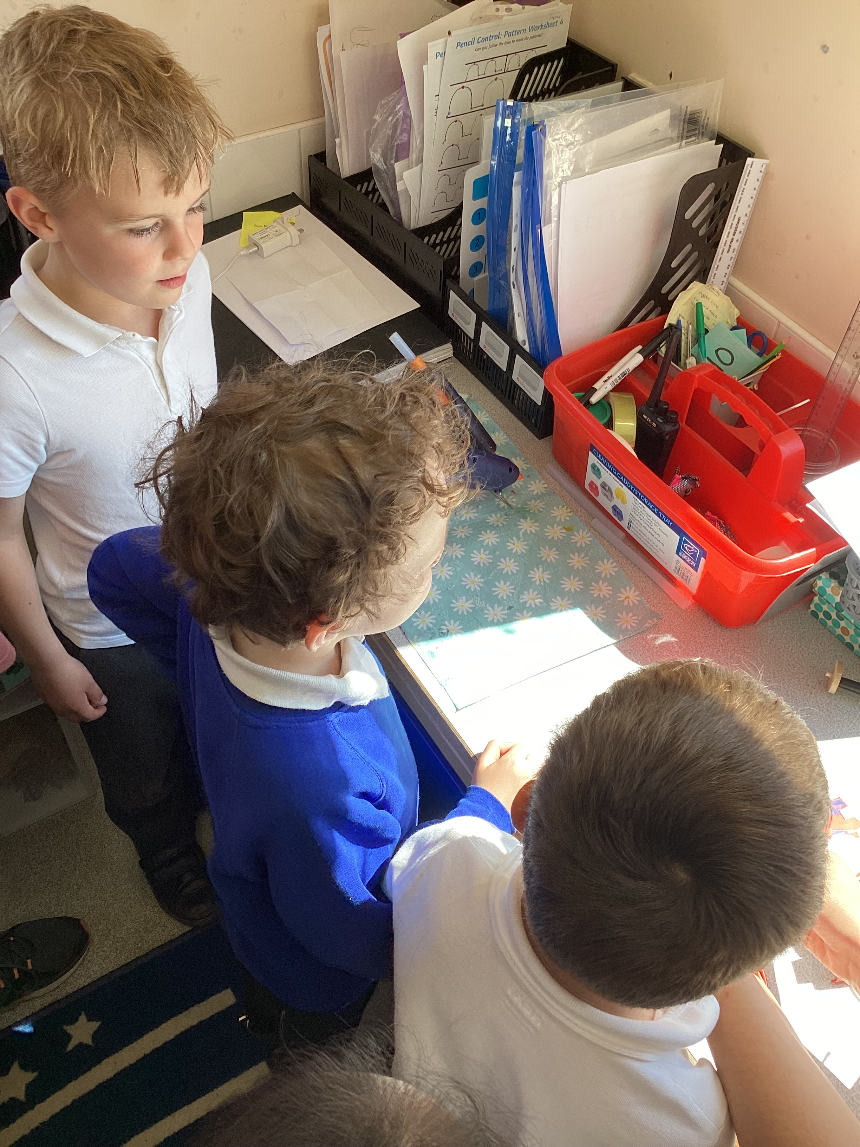
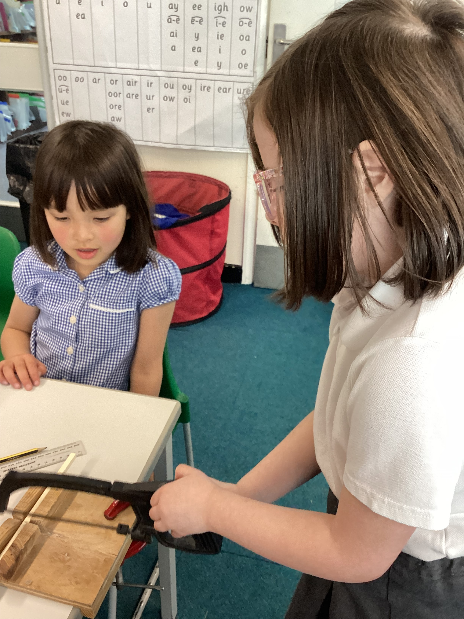
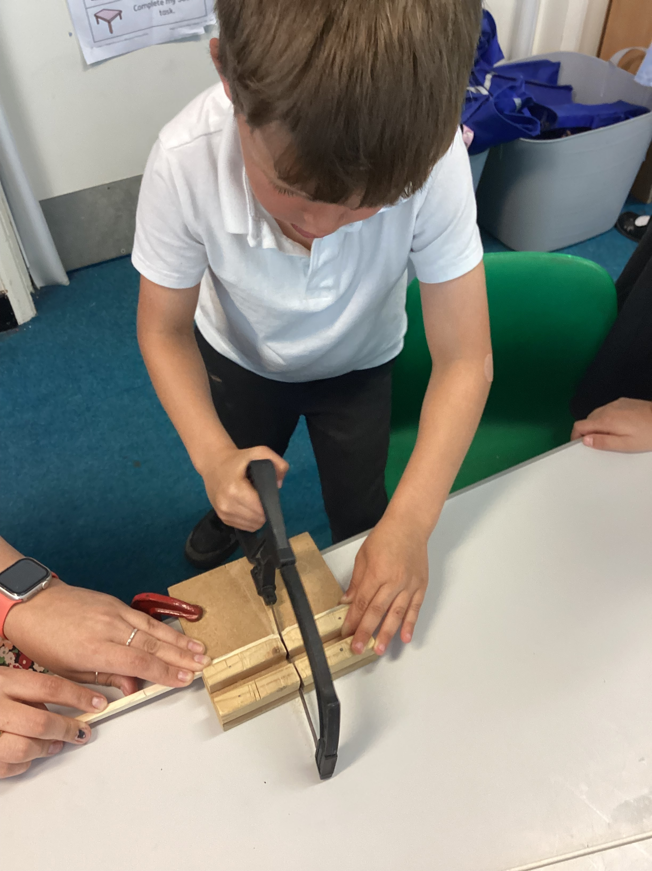
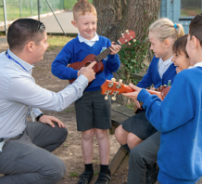
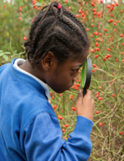
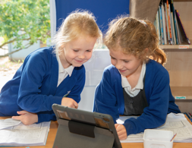
Newsletter 3rd May
Learning, growing and achieving excellence together
Dear Parents and Carers,
A big thanks to all the parents who came to the coffee morning this week. It was lovely to meet you all to hear feedback and discuss ideas. Regrettably, I am having an operation on the 13th May which will put me out of action for two weeks, however when I return after half term there will be more formal afterschool meetings where we will share with parents work so far this term and plans for September - date to be advertised soon.
Sussex Learning Trust visited today to discuss support and plans to improve the facilities in school, once plans are finalised these will be shared. Having never worked in a Trust before, the benefits and opportunities for development are already very apparent and exciting.
Before my operation, a priority is to formulate plans for wrap around care at Billingshurst so we can support our community and families. We will keep you informed of the journey and progress towards this and of course would welcome any comments. It has been interesting and useful to talk to parents about wrap around care on the gates and what is needed.
Have a restful bank holiday weekend and we will see you Tuesday.
Ms Ley
Year 1
In Design and Technology recently, the children have been building their own cars. We've been sawing dowels, measuring with rulers, using a hot glue gun to stick parts together and also hammering nails in too! What fabulous skills the children were able to practise with real equipment and they were so interested too! We are very proud of how careful they were and thoughtful in taking turns. Well done!
Reminder for Year 6: Please sign up for the free SATs breakfast club by Monday 6th May!

Slide 2
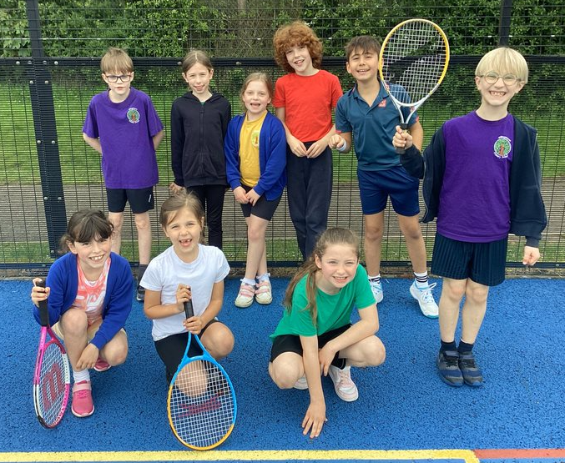
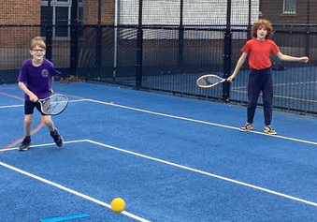
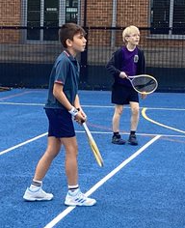
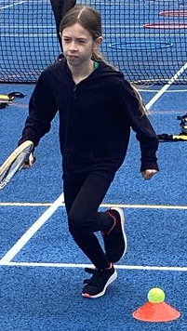
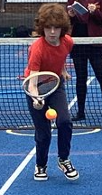
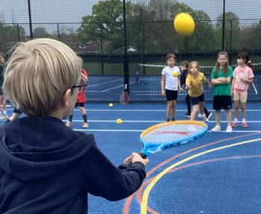
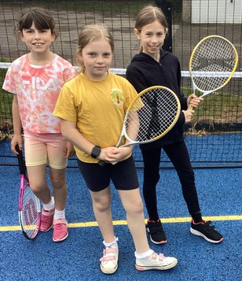
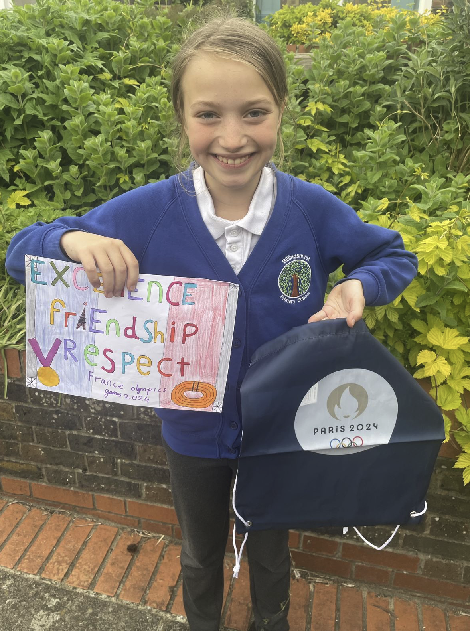
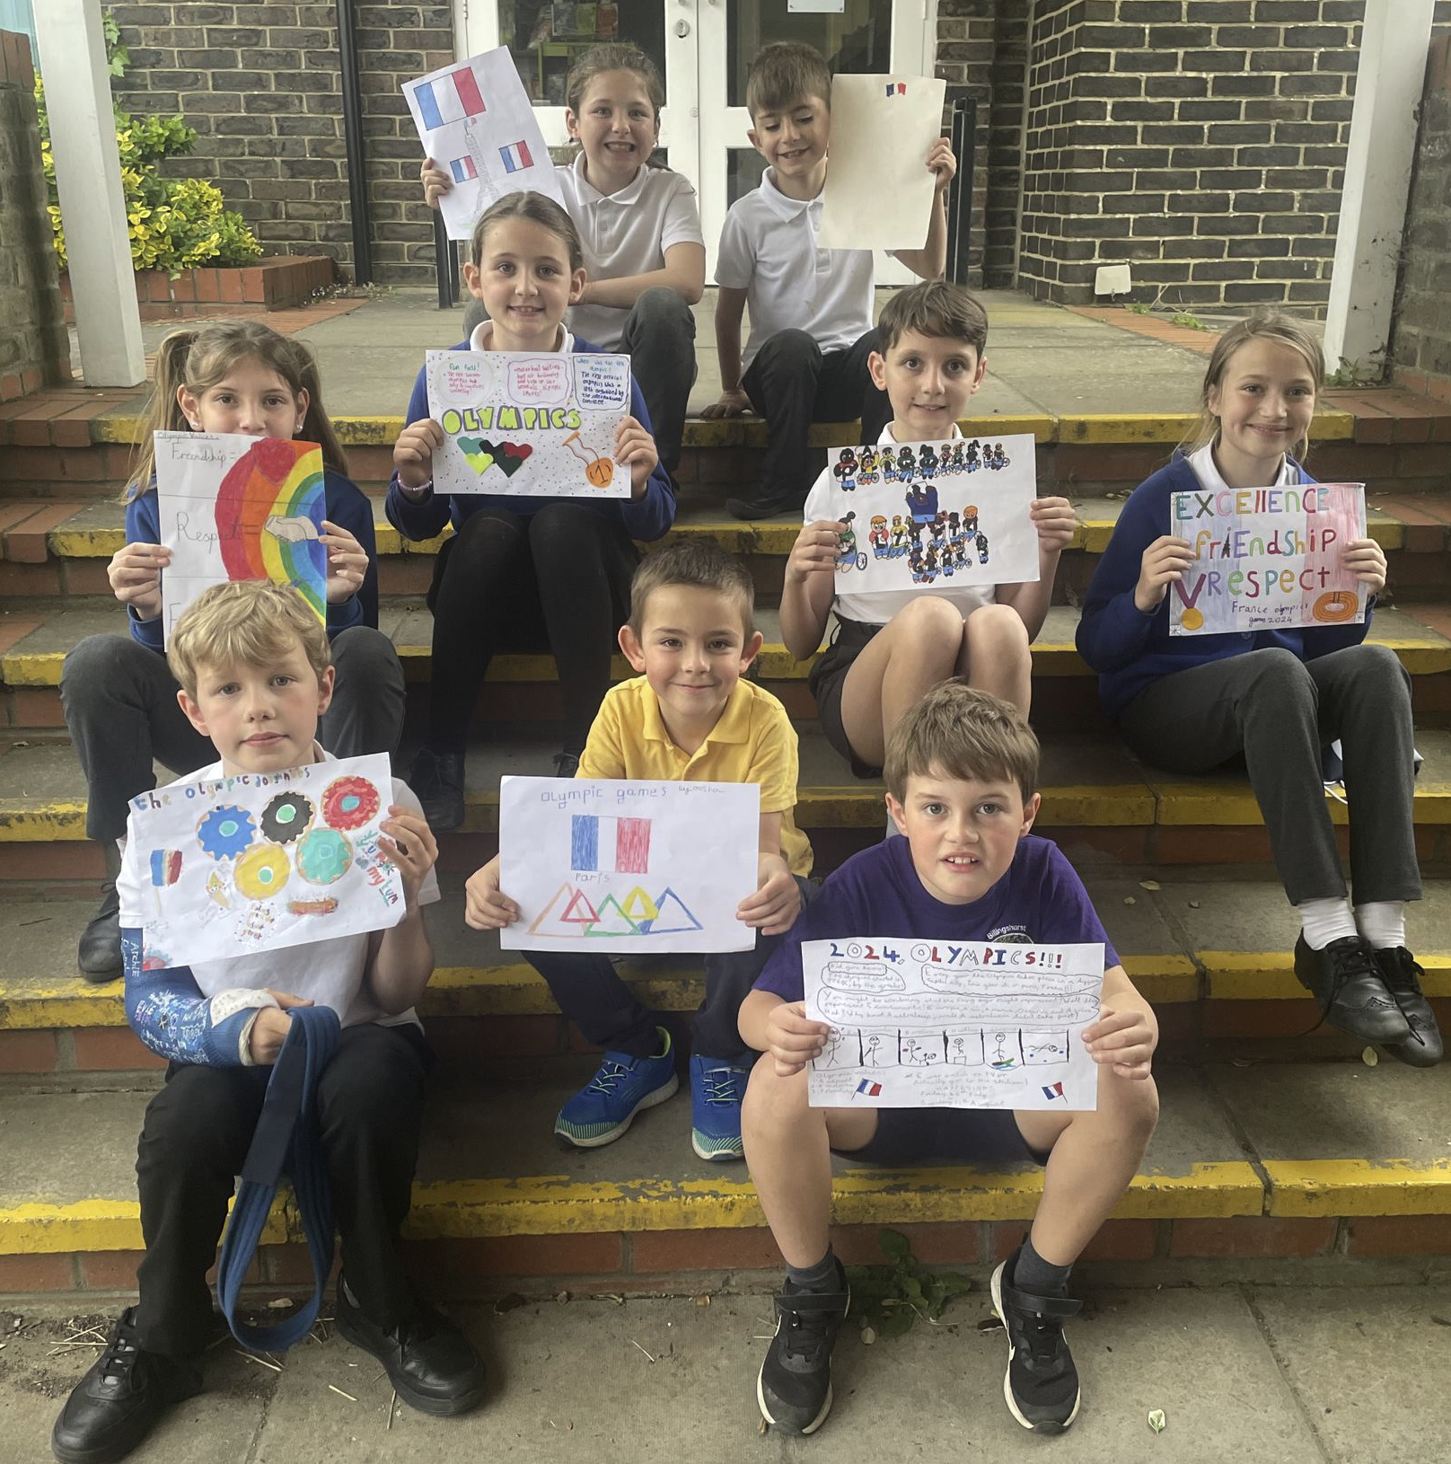
Years 3 & 4 sports event - Tennis
On Thursday afternoon, Miss Pickett had a wonderful time taking a team of nine Year 3 & 4 children to a tennis event at the Weald. Six schools competed in various drills and then children took part in head-to-head doubles games against the other schools. The competition was strong, and points were tallied throughout the afternoon. Although BPS didn’t reach the top three, the children were commended on their positive attitude, keenness and excellent sportsmanship. I certainly was very proud of their resilience and their kindness to the other children. Overall, they were just fantastic, and I am immensely proud of how they represented our school! Thank you to Mr Meany and the Sports Leaders from Year 10 at the Weald for such a brilliant afternoon.
Don't forget! Friday 10th May!
Sophy Henn: Author Visit – Years 2, 3 & 4
Award-winning author and illustrator Sophy Henn (author of Pizazz)
Book signing KS2 Hall after school.
Pre-order books from the Book Nook using the code Henn for a DISCOUNT!
https://booknookuk.com/sophy-henn-school-events/
Books also available to purchase from the KS2 Hall at pick up on Friday 10th May.
Request Year 1 outdoor area
We love our area but now we want to enhance it even more. If you have any of the following, please get in touch or drop off to a Year 1 classroom:
A medium cable drum (to make a table)
Hooks (to attach things to our fence)
Slices of wood (or a log we can slice)
Ribbon and fabric for weaving
Plastic crates to store things inside
Guttering or tubes to pour water
Plastic fairies/houses/dinosaurs/mountains
(we want to make a fairy garden and dinosaur land)
A plastic shopping till to play shops
Artificial grass scraps
Henry Adams Olympic Flag Competition
Several children across the school entered the Henry Adams Olympic Flag Competition. Their designs were both colourful and informative. Congratulations to Amelie in Year 6 for her fabulous winning design. Friendship, Excellence, Respect

Slide 3
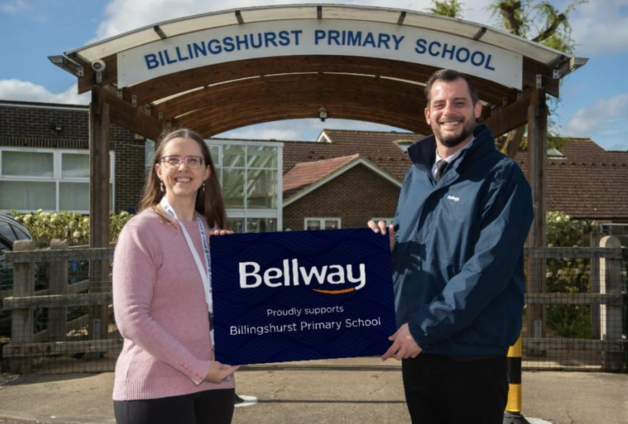
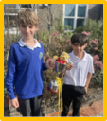
BPSCA - 6 July 11-2 Summer Fun Day; our biggest annual event at school. Join us for games, raffles, crafts, food, and giant inflatables! Several local businesses are supporting our Summer Fun Day, including Bellway Homes. Ian Trindall from Bellway came to BPS last week for a tour and to present us with £450. We're very grateful to all our local sponsors who make the Summer Fun Day possible!
Note from the Governors
It was a pleasure to pop into the coffee morning for parents and carers earlier this week and meet some of you. I hope this event was useful and gave you an opportunity to meet informally with members of the senior leadership team and to chat with other parents and carers.
Our survey for parents and carers closes this evening; if you have not already done so, please take this opportunity to provide feedback. There is a link to the survey here: Survey for Parents and Carers.
House Point Results
Winning House - Cowdray
Cowdray
855
Parham
795
Thank you to our sponsors for their support!
Goodwood
788
Petworth
809
Gil Parham Woodside Sculpture
www.woodlouseindustries.com
Upcoming dates:
Thursday 9th – Year 3 & 4 Weald golf event 2.00-4.00pm
Friday 10th – Year 2, 3, 4 author event (2.00-3.00pm) with book signing after school
13th – 16th May – KS2 Standard Assessment Tests (SATs)
Monday 13th May - Year 5 Weald athletics event 3.30-5.15pm
Friday 17th – Year 6 Tile Barn parent meeting 3.30pm KS2 Hall
Letters home this week: No additional letters
Best quality Blast-frozen Family run
www.tomthefish.co.uk
@BPSEYFS
@BPSYearOne
@BPSYearTwo
@BPSYearThree
@BPSYearFour
@BPSYearFive
@BPSYearSix
Year groups regularly post photos of children and learning on their X account. Please follow your child’s Year Group using the handles above.
www.professionalrubbersurfaces.com
The Budding Foundation
Follow us on Facebook for all the latest updates:
www.facebook.com/BillingshurstPrimary

