Slide 1
Welcome to ​ Miss Walker’s Class

Slide 2
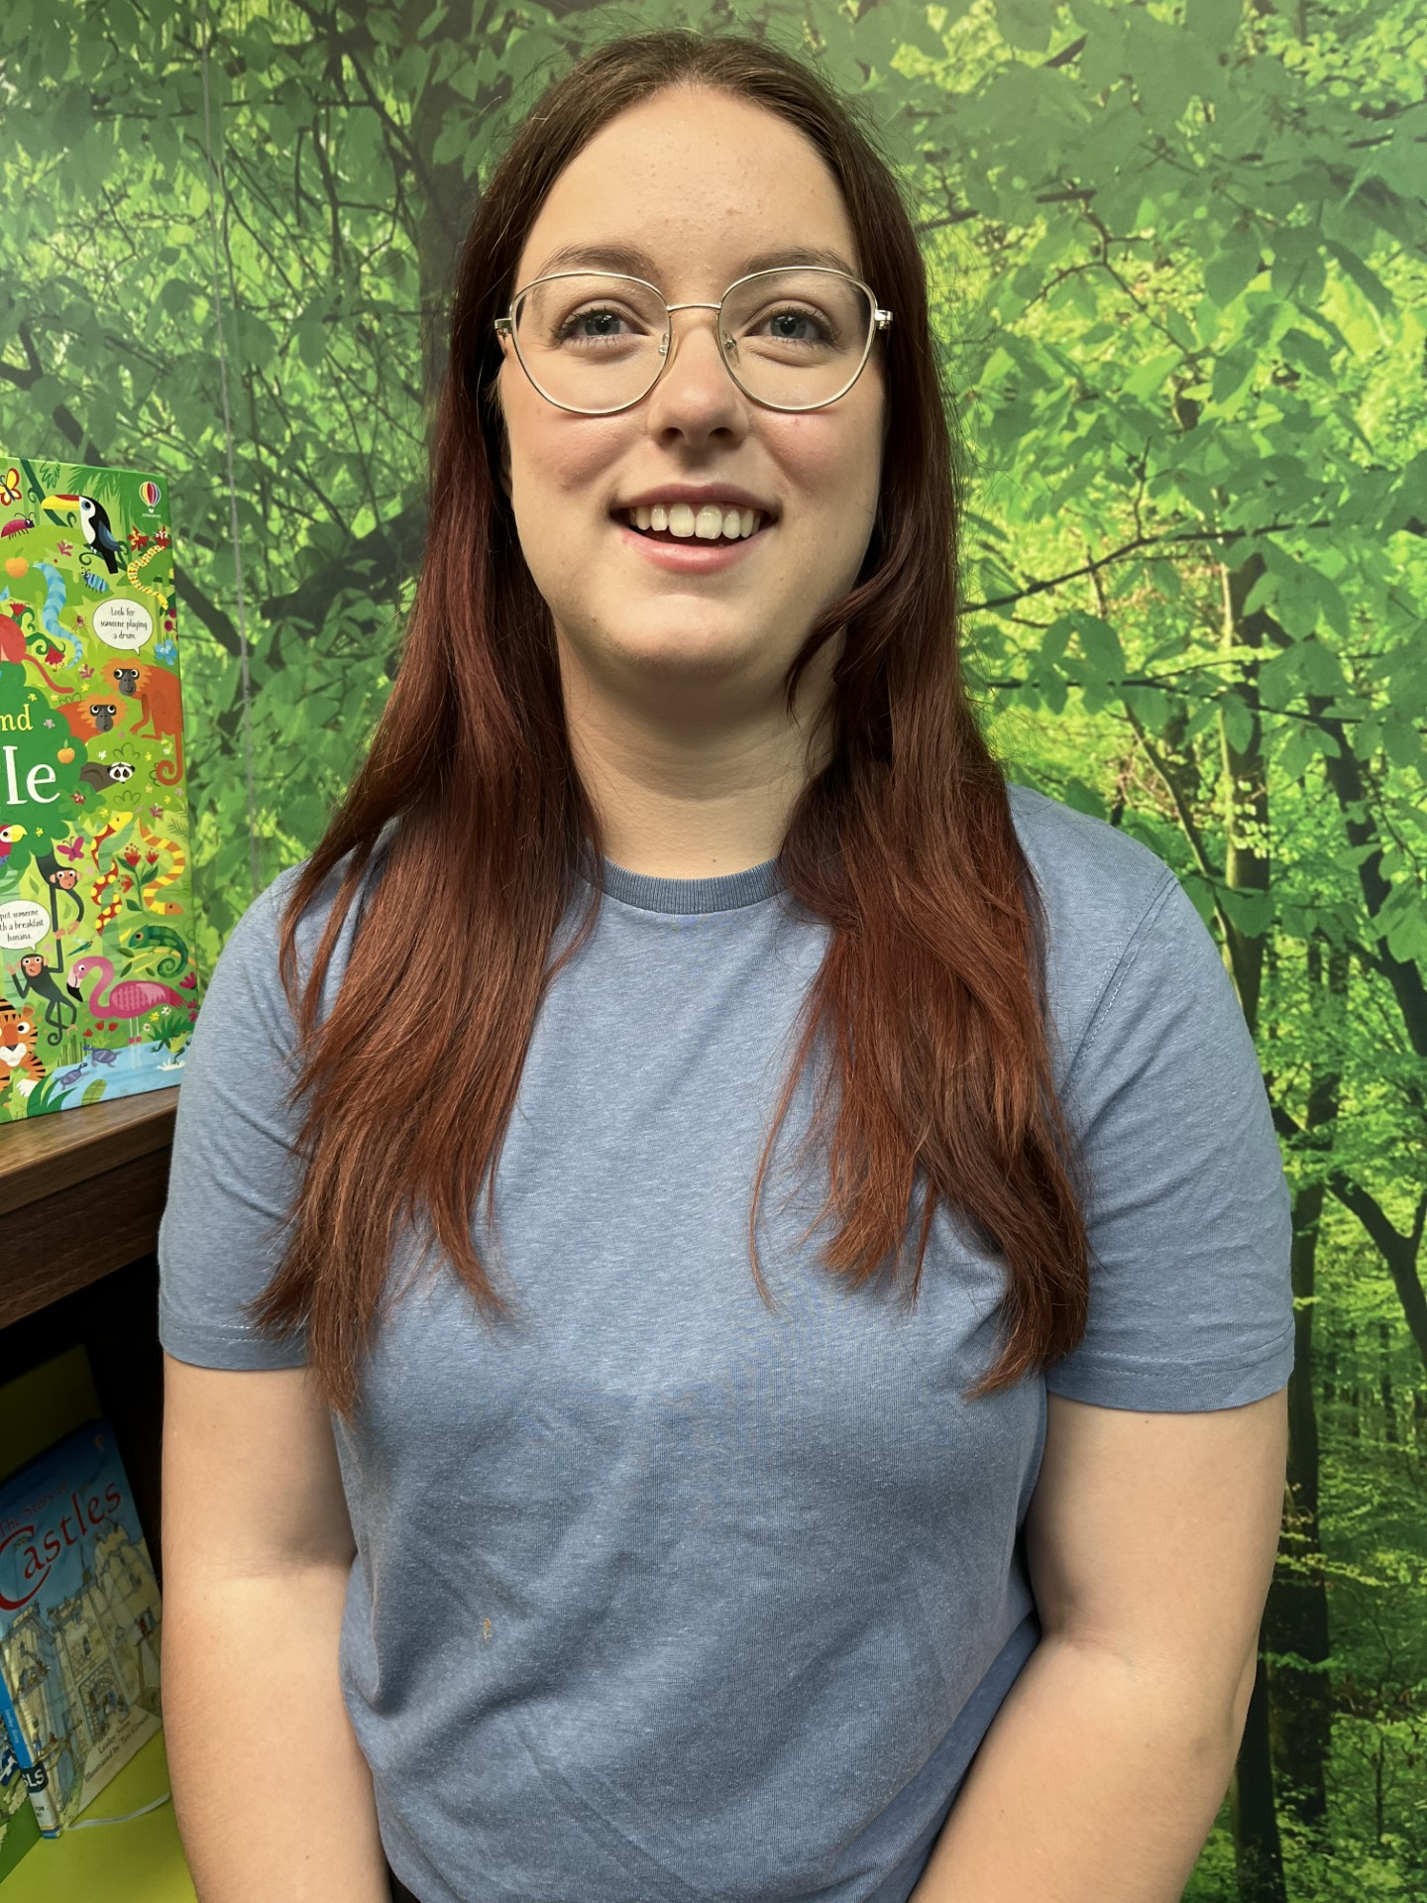
These are the adults that will be working in your classroom.
Miss Walker
Year 2 Teacher
Miss Barnes
Year Group Learning Support Assistant

Slide 3
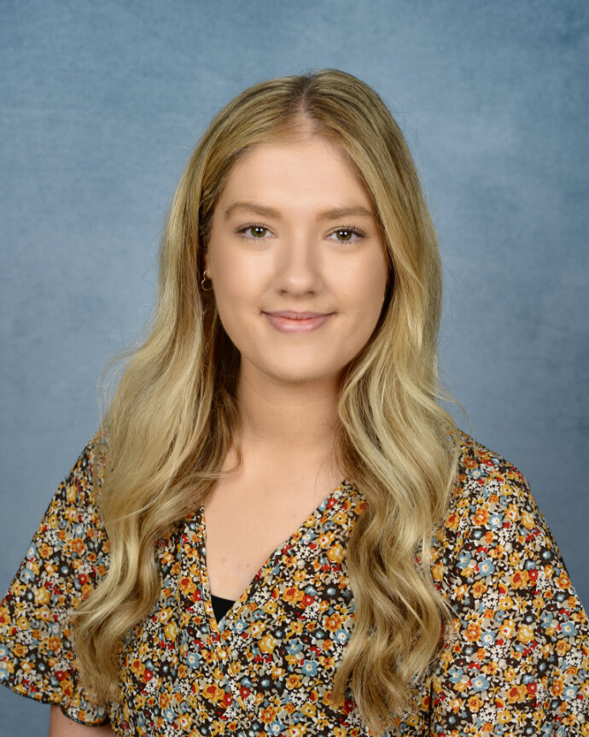
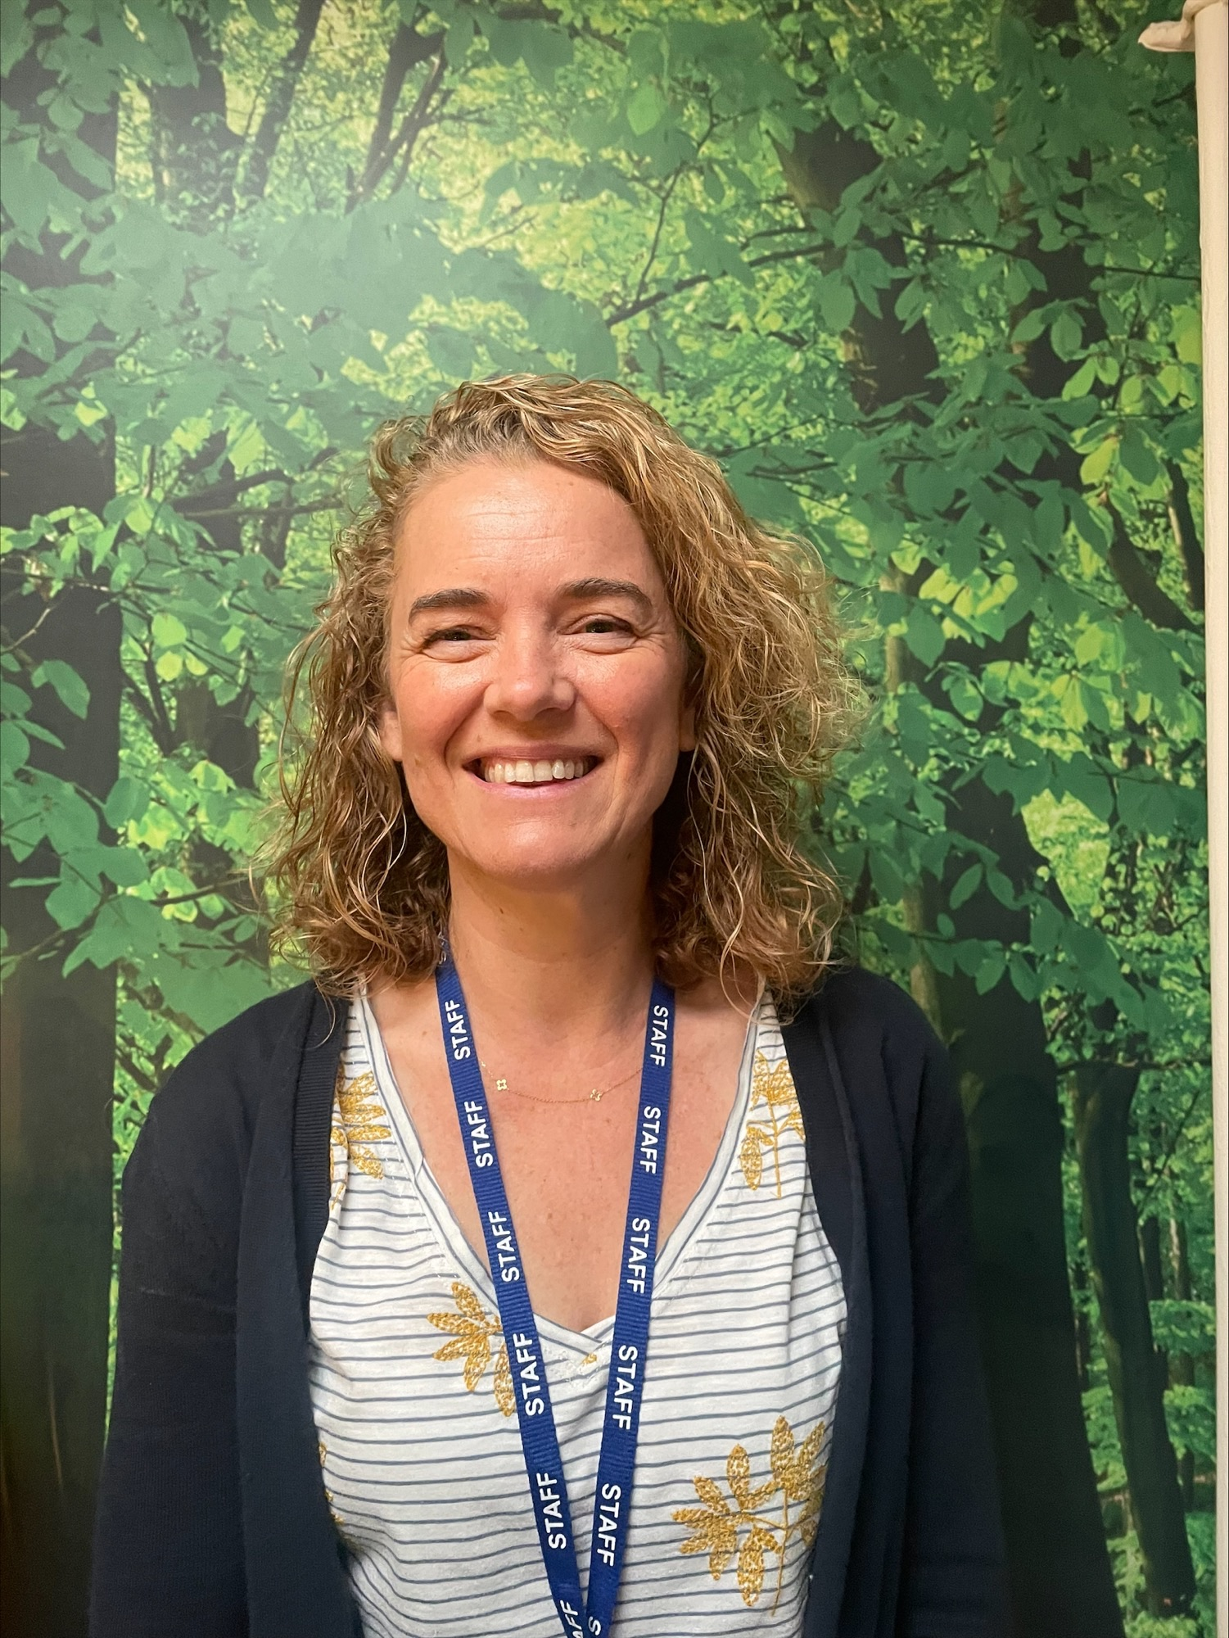
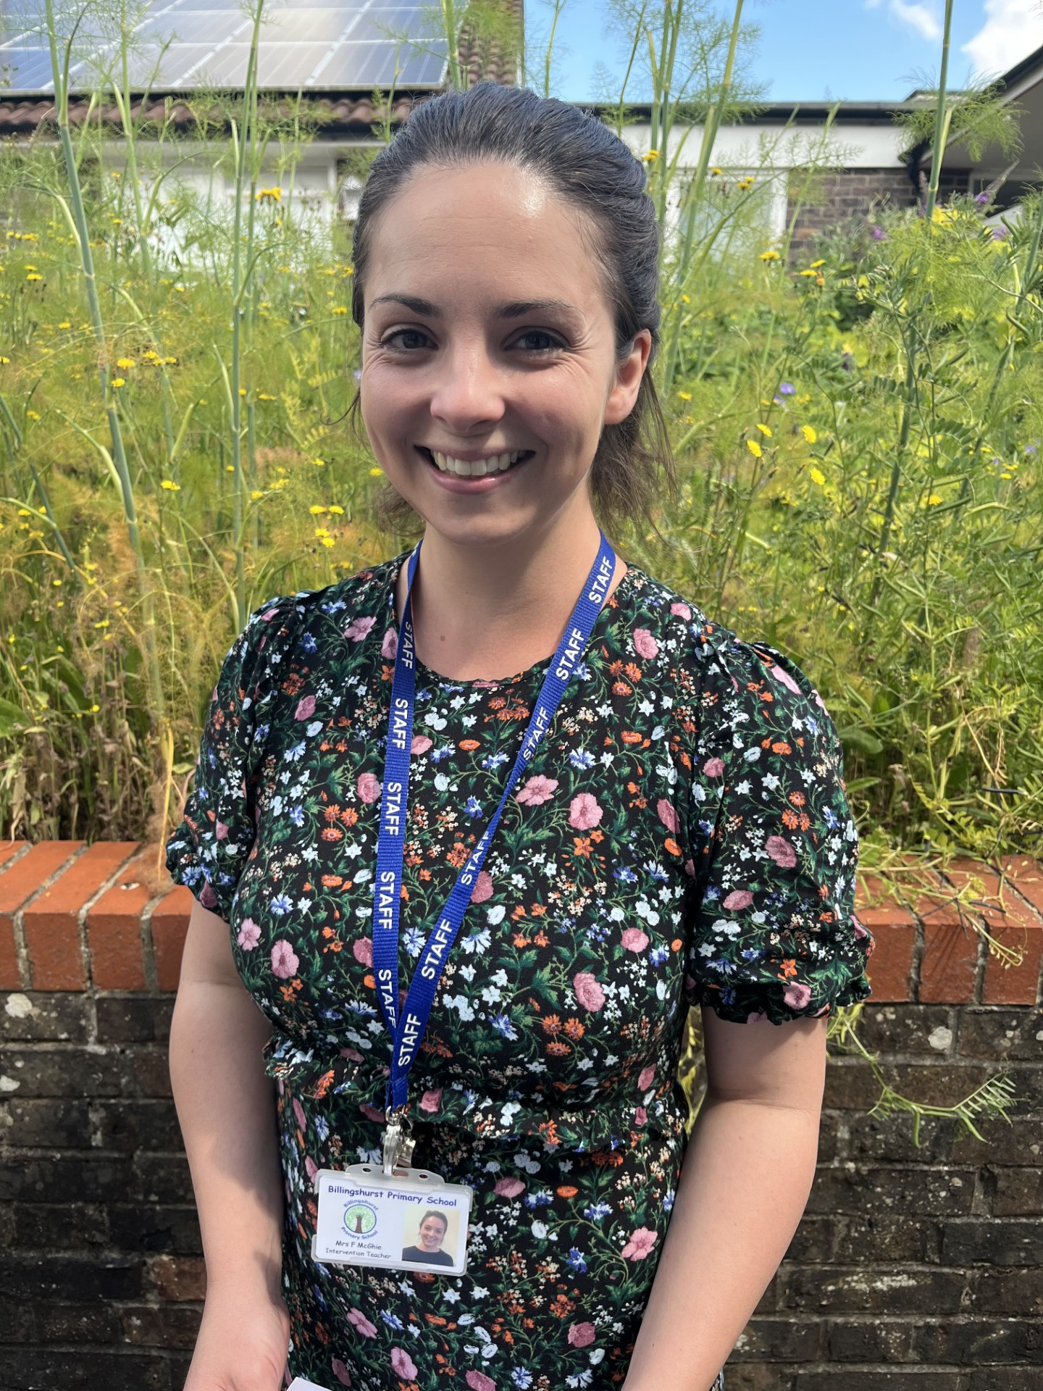
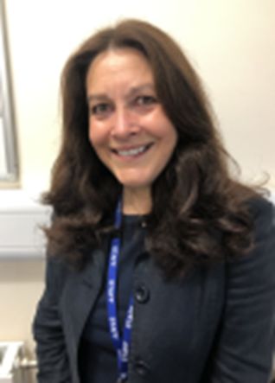
These are the other adults that will be working in Year 2.
Mrs Steer
Year 2 Teacher
Mrs Gold
Year 2 Teacher
Mrs McGhie
Year 2 Teacher
Mrs Barber
PPA/ Intervention Teacher
Miss Harmer
Learning Support Assistant
Mrs Parr-Rapley
Learning Support Assistant
Mrs Molla
Learning Support Assistant

Slide 4
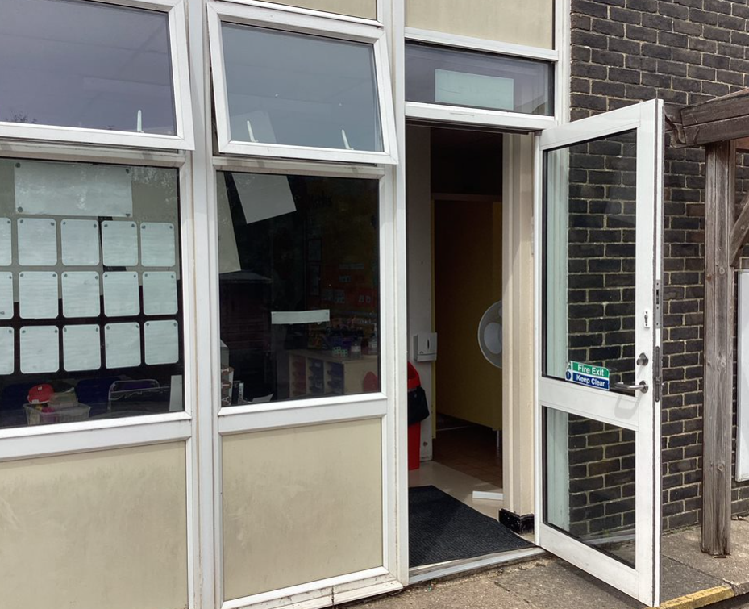
This is where you will enter the school and your classroom.

Slide 5
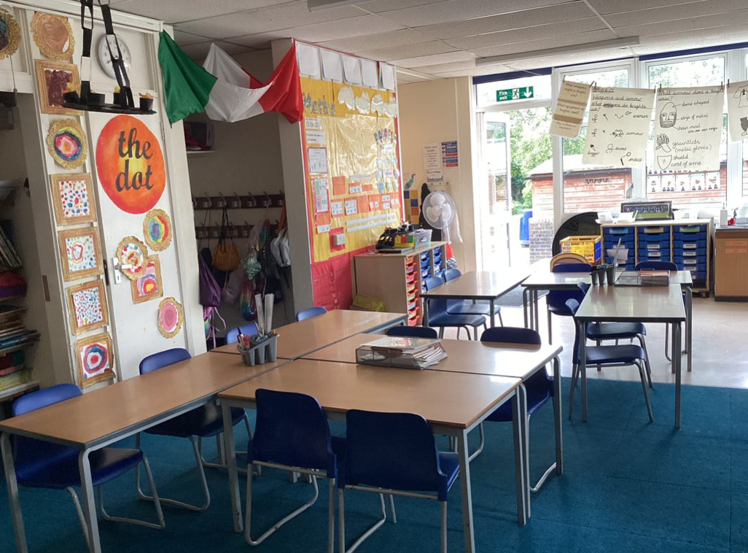
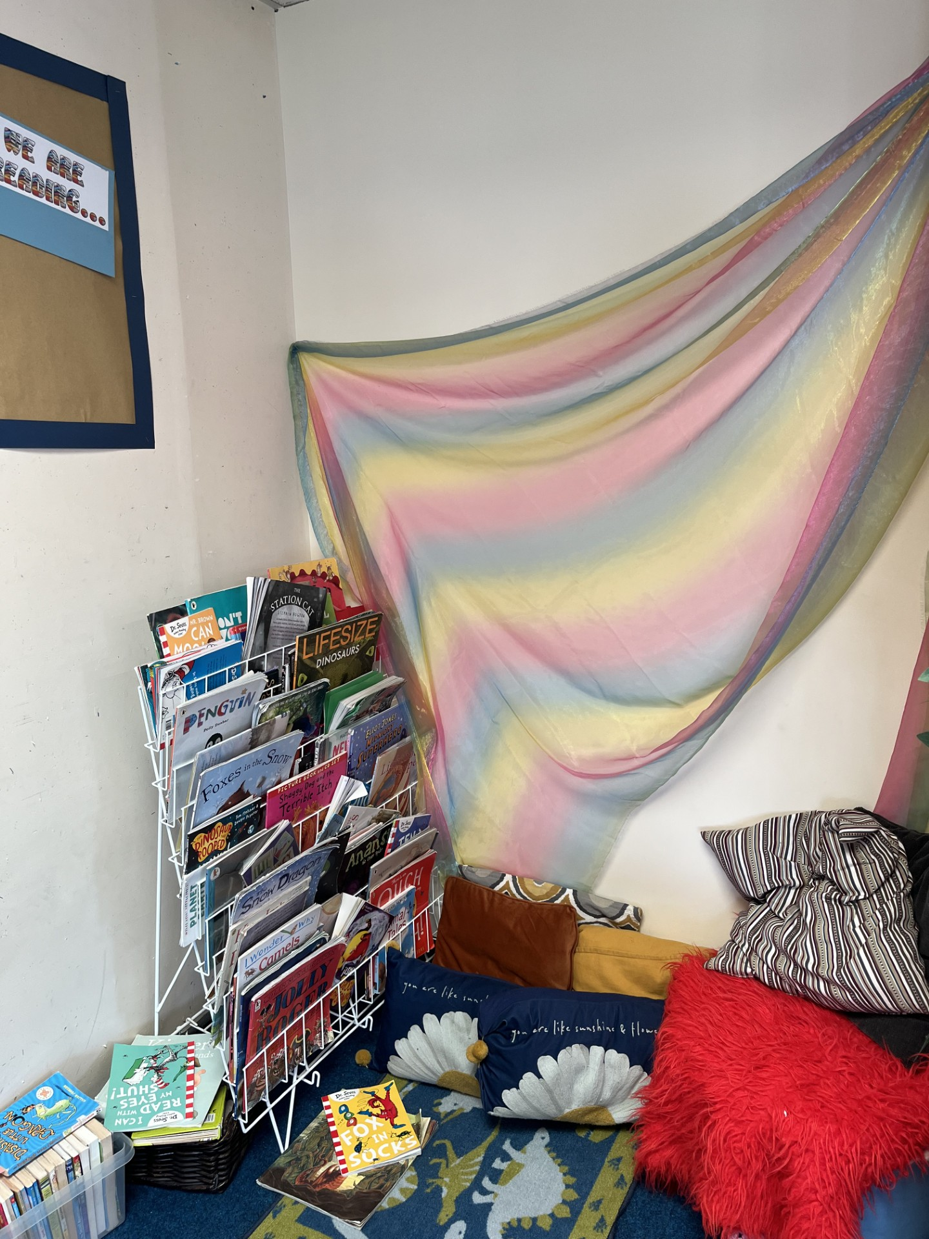
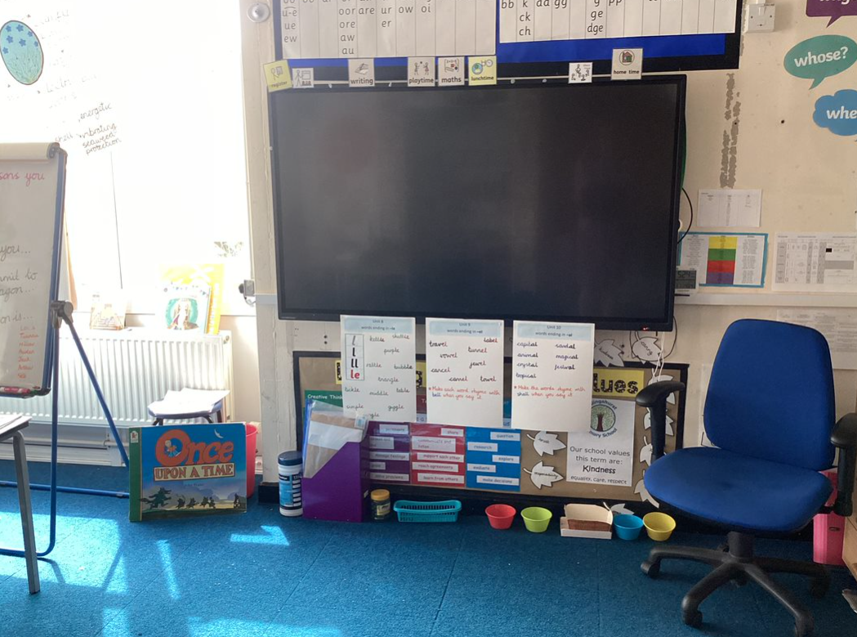
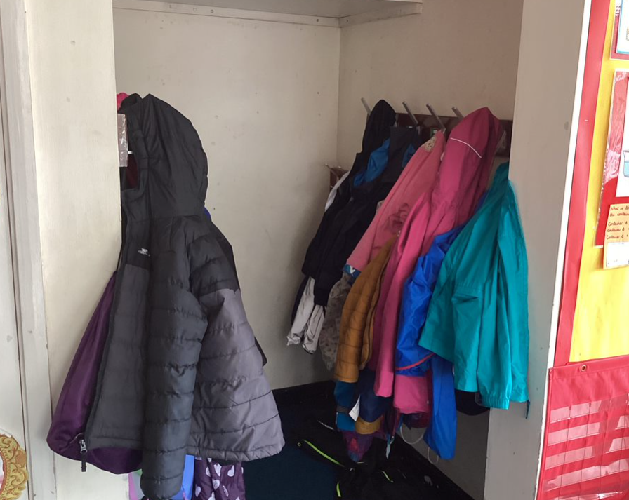
This is your classroom.
This is where you will hang your coat and PE bag.

Slide 6
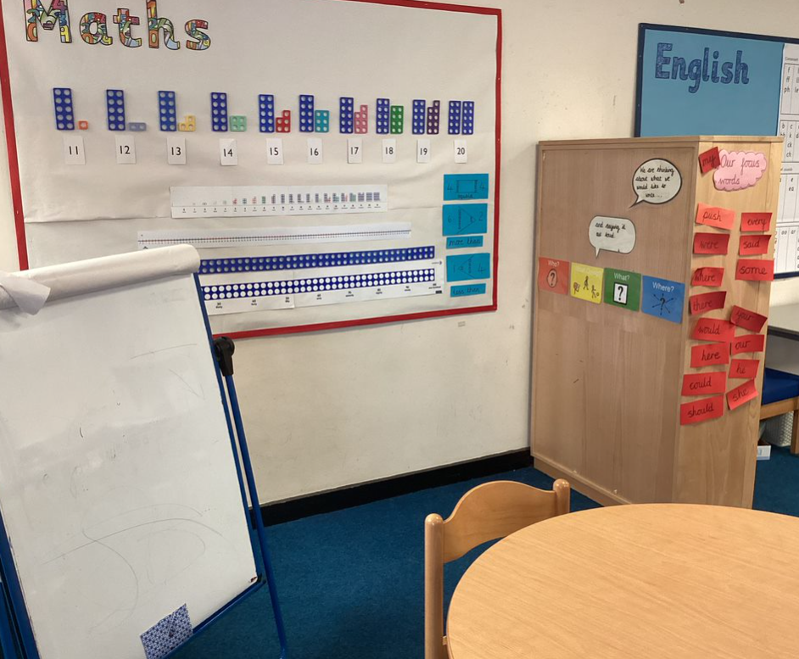
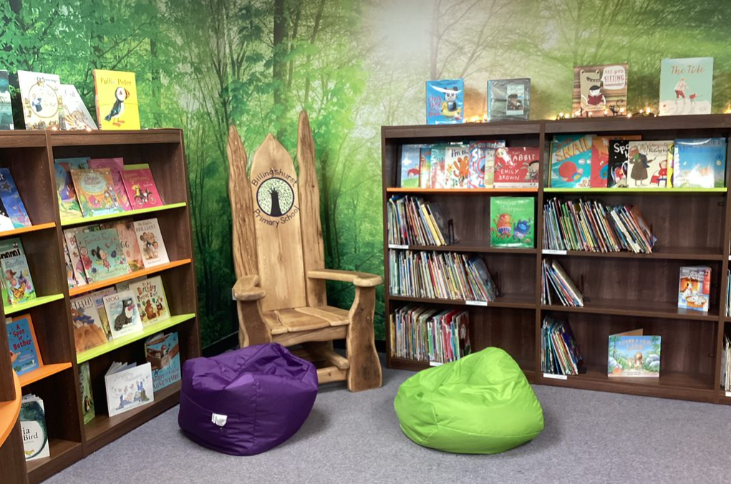
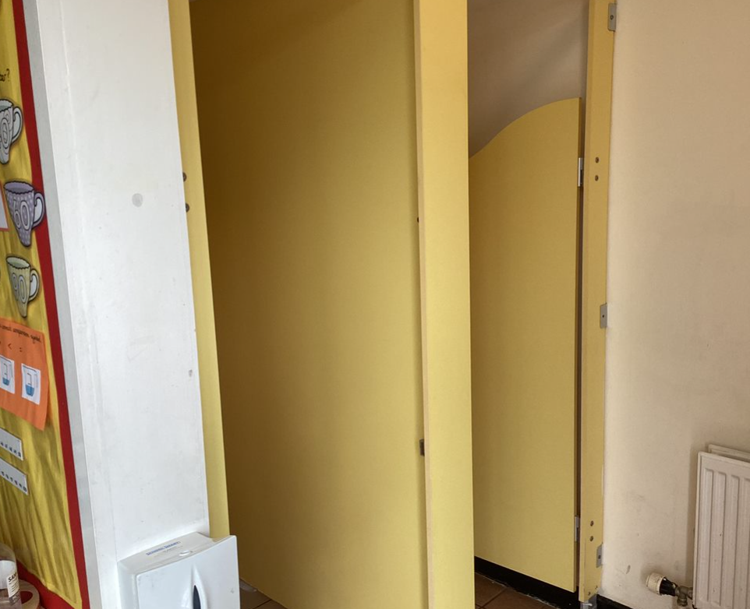
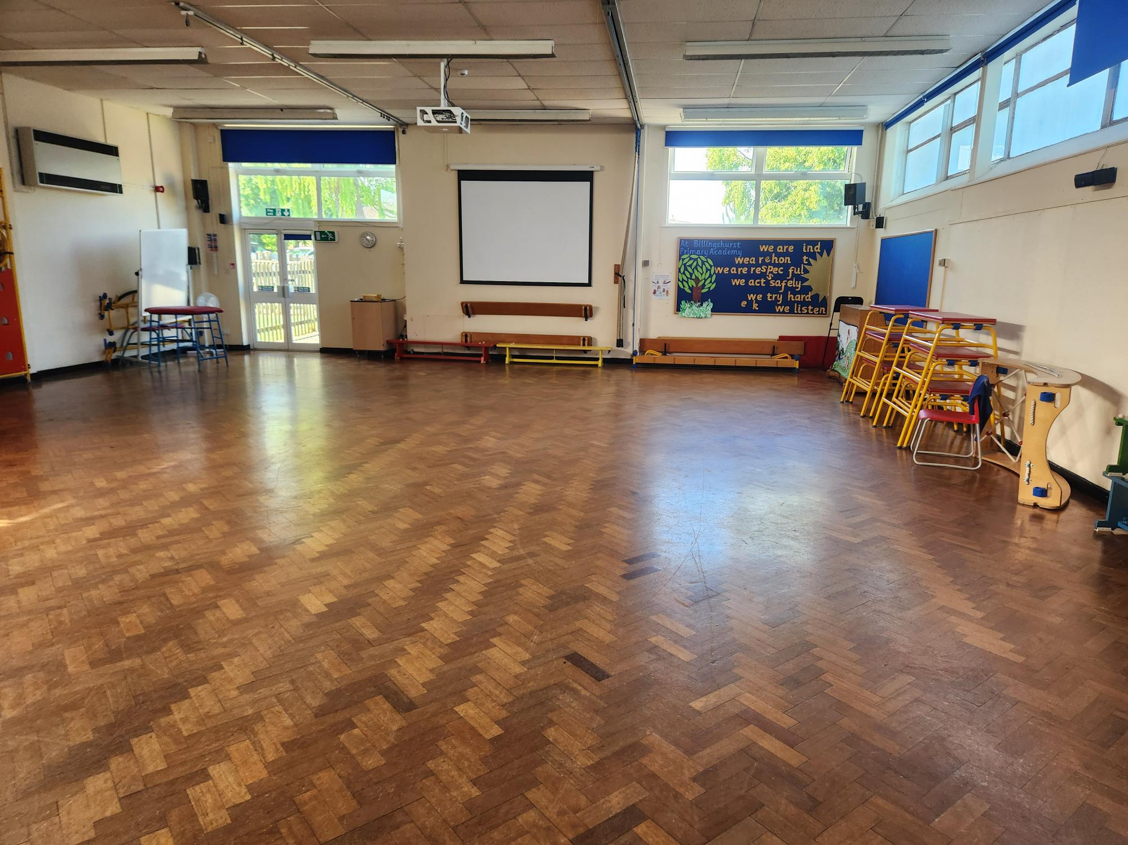
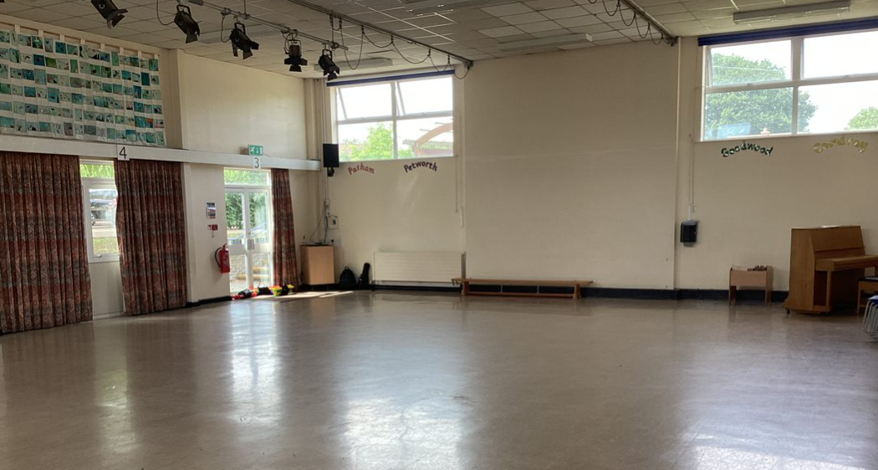
This is the area outside of Year 2 where you may sometimes work.
This is the Key Stage 1 library.
These are the toilets in your classroom.
These are the KS1 & KS2 Halls where you will have lunch and assemblies.

Slide 7
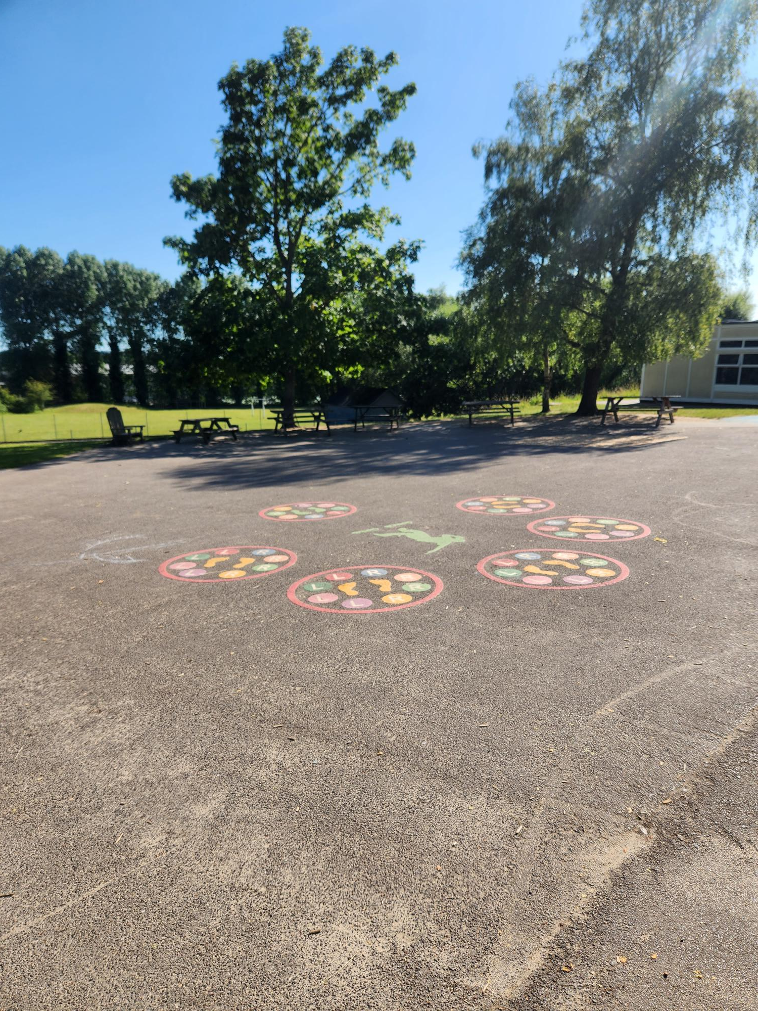
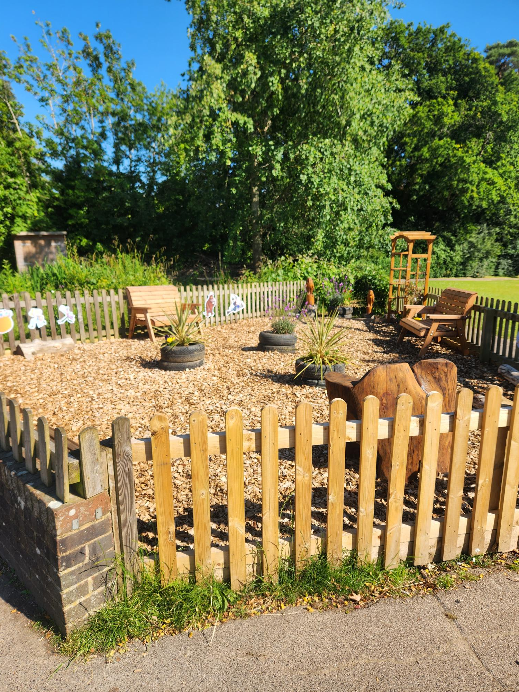
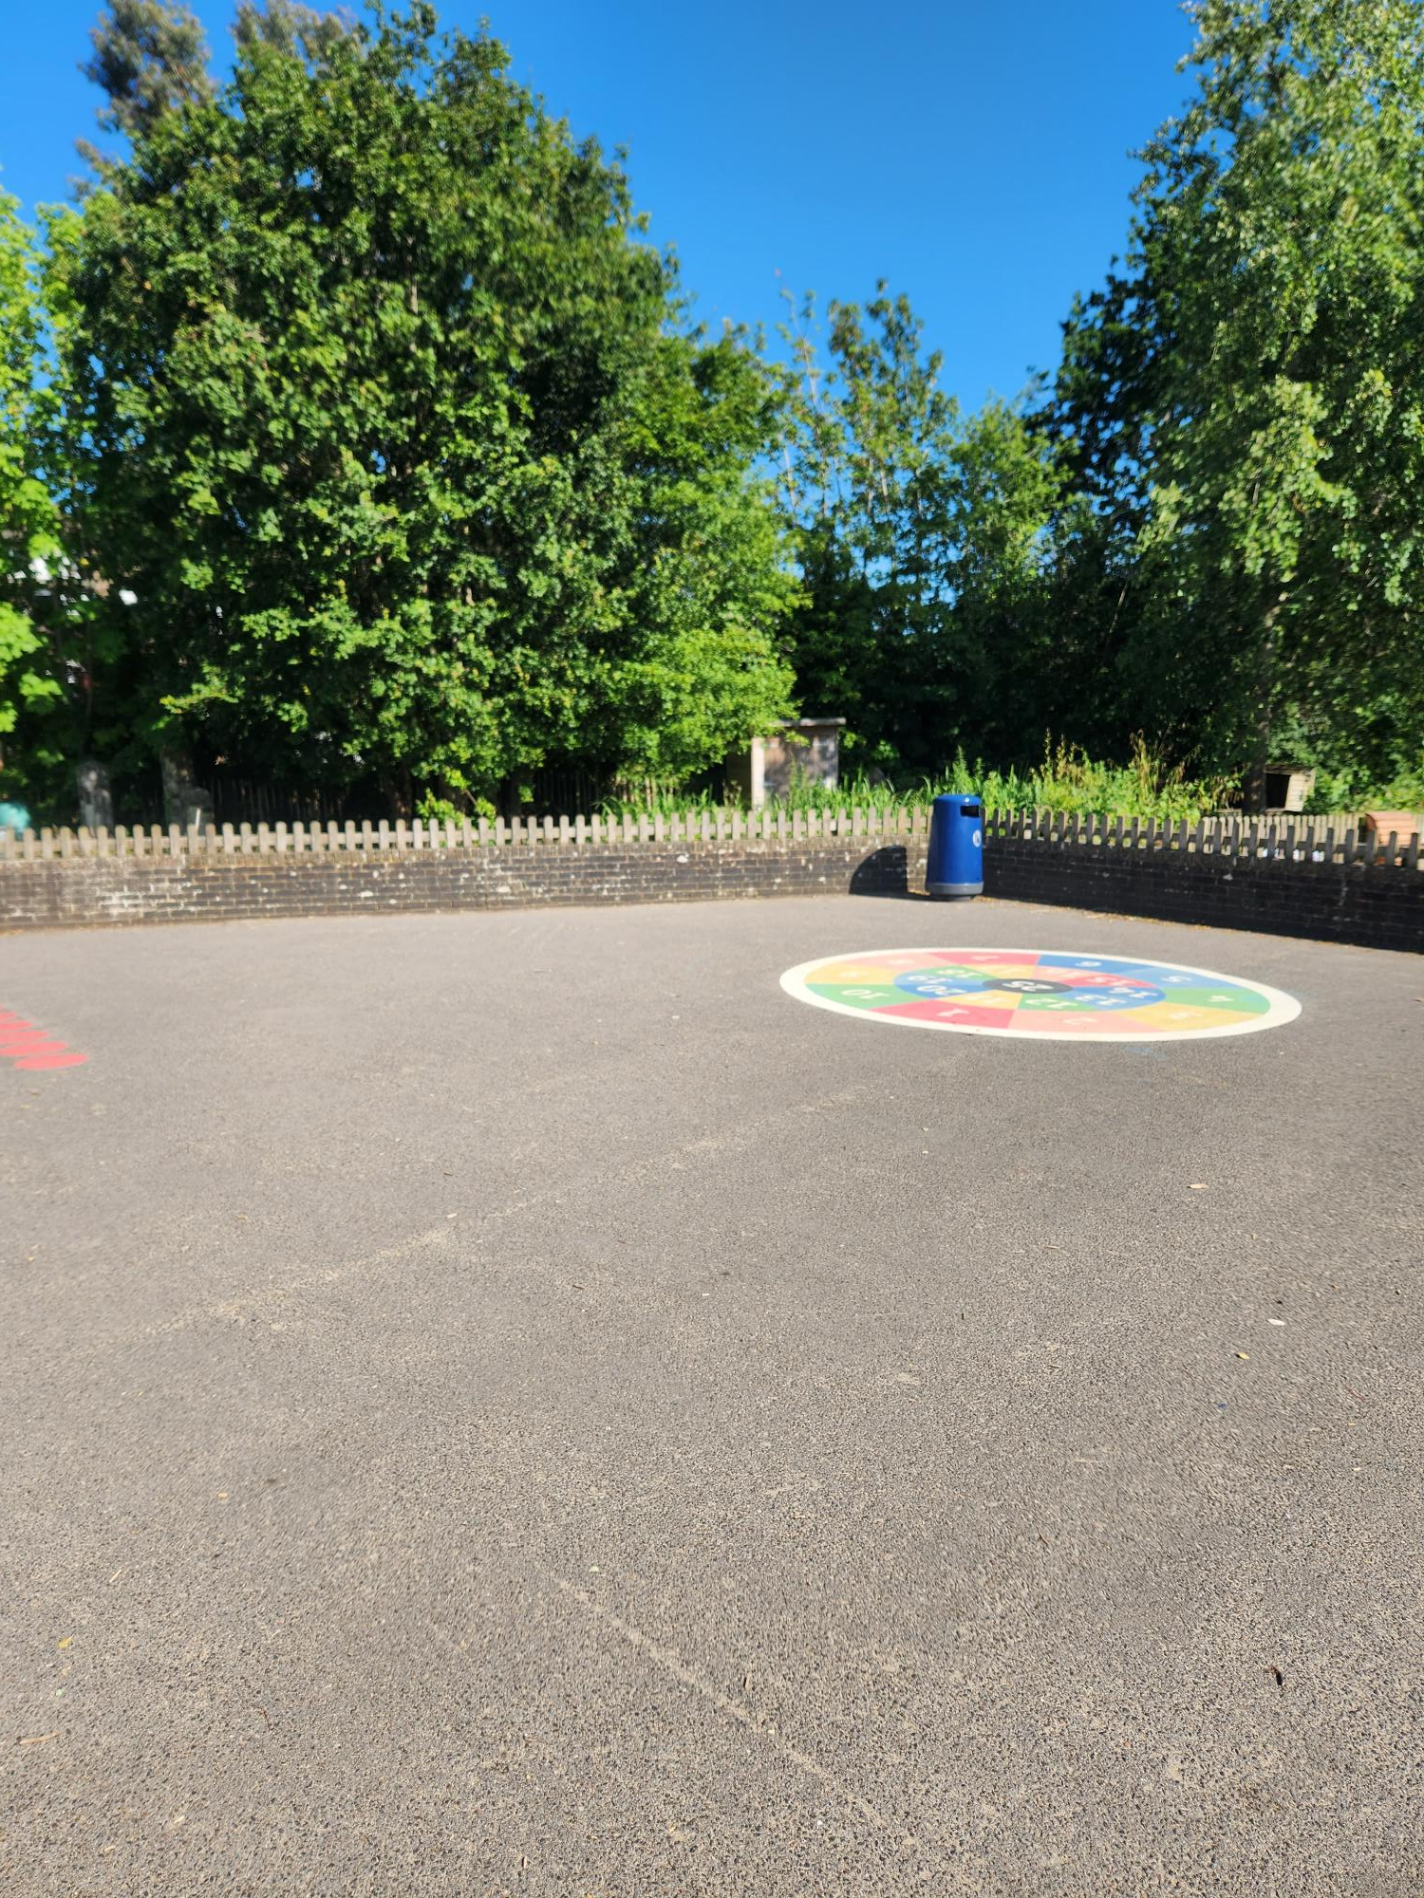
This is your playground

Slide 8
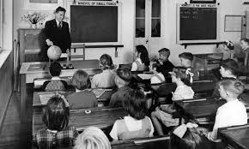
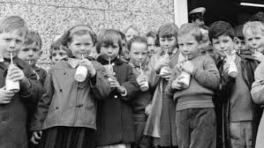
When you return to school your topic theme will be
A Moment in Time…
We will be learning about what school was like in the past.
You might like to start exploring this theme during the summer holidays by asking your family about their experiences at school and how this has changed.
Please feel free to bring in any old school photos and memorabilia you have.

Slide 9
We are really looking forward to seeing you in September.

