Slide 1

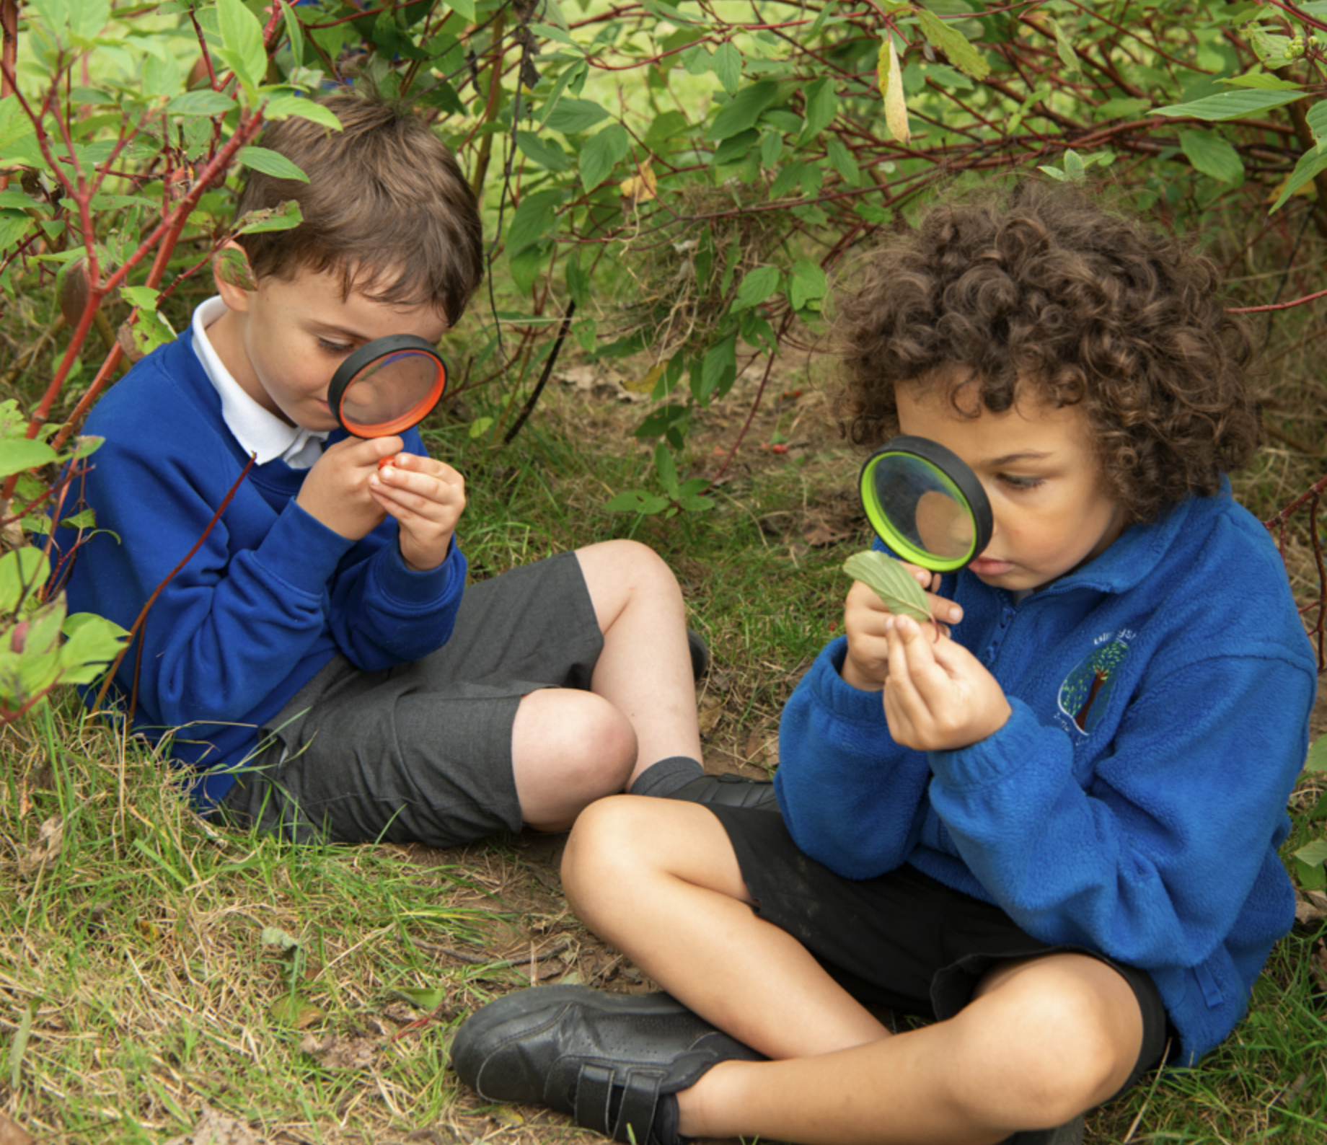
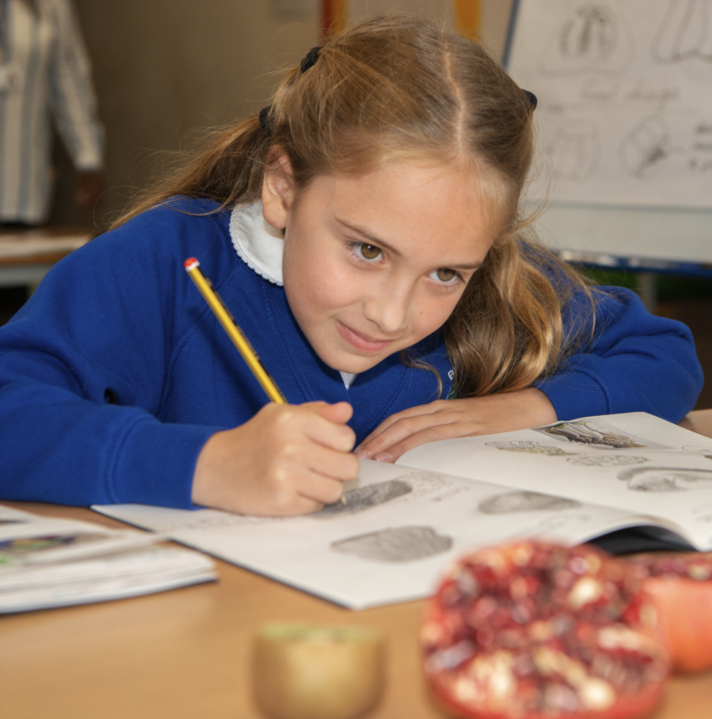
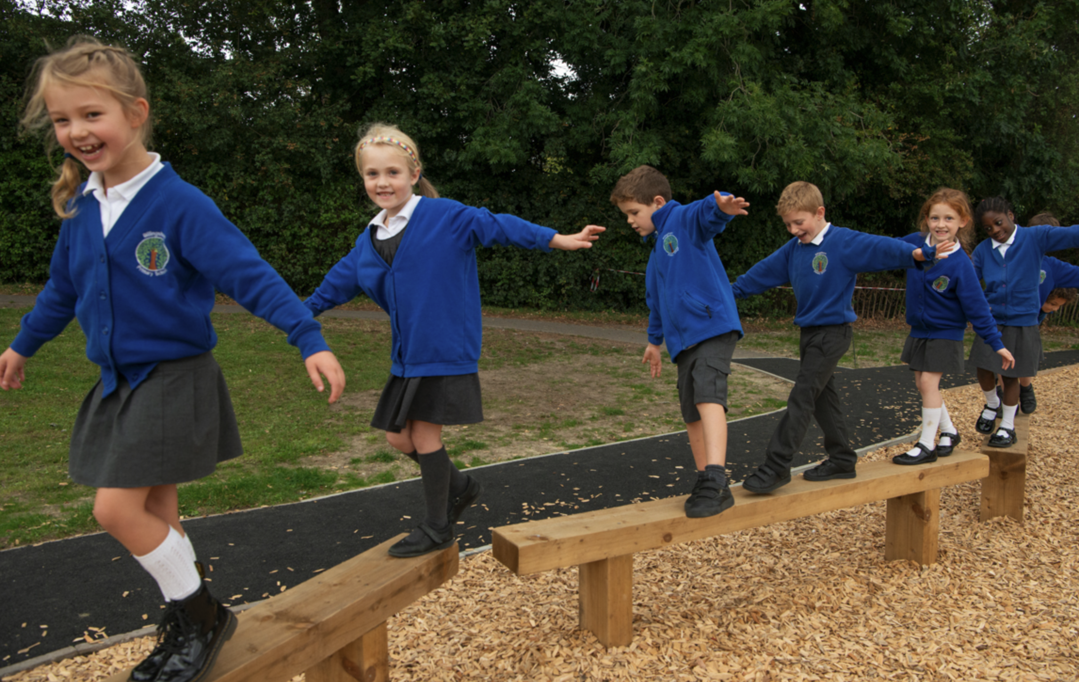
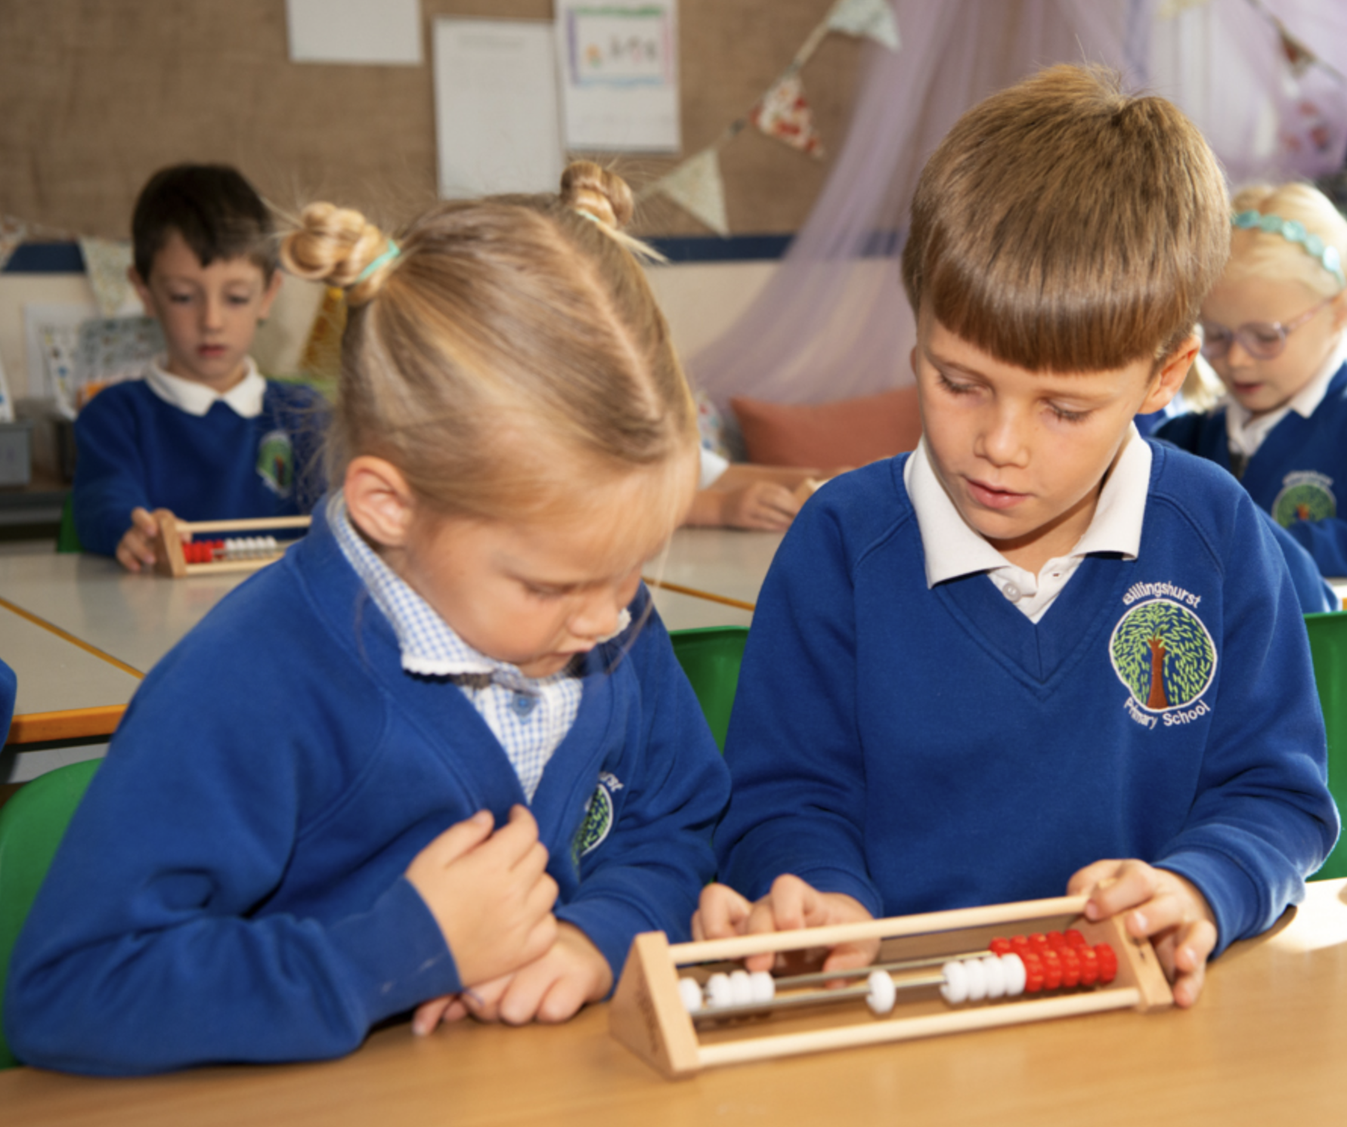
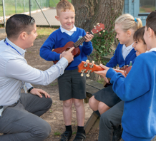
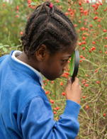
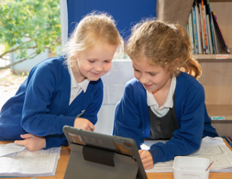
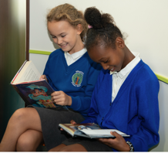
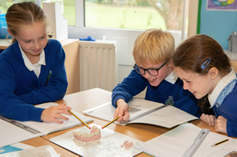
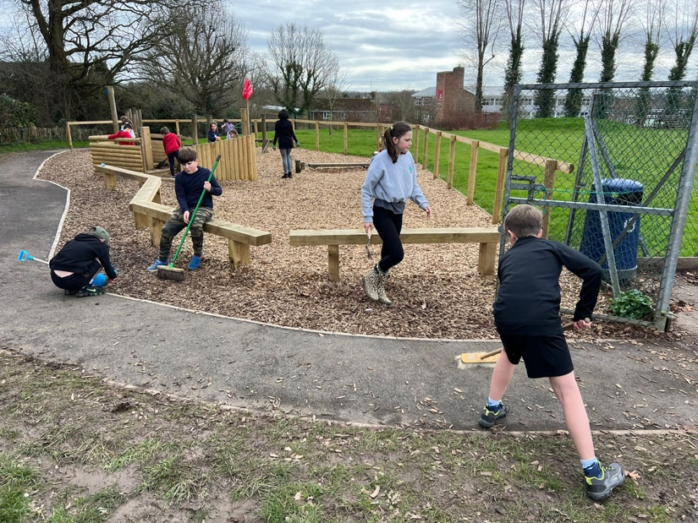
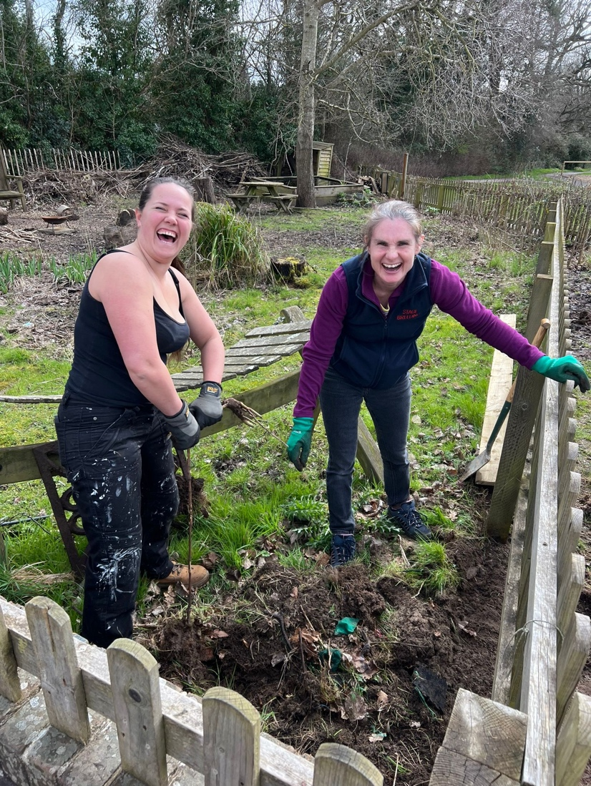
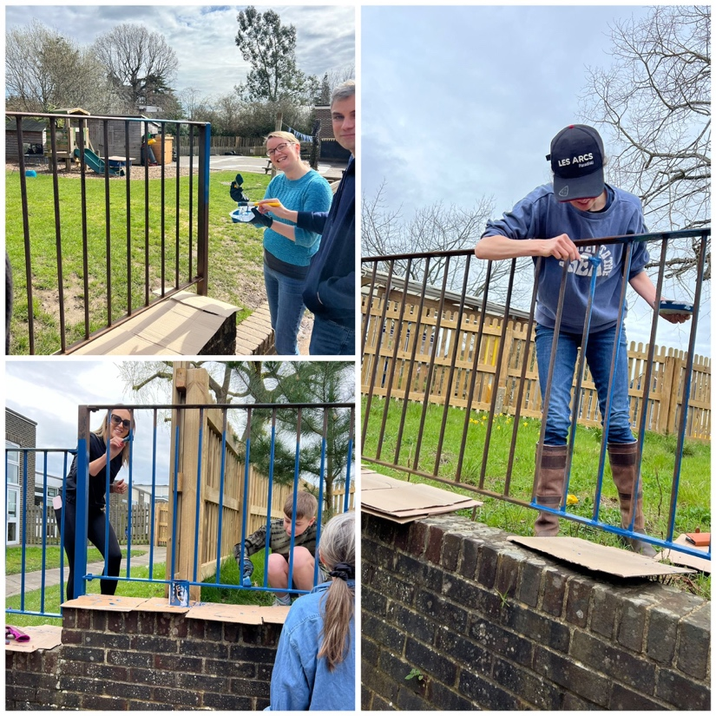
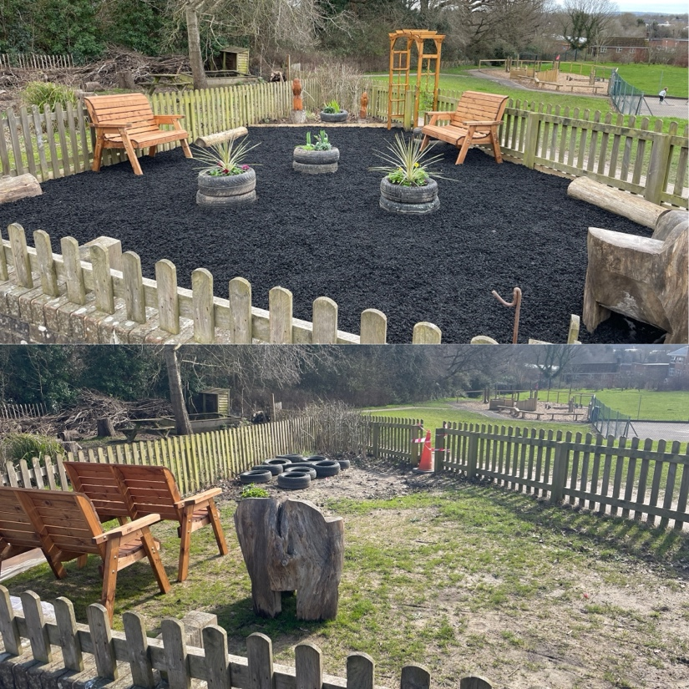
Newsletter 23rd May
Learning, growing and achieving excellence together
Dear Parents and Carers,
We have enjoyed another fantastic week with your children, and they have certainly earned a half term break.
Year 2 have now completed their SATs assessments and it has been brilliant to see how much they have learned this year so far. We have welcomed other schools here for some beautiful singing – more about the below! - and Year 6 have begun rehearsing and auditioning for their end of year production.
It was fantastic to see so many of you here during open classrooms and sharing your children's learning. We are working hard to explore ways to share how your children is getting on with their learning and to share their successes moving forwards, as well as ways we can all support them to make further progress.
I hope you all have a wonderful half term with at least a sprinkle of sunshine. I am really looking forward to a phased return during the first week back and reconnecting with you all. A huge thank you to the wonderful team of staff at Billingshurst for their hard work during my absence.
Ms Ley
Winning success in the pool!
On Tuesday, a squad of 12 year 5 & 6 children took part in a swimming gala at the Leisure Centre. Five local schools competed in 2 heats and our fabulous squad snatched a clear win. Our team consisted of team and non-team swimmers alike, and all children performed brilliantly and to the best of their abilities! I was especially impressed with the determination shown by Taylor in Nepal class, with his butterfly stroke, and extra-speedy swimming from Sophie in Maldives class. The standard of swimming was high, but I was even more proud of the excellent behaviour and sportsmanship shown by the whole team. It was a great event and the children represented BPS wonderfully.

Slide 2
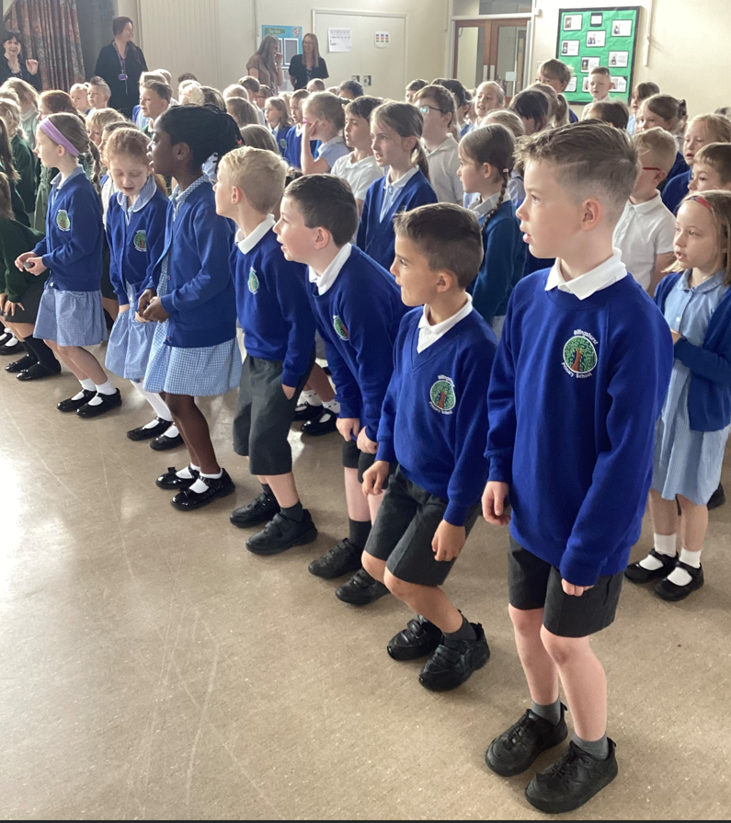
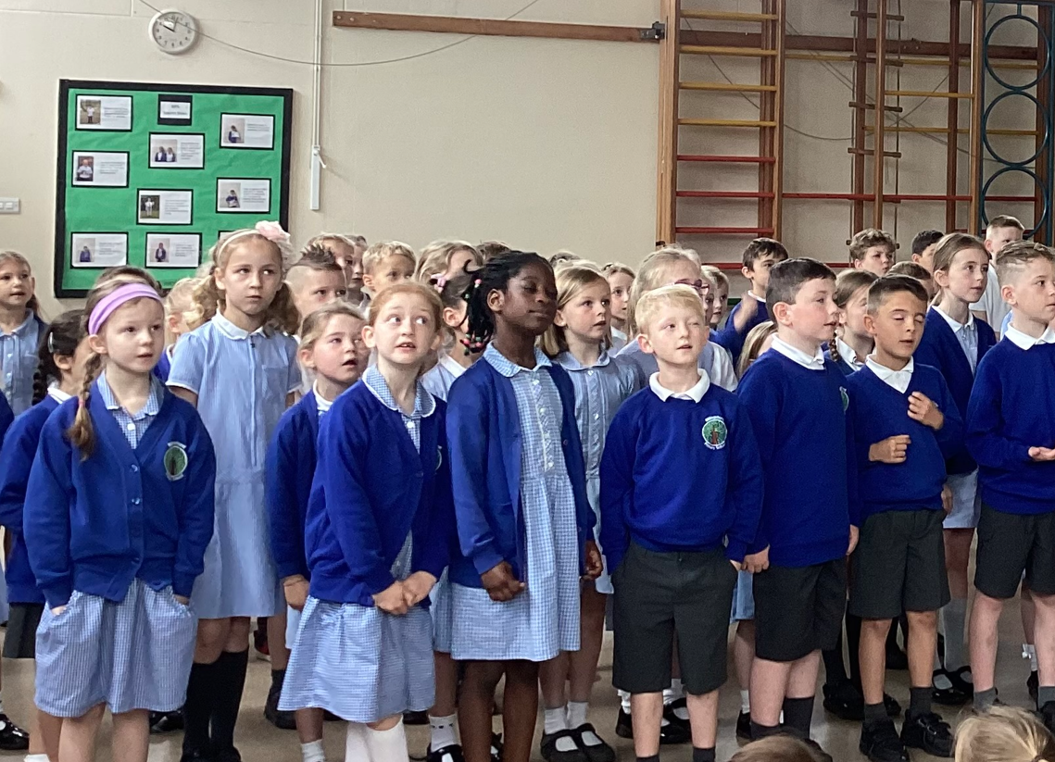
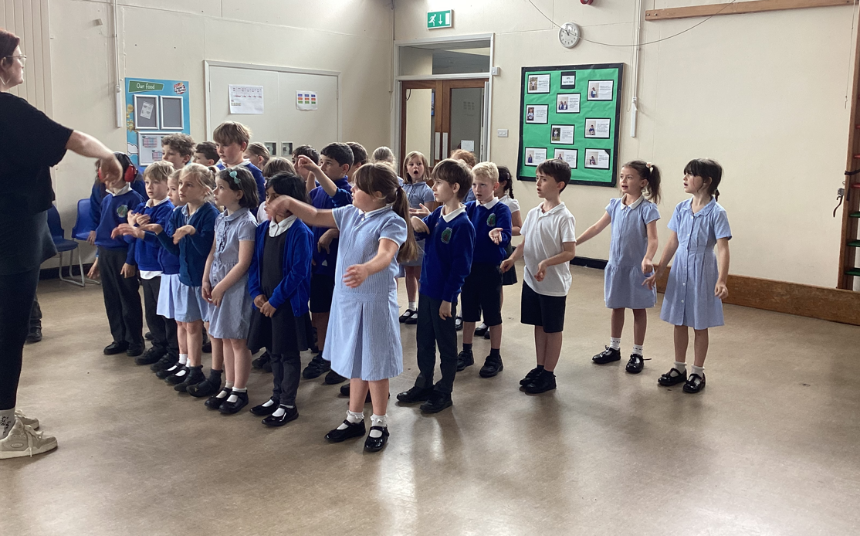
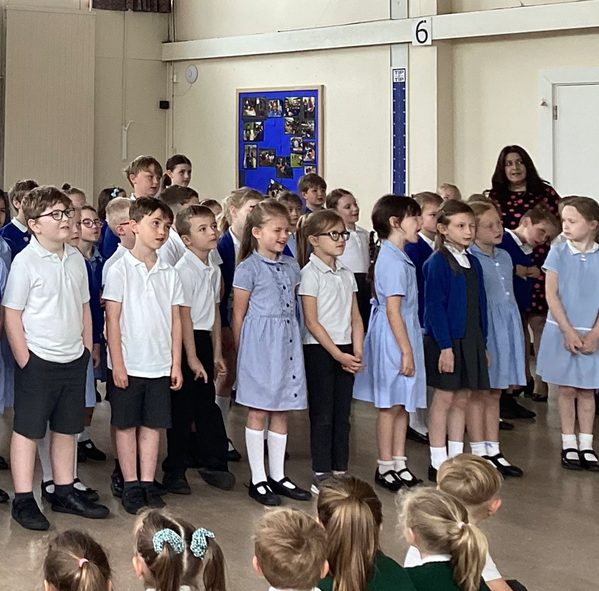
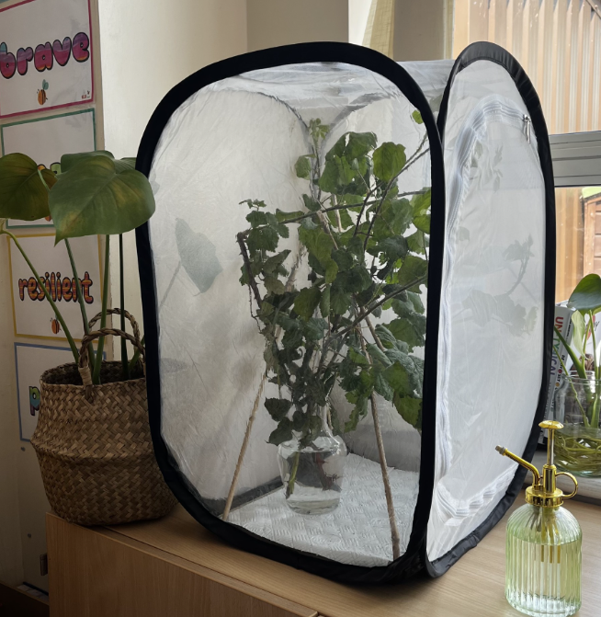
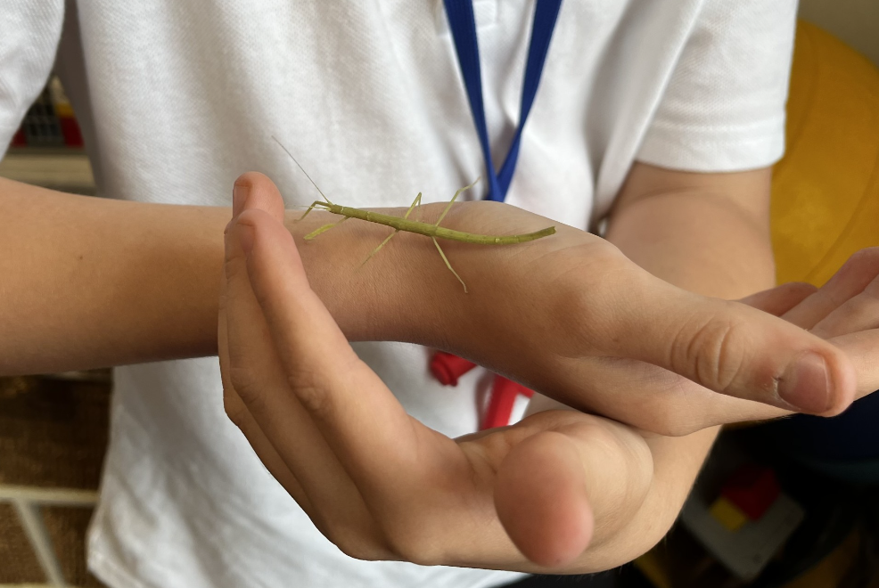
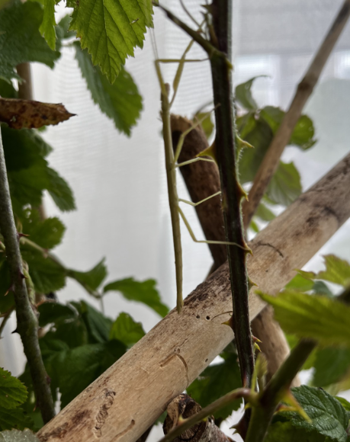
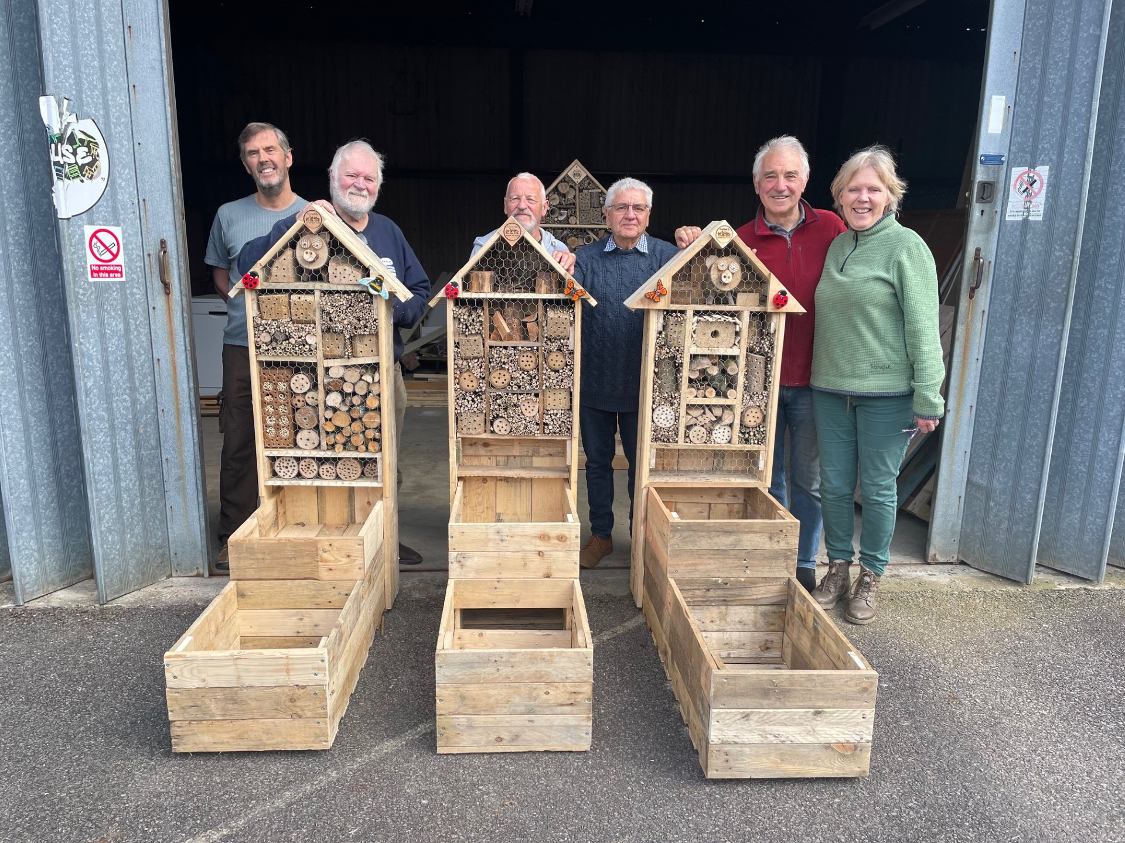
Year 2 Little Big Sing - The Circle Of Life
Little Big Sings are a wonderful opportunity to bring together KS1 pupils from multiple schools for a morning of singing, led by a specialist singing leader. BPS were proud to host this event and enjoyed welcoming other schools from our locality. The children sang 'Butterfly' and 'Down Under The Sea' in a massed choir. Alongside these performances, each school performed a song of their choice linked to 'The Circle Of Life' theme. Our enjoyed performing 'The Ugly Duckling'. Well done Year 2, we are very proud of you!
Stick insects in our school
Firstly, I would like to introduce myself, I am Katja Scurr and the Emotional Literacy Support Assistant (ELSA) at BPS. I work across the whole school supporting children with their emotional needs. Recently, I had the opportunity to acquire stick insects and thought that these may make a nice addition to our school and may help children break barriers approaching me with their worries.
I need to say a big thank you to Mrs. Eames who has kindly donated the insects, including the complete set up.
So far, the insects have been very popular and children have already started to take responsibilities, caring for them daily.
They are lovely, little creatures and some have grown big enough to be handled with care. I have noticed children instantly calming, trying to spot them in their enclosure and when they are handling them.
We are all very excited to watch them grow and are very grateful for this kind donation.
Pollination Education station gift!
Barratt Homes have generously donated some money to Sussex Green Living who have chosen to spend the money on Pollination Education Stations. Sussex Green Living have kindly gifted one to us! It will be installed on Thursday 13th June during 'Great Big Green week!' It will be located at the bottom of the path onto the KS1 playground. The Eco team will be helping with the installation which will involve the planting of various herbs and plants. We would like to say a huge thank you to the BPSCA who have donated money for these.

Slide 3























BPSCA - Uniform sale Friday 7th June 3pm Summer Fun Day 6 July 11am-2pm. We need your help! Donations of cuddly toys and tomboys prizes for both children and adults can be left in the main office. Volunteers to set up or run a table for an hour; sign up will be circulated soon! Having a party?
Hire our eco-friendly party pack of 30 place settings and serving equipment. Email bpsca@billingshurstprimary.org.uk
Note from the Governors - The Governing Body held its half termly meeting this week. The agenda included updates on the school improvement plan, analysis of school data and reports from governors in relation to monitoring visits carried out this half term. We hope you have a super holiday, hopefully with lots of sunshine!
House Point Results
Winning House - Goodwood
Thank you to our sponsors for their support!
Cowdray
597
Parham
717
Goodwood
787
Petworth
704
Gil Parham Woodside Sculpture
www.woodlouseindustries.com
Upcoming dates:
Friday 23rd May – School closed for INSET day
Tuesday 4th June – New intake EYFS parents information evening
Wednesday 5th June – Year 3 trip to Wakehurst Gardens
Wednesday 5th June – SEND coffee morning, 8.45 am KS2 Hall
Monday 10th – Friday 14th June – Year 6 Tile Barn residential and Activity Week
Monday 10th June – Year 4&5 Weald Dance Workshop
Wednesday 12th June – Year 5 Weald athletics, 1-4pm
Tuesday 18th June – Year 2 Arundel Castle trip
Letters home this week: Activities week letter (Selected Year 6 Pupils), Tile barn kit list and presentation.
Best quality Blast-frozen Family run
www.tomthefish.co.uk
@BPSEYFS
@BPSYearOne
@BPSYearTwo
@BPSYearThree
@BPSYearFour
@BPSYearFive
@BPSYearSix
Year groups regularly post photos of children and learning on their X account. Please follow your child’s Year Group using the handles above.
www.professionalrubbersurfaces.com
The Budding Foundation
Follow us on Facebook for all the latest updates:
www.facebook.com/BillingshurstPrimary

