Slide 1
Welcome to Early Years

Slide 2
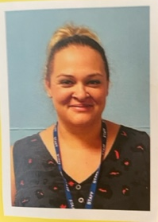
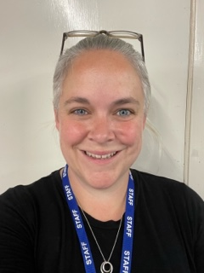
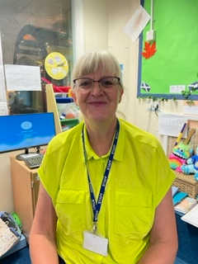
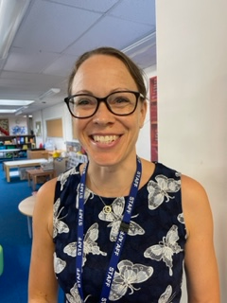
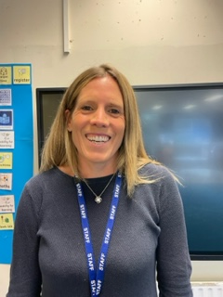
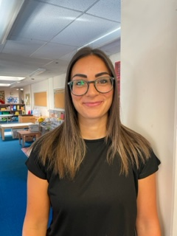
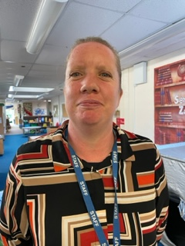
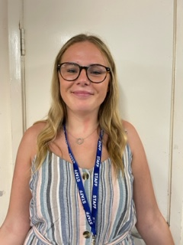
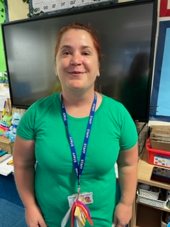
Early Years Team
Phase leader Year Leader / Wales Teacher Scotland Teacher Ireland Teachers
Mrs Cobden Mrs Walker Mrs Footer Mrs Langley (Mon-Wed) Mrs Hunt (Thurs – Fri)
Our Learning Support Assistants …
Mrs Woods Mrs Palmer Miss Spiceley Mrs Richardson

Slide 3
Communication
Class teacher is your first point of contact
Please come and chat to us first thing in the morning or at pick up time
Alternatively, contact through year group email
Year group email – eyfs@billingshurstprimary.org.uk
Emails checked up until 8.15am & 3.20-4.30pm
Your email will be acknowledged as soon as it is read
You may then be called at the end of the day or a meeting will be organised
Emails will be responded to within 24hrs
Call the school office for absence or changes to pick-up arrangements

Slide 4
Autumn term topic web – How Do I?

Slide 5
How we learn in Early Years Children have their class bases where they will have their register and have their taught sessions. The children will be able to mix with the other classes in the outside classroom and the shared corridor space. During the school day, children will have some taught sessions and then the children will 'explore and learn'. This is where the children can choose from the provision to enhance their understanding. The children are looking for learning! At the end of the year your child's teacher will collate all their evidence and teacher knowledge to come to a secure judgment for each child against the Early Learning Goals.

Slide 6
Reading
Children will have weekly sessions in the library where they will hear a story and can then choose a new book to share in class.
The children will change their home reading book at least weekly; this is a book that you can share together at home.
Please also continue to read your own books at home, we love to see what you have read at home.
Throughout the week we timetable high quality opportunities for the staff to read and share their favourite books with the children.
Once a fortnight a member of the EY team will hear or share a book with your child and record this in their reading record.

Slide 7
How to support reading at home
Reading:
A love of reading is hugely important, so we love to see children reading/looking at a range of different books.
Please continue to read with your child at bedtime, this could be a book they bring home or could be something you have at home already.
Don’t forget looking at magazines is also a good way to get some children looking at different texts.
Reading records – please write in them when you read with your child, at home we would like you to find time to share a book or story every day for about 10/15 mins.

Slide 8
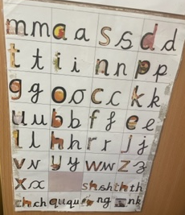
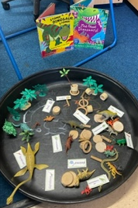
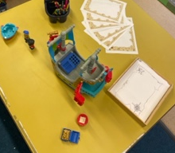
English
We follow the Read Write Inc phonics scheme. The children will have a phonics sessions every day.
Throughout the week the children will have taught carpet sessions, around a literacy skill, this could be letter formation, story ordering or list writing just to name a few things.
Continuous provision – this is something that is very strong in Early Years. We ensure that all spaces are zoned so children know where to find resources to support their independent learning.
Enhanced provision – These are the things we add to the continuous provision to enhance a learning experience, for example with English maybe a selection of books written by a specific author.
Writing – you will find that your child will write phonetically, for example, gate might be written gait.

Slide 9
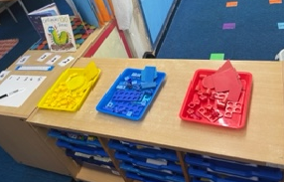
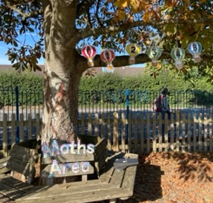
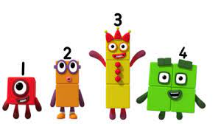
Maths
Mastering number is the planning we follow, it breaks down the skills we will teach throughout the year, so the children's learning is progressive and builds on their skills.
Things we will look at over the year are... developing a deep understanding of numbers and their composition, being able to subitise, recall number bonds to 5, double facts, 1 more / 1 less, odd and even numbers.
As with English we use continuous provision to give children opportunities to develop their independence and learning, and then we enhance this provision to help support specific skills we might be teaching.

Slide 10
Twitter / X
Regular photos and comments showing Year Group learning will be posted on Year group Twitter to follow:
@BPSEYFS

Slide 11
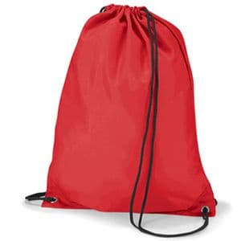
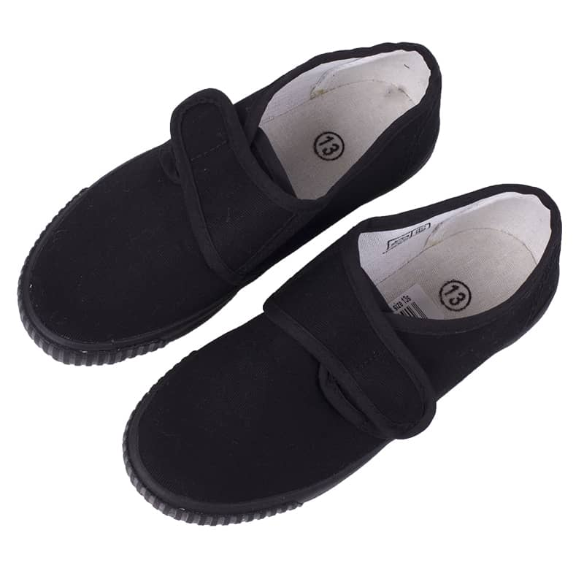
Physical Education
PE takes place weekly (children will be introduced to the hall from next week, more structured session from after October ½ term).
We also go on daily walks.
This is the kit that your child should have in school. Please ensure that every item is clearly labelled with their name.

Slide 12
Uniform
Children will need to wear correct uniform everyday, including plain black school shoes.
Grey skirts, shorts or trousers should be worn, together with a white polo shirt and blue jumper or cardigan.
Our BPSCA often have second hand uniform sales – keep an eye out for dates.
In summer, blue and white summer dresses may be worn.
Please do name ALL items of clothing – with over 600 children it is challenging to reunite people with unnamed uniform.
Lost property will be put in the school entrance every Friday

Slide 13
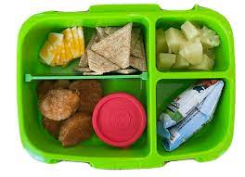
Healthy Minds
Water bottles – access all day
Morning snack (provided in EY/1/2)
Milk – Make sure you order this, children are entitled to free milk up until the age of 4. From 5 years old this needs to be paid for.
Healthy lunchboxes - for example a sandwich, fruit / vegetable, yoghurt.
Please remember that we are a nut free school, therefore, nothing with nuts can be brought in.

Slide 14
Behaviour and expectations
The children in EY will learn to share, to be kind and considerate, to listen to one another and solve problems in groups and independently as confident enabled learners.
Emotional support – we are introducing 'feeling' walls in all classrooms, so children can express their emotions and start to understand others.
House points – children have now been put into their colour houses, when a child is spotted engaging in some positive learning, or an act of kindness the child will be given a house point, which will be added to the whole school's totals to determine the winning house each week.

Slide 15
Attendance
Please make sure we have an up to date email address and phone number for you.
If your child is going to be absent from school, please contact the school office to let us know.
If you don’t contact us, expect us to contact you!

Slide 16
Arrival and departure
Start of day: EY / KS1 & KS2 gates open at 8:40am and close at 8:55am. Registration is at 8:55am.
End of day: EY / KS1 gate opens at 3:05pm, KS2 gate opens at 3:15pm.
Finish times: EYFS: 3:10pm, KS1: 3:15pm, KS2: 3:20pm.

Slide 17
BPSCA
The BPSCA support all of our events throughout the year, helping us to raise money for the school. Year 6 leavers, Christmas trugs, Welly walk, Summer fun day and much more!
Over the summer they have funded the new markings on the KS1 playground.
If you are interested in helping out then please do let us know.

Slide 18
Thank You
Thank you for attending and we look forward to getting to know you all!
Any Questions?
We are always looking for reading volunteers!

