Slide 1
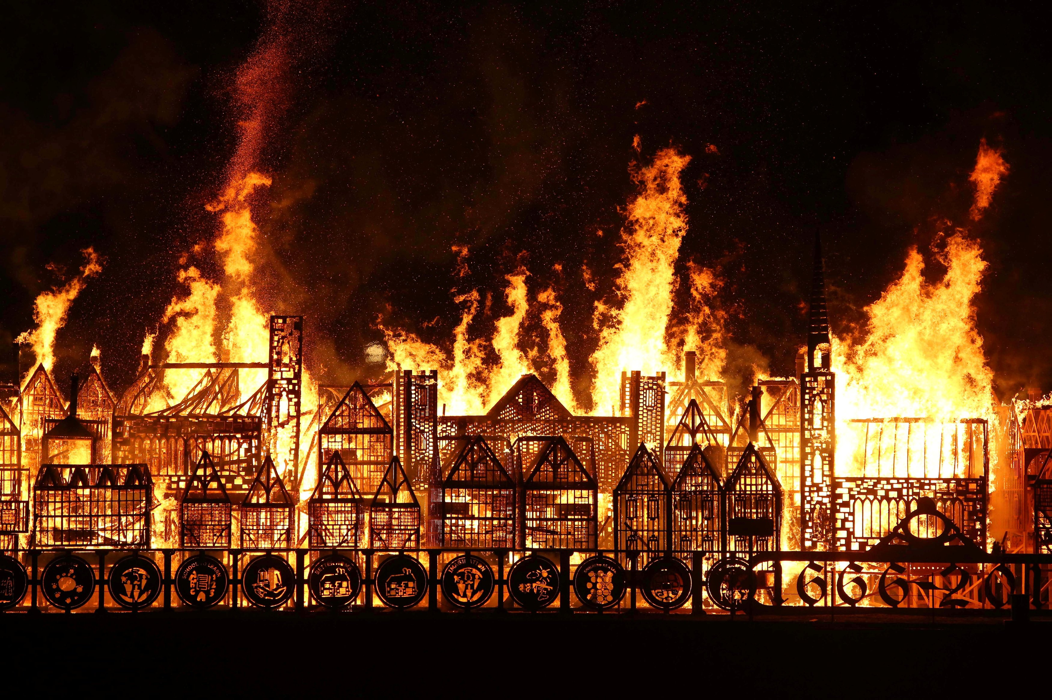
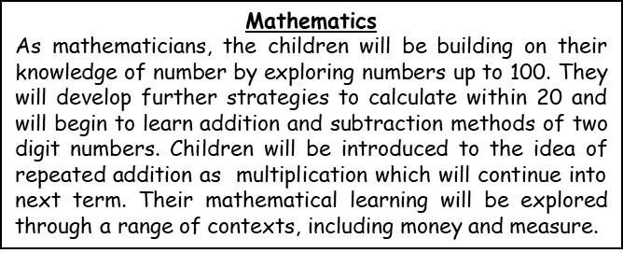
Writing
As writers, the children will get into character and travel back in time. They will learn to write in role to inform their reader about the fire. They will write a diary entry about their experience of the Great Fire, using compound sentences and a range of vocabulary to convey their feelings.
Geography
As geographers, the children will learn how to use compass directions to describe key physical and human features. They will also describe and locate the position of the 4 countries of the UK. The children will develop their map skills by drawing a map using basic symbols in a key.
Physical Education
As athletes, the children will learn how to combine dribbling, passing and receiving in order to keep possession and score a point.
Music
As musicians, the children will learning how to create a soundscape using percussive instruments. As always at this time of year, they will also be learning, appraising and most importantly, performing a number of Christmas songs.
History
As historians, we will learn what sources are and why they are important during historical enquiry. We will develop our chronological understanding by using timelines. We will also answer questions about the past and pose new questions too.
Year 2 Autumn 2 2023
Topic Web
What happened on 2nd September 1666?
Computing and E4S
This term, anti-bullying week takes centre stage but there will continue to be opportunities to learn more about how to stay safe online and what dangers to look out for.
Religious Education
The children will learn about important religious stories. They will also explore the concepts of 'God' in Christianity and Hinduism.
Design and Technology
As designers, we will evaluate pre-existing structures. Then, we will design and make a new bakery for Thomas Farriner. We will use lots of different materials to make the models. We will develop our cutting and measuring skiils.
Core Texts
Toby and the Great Fire of London – Margaret Nash
Vlad and The Great Fire – Kate Cunningham
The Great Fire of London: Unclassified - Nick Hunter

