Slide 1
Welcome to Mrs Mason and Miss Jolley's Class

Slide 2
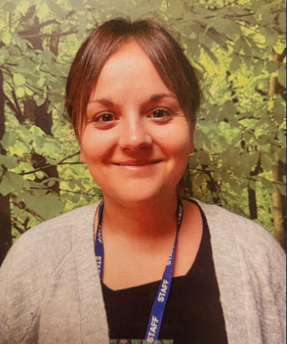
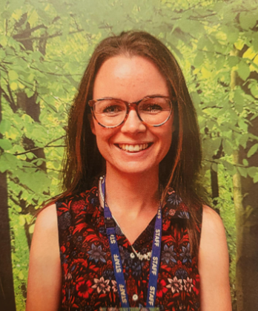
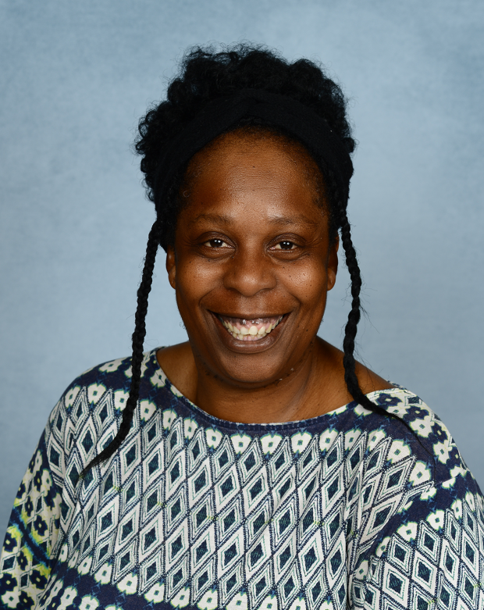
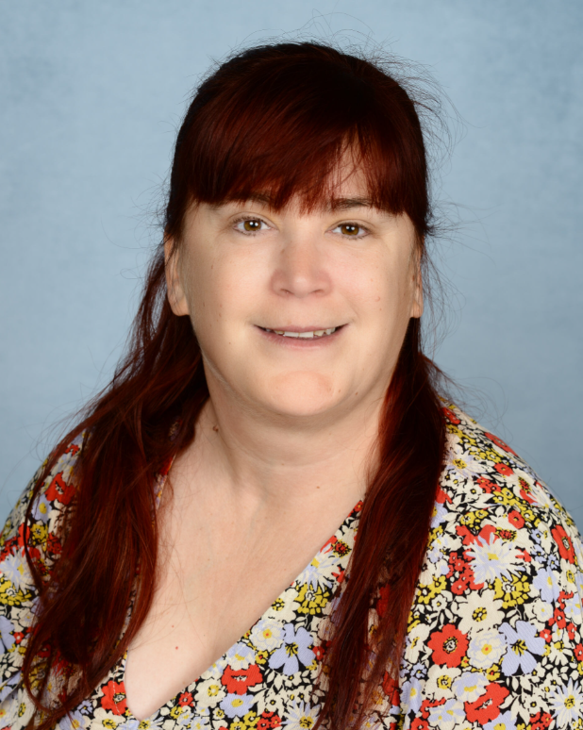
These are the adults that will be working in your classroom.
Mrs Mason
Your Class Teacher
Miss Jolley
Your Class Teacher
Ms Alexis
Learning Support Assistant (LSA)
Mrs Richardson
1:1 Learning Support Assistant (LSA)

Slide 3
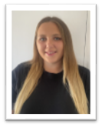
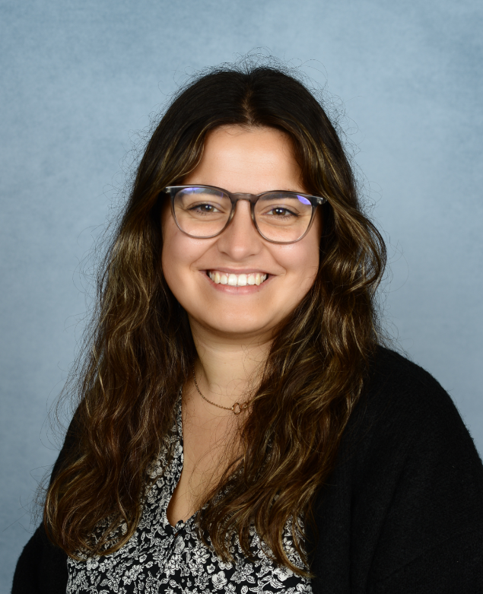
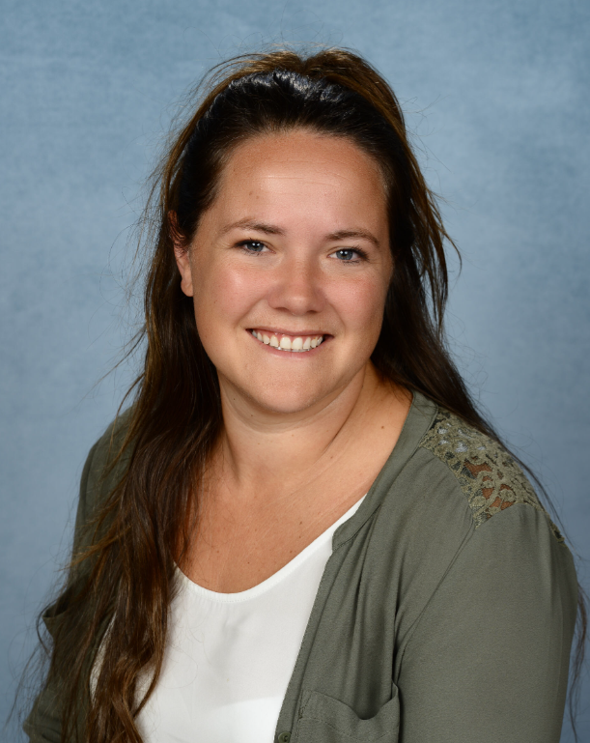
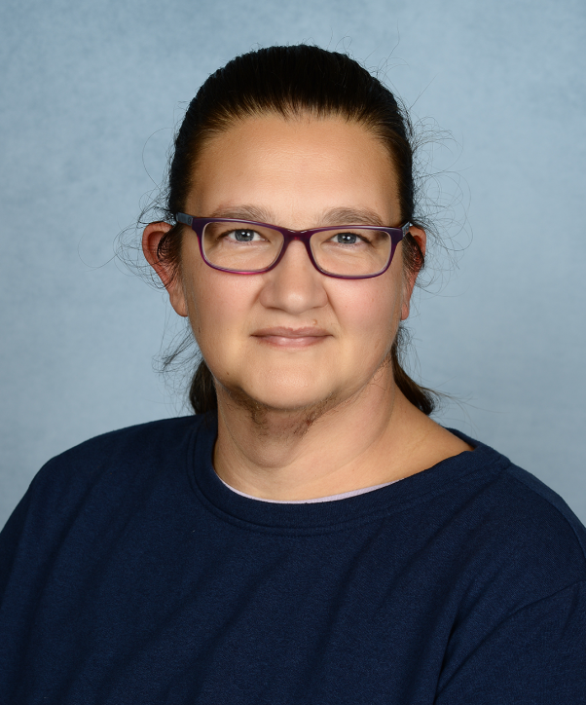
These are the adults that will be working in Year 2.
Miss Spoard
Year 1 Teacher
Mrs Mason
Year 1 Teacher
Miss Jolley
Year 1 Teacher
Miss Milner
Year 1 Teacher
Mrs Dewell
Year 1 Learning Support Assistant (LSA)
Ms Alexis
Year 1 Learning Support Assistant (LSA)
Mrs Casagrande
Year 1 Learning Support Assistant (LSA)
Mrs Richardson
1:1 Learning Support Assistant (LSA)c

Slide 4
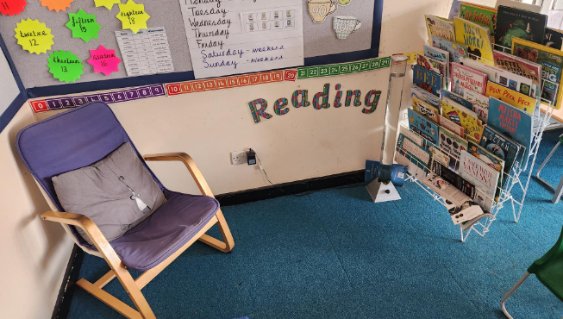
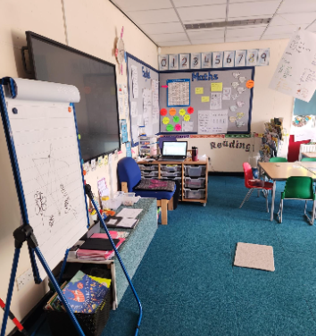
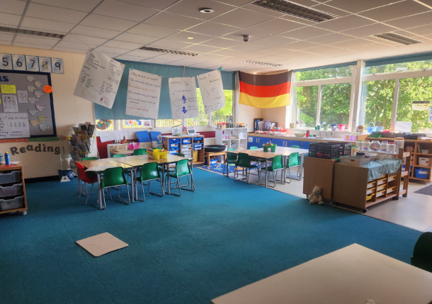
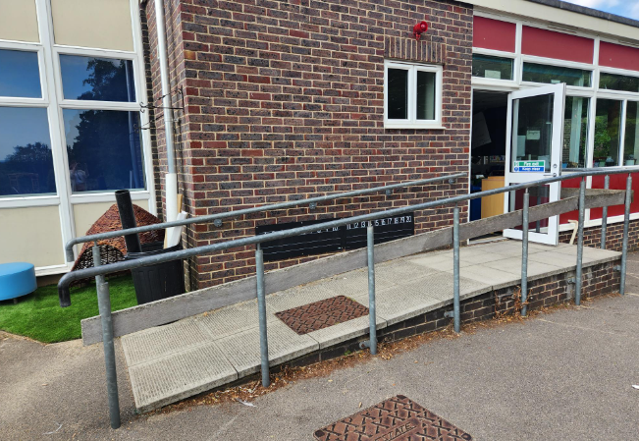
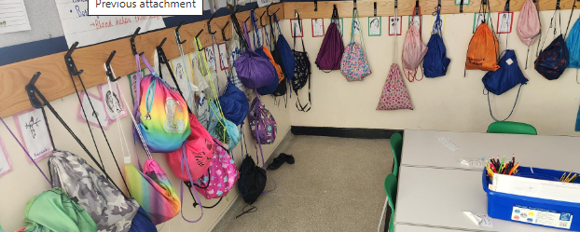
This is your classroom.
This is where you will hang your coat and book bag.
This is where you will enter the school and your classroom.

Slide 5
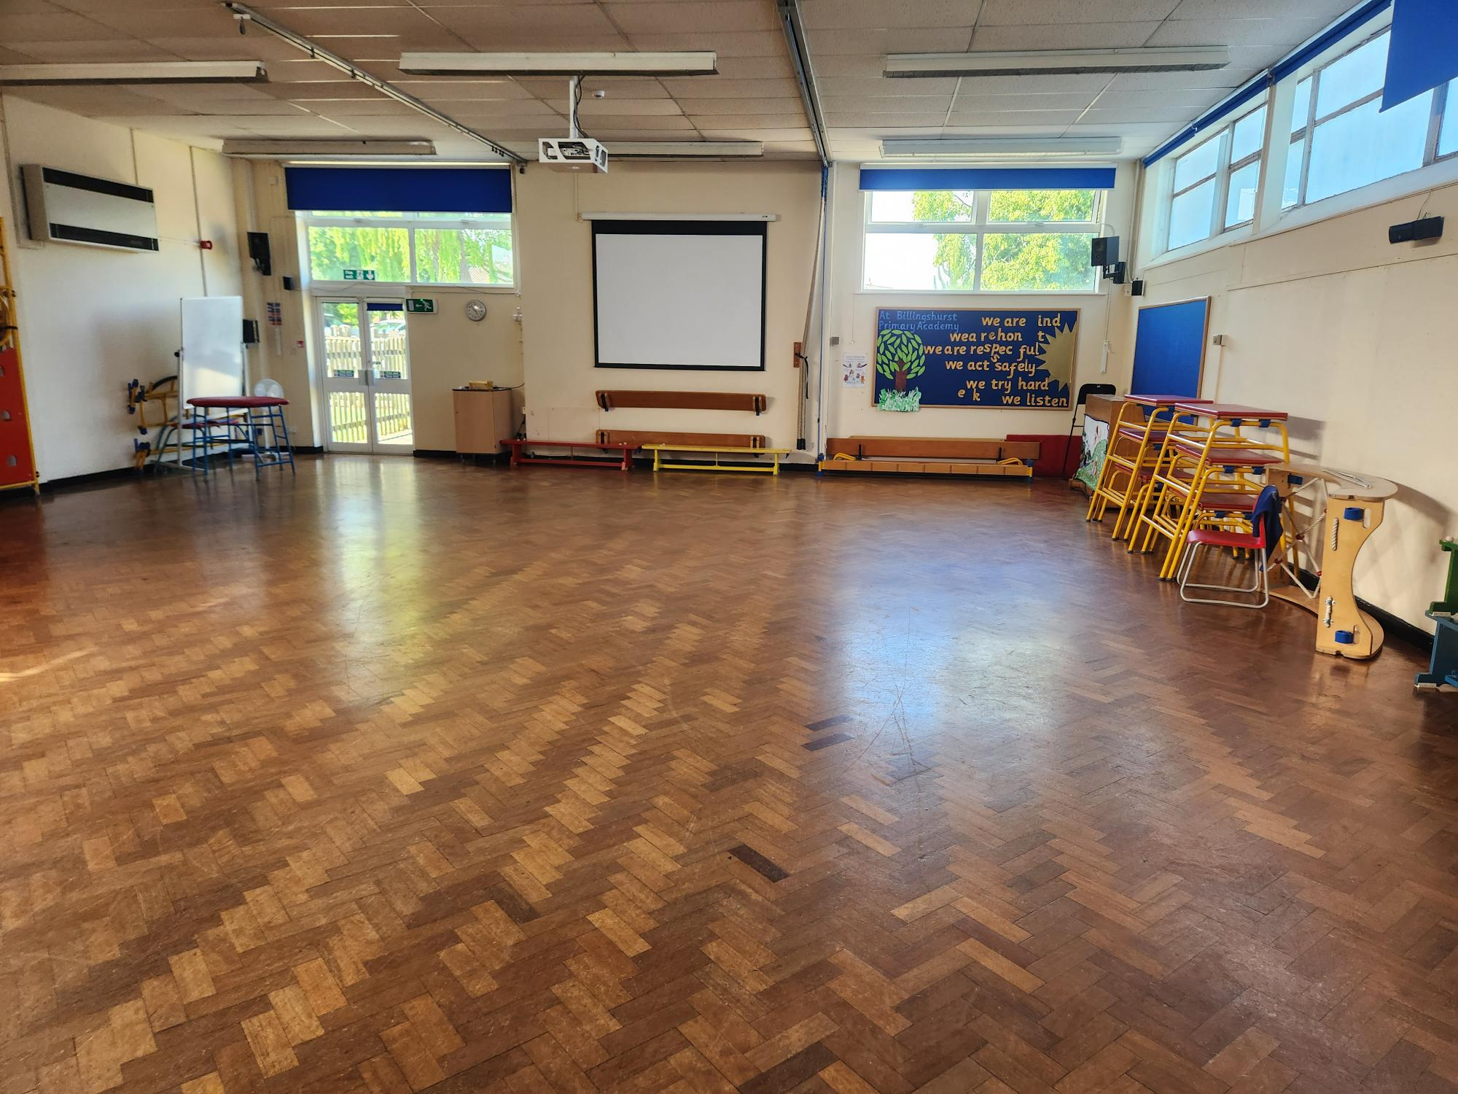
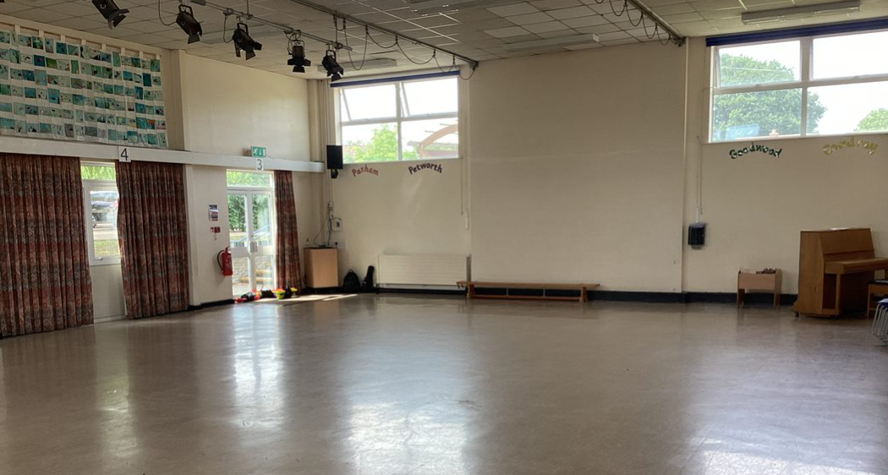
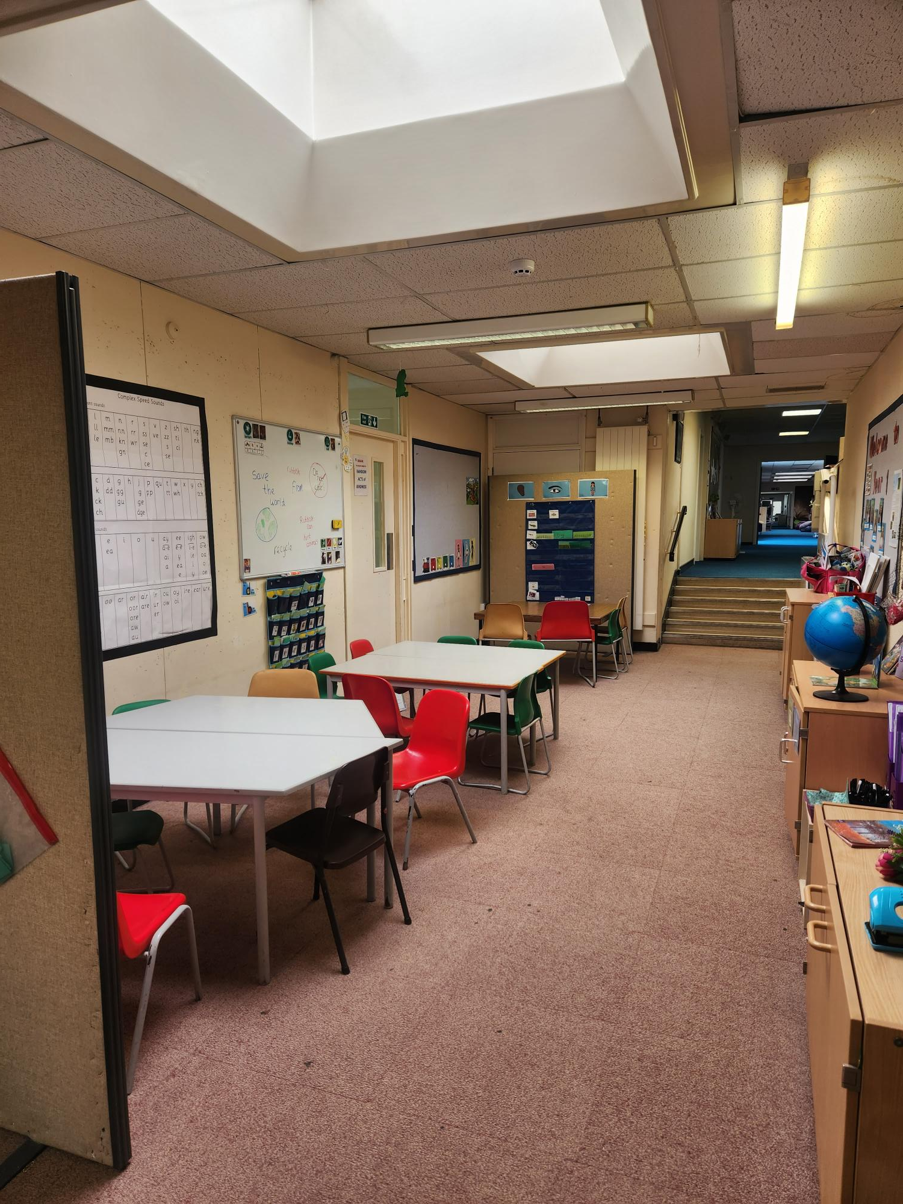
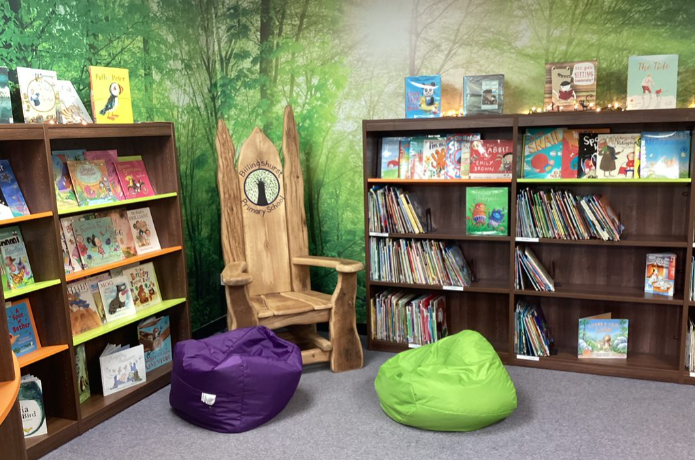
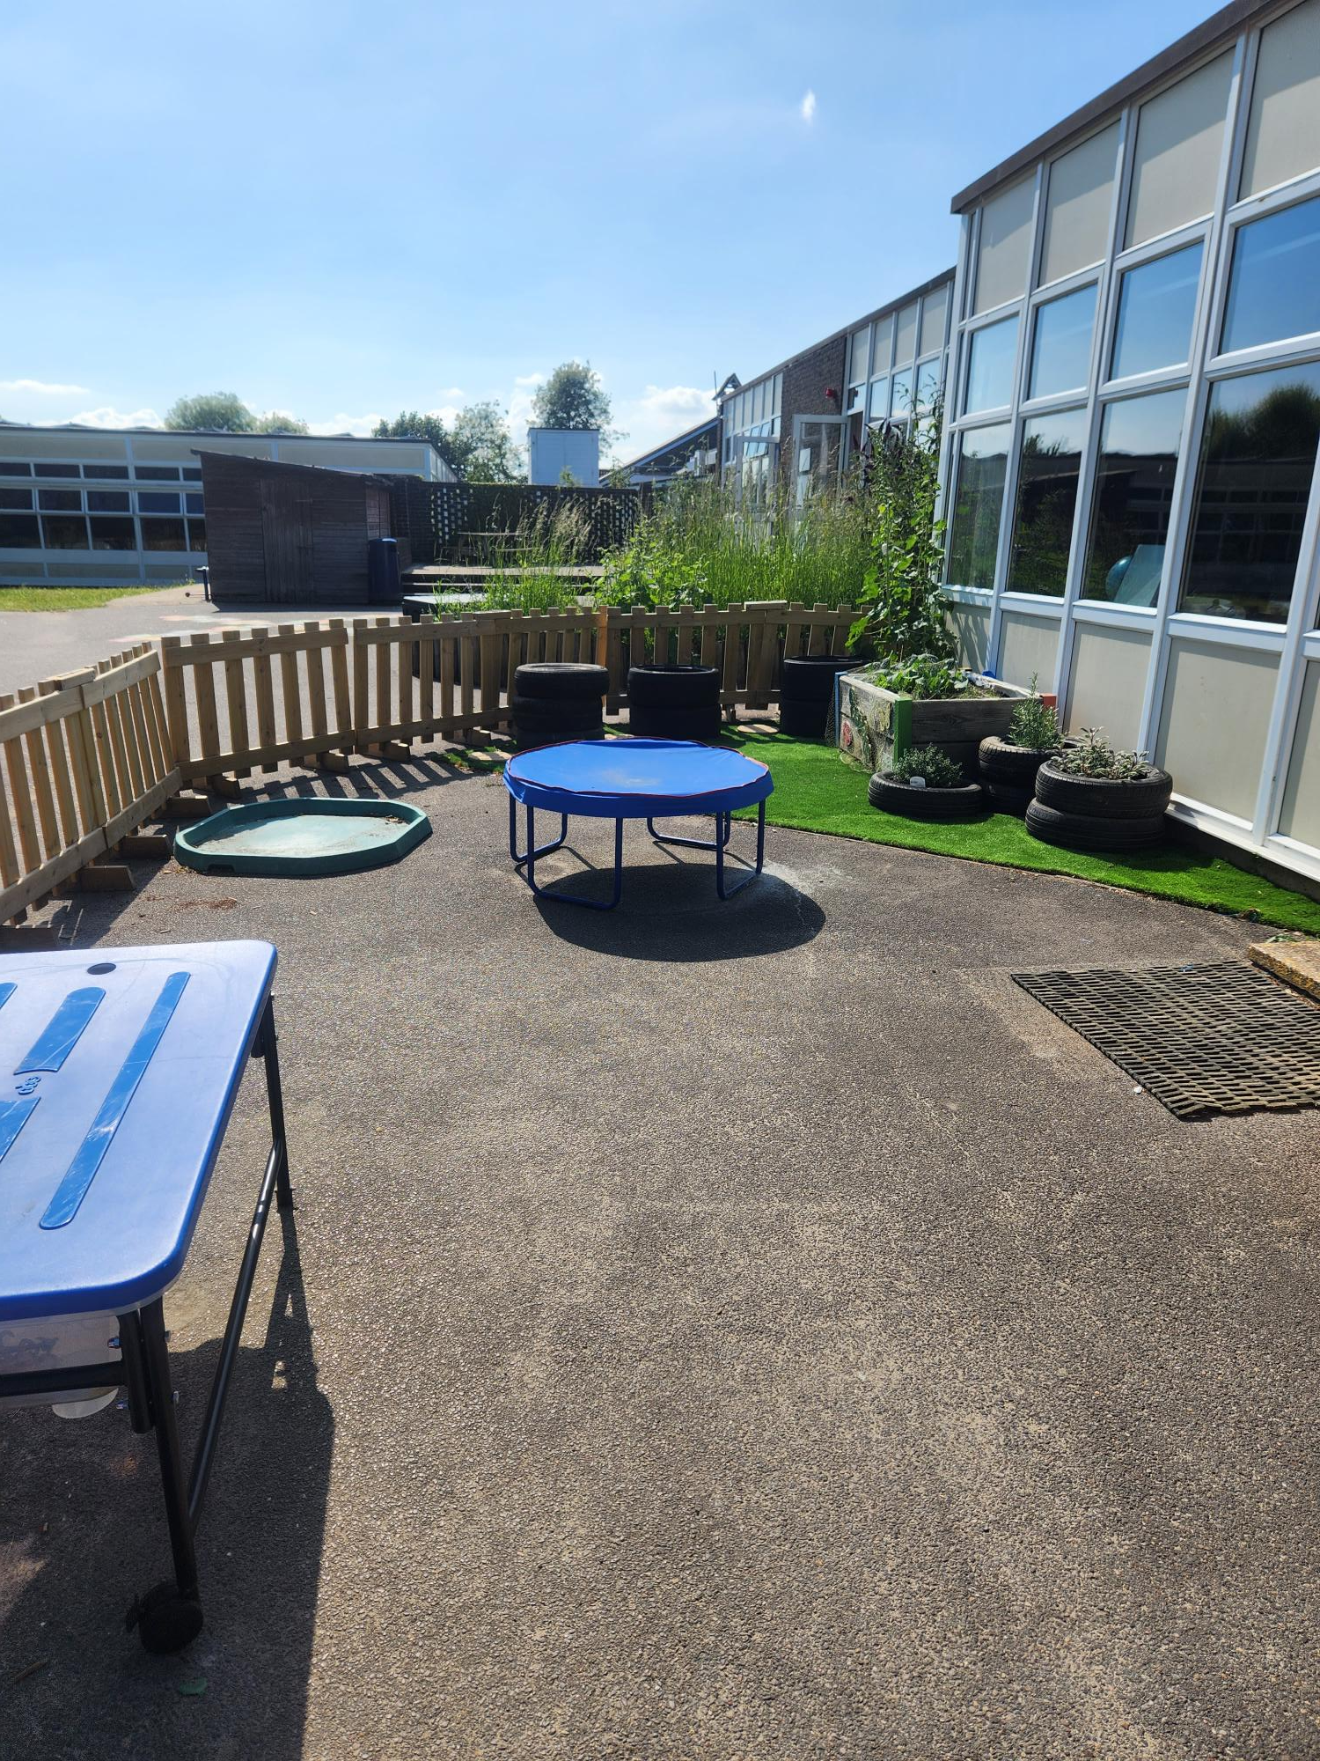
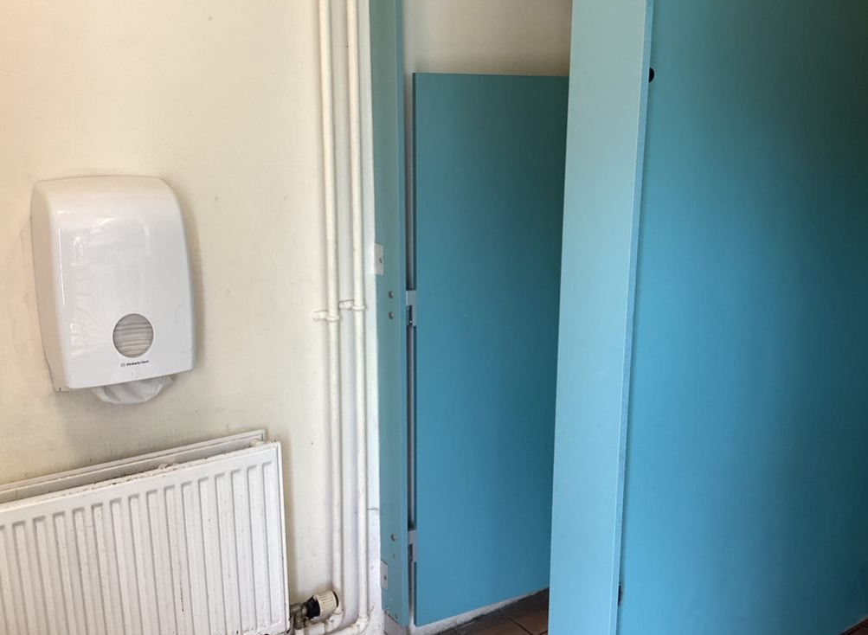
This is the area outside of Year 1 where you may sometimes work.
These are the KS1 & KS2 Halls where you will have lunch and assemblies.
These are the class toilets.
This is the KS1 library
This is the Year 1 outside area.

Slide 6
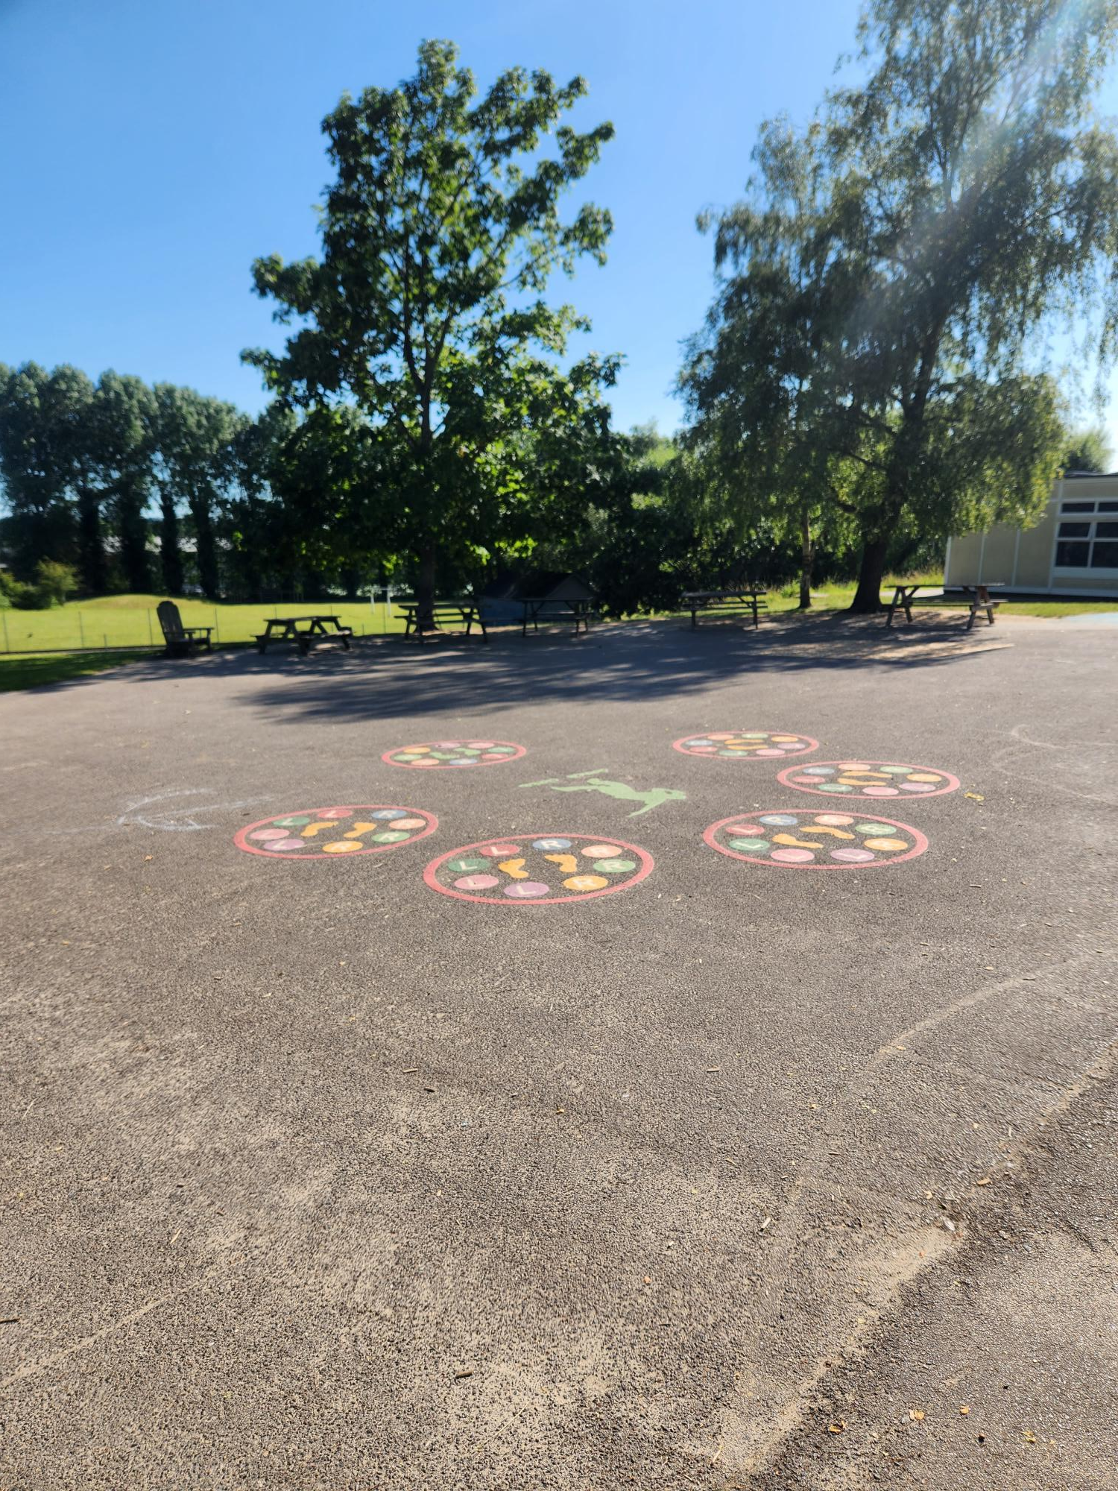
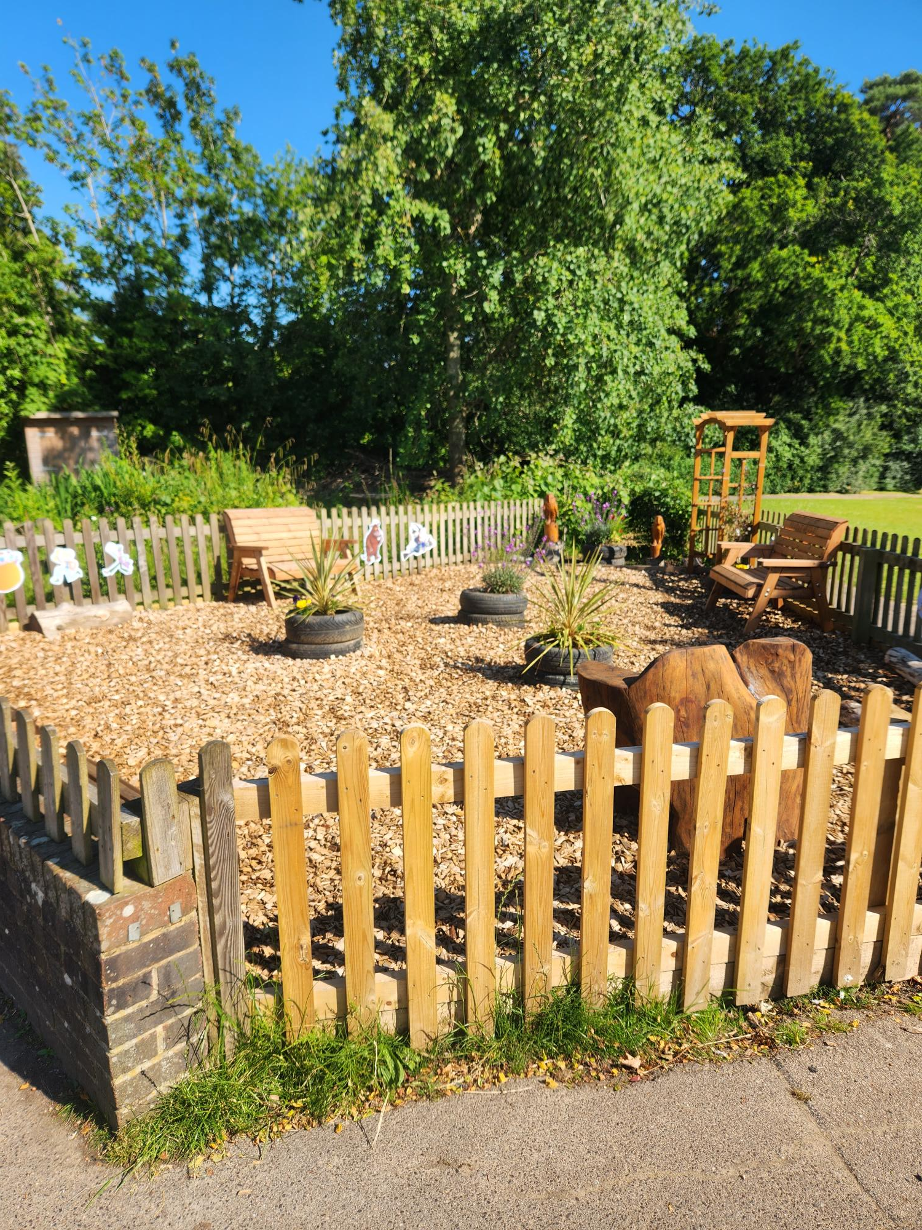
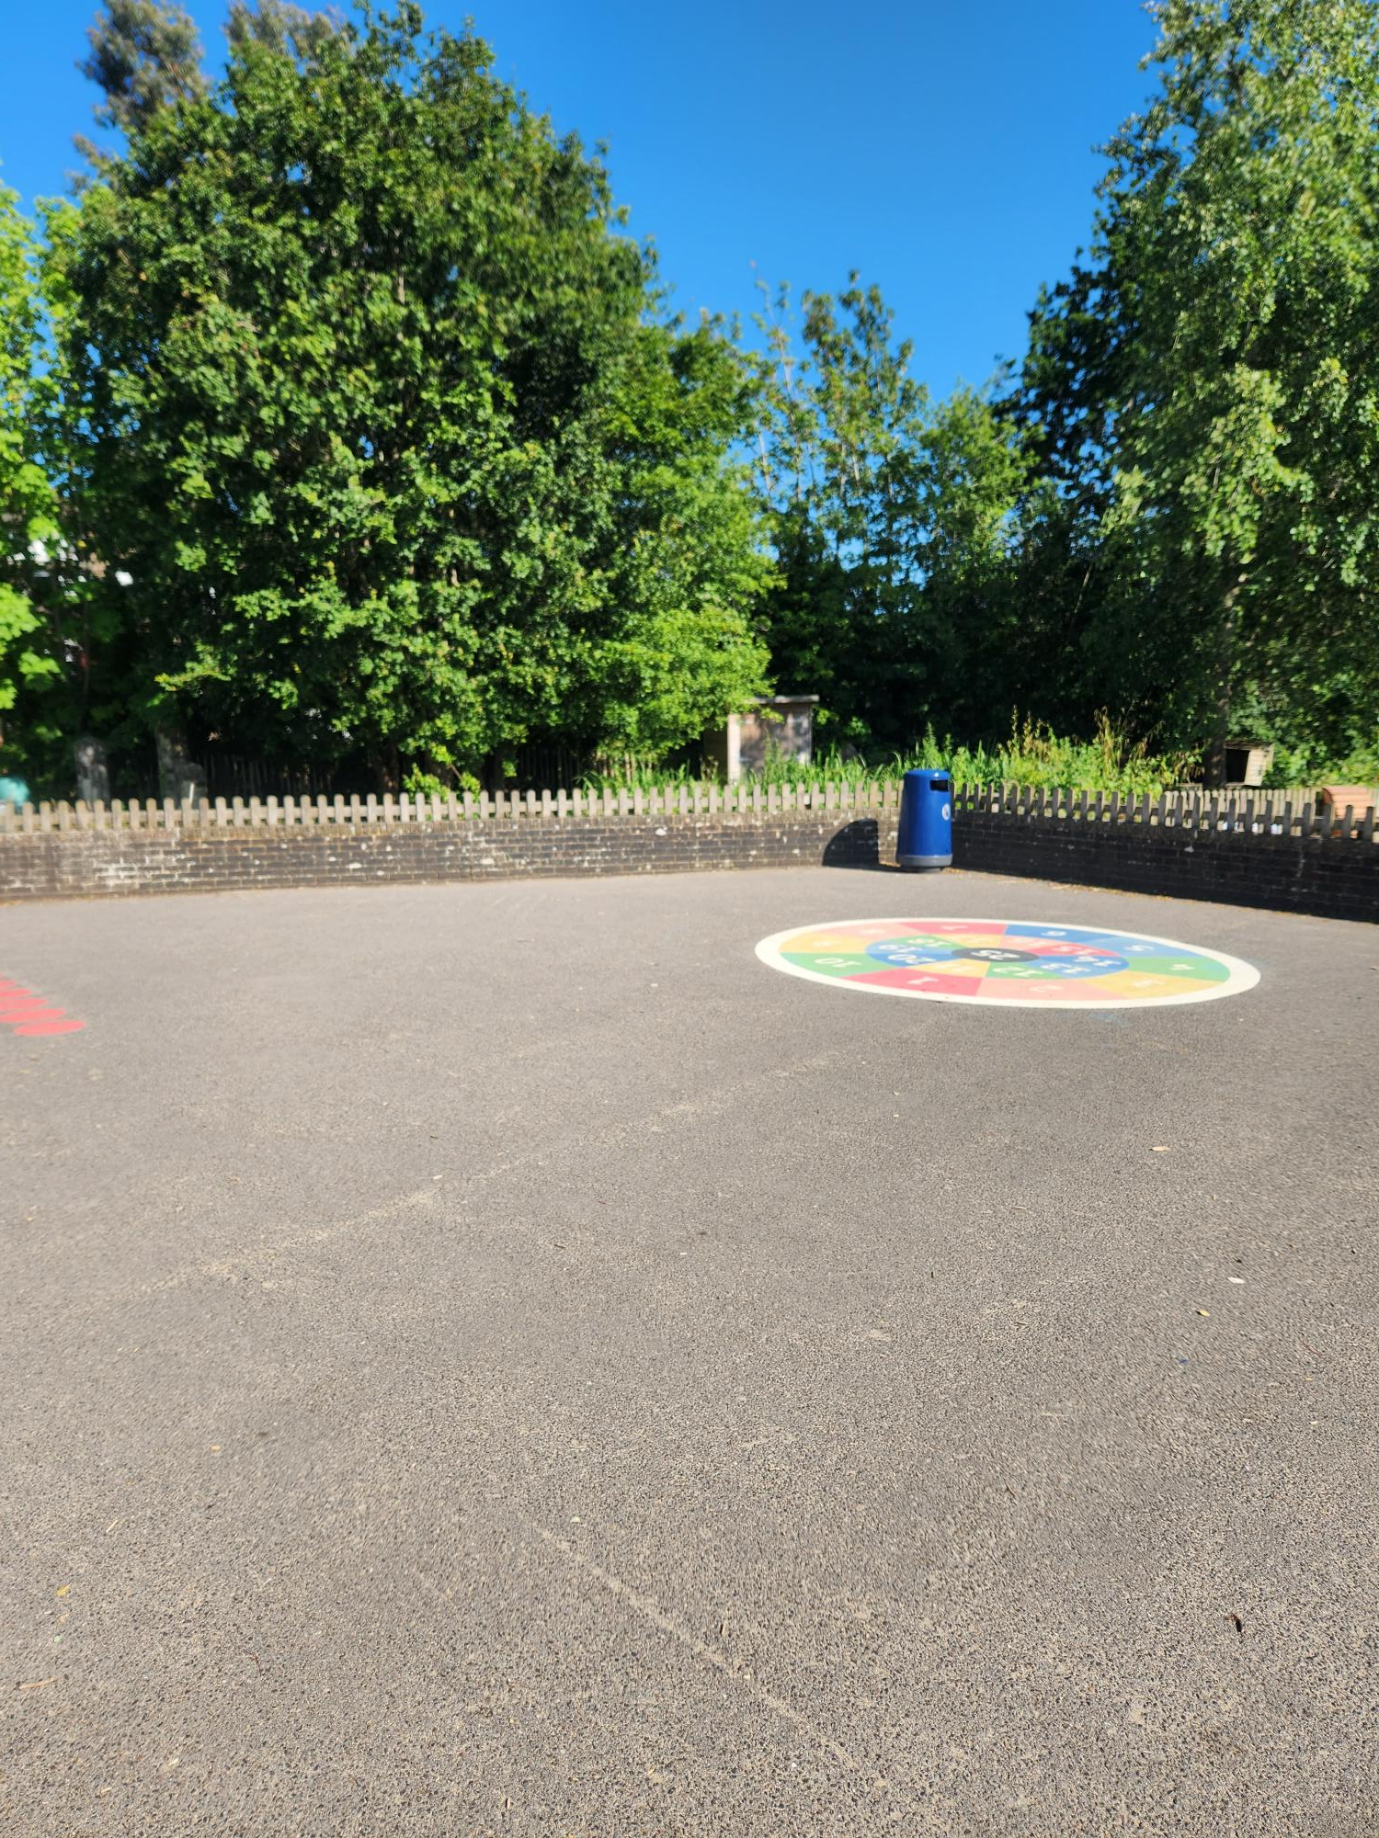
This is your playground

Slide 7
When you return to school your topic theme will be ‘Why am I super?’
You might like to start exploring some of these books during the summer holidays.

Slide 8
We are really looking forward to seeing you in September.

