Slide 1
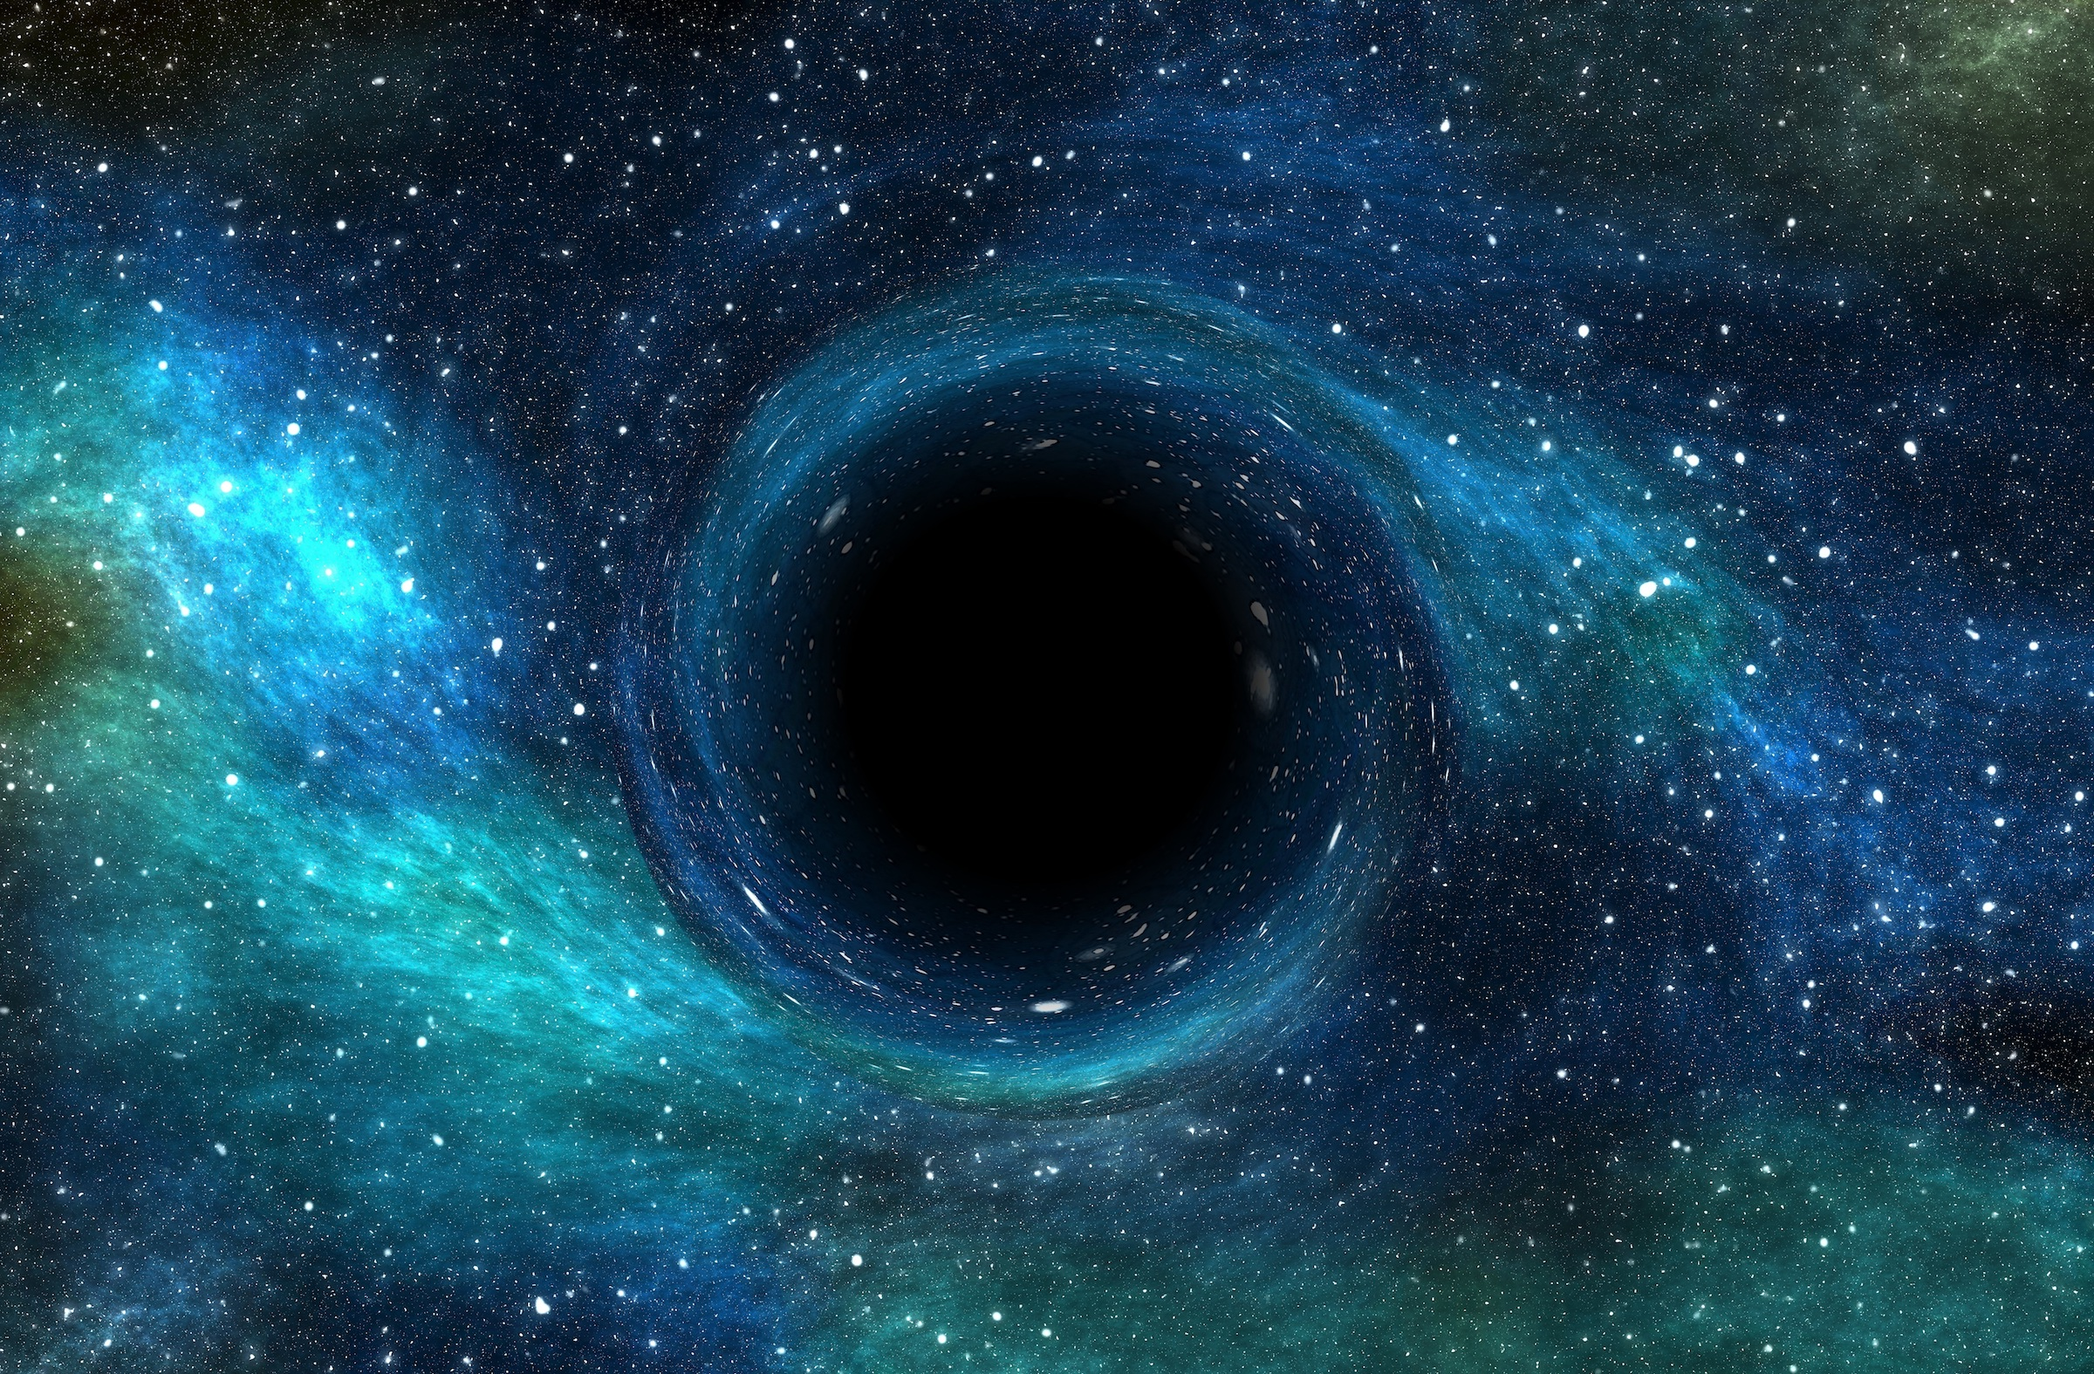
As readers and writers, we will start our new topic with some of our own space poetry, where we focus on precise vocabulary choices, learning them off by heart and performing them. Then we will learn how to write education narrations, with scientific language and complex sentences to inform and amaze. We will finish the term with a story inspired by the Apollo 11 moon landings, bringing together all of the skills we have learnt this term.
As scientists, we are learning about the movement of the Earth, Moon and other planets in relation to each other and the solar system. We will investigate the rotation of the Earth to be able to explain what makes day and night and we will conduct a shadow investigation to prove how the Earth spins on its axis.
As computer scientists, we will first be recording and editing iMovies using our knowledge of space. Then, in the second half of this term, we will be developing our coding skills and learning how algorithms work and evaluating their effectiveness.
Space - What Lies Beyond ?
As athletes,. we will be practising our Netball skills through passing, marking and shooting. We will be using these in a mini tournament at the end of the unit. Which house will win? For indoor PE this half term, we will be developing our counter tension skills as part of gymnastics. We will learn how to link movements to produce routines and then perform these to our classmates.
As musicians, we are learning how to play the glockenspiel. We are revising previously learnt notes and learning new ones. We are learning and rehearsing a longer piece of notation for a special event nearer the end of the term.
As linguists, we will be learning how to engage in conversations about our hobbies. We will ask and answer questions; express opinions and respond to those of others.
As designers, we will be exploring , designing and making simple orreries using mechanisms such as pullies to show the movement of the sun, earth and moon. We will use simple tools for this design process and evaluate our designs at the end of the project.
As artists, we will be exploring 3D design and sculpture, inspired by the works of artists and architects such as Thomas Heatherwick, Lisa Traxler, Dennis Creffield and Anish Kapor. We will use their works to create a language of 3D sculpture, including line, shape and tone, which we will explore using pencils and charcoal. We will then learn how to transform our ideas into our own 3D paper sculptures.
As mathematicians, we will be learning about negative numbers, interpreting numbers greater than and less than zero in different contexts. We will be explaining how negative numbers are used on a coordinate grid and finally we will use our knowledge of positive and negative numbers to interpret graphs. We will then revise and learn written, formal methods of short multiplication and division.
Key texts and complimentary reading:
A Boy in the Tower – Polly Yo-Hen
Cosmic - Frank Cottrell Boyce & Steven Lenton
The Kid Who Came From Space - Ross Welford
The Jamie Drake Equation - Christopher Edge

