Slide 1
Welcome to Mrs Walker’s Class

Slide 2
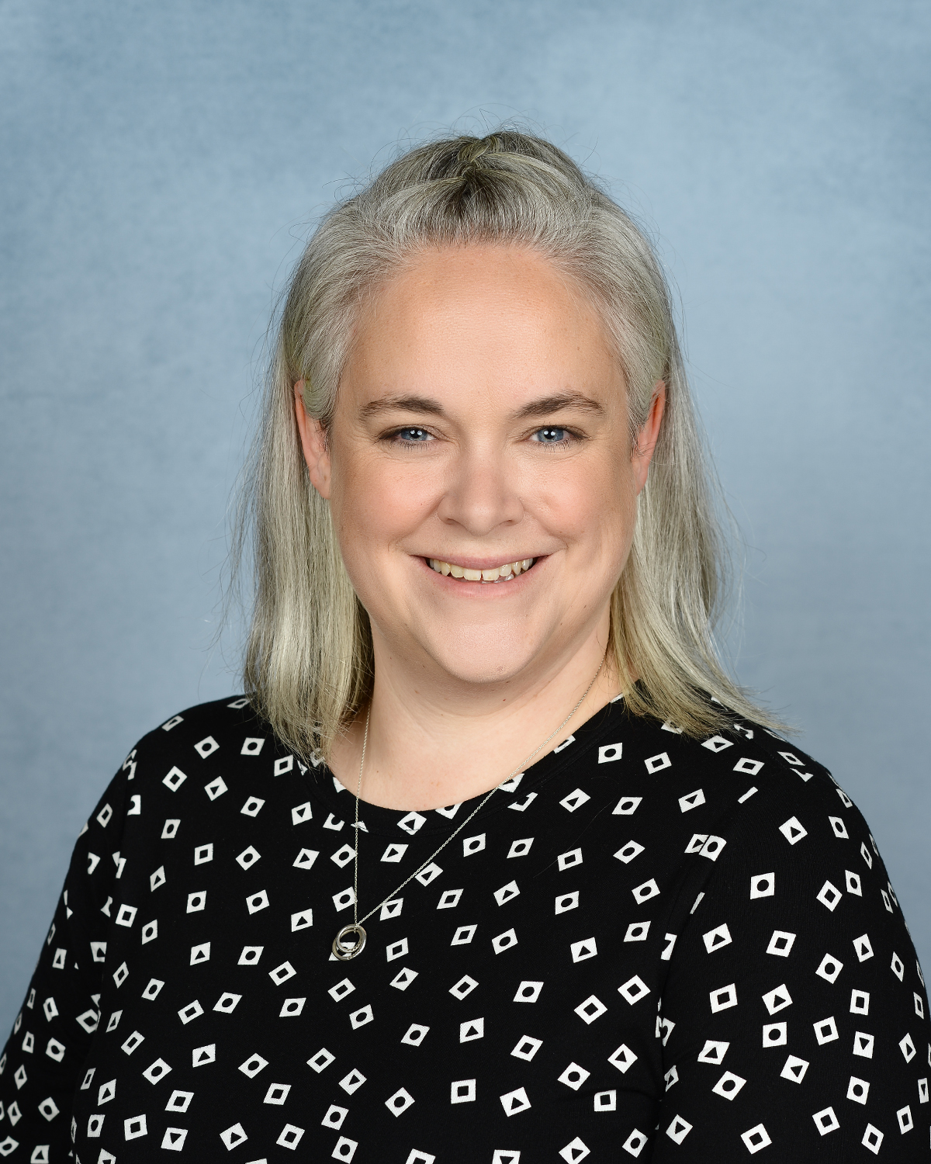
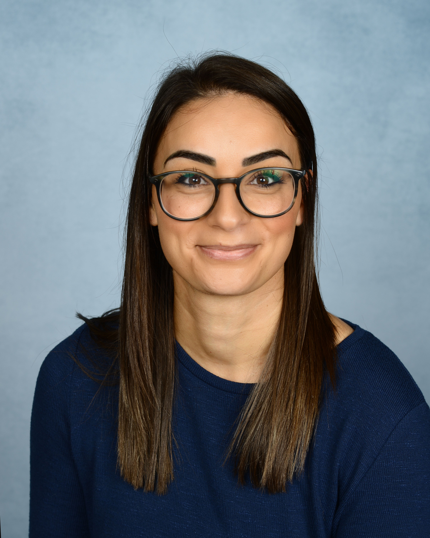
These are the adults that will be working in your classroom.
Mrs Walker
Your Class Teacher
Mrs Woods
Learning Support Assistant (LSA)

Slide 3
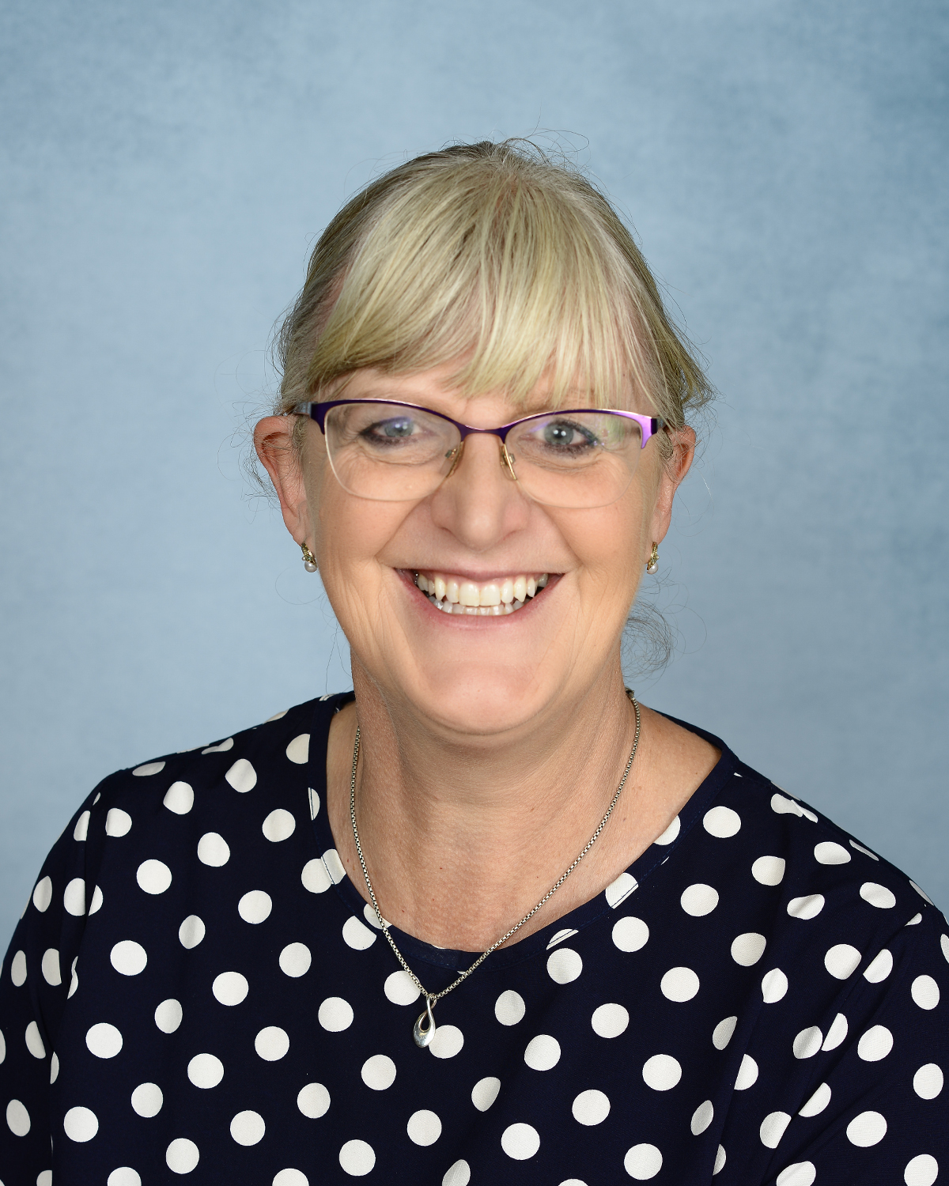
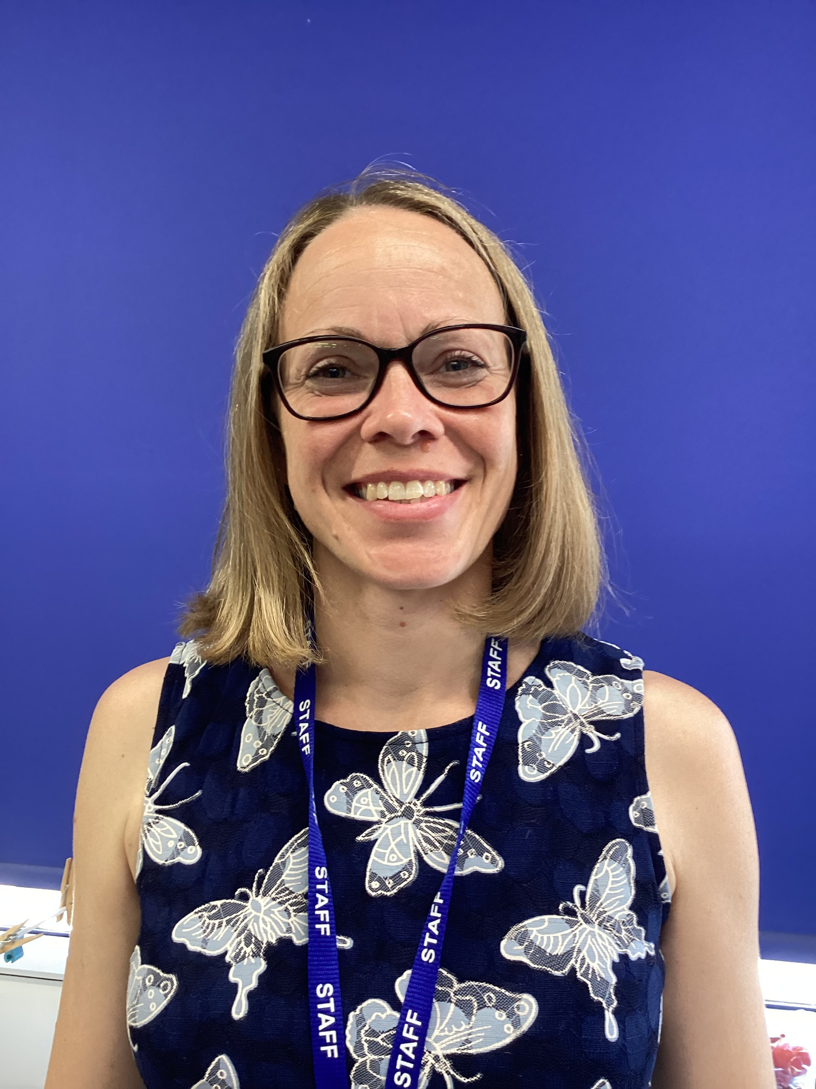
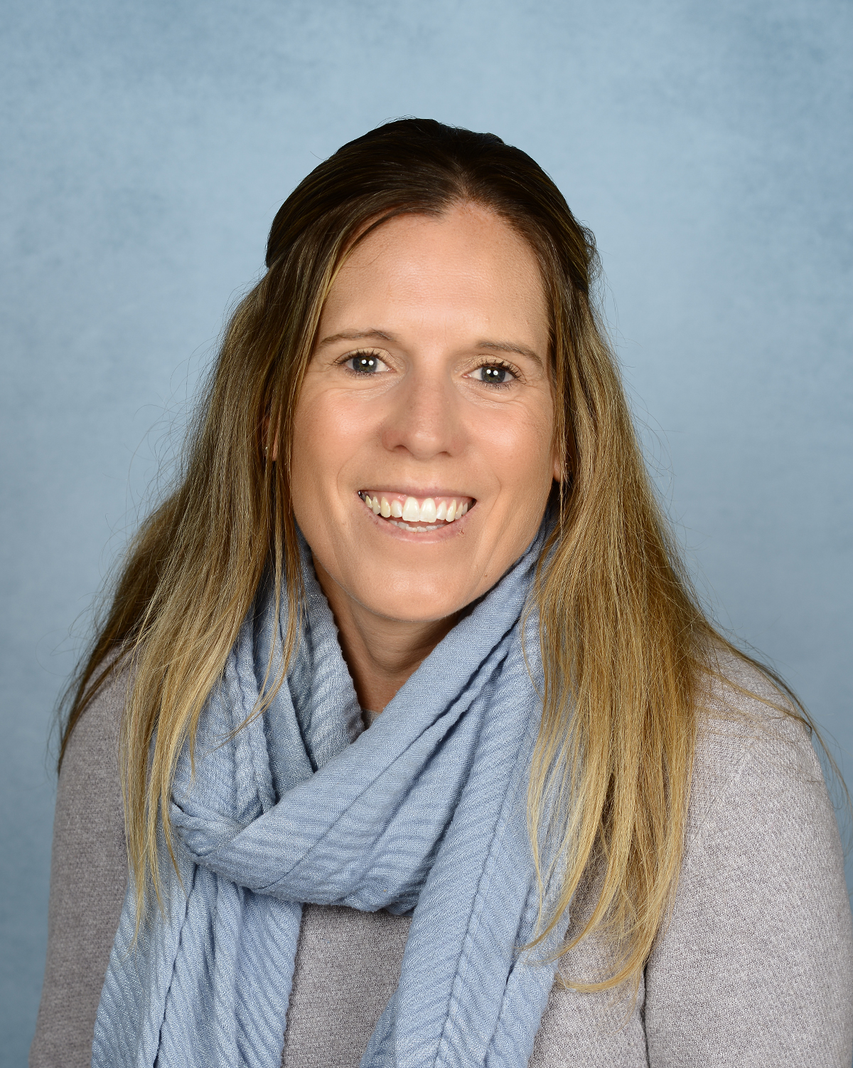
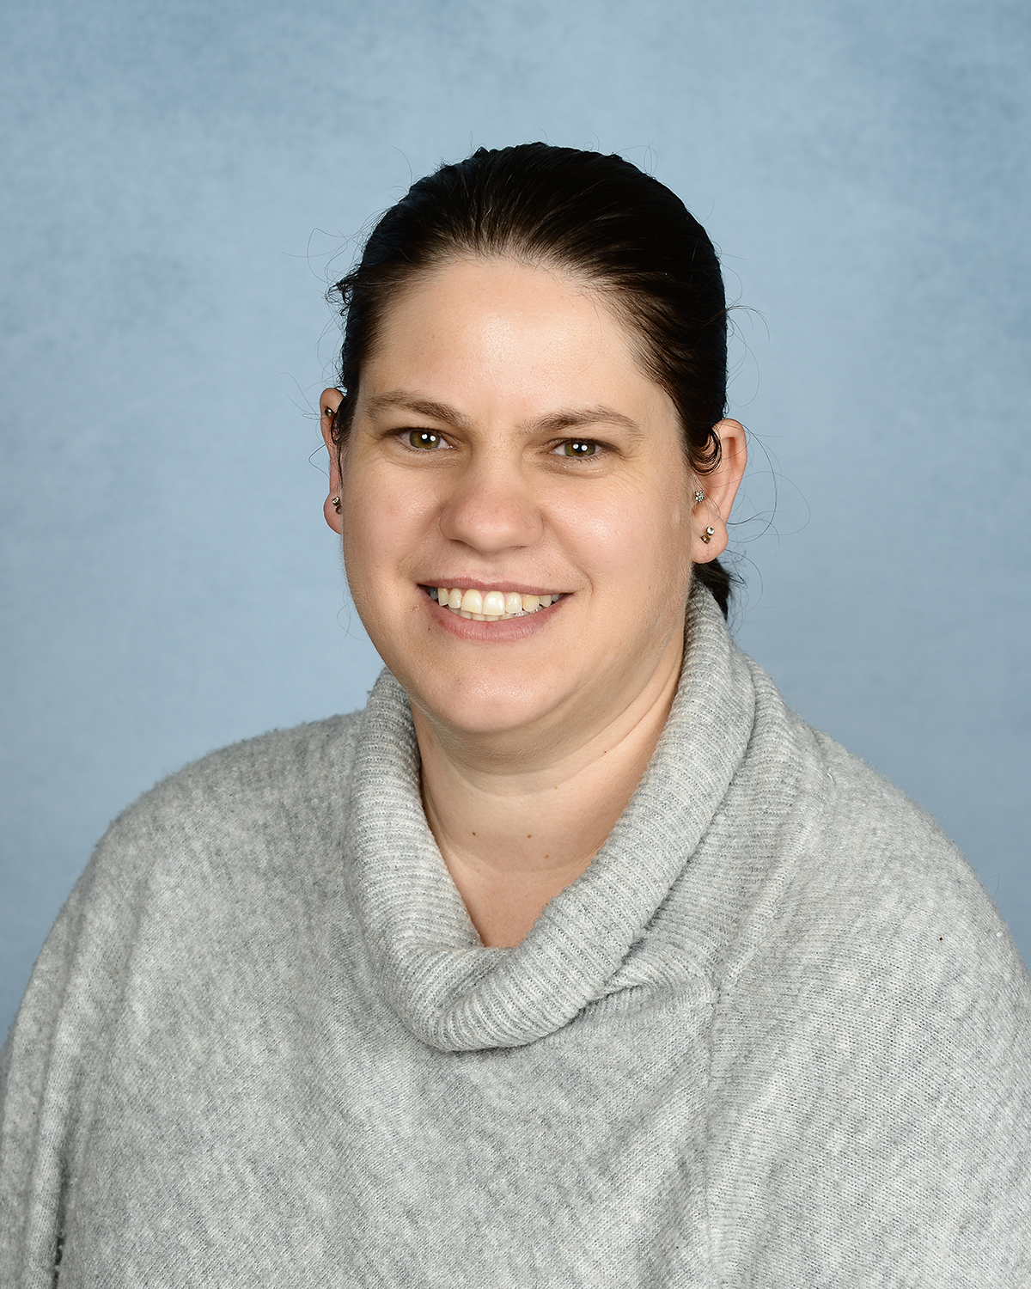
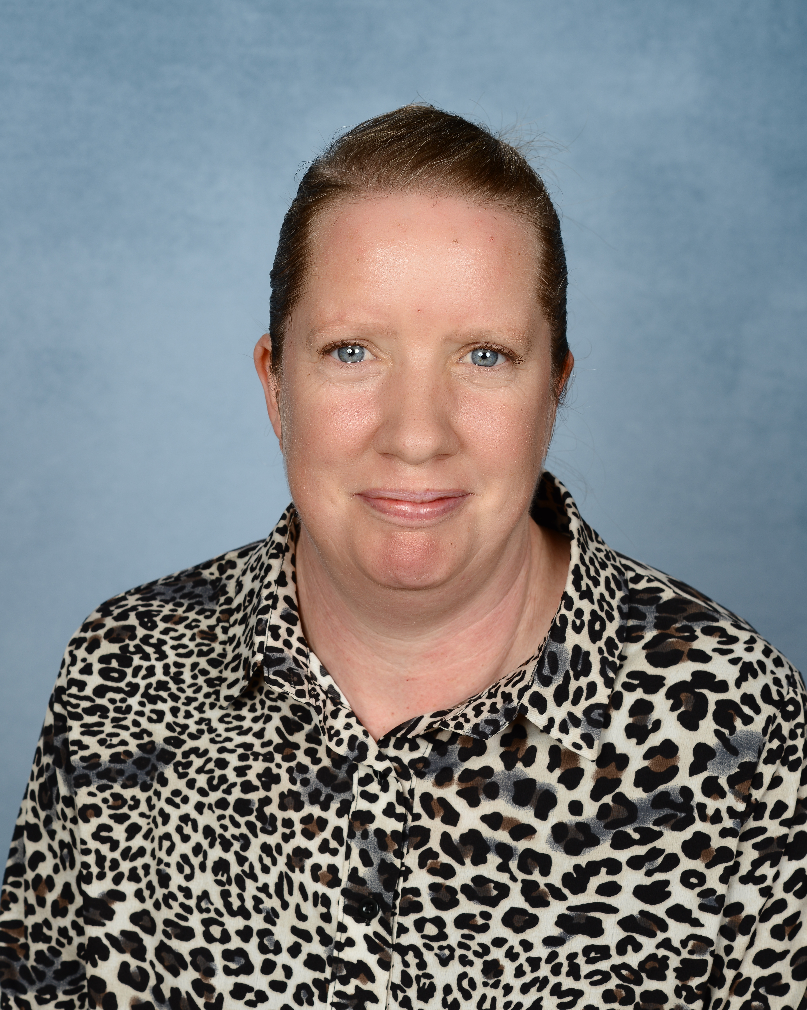
These are the adults that will be working in Early Years.
Mrs Footer
Early Years Teacher
Mrs Langley
Early Years Teacher
Mrs Hunt
Early Years Teacher
Mrs Van Jaarsveld Learning Support Assistant (LSA)
Mrs Palmer Learning Support Assistant (LSA)

Slide 4
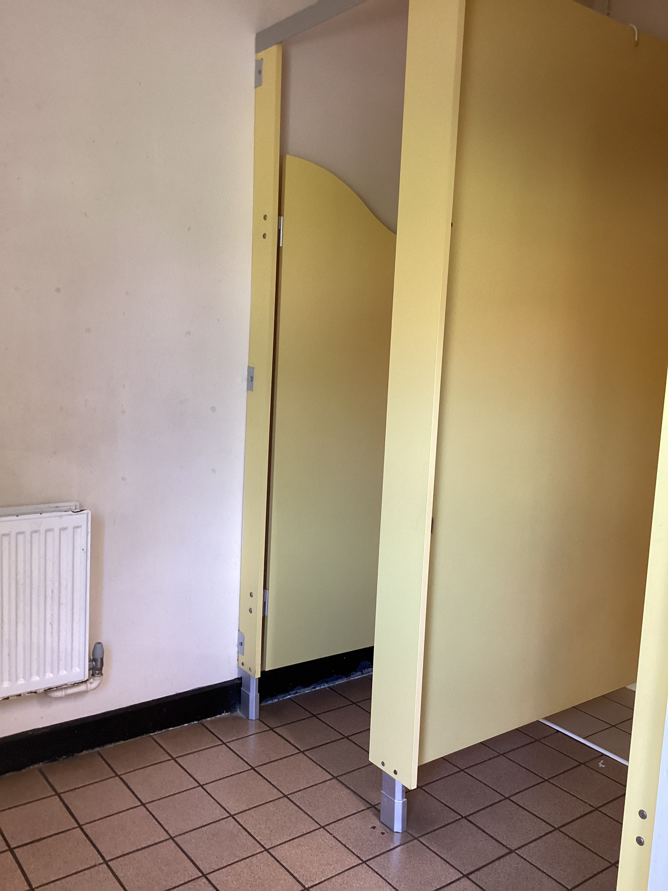
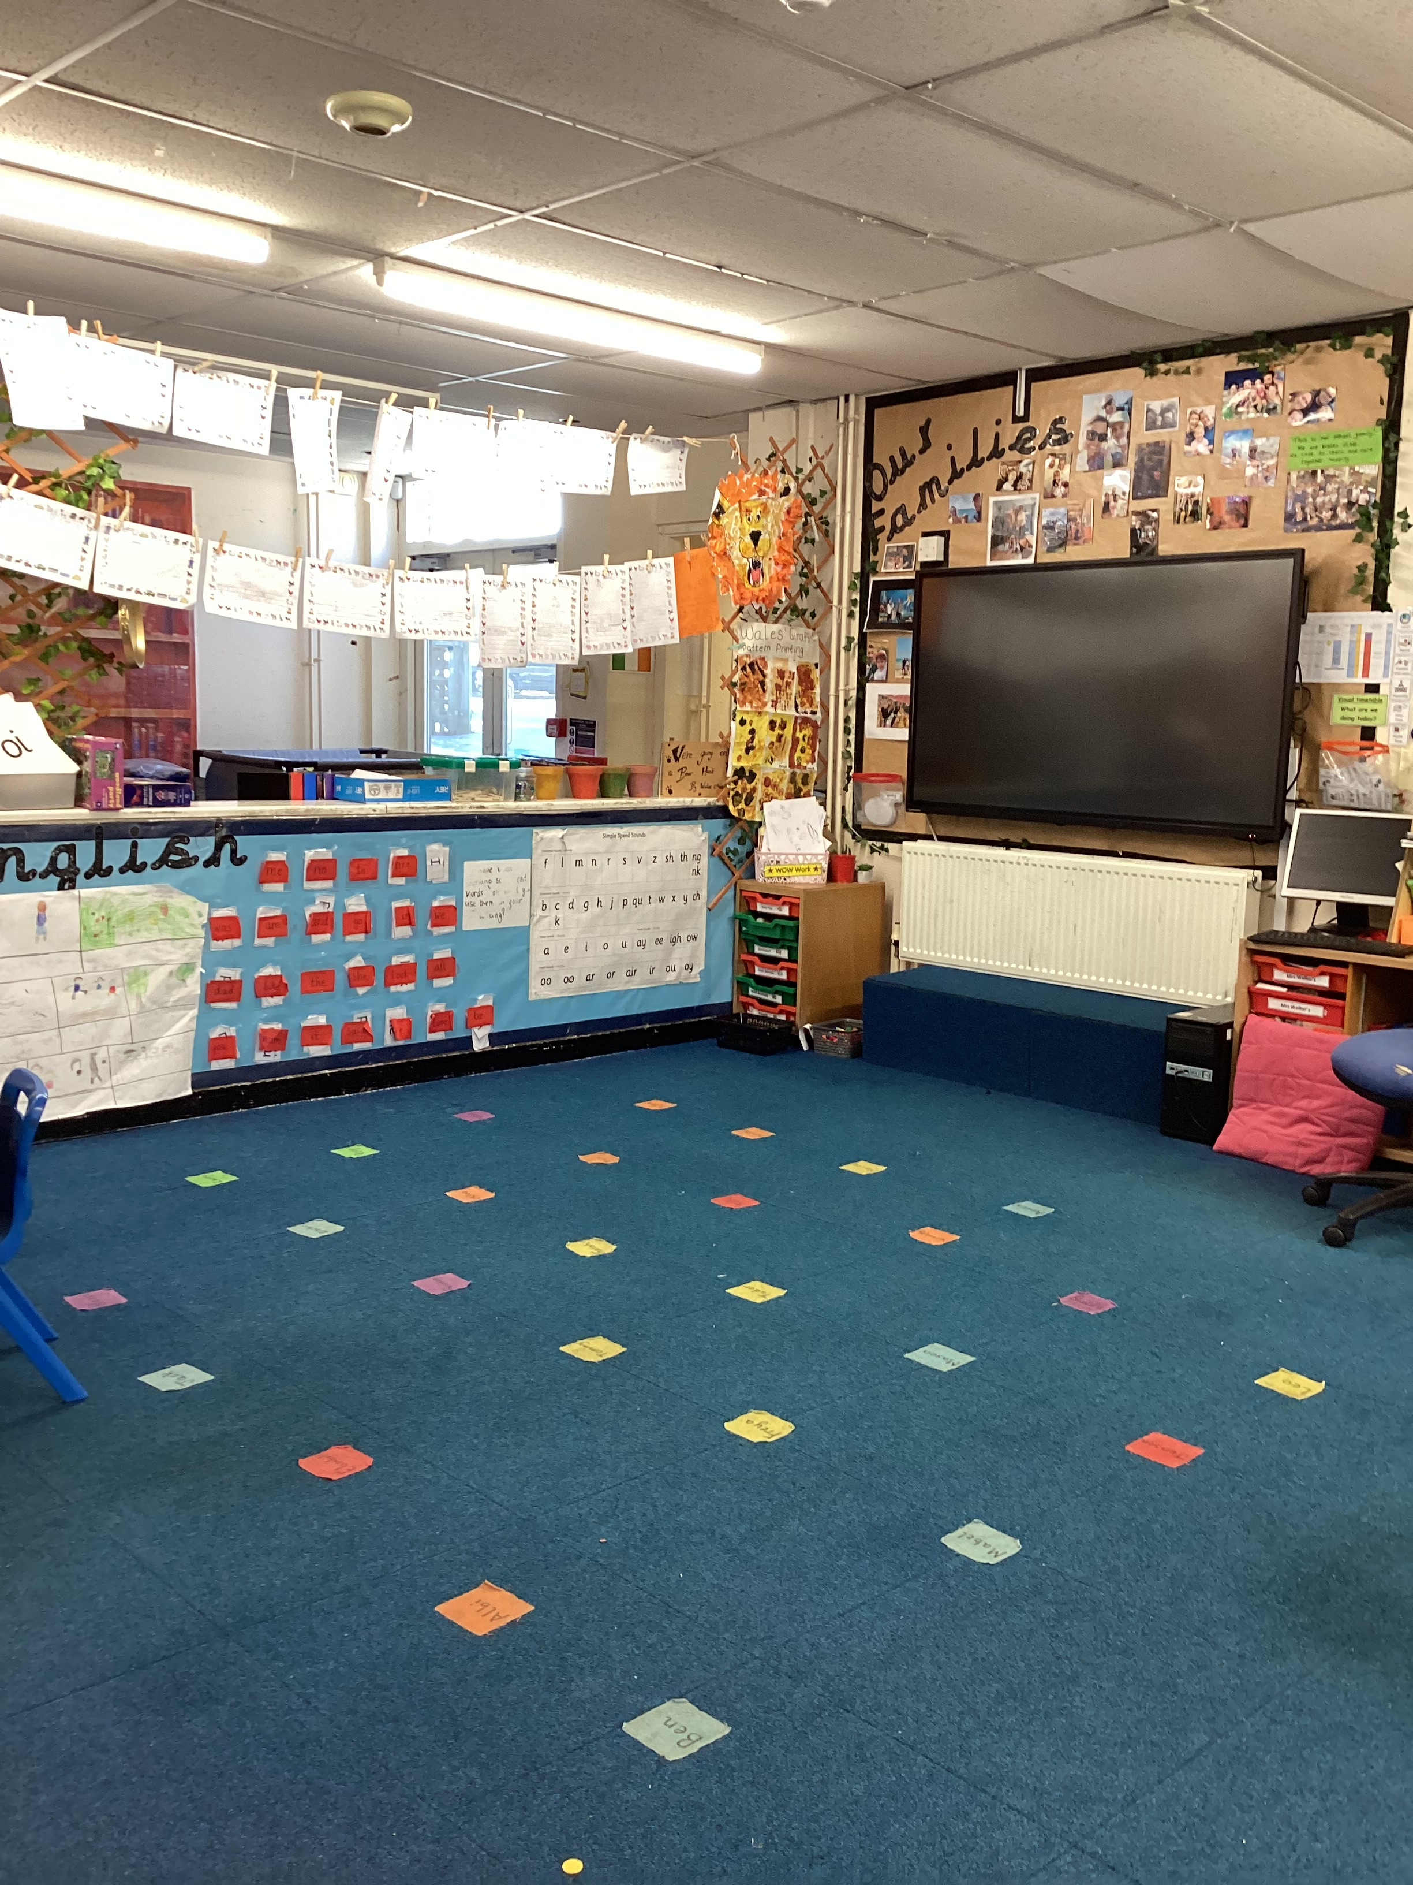
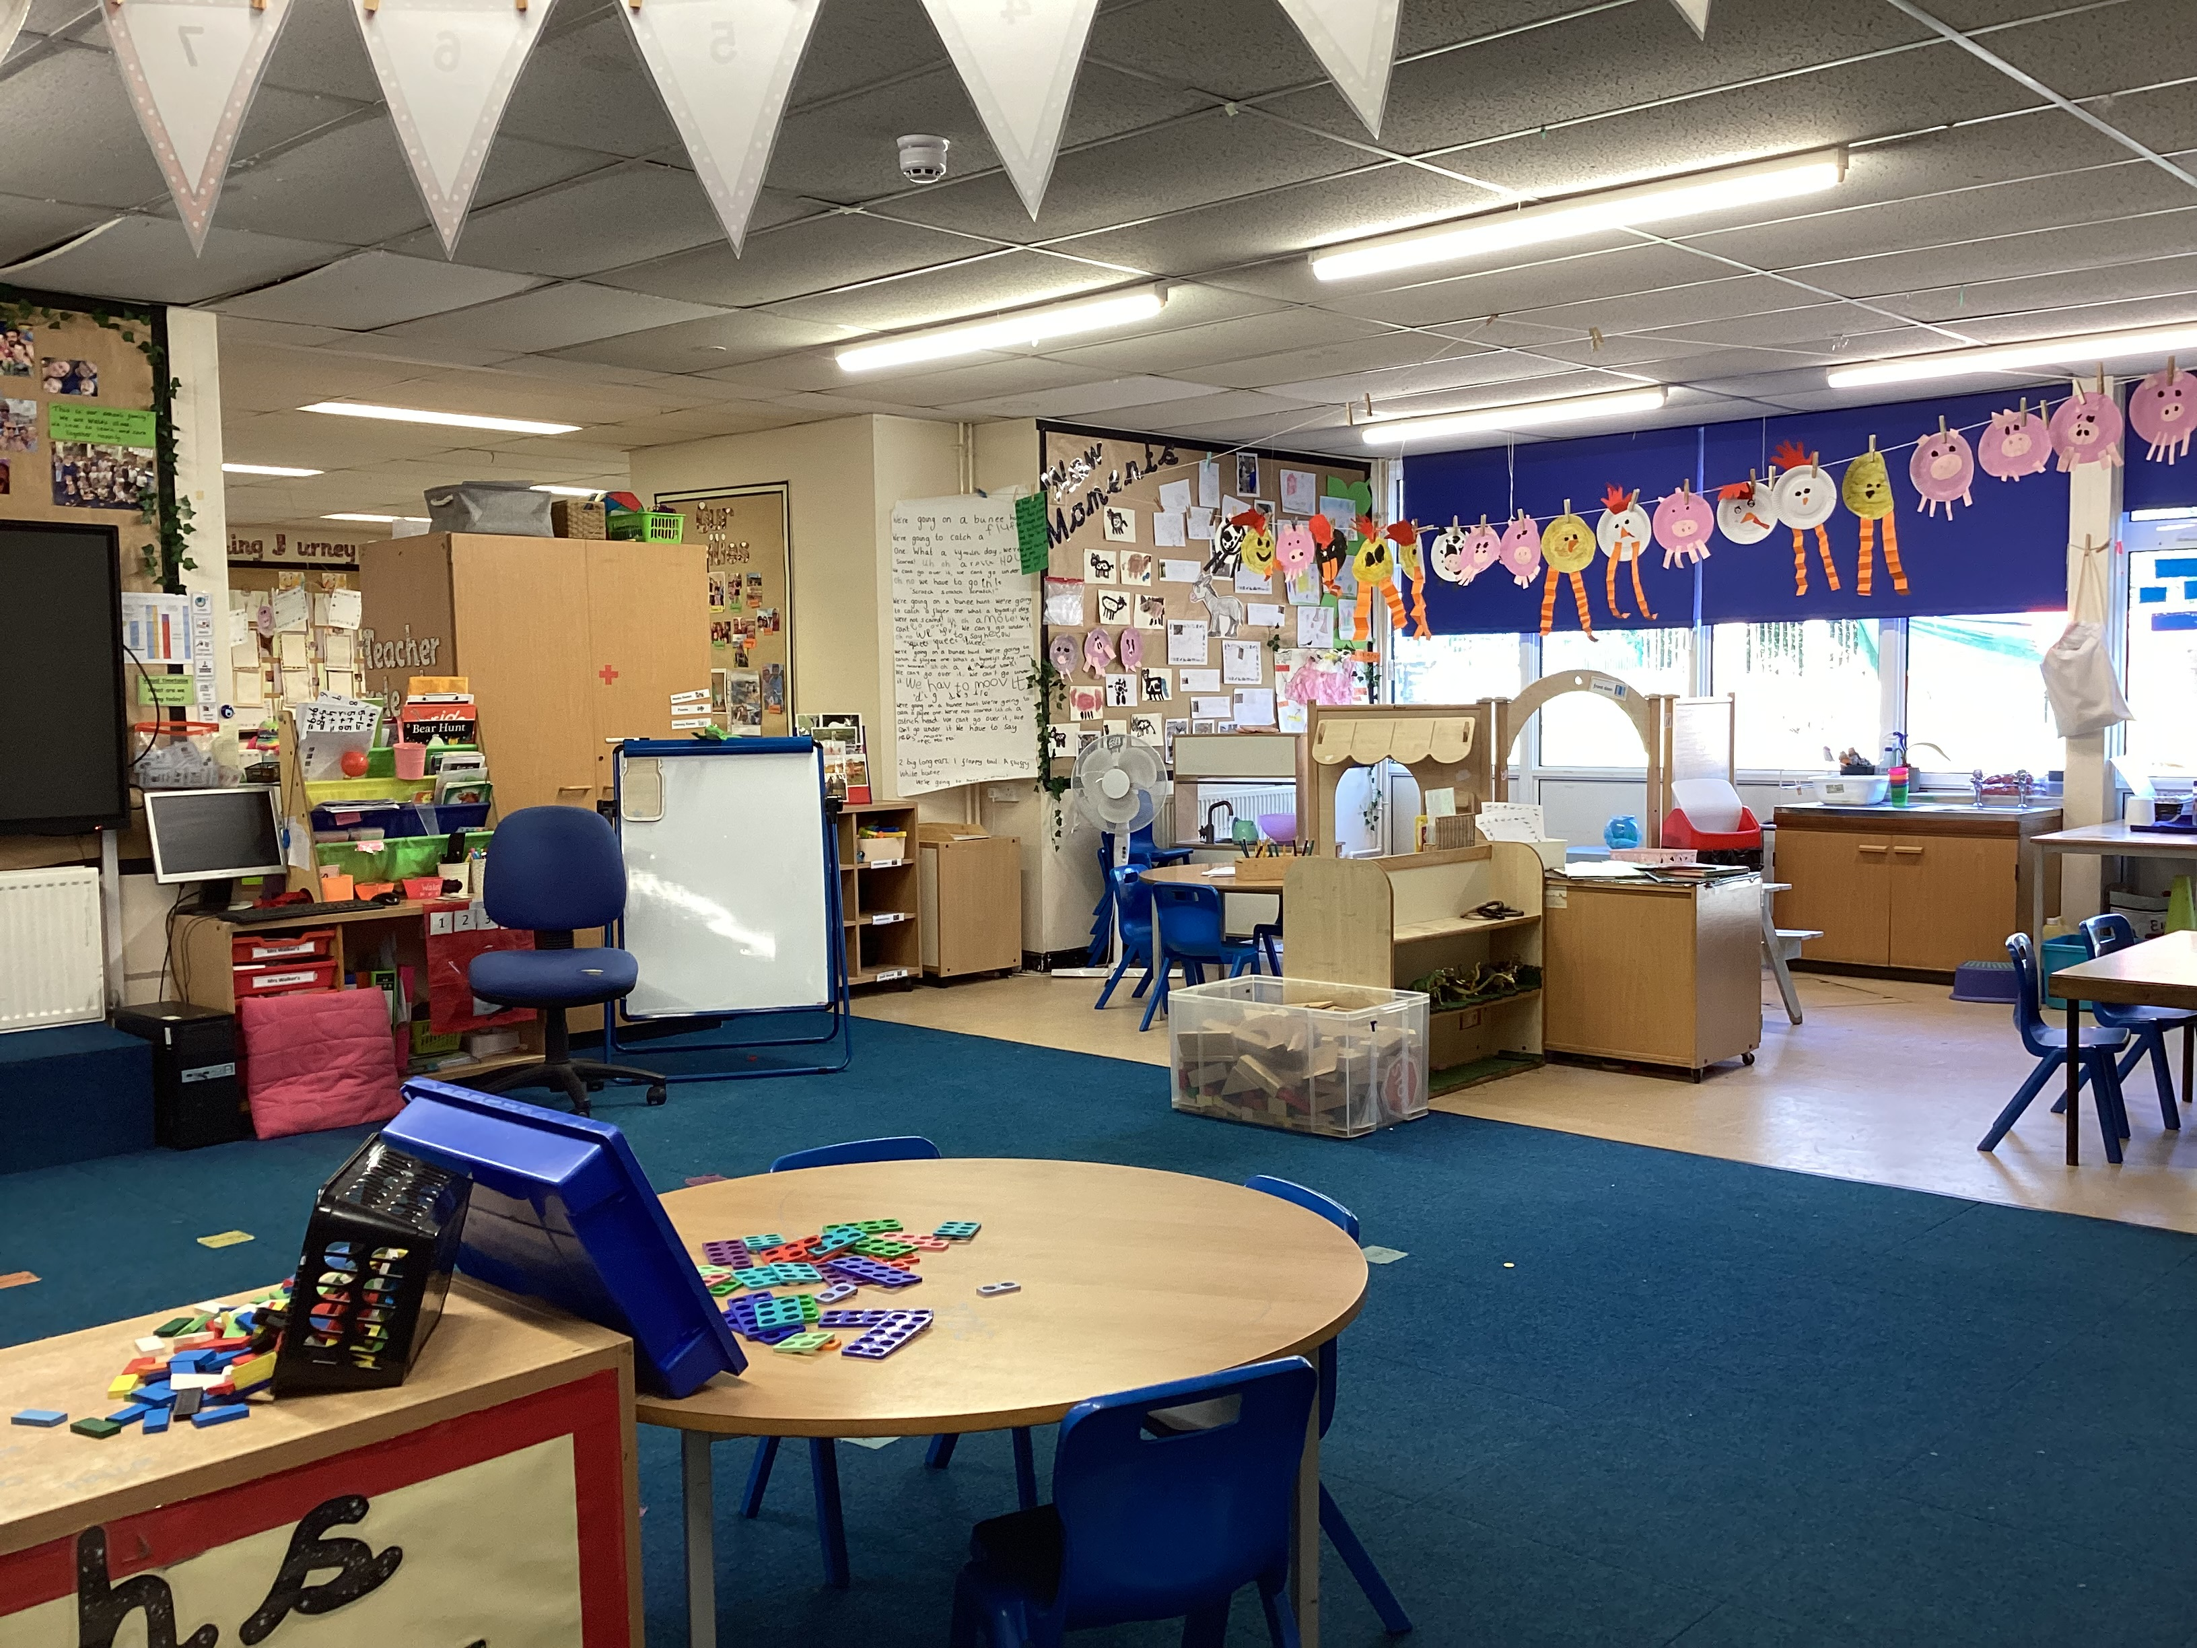
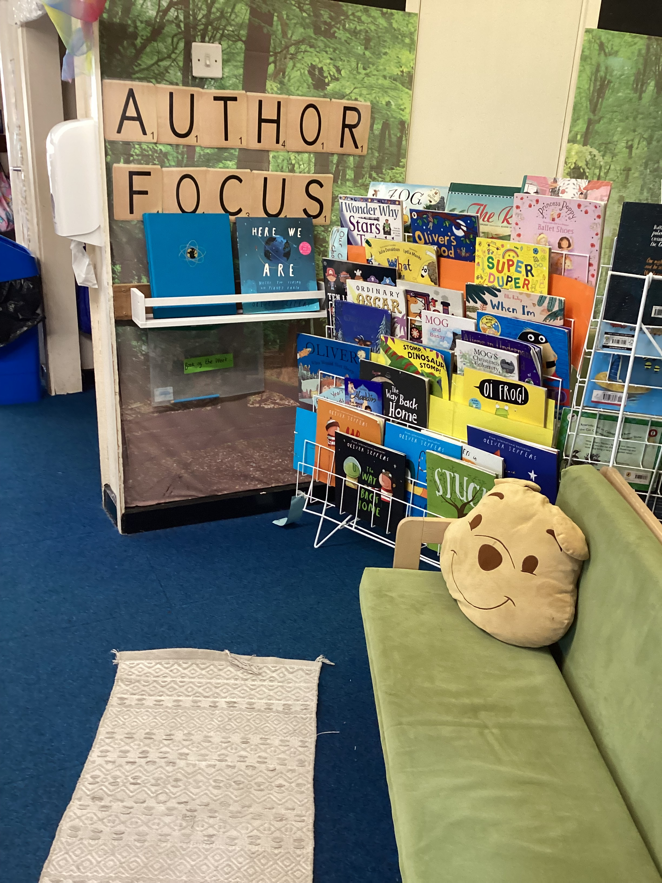
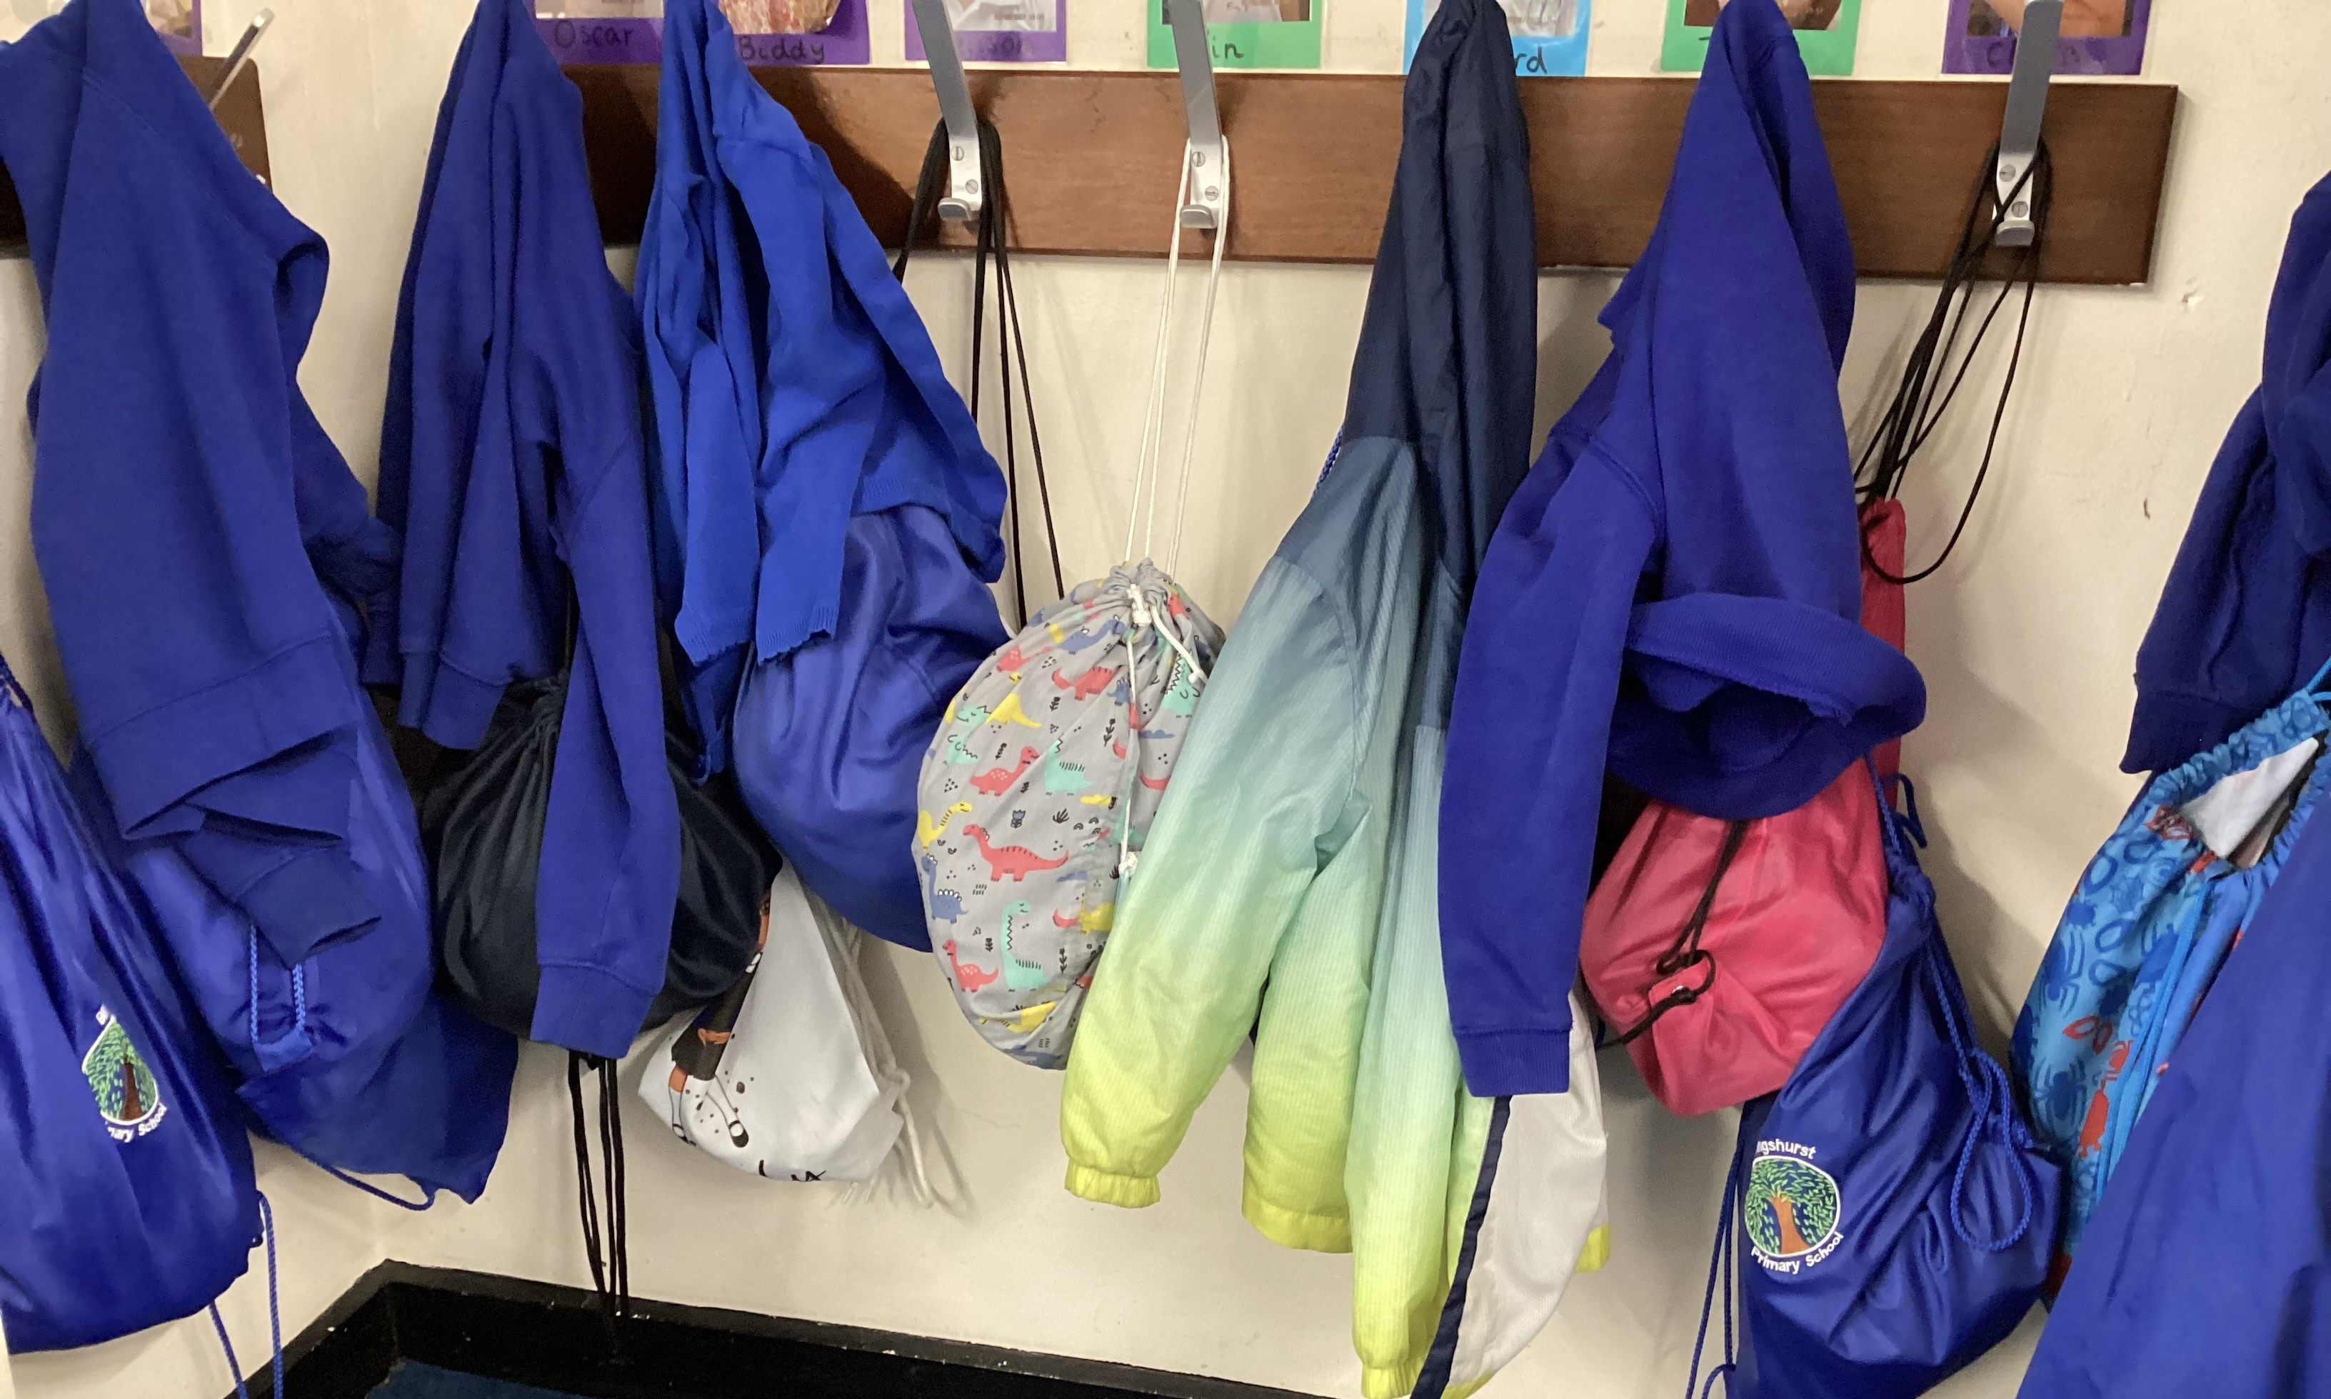
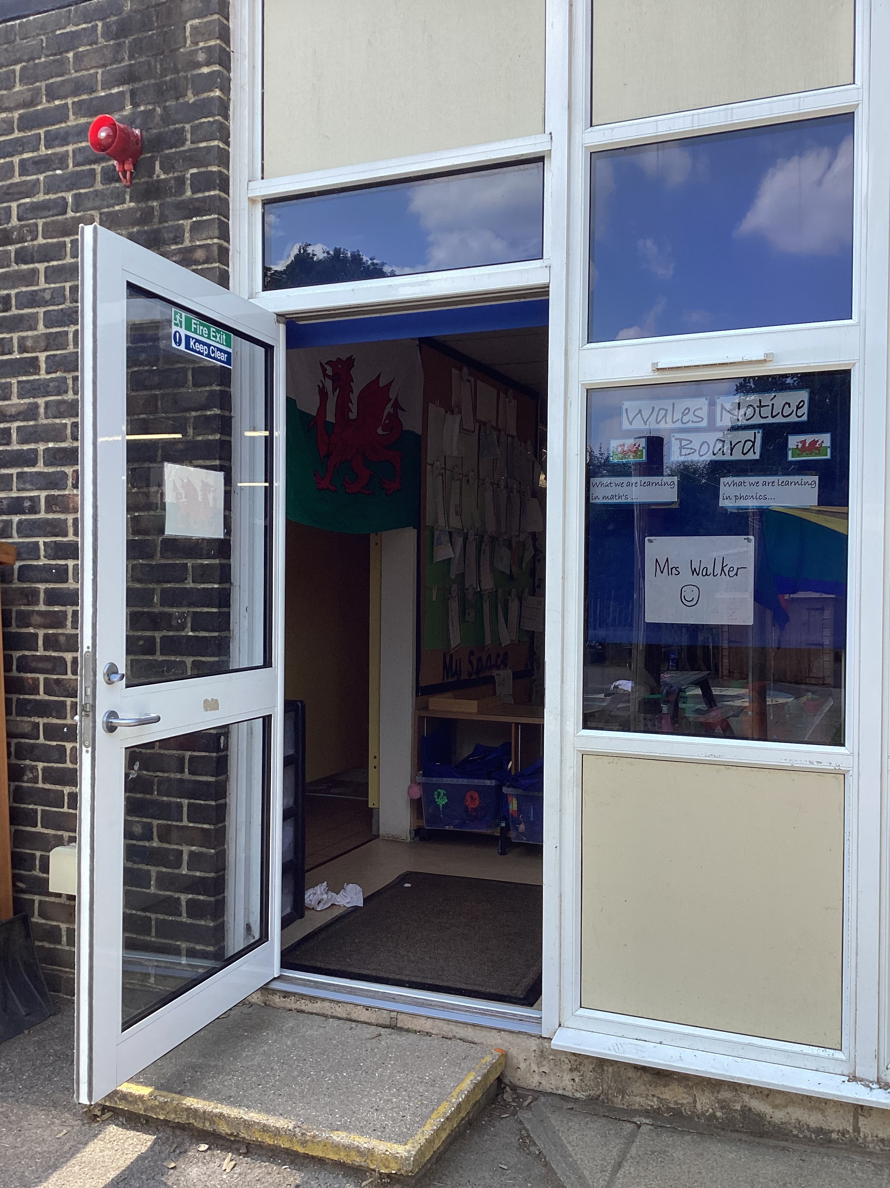
This is your classroom.
These are the class toilets.
This is where you will hang your coat.
This is where you will enter the school and your classroom.

Slide 5
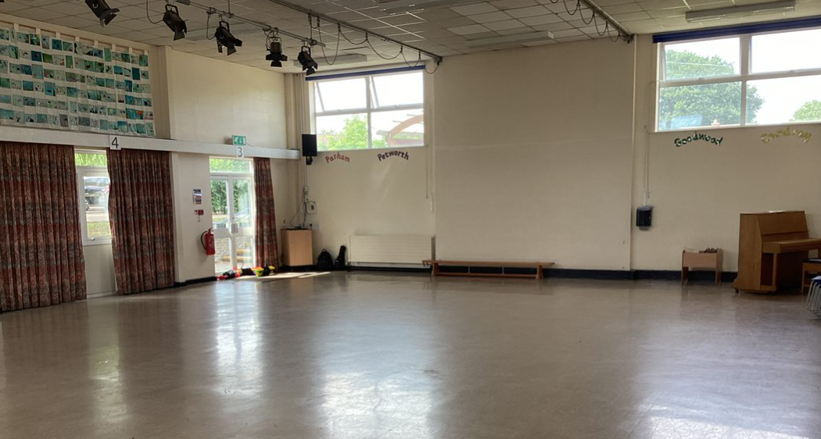
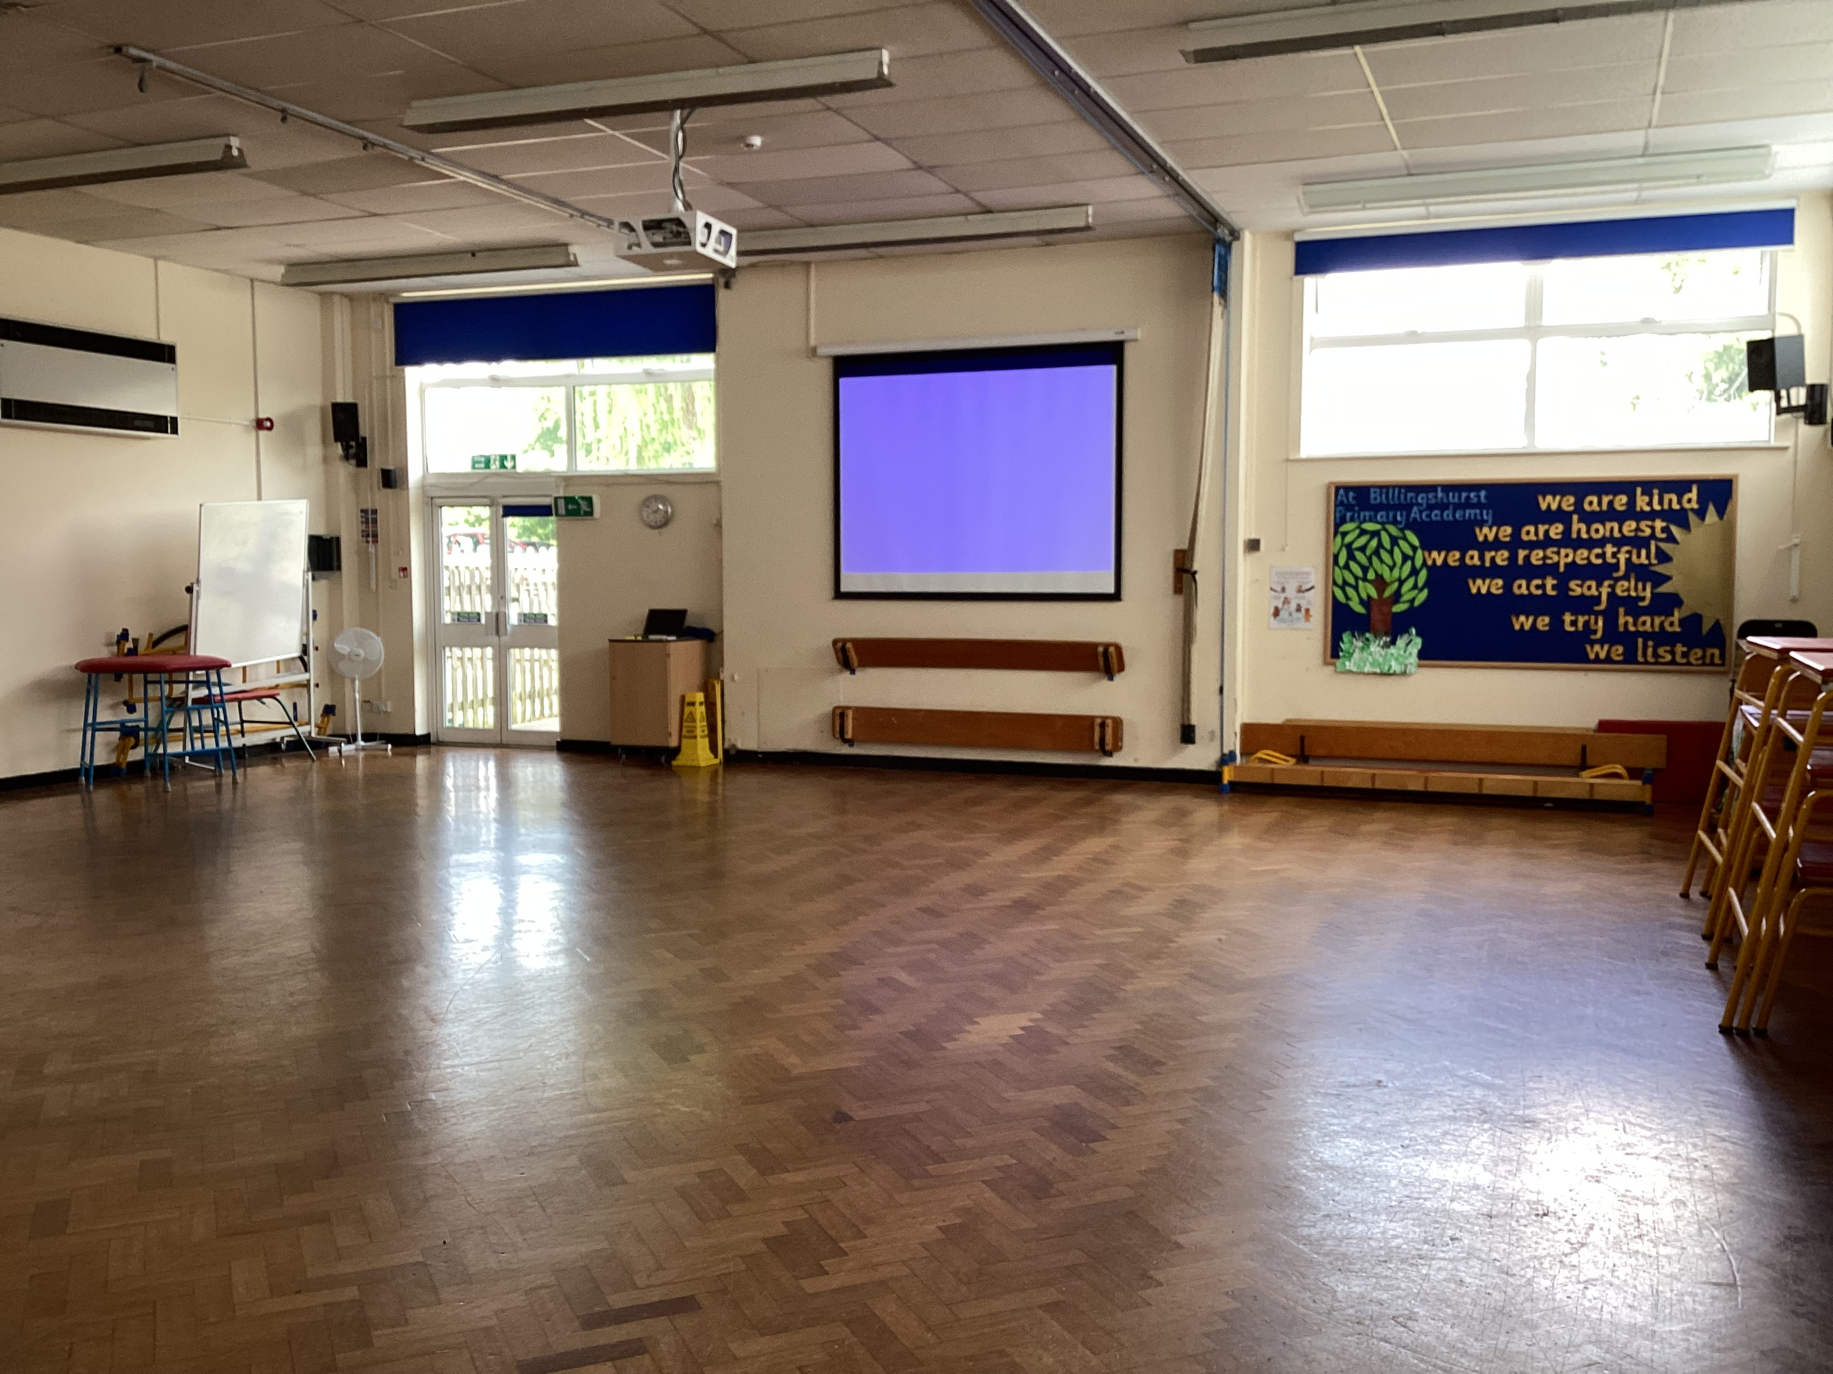
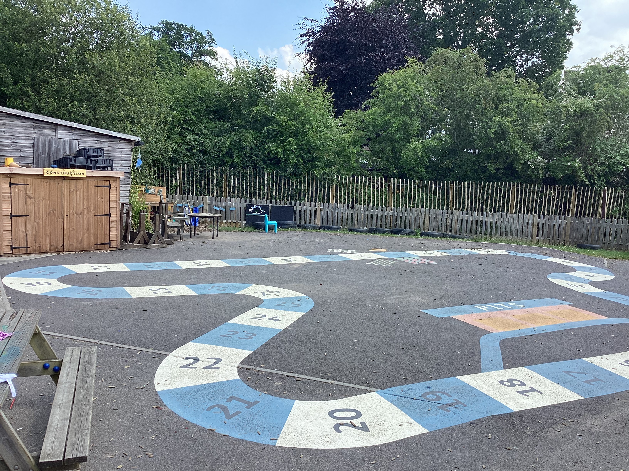
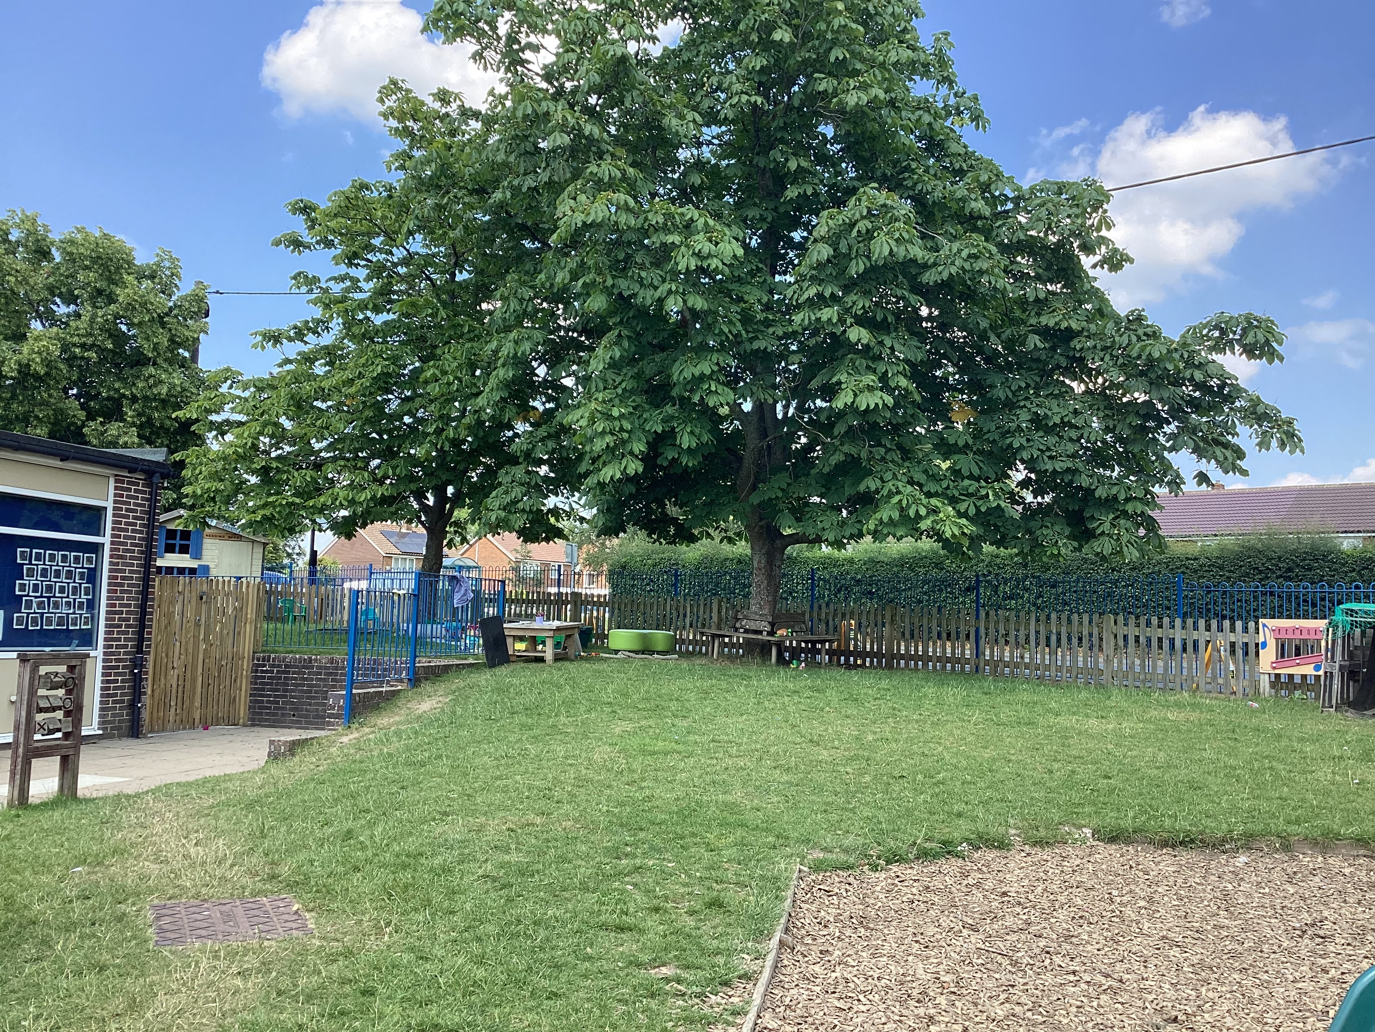
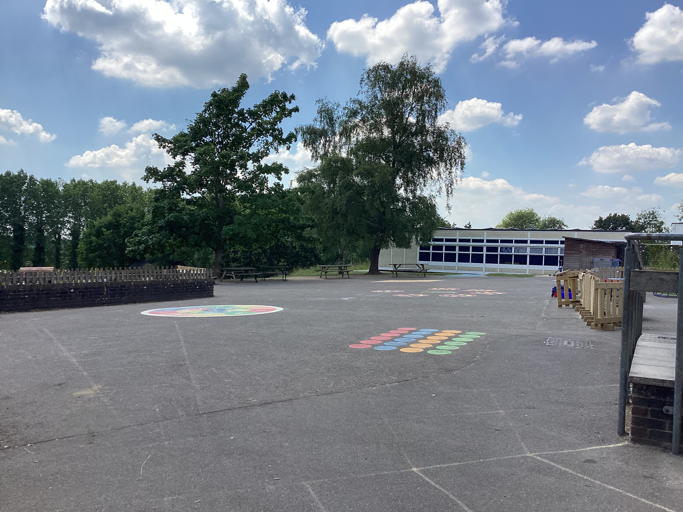
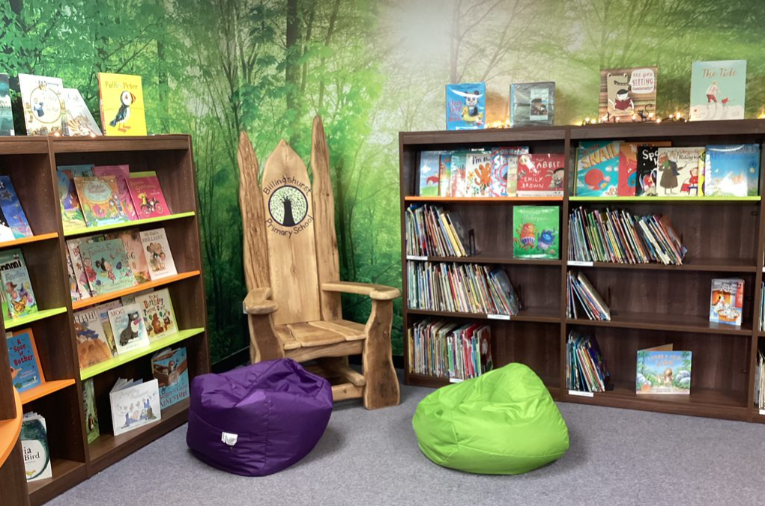
These are the KS1 & KS2 Halls where you will have lunch and assemblies.
This is our outside Learning Garden, you will be able to use this everyday.
This is the KS1 playground that you will use at lunchtimes
This is the KS1 library

Slide 6
When you start school we will be learning how to use our new classrooms and our outside classroom. We will also be developing new friendships.
These are some books we will be looking at.

Slide 7
We are really looking forward to seeing you in September.

