Slide 1

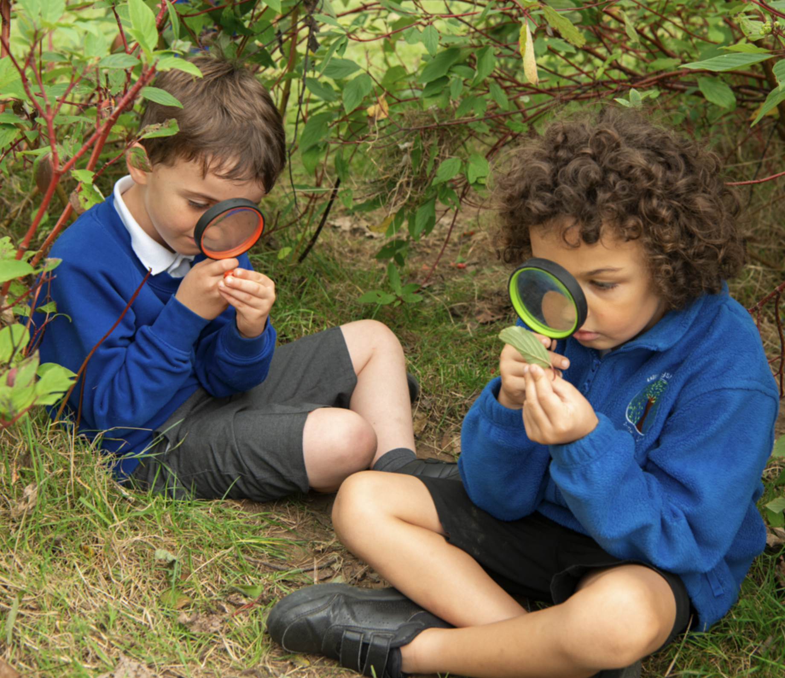
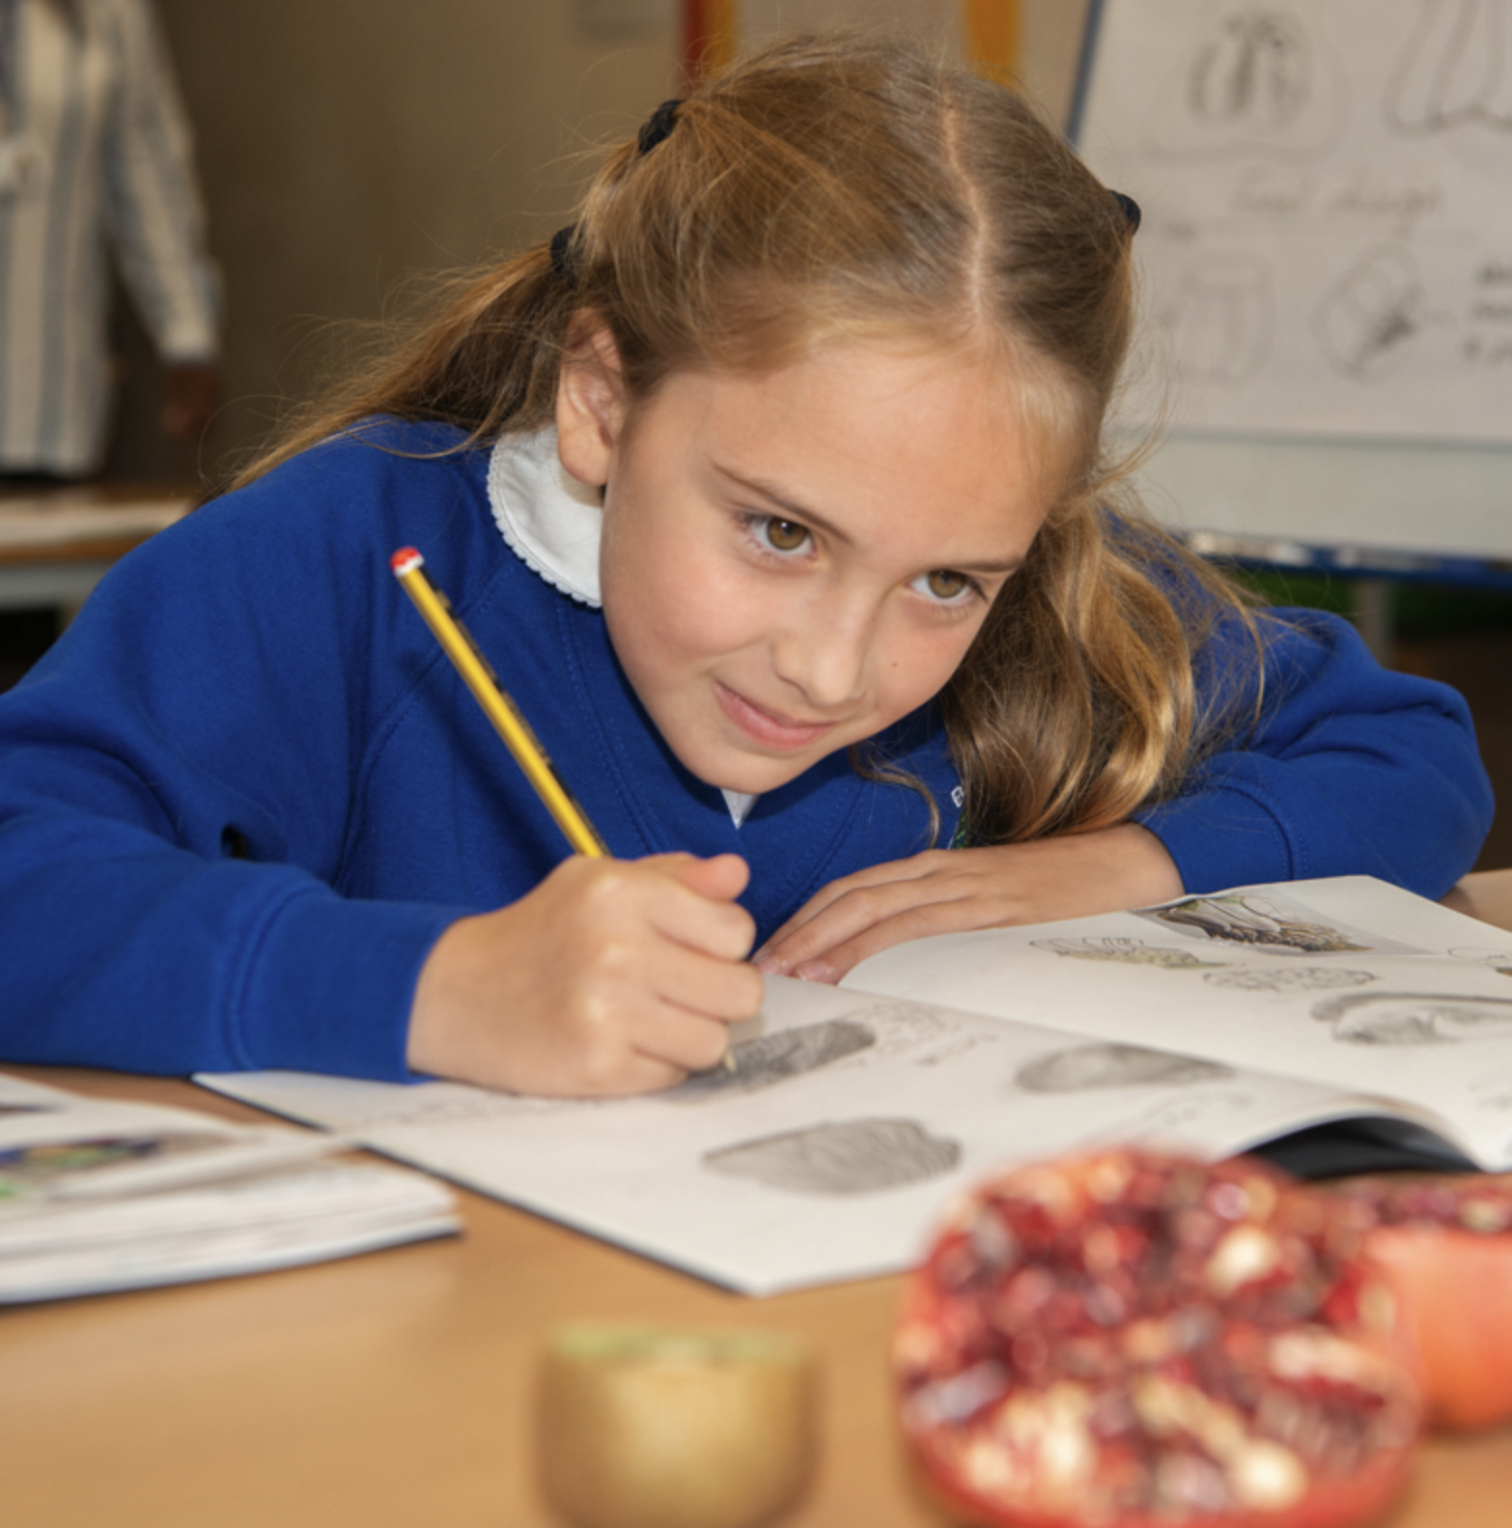
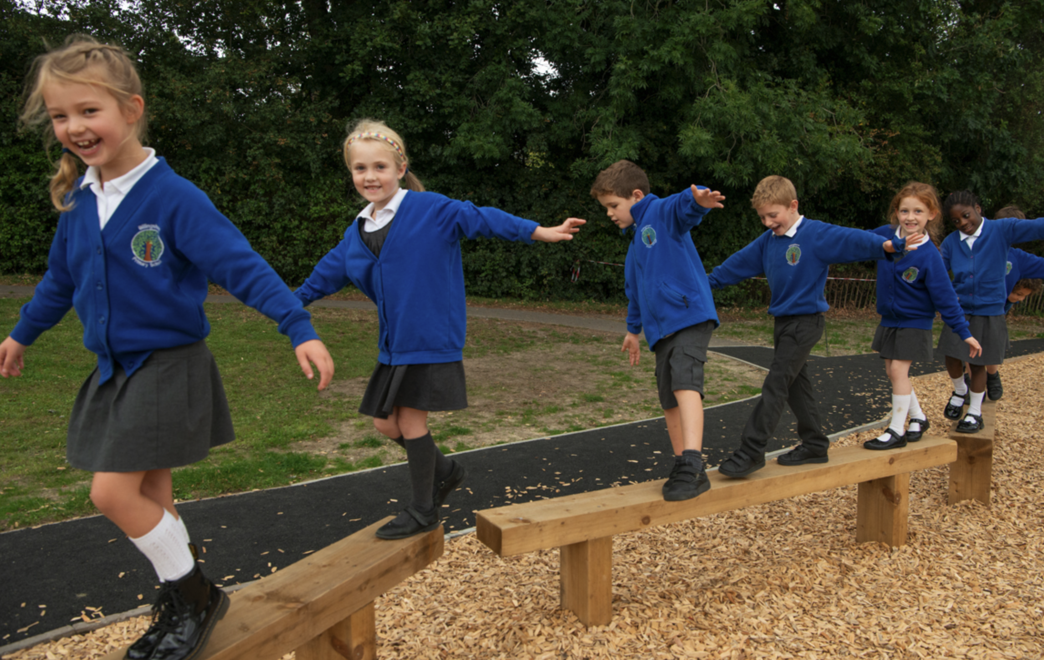
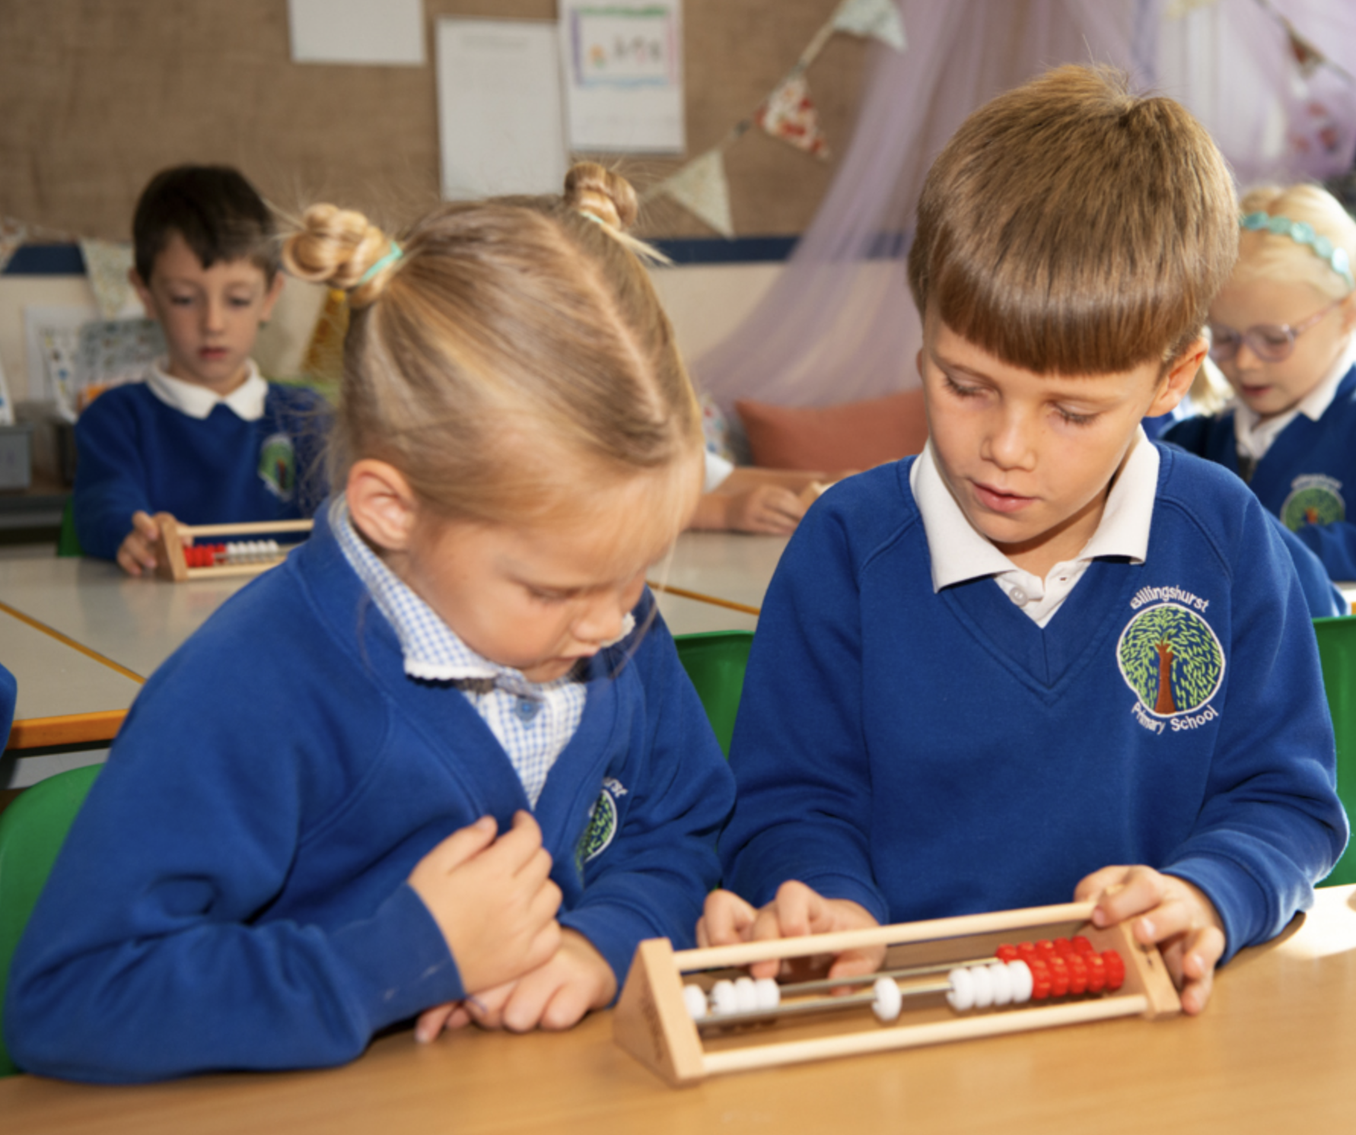
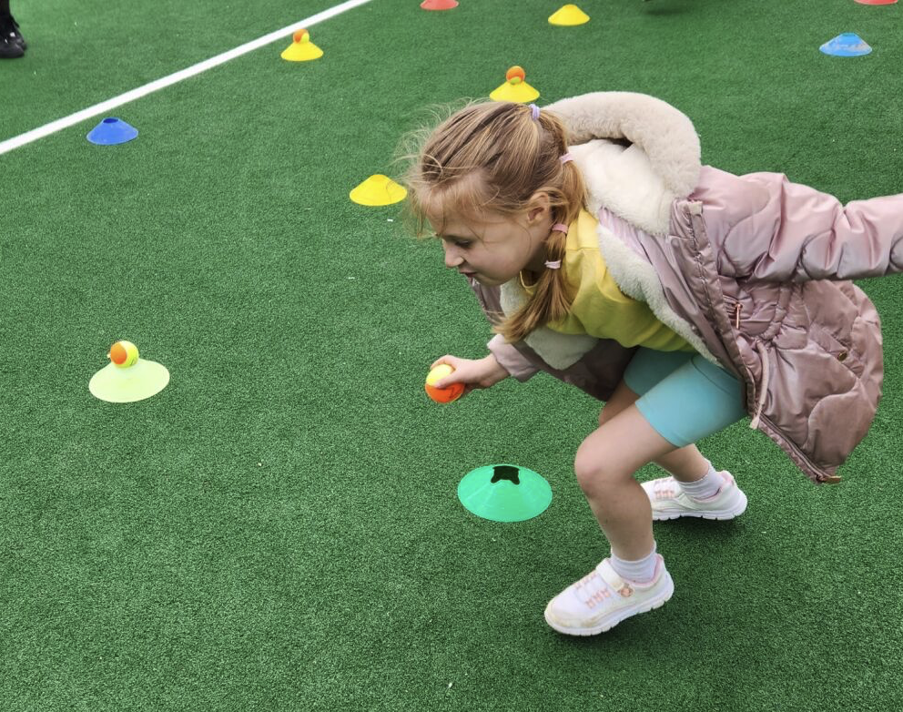
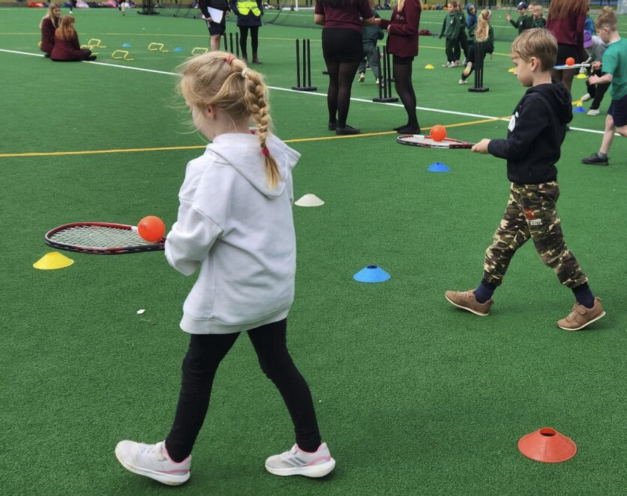
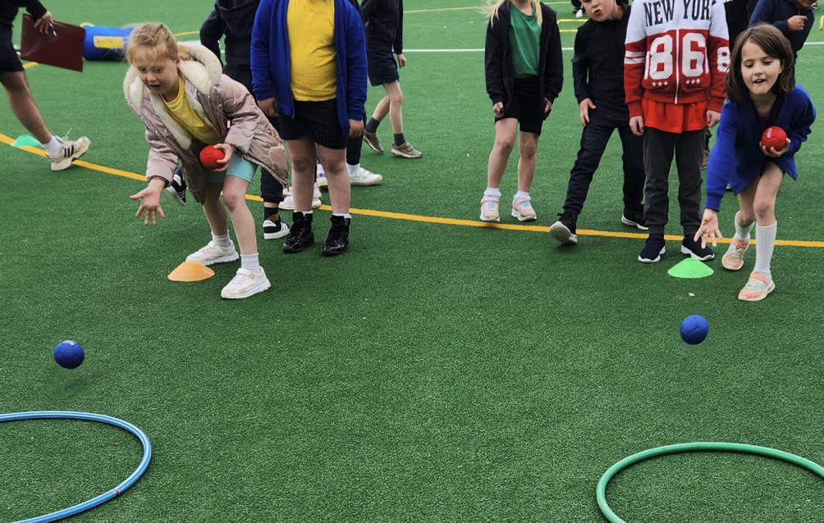
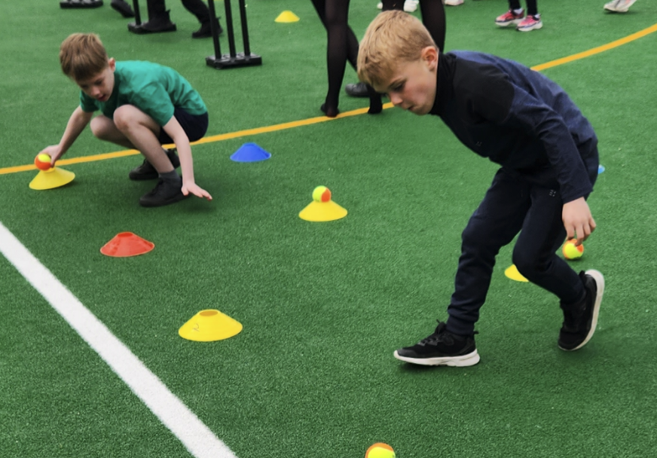
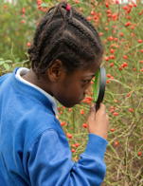
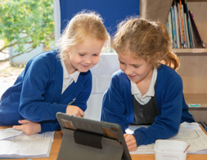
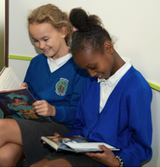
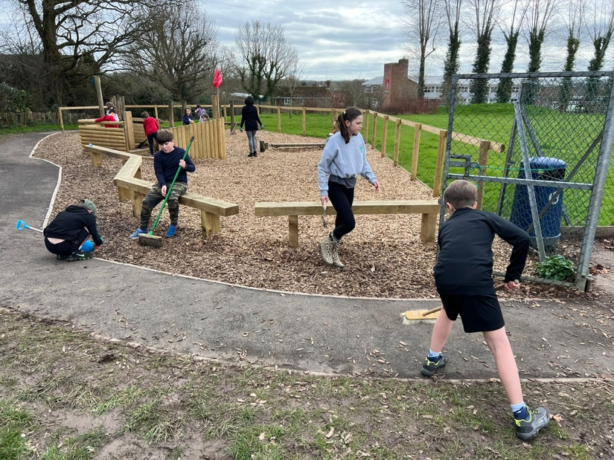
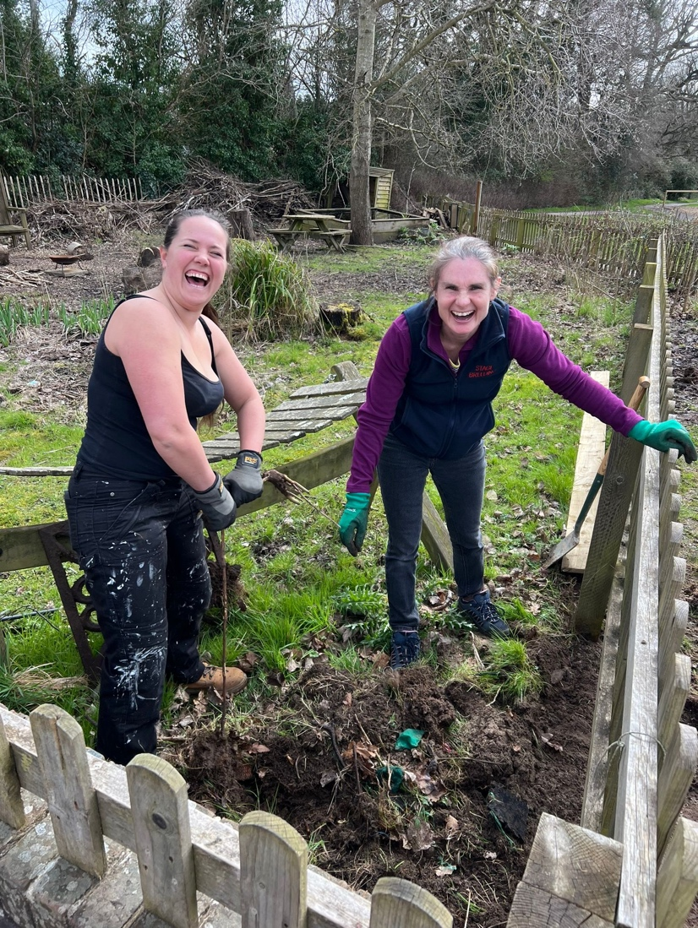
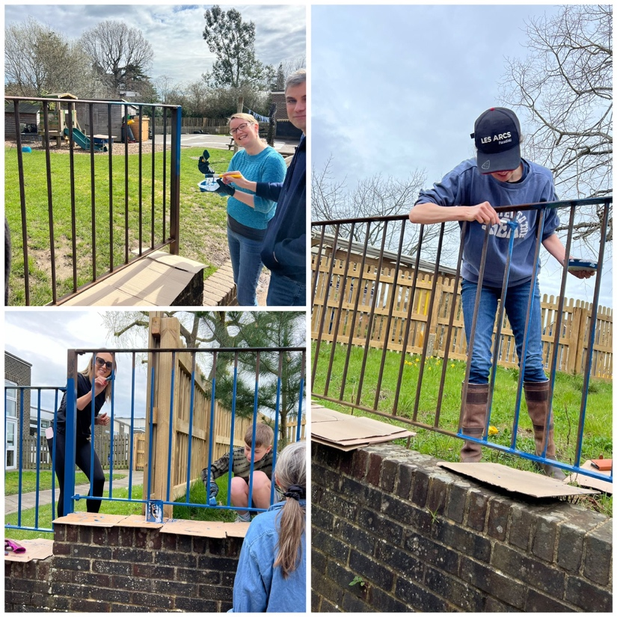
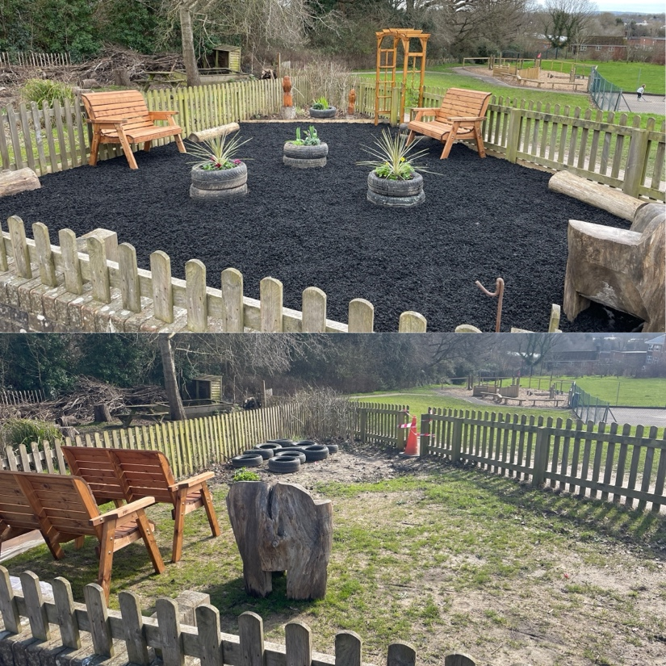
Newsletter 26th April
Learning, growing and achieving excellence together
Dear Parents and Carers,
Lots of exciting learning has been happening this week and I have been overwhelmed with the children's enthusiasm to share their work. We were congratulated this week by West Sussex for how we keep children safe and how we teach and shape our curriculum to ensure children are able to make decisions about safety. Children spoke confidently to West Sussex about this and were able to explain why safety and decisions about keeping safe were so important.
Keep sending those logo designs in, we have received lots of fantastic and thoughtful entries so far!
Have a wonderful weekend and remember we are here to support and listen.
Ms Ley
On Wednesday, 18 Year 1 and Year 2 children attended a Multisports event at the Weald. The children took part in 8 different activities, such as boules, javelin, hurdles and tennis. They showed excellent teamwork and turn-taking working in each activity. The children had a brilliant afternoon and thoroughly enjoyed themselves. They were impeccably behaved and a real credit to the school.
Reminder: Wed 1st May, 8.45 coffee & catch-up with Ms Ley
KS2 Hall
Reminder: Y6 Leavers' hoodies ordering deadline is 2nd May.

Slide 2
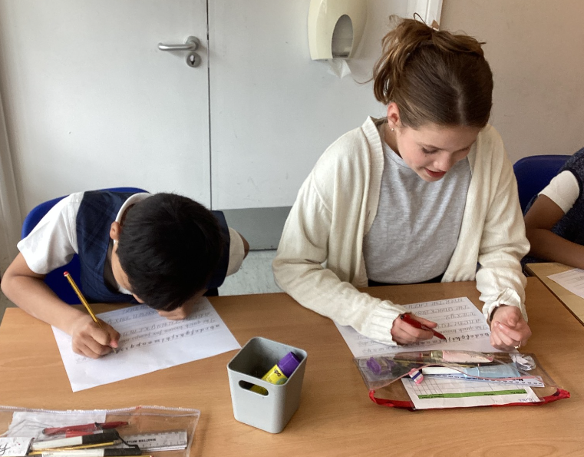
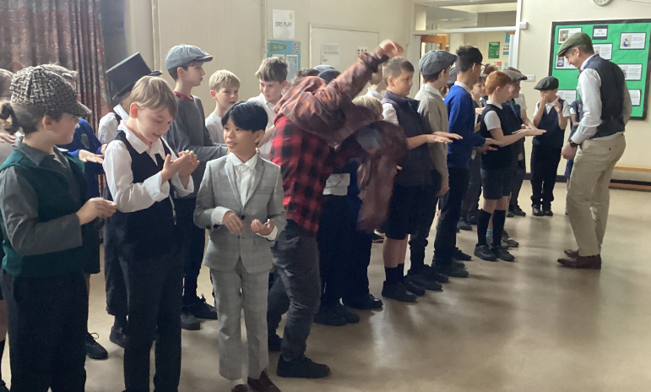
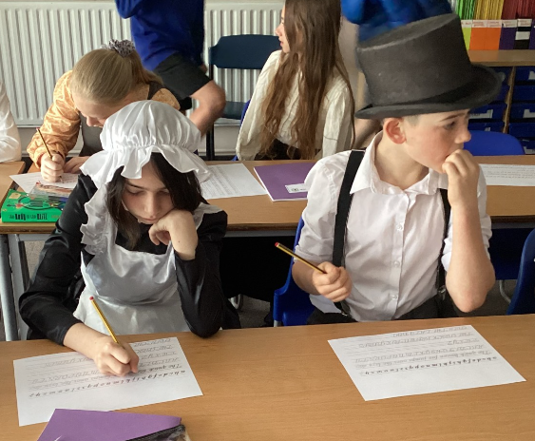
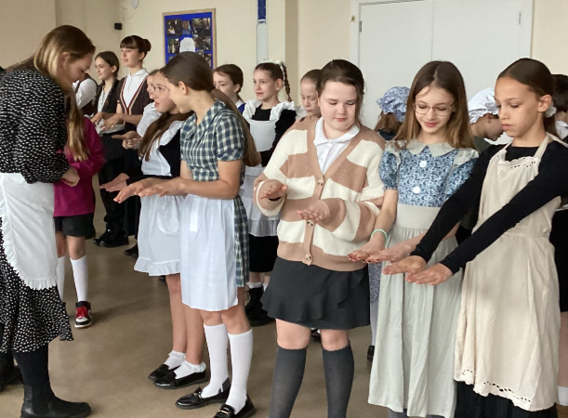
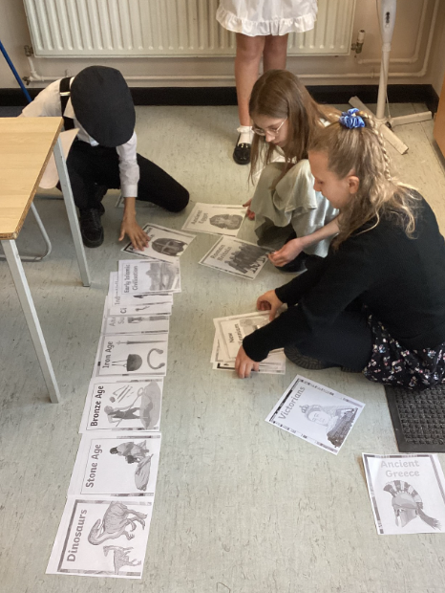


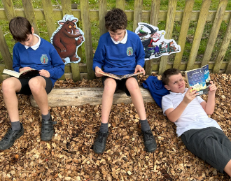
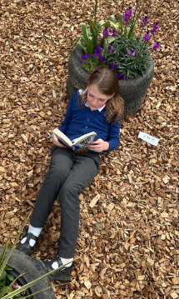
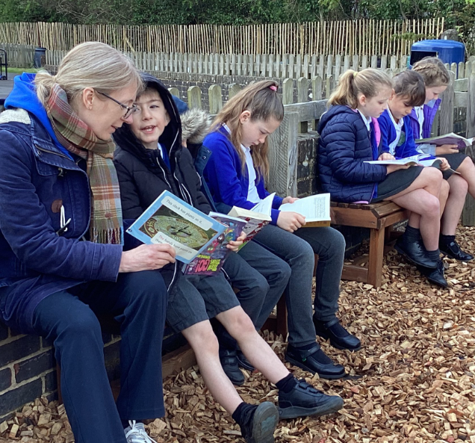
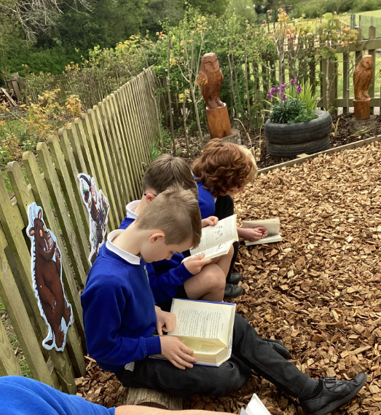
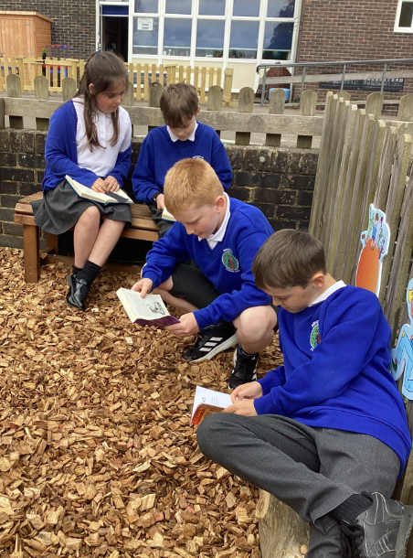
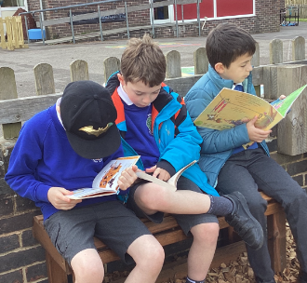
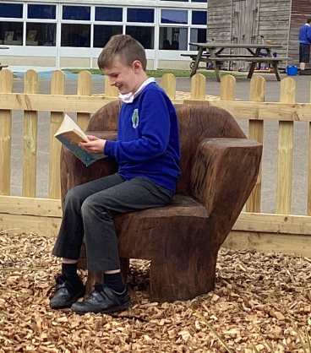
Year 6 Victorians Immersion Day:
Year 6 enjoyed a historical immersion day where they dressed up as Victorian children and experienced a day in a Victorian school. They were quite surprised by the new classroom rules! Throughout the day, the children learnt about the Victorian era, using their knowledge of chronology to create a class timeline, and discovered some key historical figures from this period.
"We had lots of fun being Victorians for the day. We had to follow some strange new rules like only writing with your right hand, standing up when an adult walked in the room and not being allowed to play with the boys!" Bella (China class)
"The Victorian day was really fun as we had taster of what it would be like to be a Victorian child. When we went into the hall, we had our shoes, fingernails and teeth checked!" Henry (Japan class)
"It was a great day but I didn't like it when we had to stand up when adults came in the room. It was really annoying!" Freya (Japan class)
"I dressed up as a rich child during the Victorian times – I had to wear a big collar as part of my costume. I don't think I would have liked being a Victorian child as the rules seemed quite harsh." Leila (Russia class)
Sophy Henn: Author Visit – Years 2, 3 and 4
We are very excited to welcome back award-winning author and illustrator Sophy Henn (author of Pizazz) for another visit on Friday 10th May! This is going to be a fun interactive event for Years 2, 3 and 4 and Sophy will be talking about Happy Hills, her brand-new hilarious graphic novel, and doing a draw-along with the children.
Sophy will be signing books in the KS2 Hall after school. If you would like to take advantage of this unique opportunity for your child to get a book signed, then please pre-order books from the Book Nook using the code Henn for a DISCOUNT!
https://booknookuk.com/sophy-henn-school-events/
Alternatively, you will be able to purchase books from the KS2 Hall at pick up on
Friday 10th May.
Lots of children have been enjoying some quiet time in the reading garden this week!

Slide 3






BPSCA - Sample name label stickers from Stikins have gone home this week. Use our school code 1910 when you order and BPS gets 30% commission! Our next uniform sale will be Friday 3 May at 3pm under the KS1 canopy. If you’re looking for specific items, get in touch and we’ll have a rummage for you. Have you got any teddies who need a new home? Donate them in the green buckets in the main entrance for our Summer Fun Day!
Note from the Governors - This week we launched our stakeholder surveys for staff, parents/carers and pupils. Thank you to the significant number of you who have already completed a survey – we have had over 100 responses in just a couple of days. We review every question and read all your comments in full – we are genuinely listening and want to receive your feedback. The survey will remain open for another week, please do take this opportunity to share your thoughts so that we can work with you to improve the provision for your children. There is a link to the survey here: Survey for Parents and Carers.
House Point Results
Winning House - Goodwood
Cowdray
667
Parham
511
Goodwood
747
Petworth
688
Upcoming dates:
Wednesday 1st May – Coffee & Catchup with Ms Ley, 8.45am in KS2 Hall
Wednesday 1st – 27th May: window for KS1 Standard Assessment Tests
Thursday 2nd May – Year 3 & 4 Weald tennis event 2.00-4.00pm
Thursday 9th – Year 3 & 4 Weald golf event 2.00-4.00pm
Friday 10th – Year 2, 3, 4 author event (2.00-3.00pm) with book signing after school
13th – 16th May – KS2 Standard Assessment Tests (SATs)
Monday 13th May - Year 5 Weald athletics event 3.30-5.15pm
Letters home this week: Club letters, Year 6 Weald letters, Year 3 Wakehurst trip
@BPSEYFS
@BPSYearOne
@BPSYearTwo
@BPSYearThree
@BPSYearFour
@BPSYearFive
@BPSYearSix
Year groups regularly post photos of children and learning on their X account. Please follow your child’s Year Group using the handles above.
Follow us on Facebook for all the latest updates:
www.facebook.com/BillingshurstPrimary

