Slide 1
Welcome to Year 5

Slide 2
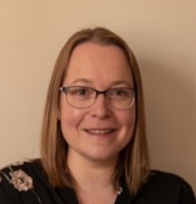
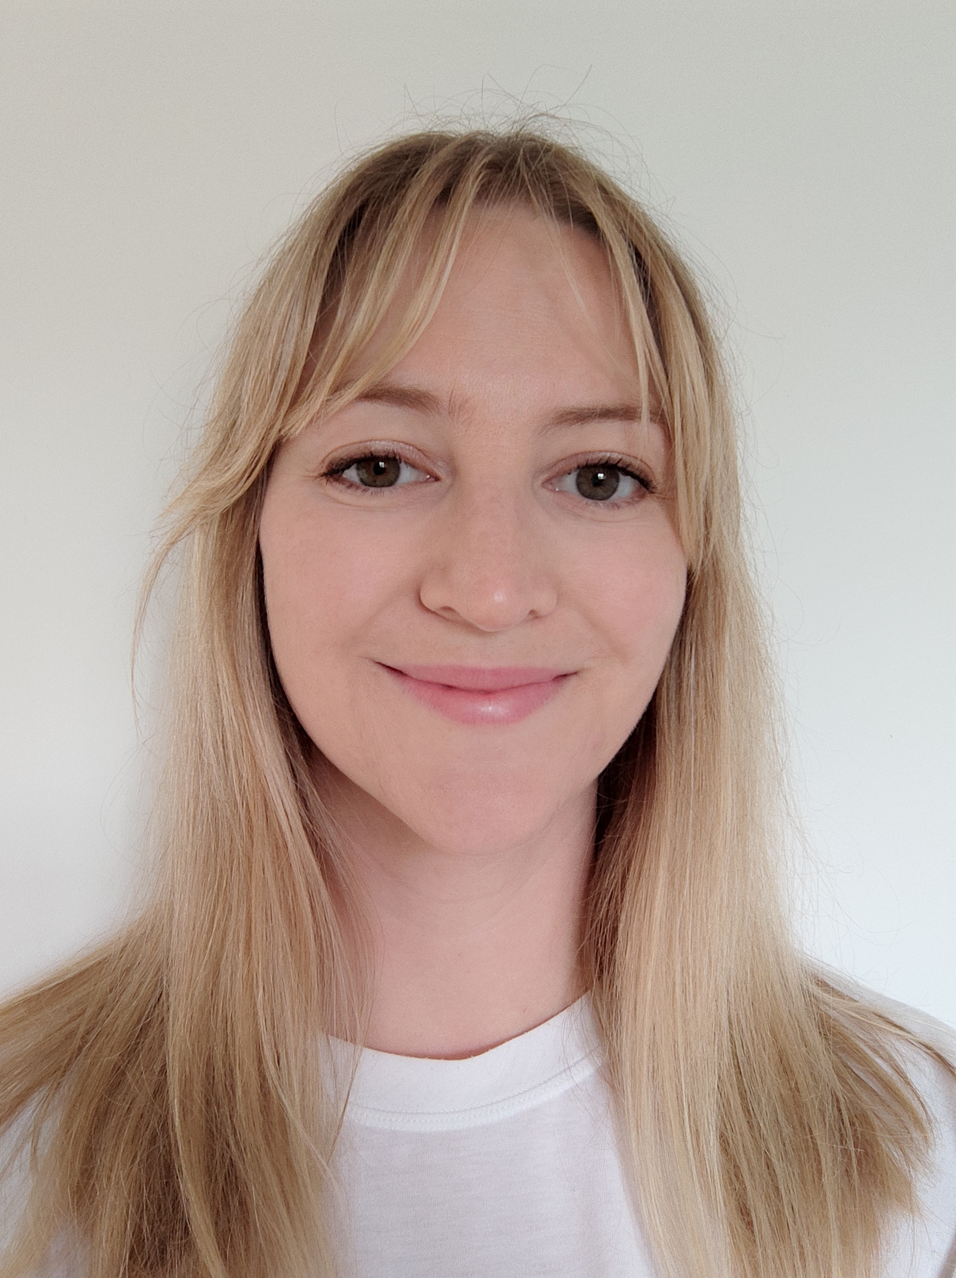
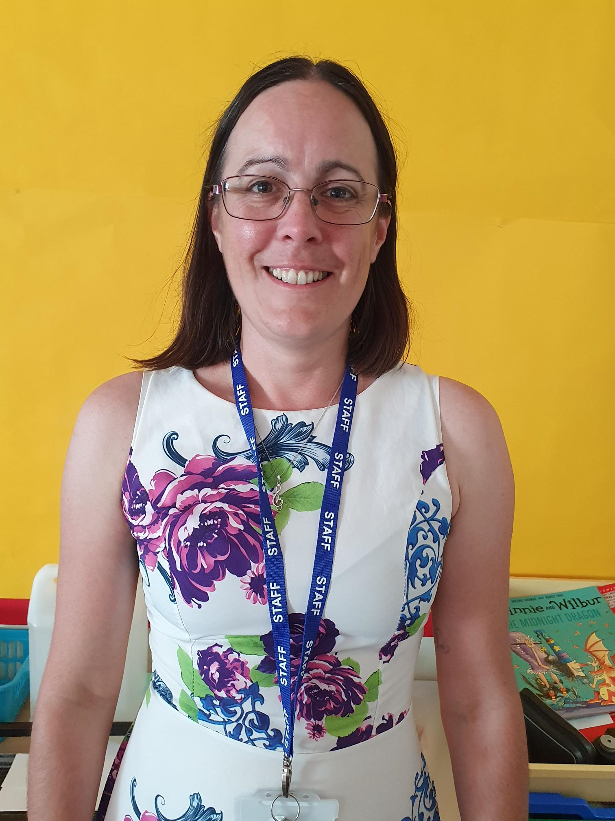
Year Team
Phase leader – Mrs Hatrick
Year leader – Miss Brown
Class teachers – Miss Brown (Cambodia), Miss Mack (Maldives), Mrs Cole (Nepal)
Support staff – Mrs Hiley, Mrs Hulcoup, Mrs Cunningham

Slide 3
Communication
Class teacher is your first point of contact
Please come and chat to us first thing in the morning or at pick up time
Alternatively, contact through year group email
Year group email – year5@billingshurstprimary.org.uk
Emails checked up until 8.15am & 3.20-4.30pm
Your email will be acknowledged as soon as it is read
You may then be called at the end of the day or a meeting will be organised
Emails will be responded to within 24hrs
Call the school office for absence or changes to pick-up arrangements

Slide 4
Our topics this term
English
History
D&T
What lies beyond?
Geography
Maths
Music
Art
Computing
Throughout the year we will also cover ….

Slide 5
Extra Year 5 events
Poetry workshop.
Planetarium visit.
Lodge Hill residential.

Slide 6
Reading
Notes:
This is just a snap shot of some of the text we will be looking at this term. We will explore these in our book talk lessons, where chn develop their reading skills through comprehension questions and drama. Each term our writing reflects the text we have chosen in our topics.

Slide 7
How to support at home
Reading:
Your children will be sent home with:
A reading record book.
A library book of their choice.

Slide 8
Reading records
When you read with your children, please do write a comment in their reading records.
The adults they read with at school will also write in these.
Please try to ensure that your child reads or is read to every night (KS2 20mins).
Whilst you are reading, please support your child to learn key words and ask questions about the books that they are reading.
Examples might include: a prediction of what may happen next; a summary of what they have read.
Notes:
Show parents the reading record book and talk them through the different elements

Slide 9
English
Areas of learning this term are on narrative writing, diary writing and explanation texts.
Spellings – spellings to be given out and tested weekly. Spellings will be individualised for each child and focus on common exception words the children have misspelt in their writing.
Expectations of presentation.
Writing for a purpose – making links.
Whole class reading – high quality texts chosen by the class teacher.

Slide 10
Maths
Areas of learning this term: Place value, Decimals, Negative numbers and Money.
Real life problem solving: Super Powers, NCTEM, I see reasoning.
Written and mental strategies: Arithmetic testing every fortnight.
Mastering number.
Presentation of work.
To continue to review times tables up to x12: Froggy Maths.

Slide 11
Optional homework
Sent out termly
We encourage creativity and look forward to seeing all your children’s brilliant learning in our sharing time. ​
​

Slide 12
Autumn Homework

Slide 13
Homework
Weekly Spellings
Times table practise
Daily reading
Notes:
Expand on each bullet point as needed

Slide 14
Twitter / X
Regular photos and comments showing Year Group learning will be posted on Year group Twitter to follow:
@BPSYearFive

Slide 15
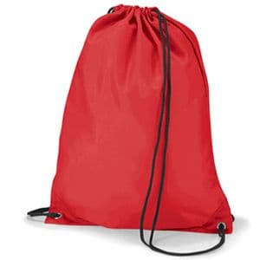
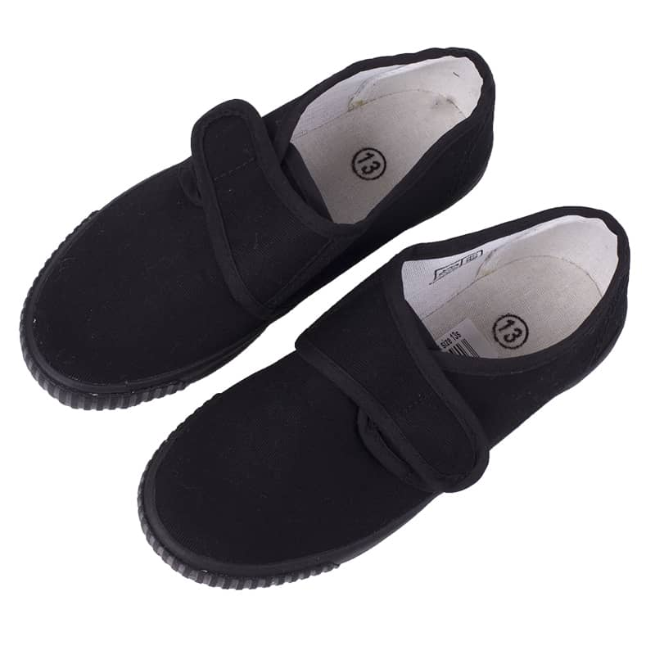
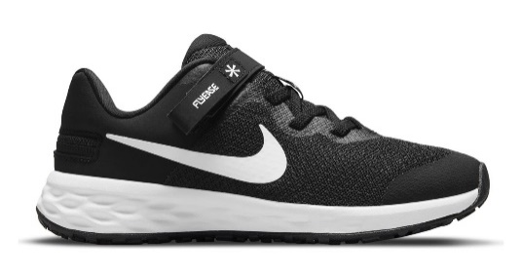
Physical Education
PE days are Monday and Wednesday this half term.
Children will need their PE kit including named shorts, T-Shirt, trainers and a jumper. In the winter, we encourage jogging bottoms instead of shorts.

Slide 16
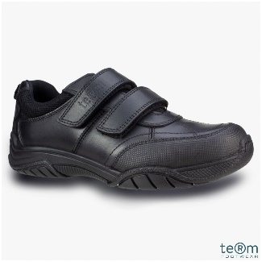
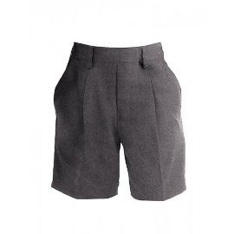
Uniform
Children will need to wear correct uniform everyday, including plain black school shoes.
Grey skirts, shorts or trousers should be worn, together with a white polo shirt and blue jumper or cardigan.
Our BPSCA often have second hand uniform sales – keep an eye out for dates.
In summer, blue and white summer dresses may be worn.
Please do name ALL items of clothing – with over 600 children it is challenging to reunite people with unnamed uniform.
Lost property will be put in the school entrance every Friday

Slide 17
Healthy Minds
Water bottles
Morning snack – fruit or vegetables
Healthy lunchboxes (no nuts!!!)
Notes:
Expand and explain as needed

Slide 18
Behaviour and expectations
Be respectful of others.
Be kind.
Try your best.

Slide 19
Attendance
Please make sure the school office has an up to date email address and phone number for you.
If your child is going to be absent from school, please contact the school office to let us know.

Slide 20
Arrival and departure
Start of day: KS1 & KS2 gates open at 8:40am and close at 8:55am. Registration is at 8:55am.
End of day: KS1 gate opens at 3:05pm, KS2 gate opens at 3:15pm.
Finish times: EYFS: 3:10pm, KS1: 3:15pm, KS2: 3:20pm.

Slide 21
Leaving school unaccompanied
In Year 5 & 6 we are happy for pupils to begin walking independently if you think your child is ready.
If you wish for this to happen with your child, then please do remember to fill in the ‘Microsoft Form’ which has been sent to you.
We do reserve the right to change arrangements for children’s journey to and from school if their behaviour and conduct brings the school into disrepute.

Slide 22
BPSCA
The BPSCA support all of our events throughout the year, helping us to raise money for the school. Year 6 leavers, Christmas trugs, Welly walk, Summer fun day and much more!
If you are interested in helping out then please do let us know.

Slide 23
Thank You
Thank you for attending and we look forward to getting to know you all!
Any Questions?
We are always looking for reading volunteers!

