Slide 1

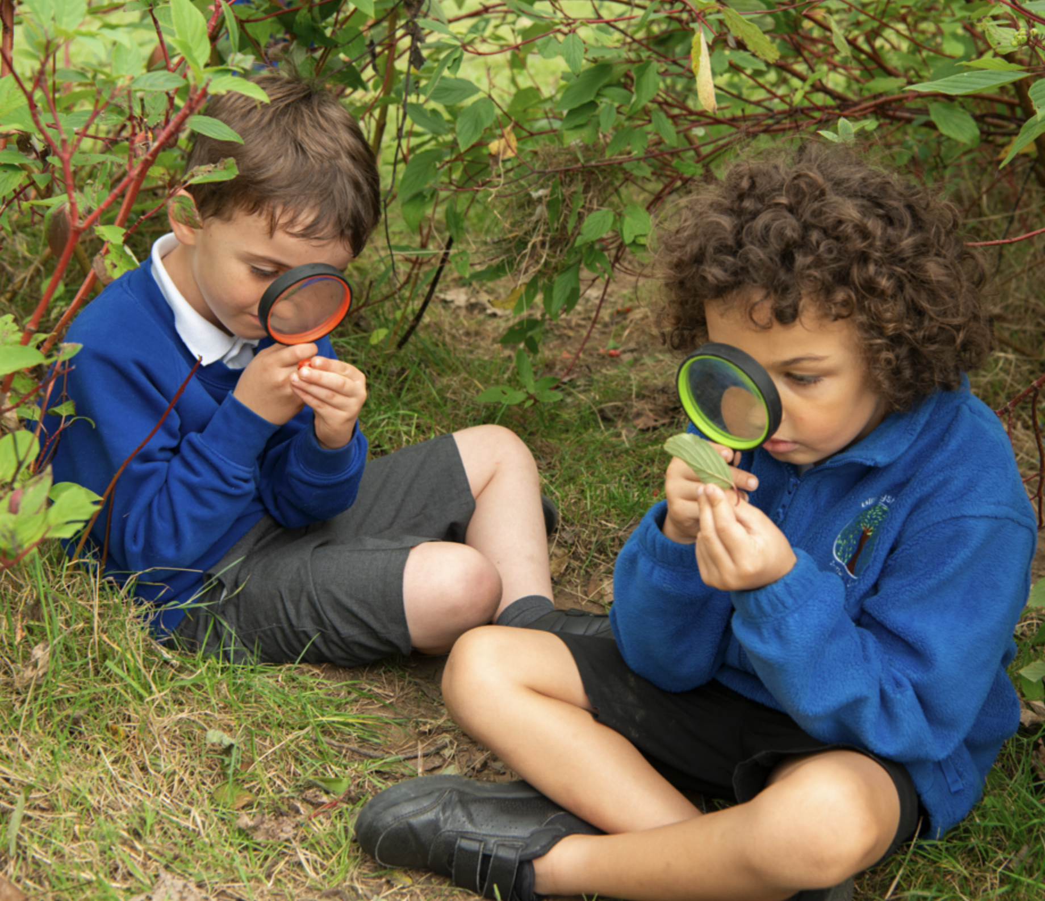
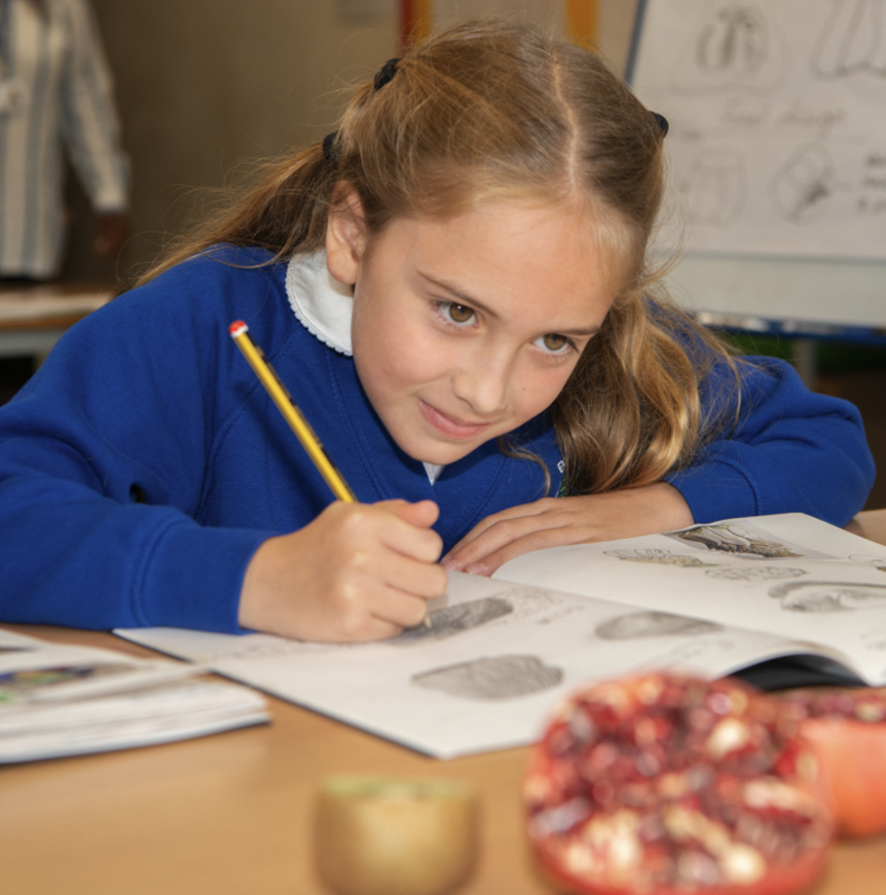
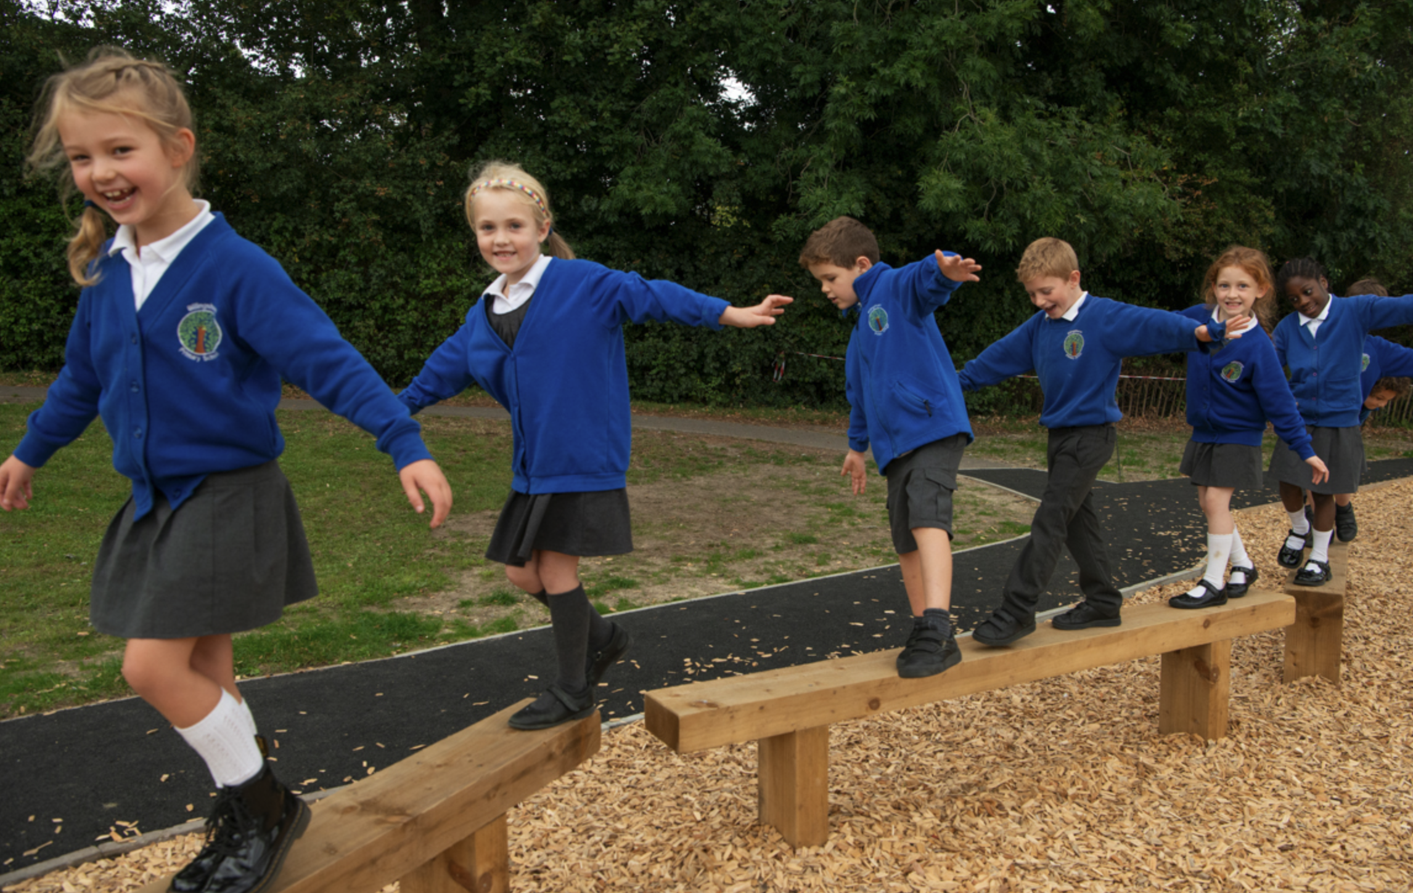
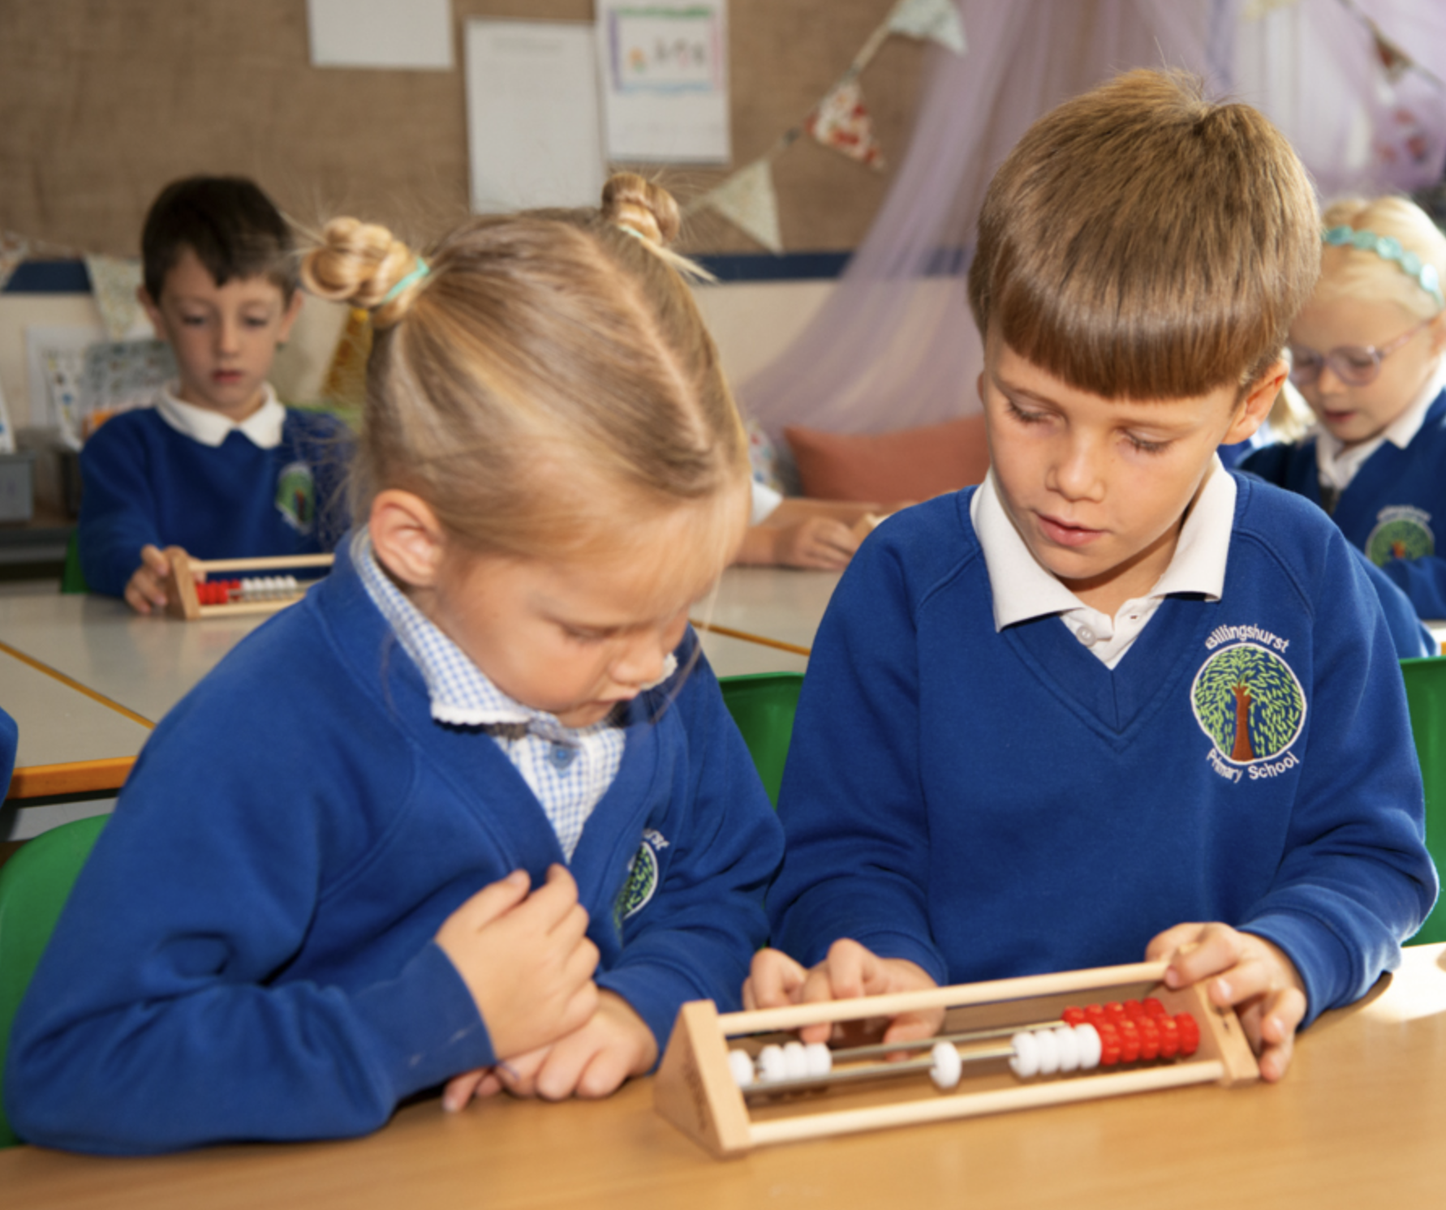

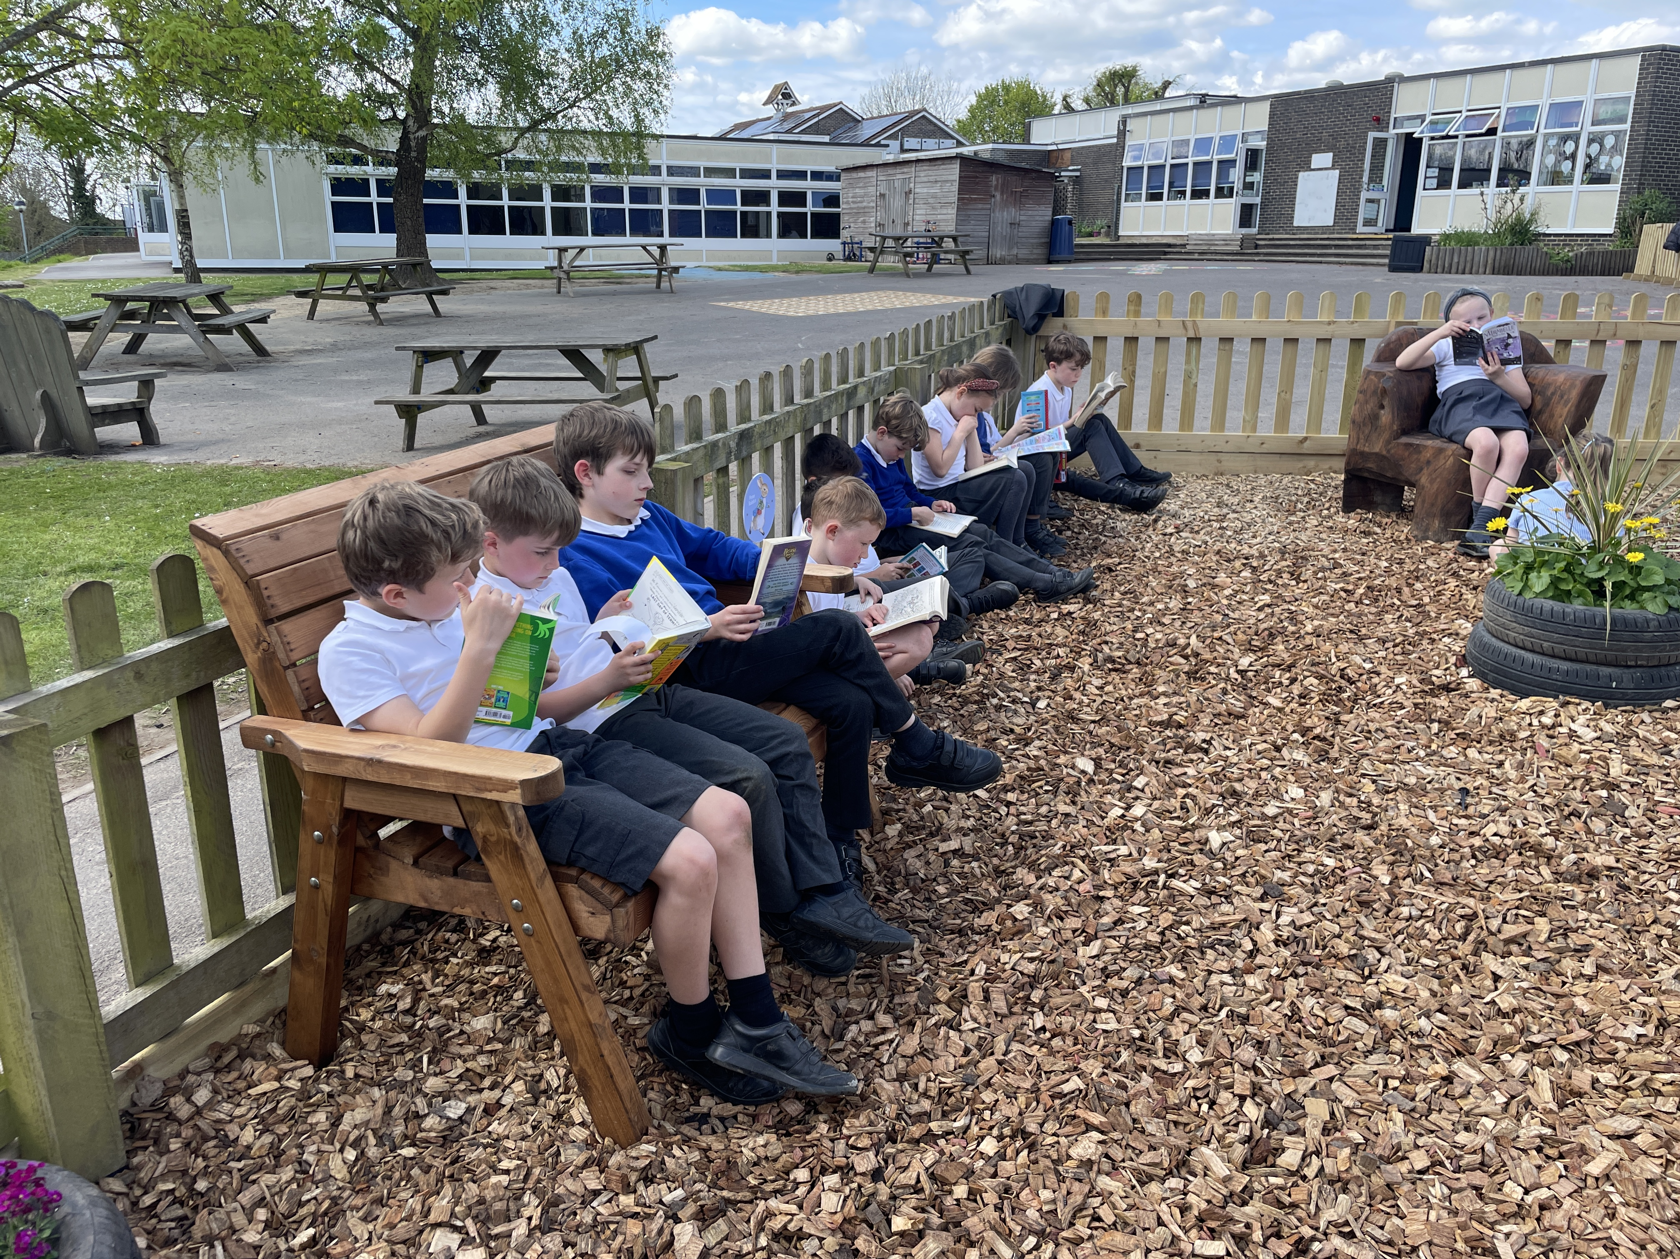
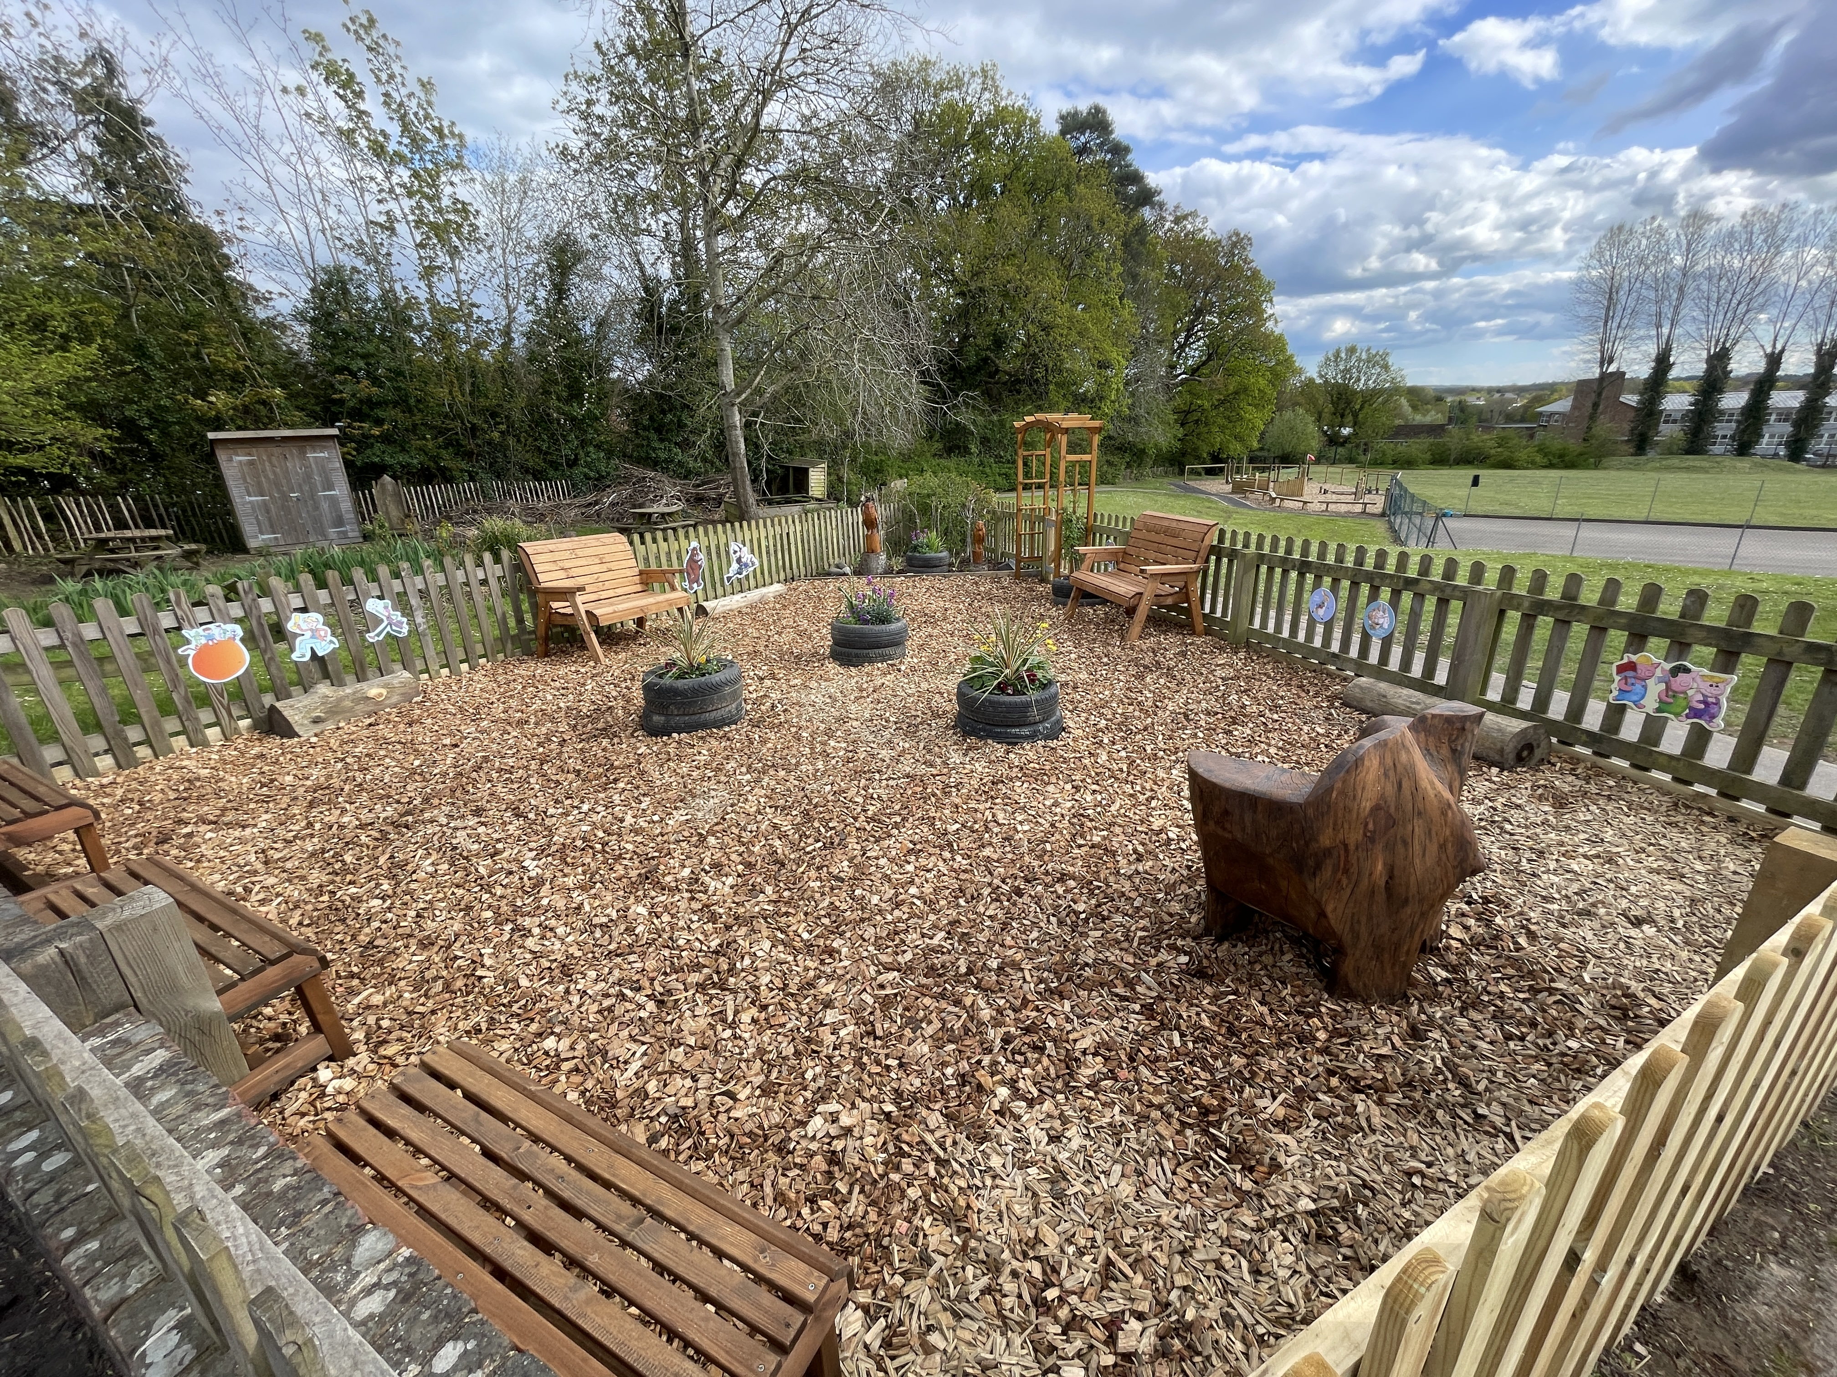

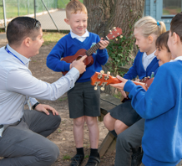
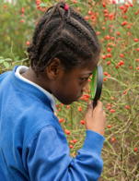
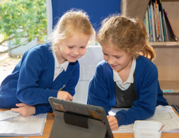
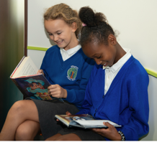
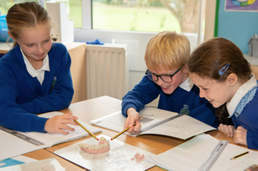
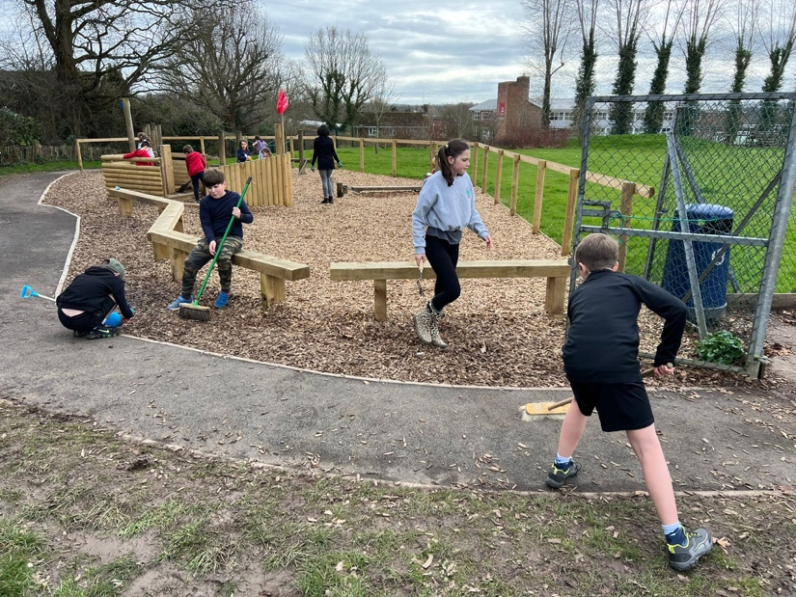
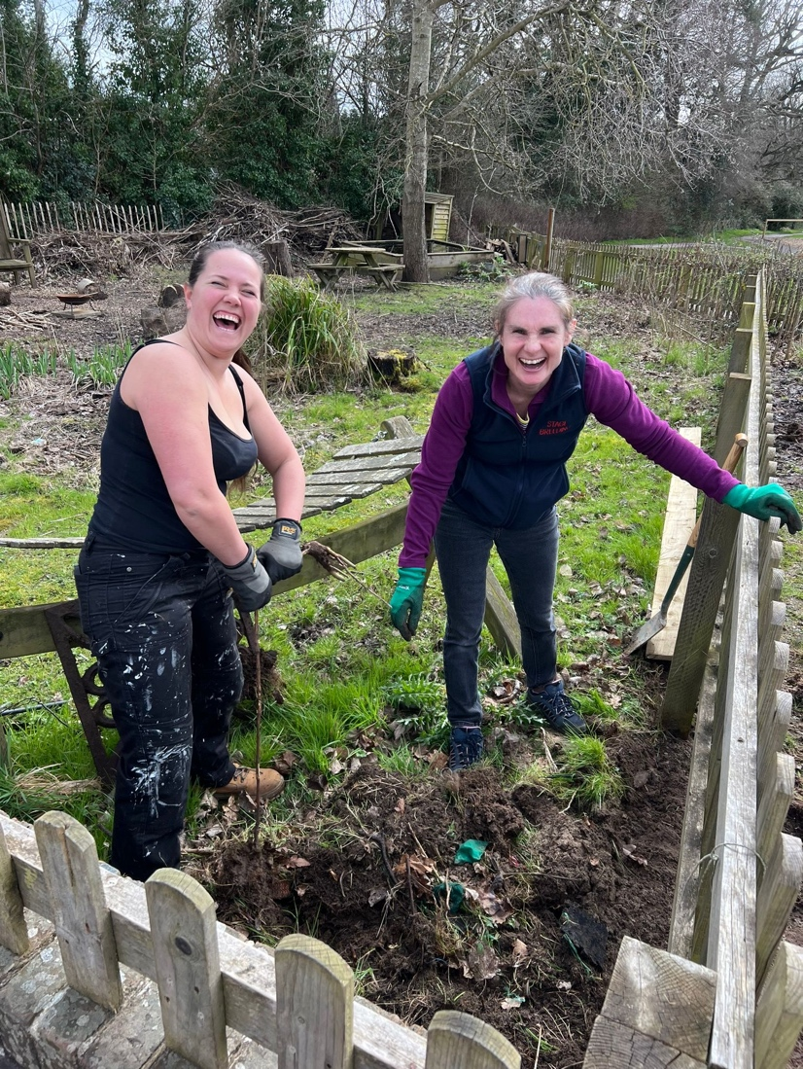
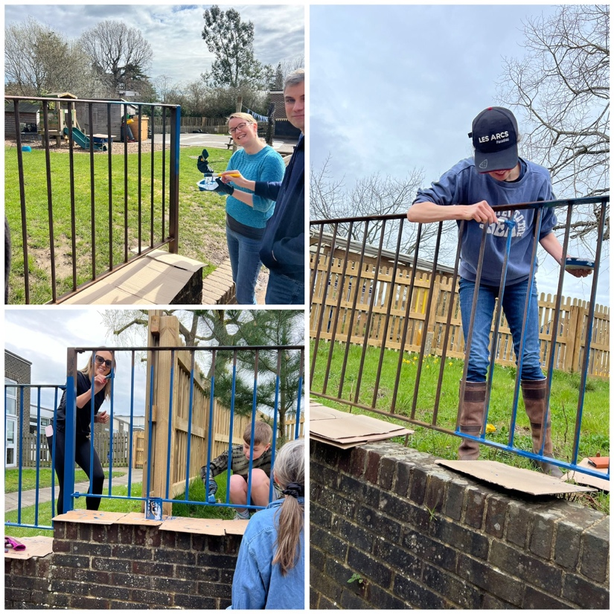
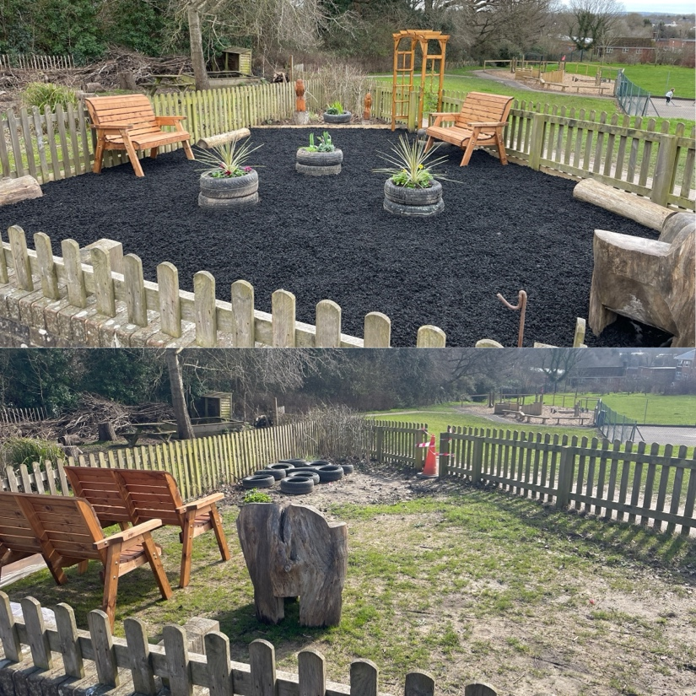
Newsletter 19th April
Learning, growing and achieving excellence together
Dear Parents and Carers,
I am delighted to welcome you to the first summer term newsletter. The sun has been shining and Billingshurst has come alive with its beautiful grounds filled with happy children.
I have had a wonderful first week, meeting staff children and parents and finding out about Billingshurst Primary. I initially applied for the job as headteacher because during my visit I was impressed by the behaviour and politeness of the children, the energy and enthusiasm of staff and the potential for change, growth and big things . This week has only confirmed my first impressions. Your children are a credit to you and their adults at school and school staff have demonstrated a desire for change and development.
Year 1 and 2 have arrived back to school this week to find the curtains that once separated their classrooms had been turned into walls. The classrooms look brilliant with the new walls and have made a positive impact on teaching and learning. A big thank you to the Sussex Learning Trust who organised and funded the walls.
I would like to introduce half termly drop-ins for parents where we open our doors and invite you in to join your child to look at the work they have enjoyed this term. We very much hope this will provide an informal opportunity for you to find out more about life and learning at Billingshurst. The first one will be on Wednesday 22nd May, doors will open at 2.45pm for EYFS and KS1 and 3.00pm for KS2.
This week our reading garden opened thanks to the hard work of Tom Hampson. It is a special place which children have already started to use, sharing and enjoying books. Thank you Mr Hampson for going above and beyond for Billingshurst.
I look forward to inviting you to meet me for a coffee and catch up on Wednesday 1st May, 8.45am in KS2 Hall. There will be an evening slot after half term for those of you who can’t make the morning.
Have a wonderful weekend.
Ms Ley
The Reading Garden
We are delighted that this week we have opened our new outdoor reading garden. This area is a superb addition to our outdoor space for children to enjoy both in lesson time and at break/lunch time. The whole project has been funded by donations from our community and local businesses as part of our Ground Force Day project. A huge thank you to everyone who has sponsored or volunteered to make such a difference for our children!
Click the link below to see the transformation video!
https://youtu.be/AzuqcQnHn2o?feature=shared&t=1

Slide 2
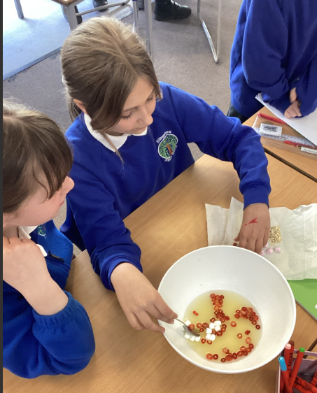
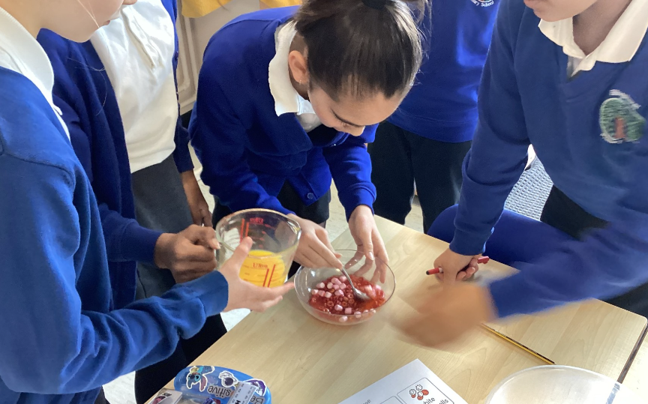
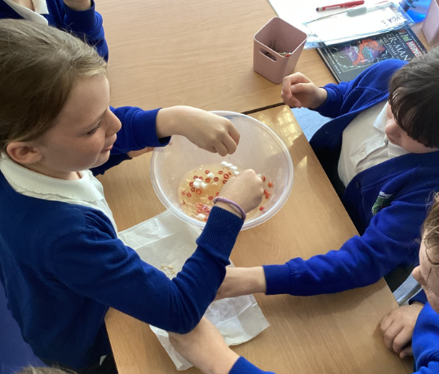
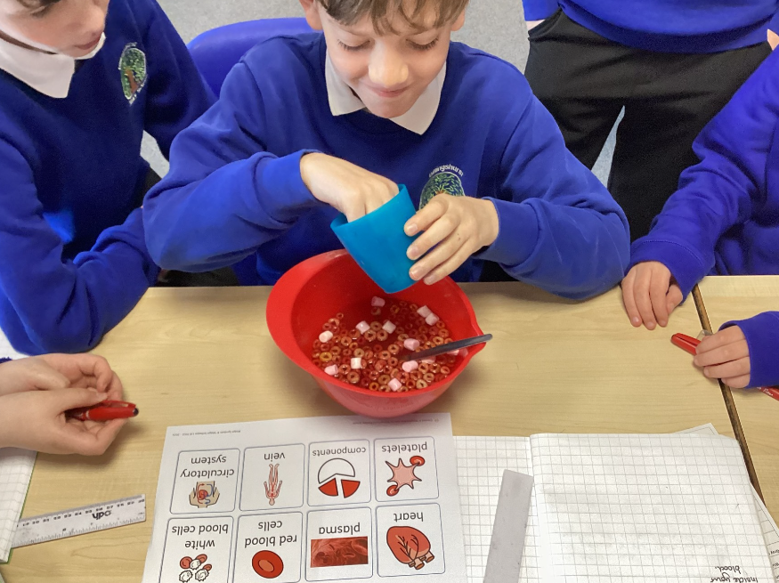
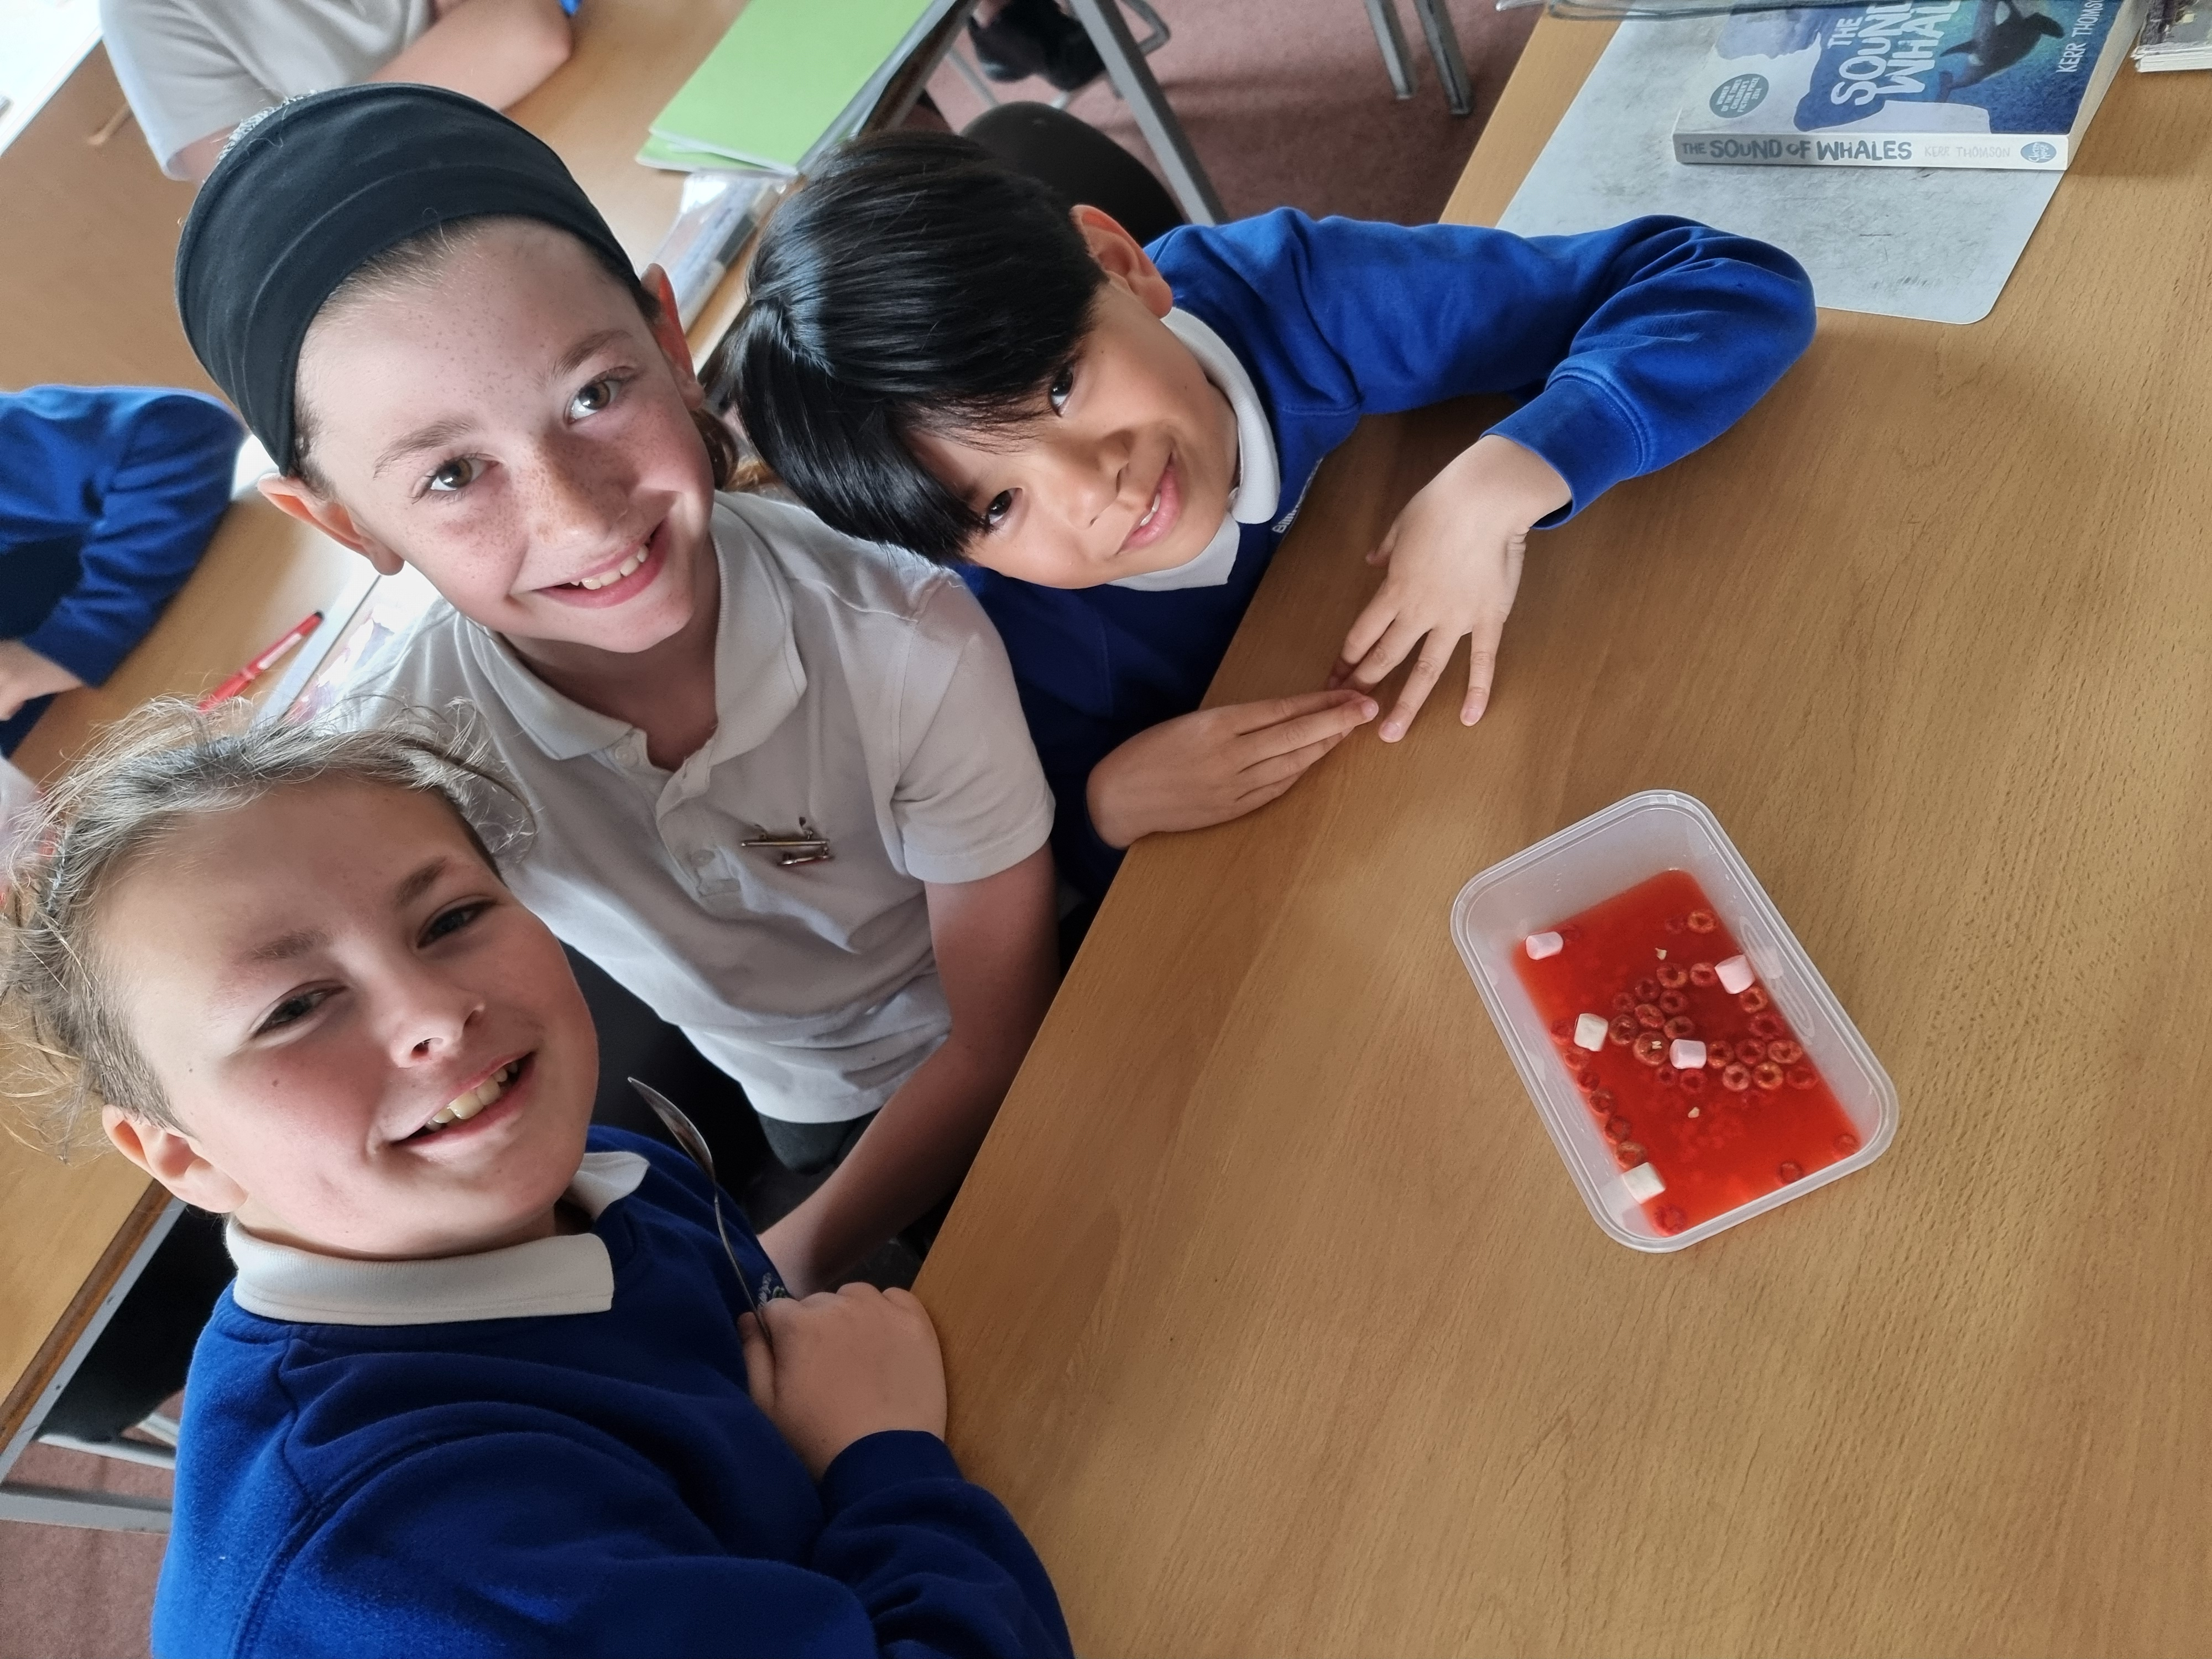
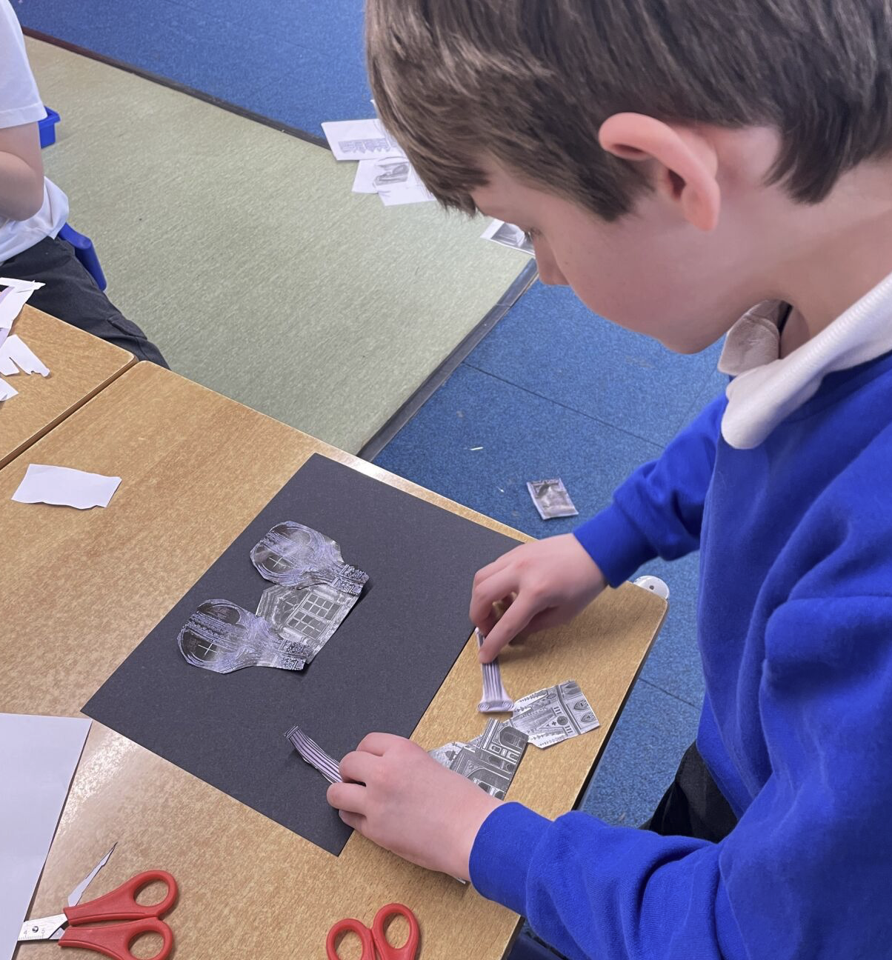
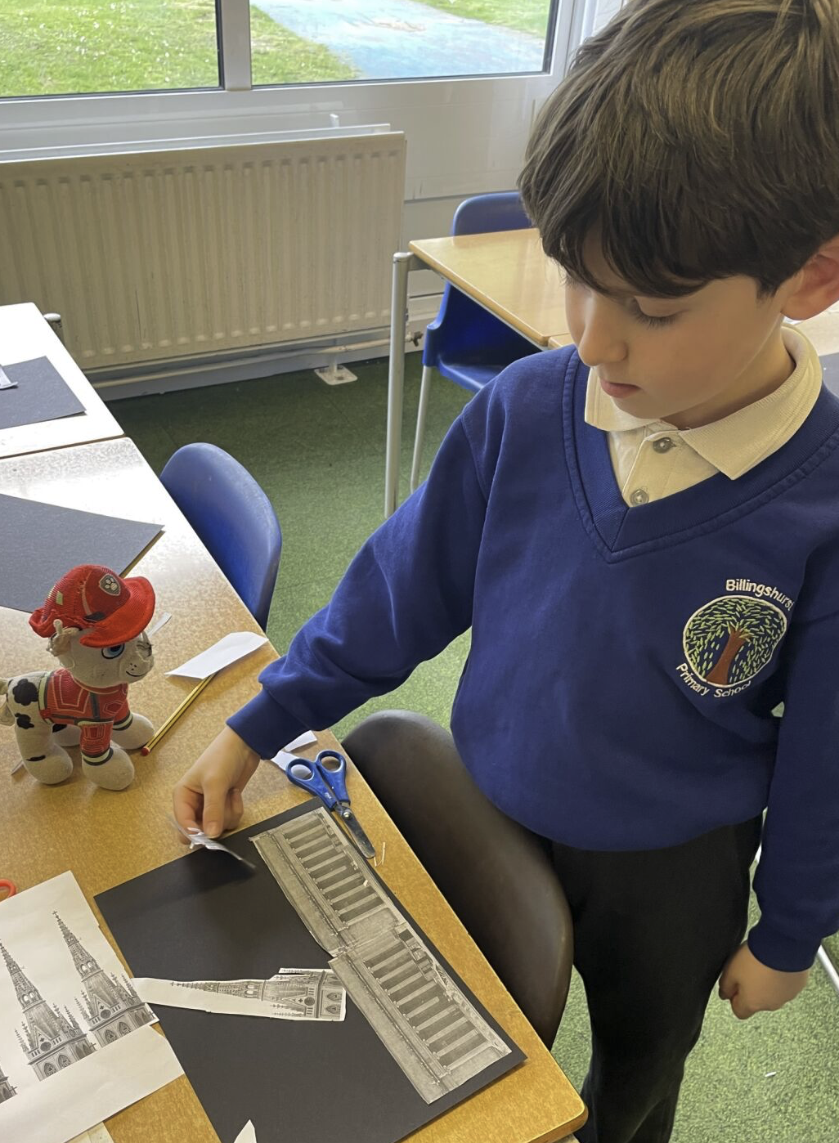
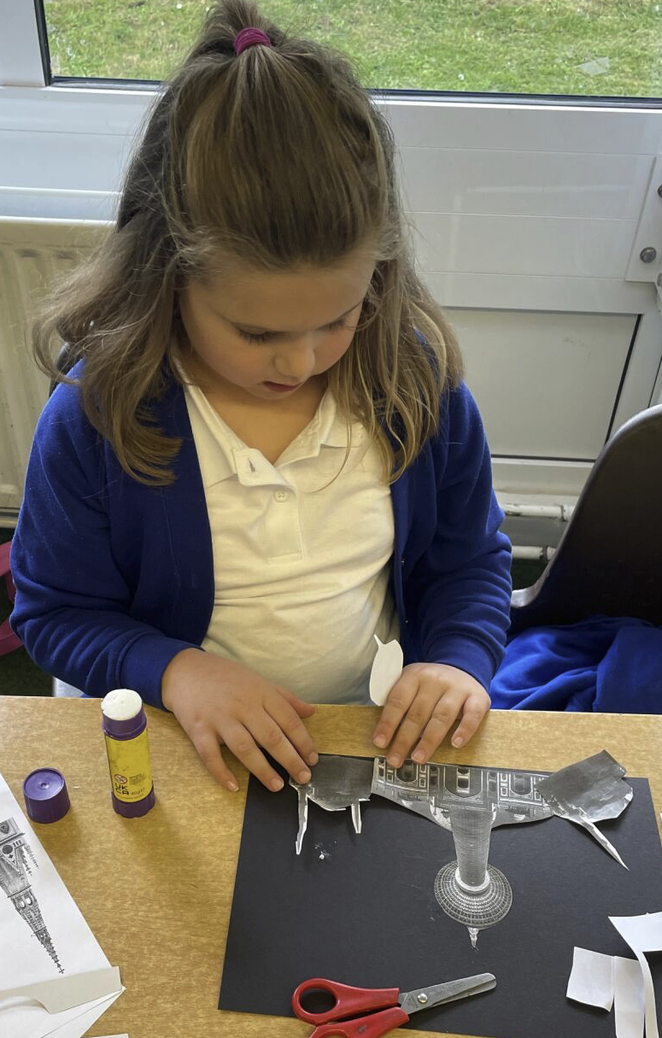
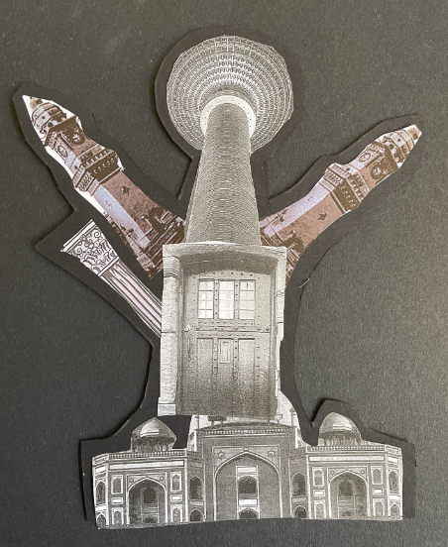
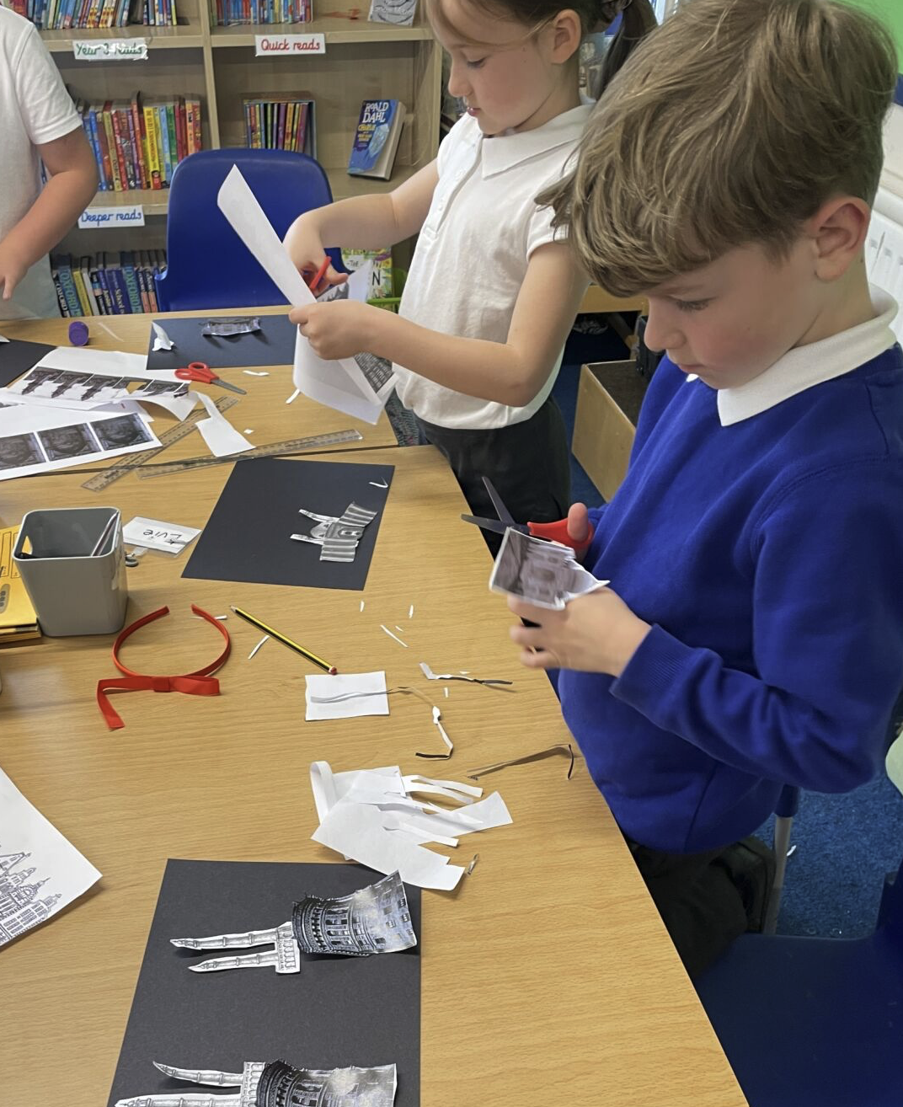
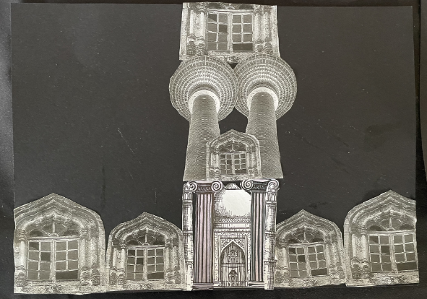
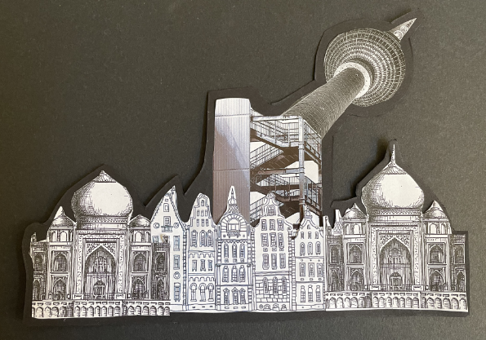
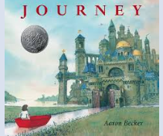
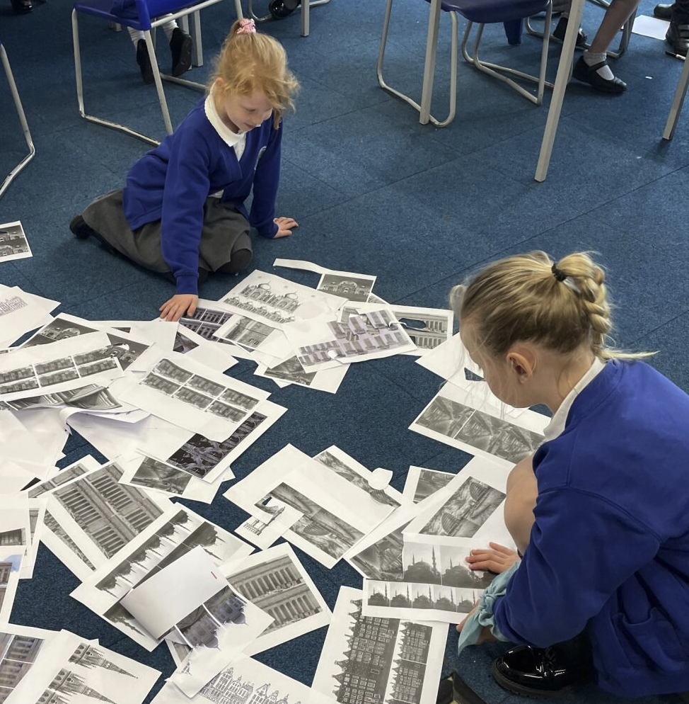
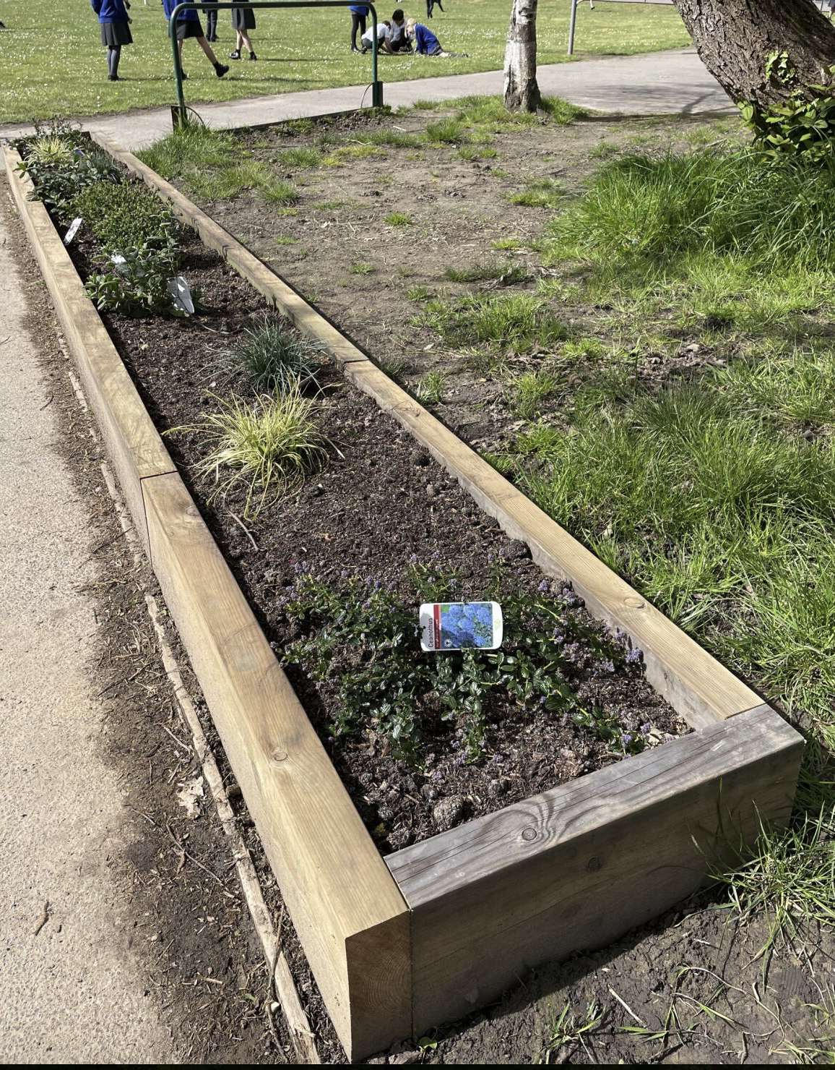
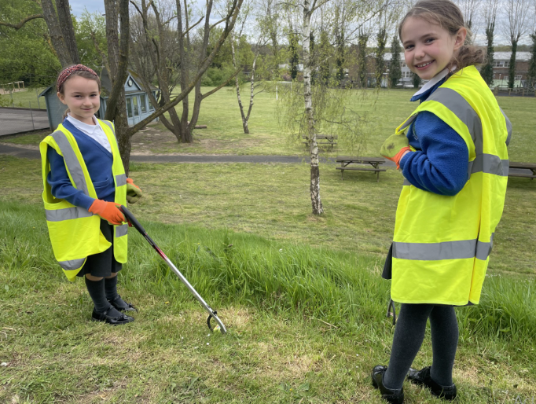
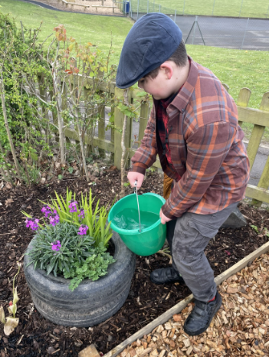
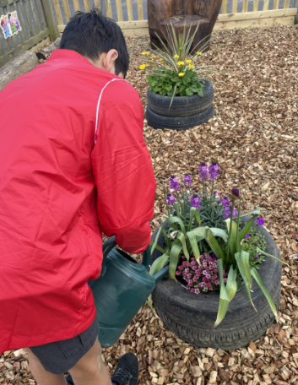
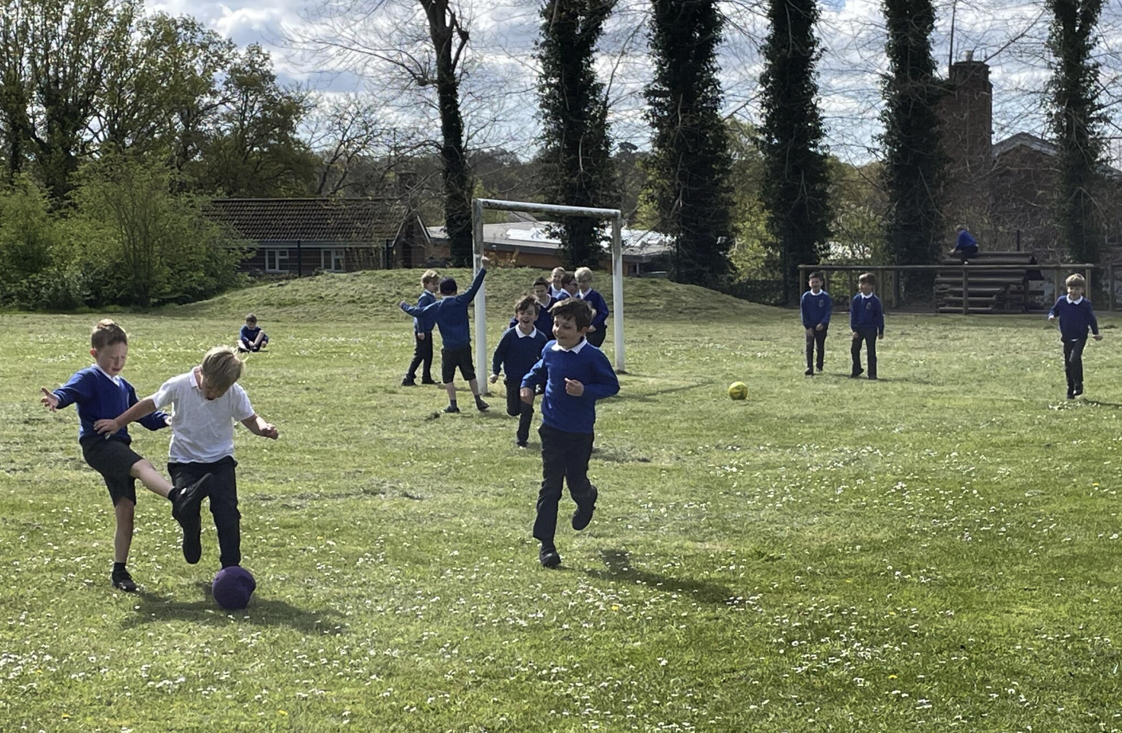
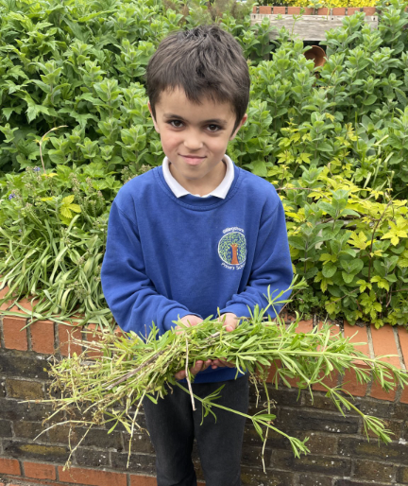
Year 6 Making Blood:
In Science, we have been finding about what blood is made of and what those different components do. To help us better understand this amazing substance, we modelled the blood's composition using different household ingredients. We will be using our learning to write information texts all about the function of blood and the circulatory system.
"It was really fun to make the 'blood smoothie' and it is a great way of understanding and remembering what the blood is made of." Amelie (Japan Class).
Year 3 Collage Art:
In Year 3 we have been creating collage work of imaginary buildings. This is inspired by the architecture from the book 'The Journey' which we are reading in class. We loved letting our imaginations go wild!
Spring has arrived at last!
We are extremely excited to be out on the school field again as the school grounds burst into life.
Our wonderful new planters are looking amazing, and the children are enjoying looking after them.
Bird feeders are full – and flower beds are being weeded.
Our litter pickers have been busy keeping the grounds looking their best. Thank you to our fabulous children who volunteer their time to take care of our outdoor environment.

Slide 3























BPSCA - The BPSCA is funding several year-group trips out and treats in school this
summer term. We’re grateful to Fowlers Estate Agents for their sponsorship, as well as
other local businesses. Could your business or employer support our school?
Let us know of sponsorships, grants, or community funds we could access!
Email bpsca@billingshurstprimary.org.uk or message us on Facebook
Note from the Chair of Governors
We are delighted to welcome Ms Ley as our new headteacher and hope many of you have had the opportunity to meet her over the course of the week. During the Easter holidays, the partition curtains in the year 1 and year 2 classrooms have been replaced with walls and doors. This has vastly improved the working environment for staff and pupils and has been financed by Sussex Learning Trust. We have now received a positive response from the Department for Education regarding funding for the necessary building works. As a result, the school’s transfer to Sussex Learning Trust will take place on 1st June.
House Point Results
Winning House - Cowdray
Thank you to our sponsors for their support!
Cowdray
796
Parham
884
Goodwood
993
Petworth
928
Gil Parham Woodside Sculpture
www.woodlouseindustries.com
Upcoming dates:
Wednesday 24th April – Yr 1 & 2 Multi Skills event
Thursday 2nd May –Yr 3 & 4 Tennis (Road to Eastbourne)
Thursday 9th May –Yr 3 & 4 Golf 2.00-4.00PM
w/c 13th May – KS2 SATs Week
Monday 13th Yr 5 Athletics Event
Friday 17th – Y6 Tile Barn parent meeting
Thursday 23rd – KS1 Little Big Sing
Best quality Blast-frozen Family run
Letters home this week:
Leavers' hoodies
Year 6 Tile Barn consent and medical forms (due back by 26th April)
KS1 Multi-skills
www.tomthefish.co.uk
@BPSEYFS
@BPSYearOne
@BPSYearTwo
@BPSYearThree
@BPSYearFour
@BPSYearFive
@BPSYearSix
Year groups regularly post photos of children and learning on their X account. Please follow your child’s Year Group using the handles above.
www.professionalrubbersurfaces.com
The Budding Foundation
Follow us on Facebook for all the latest updates:
www.facebook.com/BillingshurstPrimary

