Slide 1
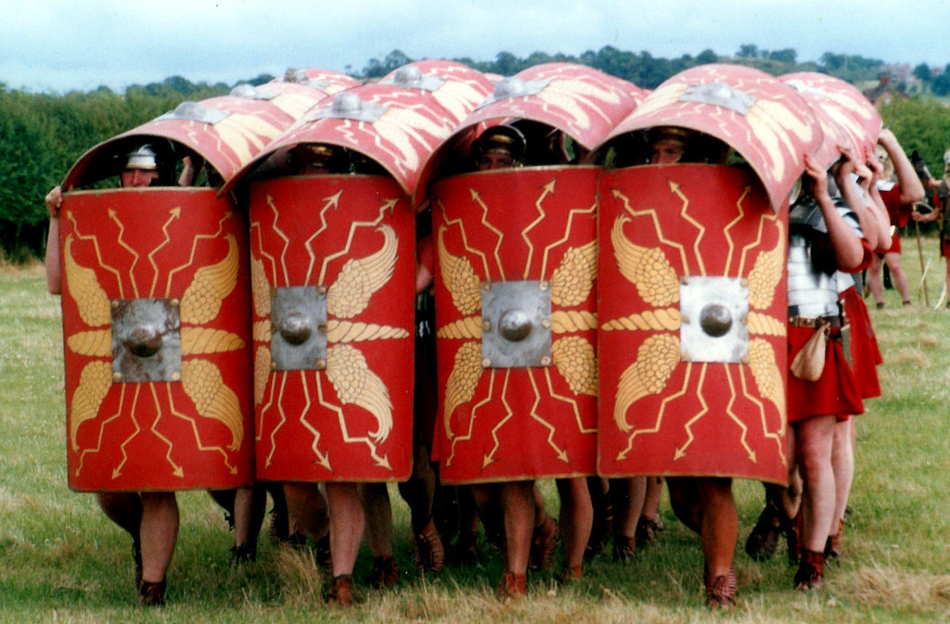
English
As readers and writers, we will be inspired by our core text 'Escape from Pompeii' to create our own stories, using emotive language and well-sequenced sentences to develop the plot. We will also be learning to write persuasive speeches from the perspective of Queen Boudicca to the Celts, using complex sentences. We will develop our public speaking skills to read our scripts with passion to persuade our audience.
DT
As designers, we will explore different types of puppets and how they are made. We will develop our own designs and templates for a Roman inspired puppet. We will then learn how to create our puppet using running or back stitch using our design. Finally, we will evaluate our puppets for strengths and areas to develop.
Computing
As computer scientists, we will be developing our word processing skills. We will be learning to touch type in a systematic way. We will then be learning short cuts to edit documents.
Science
As scientists, we will be investigating food chains, identifying producers, predators and prey. We will use our knowledge of the function of different types of teeth to inform our understanding of whether an animal is an omnivore, herbivore or carnivore. We will also learn about the effect of environmental factors on food chains.
Year 4 – Autumn 2
The Romans - What did they leave behind?
Maths
As mathematicians, we will be using our addition and subtraction skills to calculate the perimeter of rectilinear shapes. During this, we will learn how to convert between different units of measure.
We will also be developing our multiplication skills and times table facts so that we can recall them accurately and instantly. We will use our knowledge of place value to multiply and divide mentally and recognise factor pairs and commutativity.
Music
As musicians, we will be listening to, comparing and appraising Abba's music. We will be learning about pulse and rhythm while identifying the sounds of different instruments.
Physical Education
As athletes, the children will be learning and developing passing, shooting, dribbling and defending skills in football. Two classes will also be developing their vital swimming skills, whilst the other class will be creating and performing dances using a variety of movement patterns.
PSHCE
As members of the school community, we will be developing our emotional resilience. We will learn how our emotions may impact on our behaviour and consider some strategies to manage our feelings. We will also begin to set ourselves some targets to improve our self-esteem across the year.
History
As historians, we will be exploring the legacy of the Roman Empire in our country. We will learn how to evaluate evidence that is around today to assess how this has impacted on our lives and how we live. We will start to make choices about which we think is the most significant part of the Roman legacy and why.
Key texts and complimentary reading:
Escape from Pompeii – Christina Balit
Meet the Ancient Romans – James Davies
So You Think You’ve Got it Bad: A Kid’s Life in Ancient Rome – Chae Strathie & Marisa Morea
Find Tom in Ancient Rome – Fatti Burke
The Roman Soldier’s Handbook - Usbourne

