Slide 1
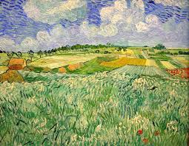
As scientists, we will be developing our understanding of evolution and adaptation. We will plan and undertake an investigation based on Charles Darwin's evolutionary discoveries, using our skills to work scientifically, making predictions, recording results and reporting our findings.
As readers and writers, we will use our focus on Yellowstone National Park to inspire non-fiction, information writing. We will consider how we can present information for different audiences and develop our understanding of how to use persuasive devices.
As food technologists, we will understand the art of preparing and preserving food by pickling different foods. In doing so, we will measure accurately, prepare the ingredients and create and follow a set of instructions. Tasting is optional!
Autumn 2
Layers of the Landscape
As computer scientists, we are going to design, write and debug programmes that accomplish specific goals. We will then use these skills and our understanding of variables to design and create a simple game.
As athletes, we will be building upon our understanding of the rules of basketball to develop our skills and progress into a conditioned game. We will also develop our understanding of health and fitness by planning and carrying out fitness circuits to better understand how cardiovascular fitness effects our bodies.
As mathematicians, we will begin by consolidating our understanding of multiplication and division. We will then extend our understanding of fractions, decimals and percentages.
As Musicians, we will develop an understanding of the history of music, listening to a variety of music and talking about similarities, differences and giving personal preferences.
As geographers, we will be developing our understanding of environmental regions, focusing on Yellowstone National Park in America and comparing this area to Snowdonia. We will also learn about volcanoes and how they shape the land.
Key texts and complimentary reading:
Fourteen Wolves: A rewilding story – Catherine Barr
On the Origin of Species – Charles Darwin
The Wolf Wilder – Katherine Rundell
The Last Bear – Hannah Gold
As spiritual learners, we will understand and compare the interpretations of major religions and the impact of this on their followers.

