Slide 1
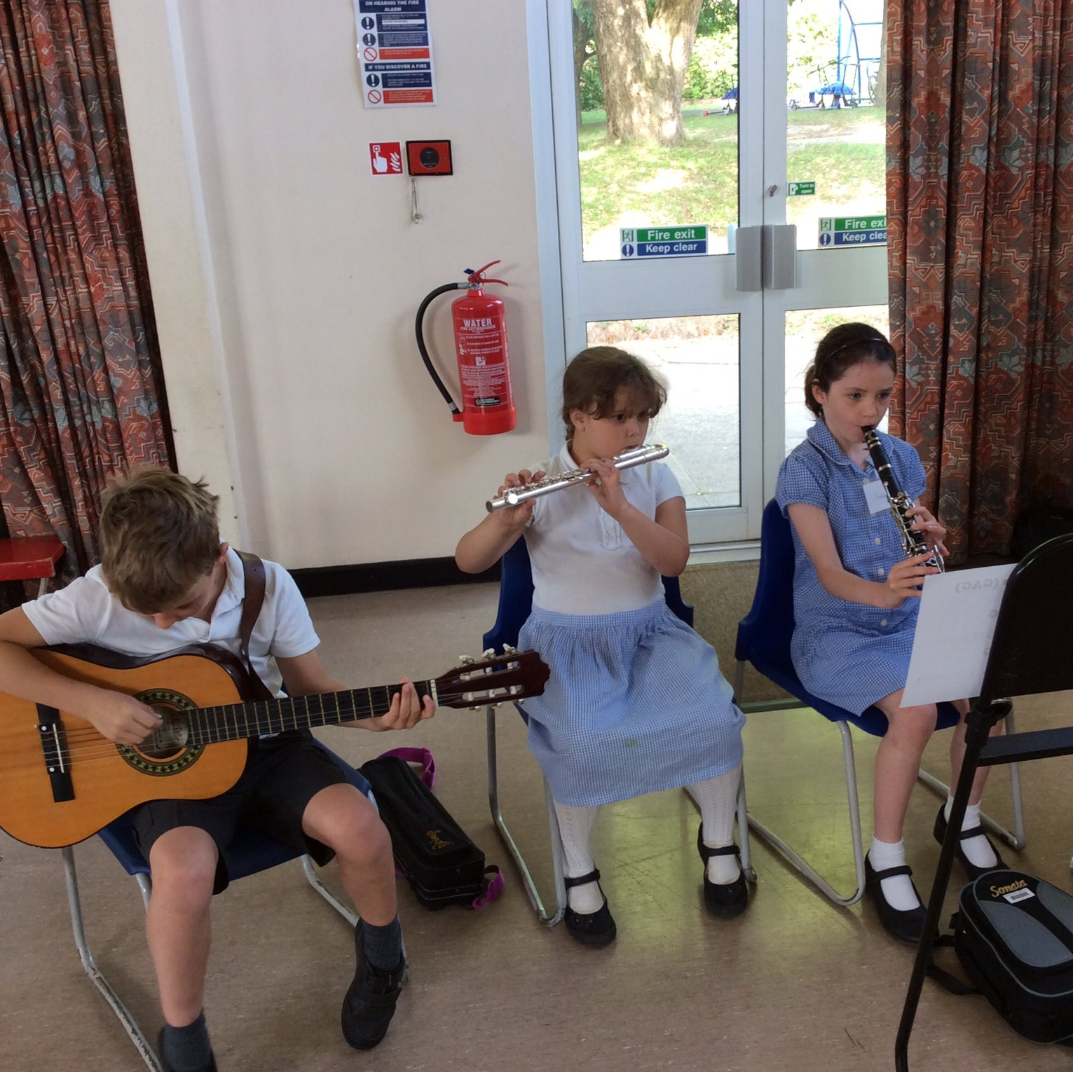
Our curriculum at Billingshurst Primary School
Our curriculum is fully inclusive, encouraging every child to engage and achieve their potential. It is broad, balanced, progressive and exciting, supporting all our children as they grow into independent, confident, articulate learners who are ready for the next stage of their education and beyond.
We follow the National Curriculum, West Sussex's Education for Safeguarding curriculum and the agreed syllabus for Religious Education, all customised to meet the needs of our children and our community. We provide a solid foundation of literacy and numeracy skills from early years to Year 6 ensuring that all our children have the foundations for future learning. We ensure that the children have a wide range of engaging experiences that progressively develop knowledge and skills and build on our children's successes as well as challenging them to make enhanced progress when they can do so.
We believe that if we have a curriculum that is exciting, fun and engaging, our children will foster a love of learning which will endure for the rest of their lives.

Slide 2
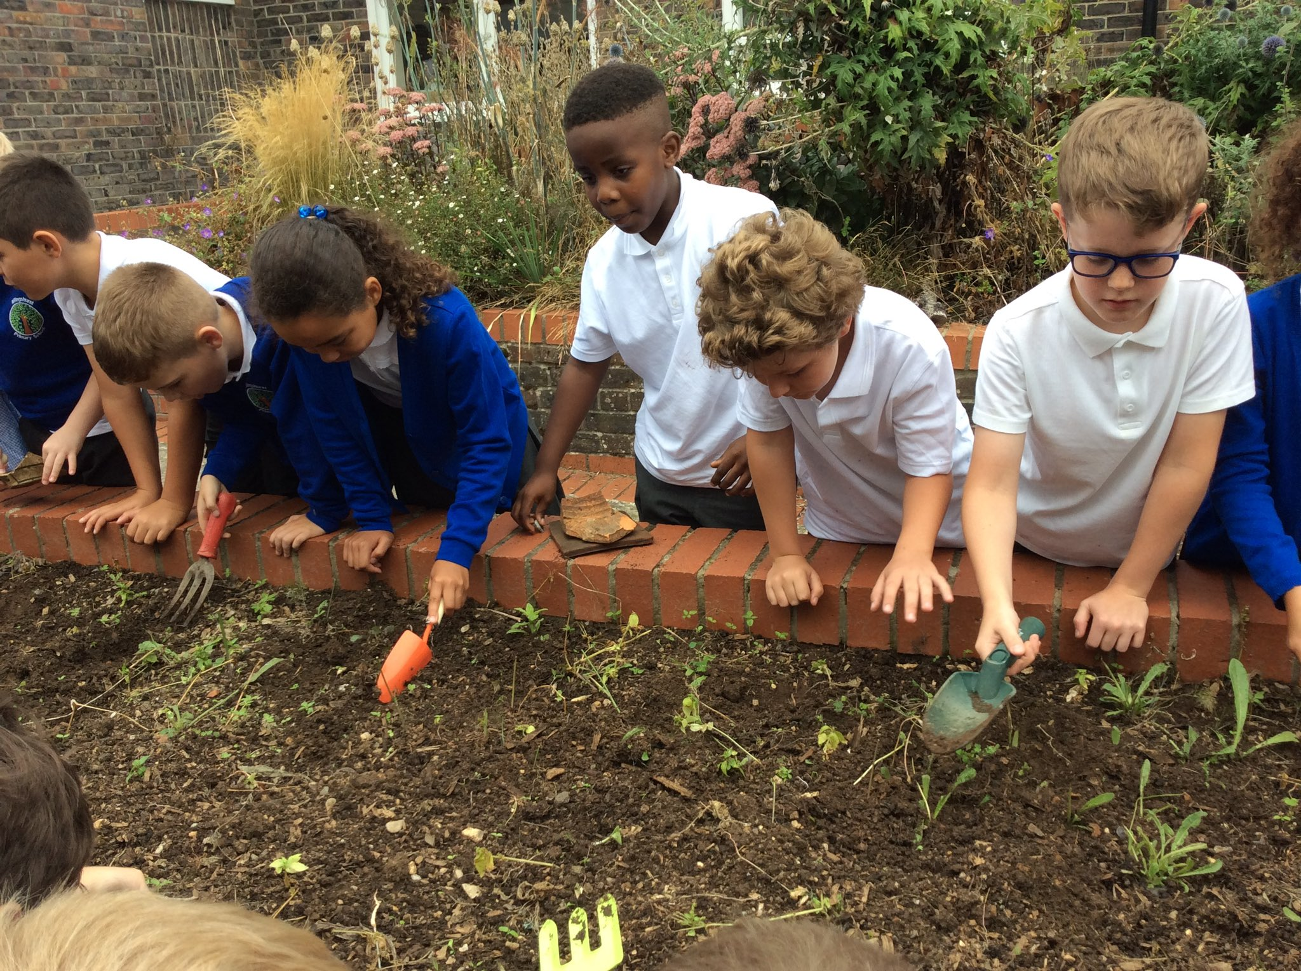
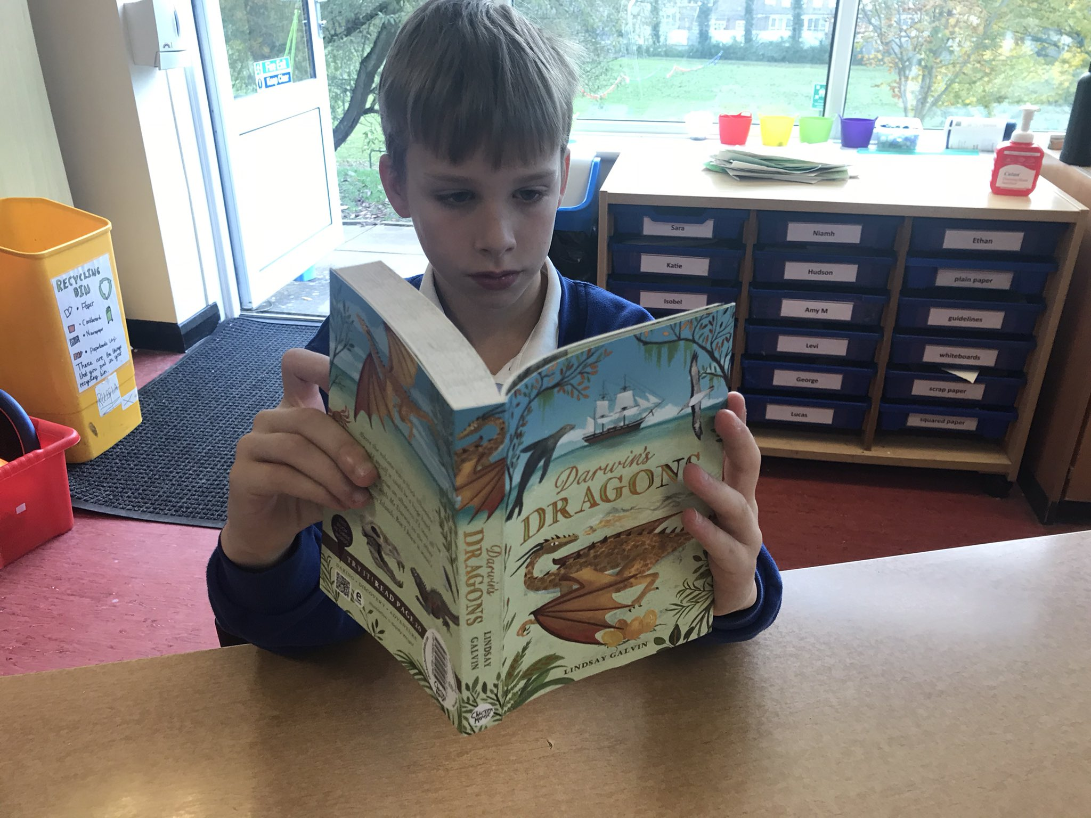
Every child is unique
Our curriculum, whilst planned and progressive and available to all, may need additional support and enhancement for individual children to ensure that they achieve their best. Our curriculum is built on a foundation of literacy and numeracy skills whilst also delivering our four key learning principles:
Every child is included
Every child is a reader
Every child has a voice
Every child is an active learner
and encouraging children to:
be curious
be creative
be resilient
be a team player

Slide 3
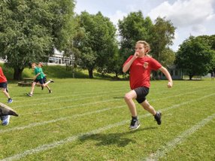
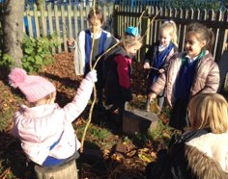
Every child is included
Our curriculum is for all our children.
Our learning journeys are broad and balanced, ensuring that all children have their moment to shine, and that all children are developing a range of skills and knowledge. Consideration for the unique child and the positive relationships we foster from an early age ensure we make the necessary adaptations for all our children to access the curriculum and make progress from their starting points. A range of assessment opportunities are planned for to ensure each child's development is planned for carefully.
Our enabling environments ensure all children have the necessary resources and scaffolds to support them, build independence and resilience, and ultimately feel successful.

Slide 4
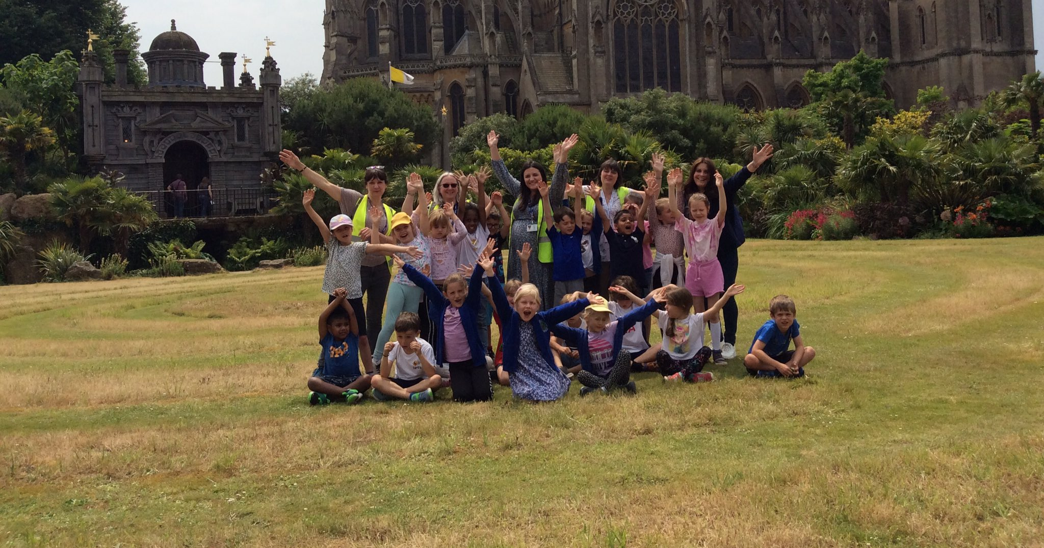
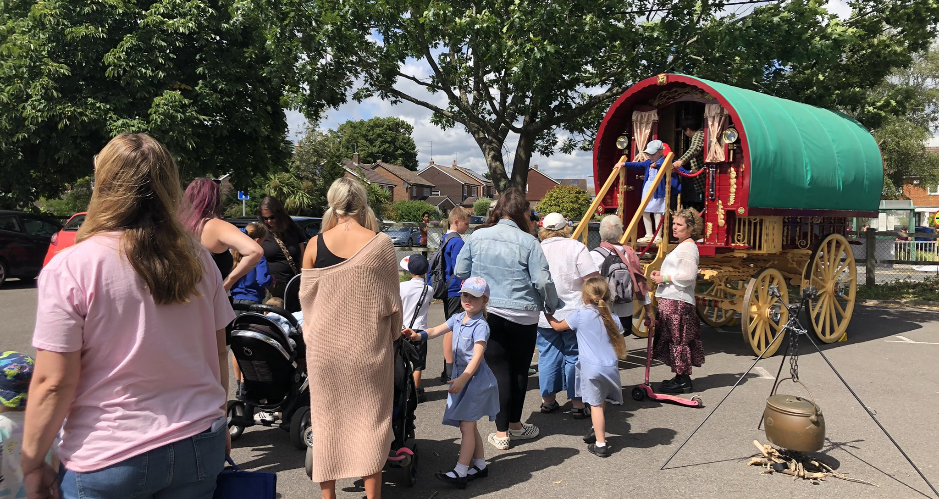
Every child is included
Authentic experiences, both real and imagined, are key to immersing all our children in their learning. We know our children learn best when learning feels immediate, relevant and tangible, whether that is through trips, visitors, artefacts, or video, music and drama.
Our subject leaders support year teams in making sure our planned curriculum is representative, diverse and gives all children the chance to build their cultural capital, enhancing their opportunities in secondary school and their adult lives.

Slide 5
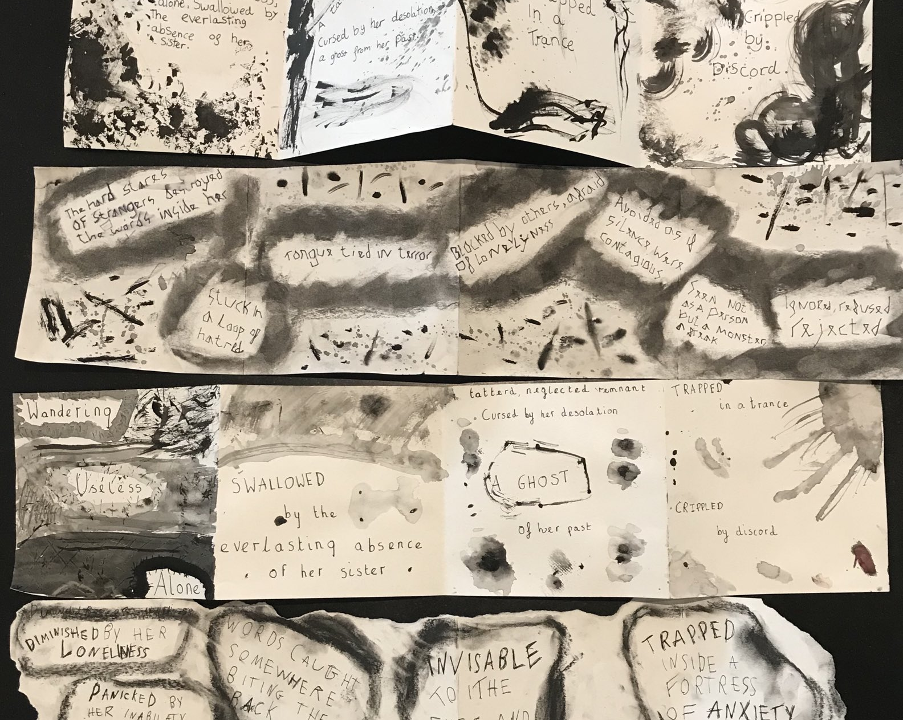
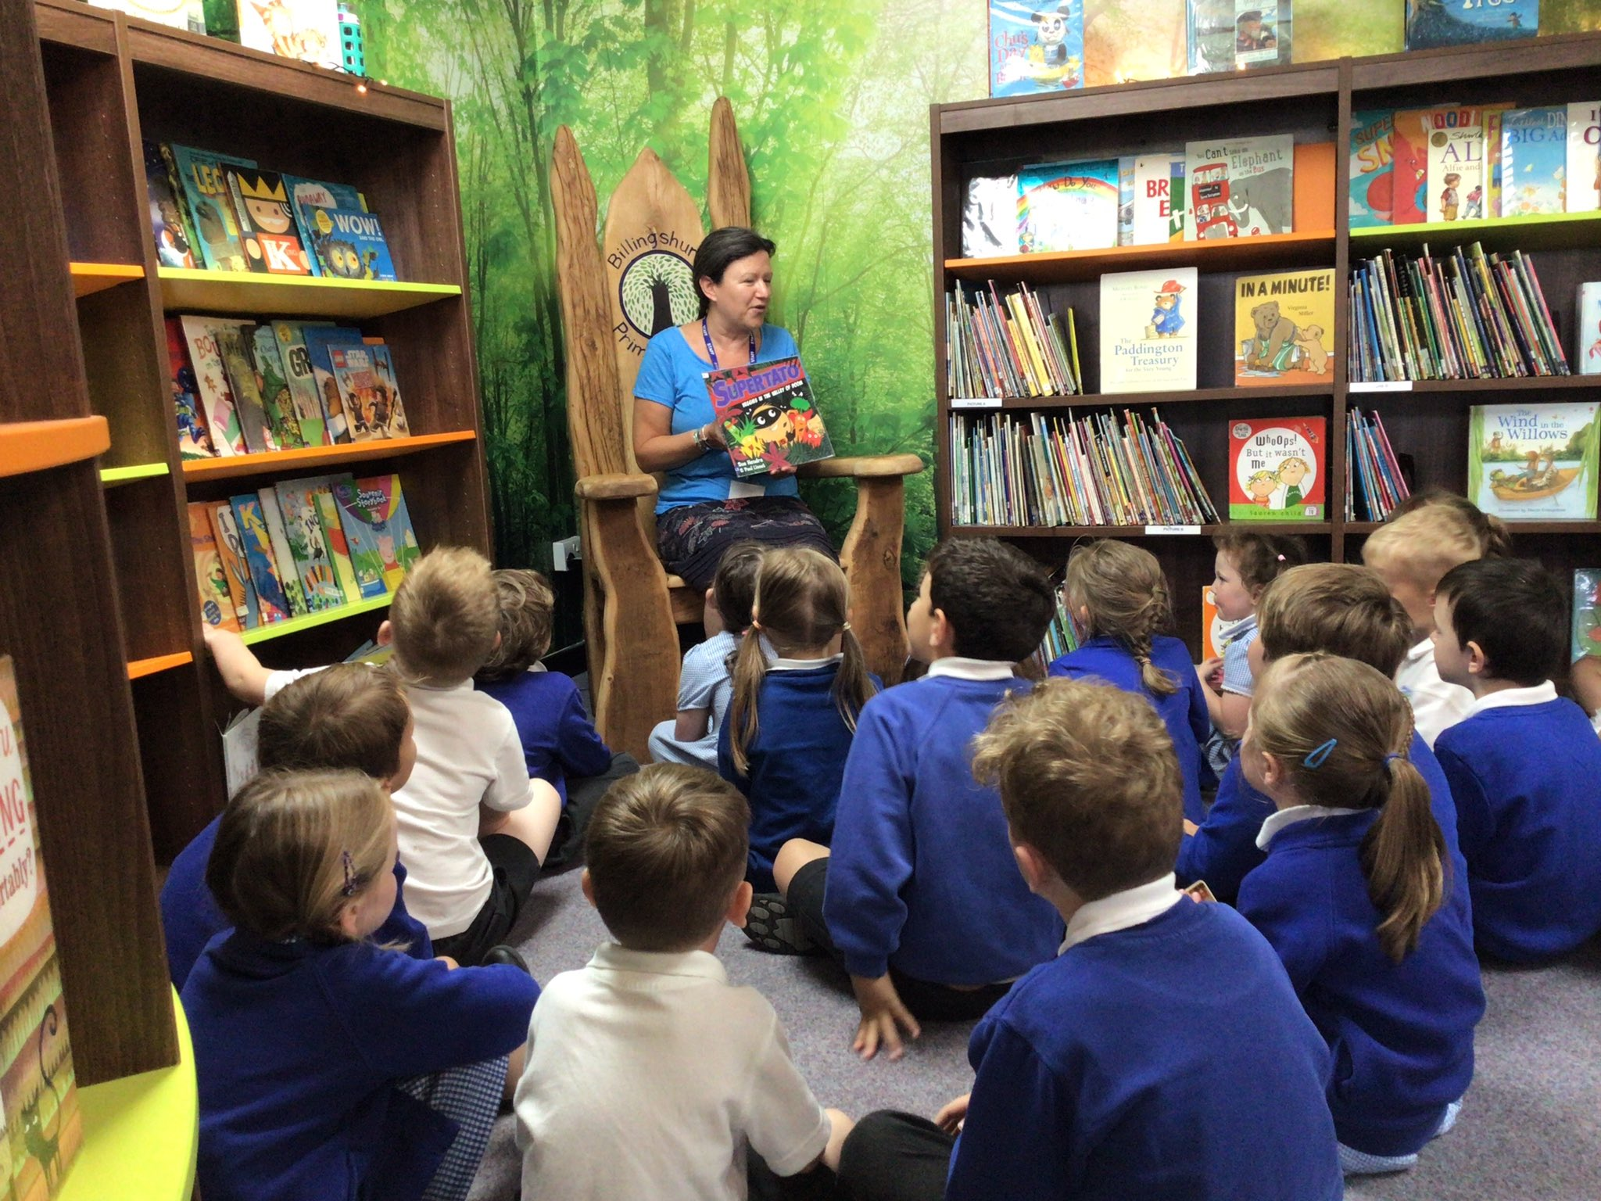
Every child is a reader
We know that developing a child's love for reading is incredibly beneficial for their development, well-being and academic achievement across the curriculum. All children, from Reception up, are afforded time to discover new books, share their personal reading experiences and read with adults and their peers. Great readers go on to become creative writers, scientists, historians and succeed in all areas of learning.
Our two high-quality libraries and partnerships with West Sussex Schools' Library Services and The Book Nook ensure that the selection of texts is current and well-matched to children's interests and reading abilities. Our librarians support research projects, curate selections of books to support learning journeys and support all children in deciding what to read next. Reading for pleasure is valued highly and celebrated in school assemblies and online, via our social media platforms.

Slide 6
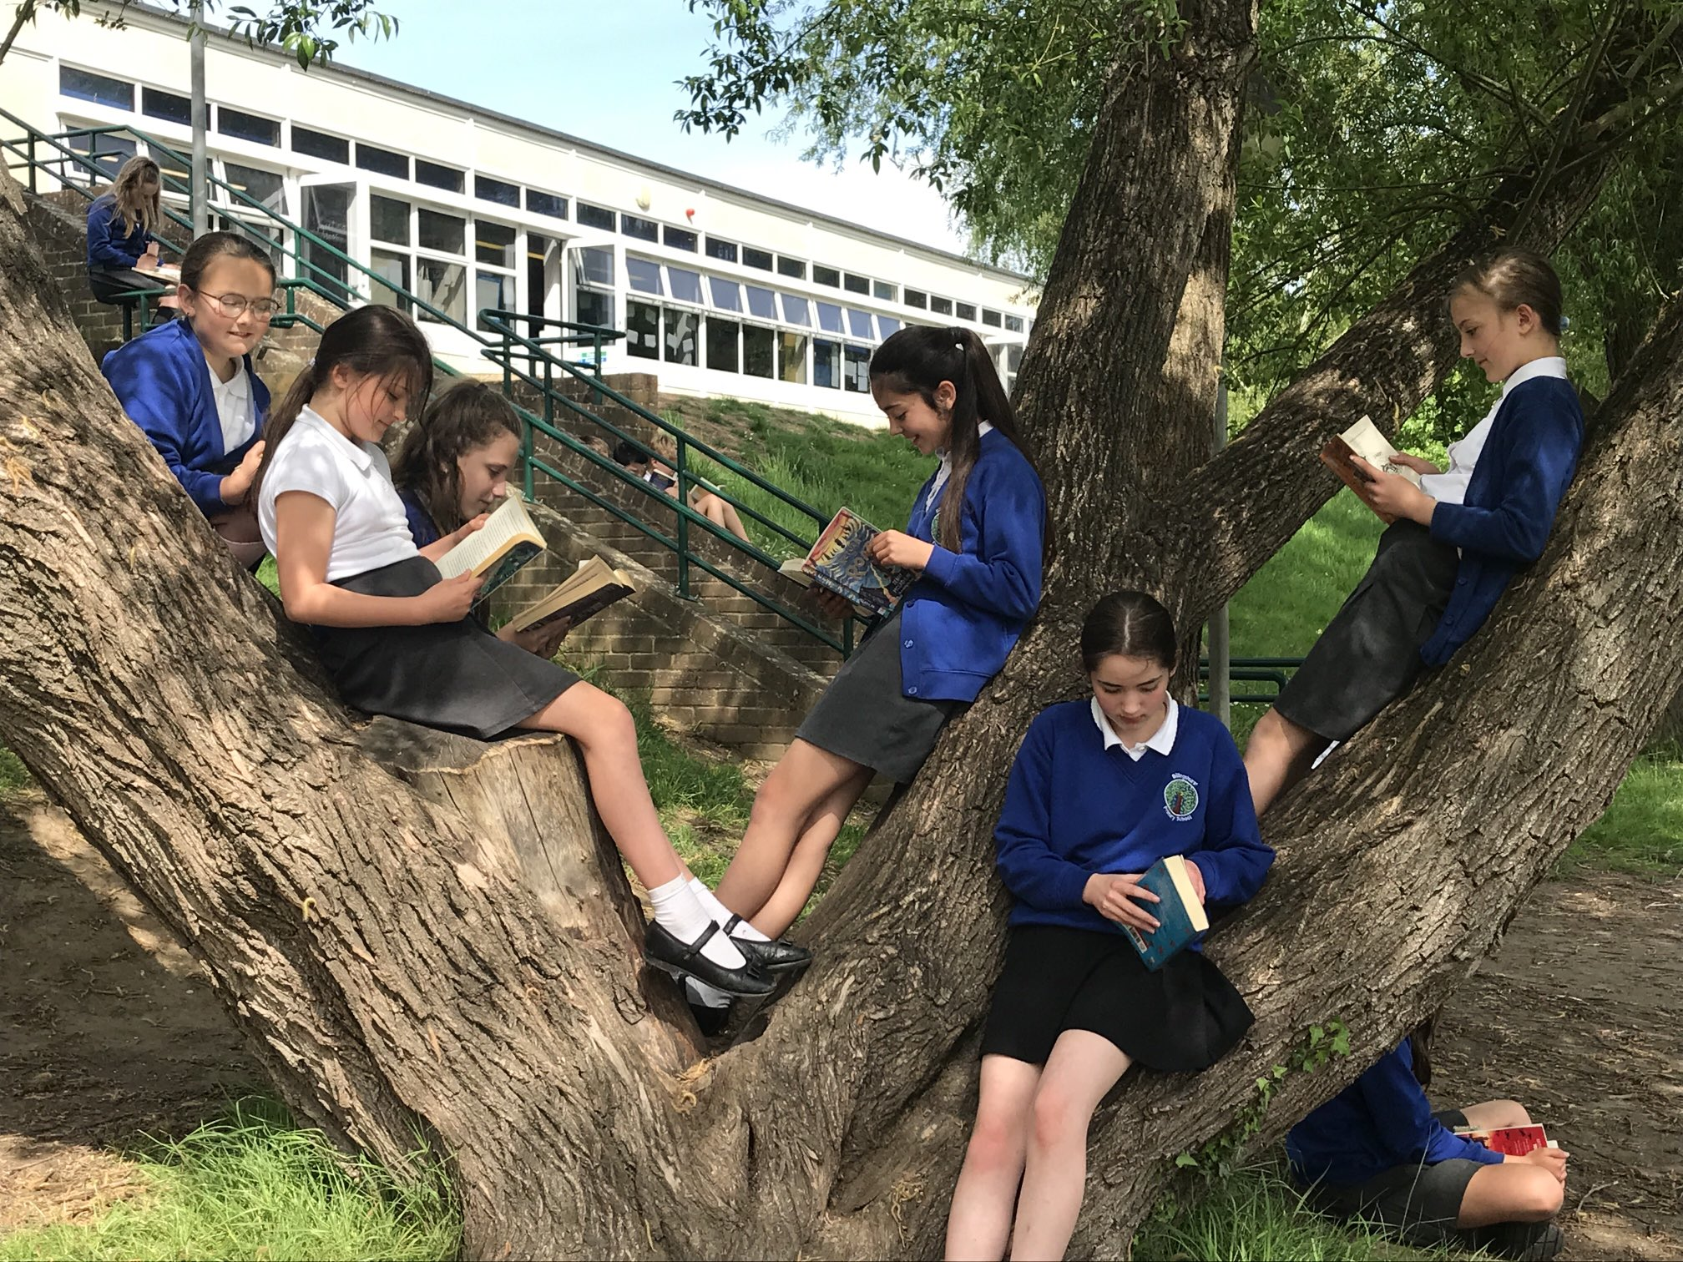
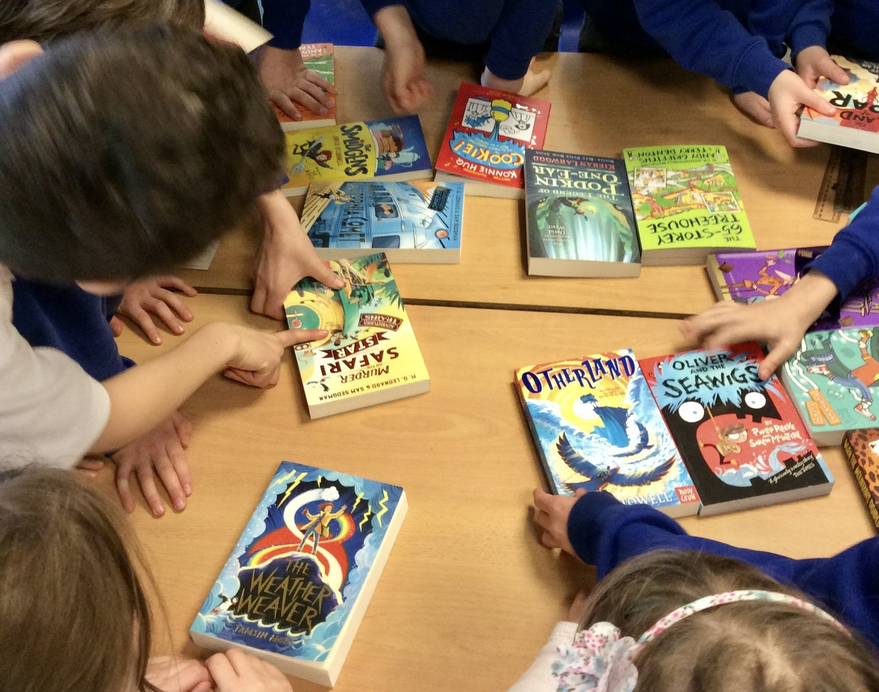
Every child is a reader
Learning to read and reading for pleasure are incredibly important to us at Billingshurst Primary School, and our curriculum is designed to teach and celebrate both. Early reading is key for our youngest children and helping them develop into confident and skilled readers is of the highest priority in their earliest school years. Our curriculum teaches phonic strategies to decode and encode that form the basis of our reading and writing approaches all the way to Year 6, and sharing stories is a common part of classroom practice.
Our curriculum is anchored and driven by quality texts, making sure all children are exposed to a wide range of supportive, interesting and enjoyable books throughout their school journey. These texts also greatly enhance their learning across the curriculum.

Slide 7
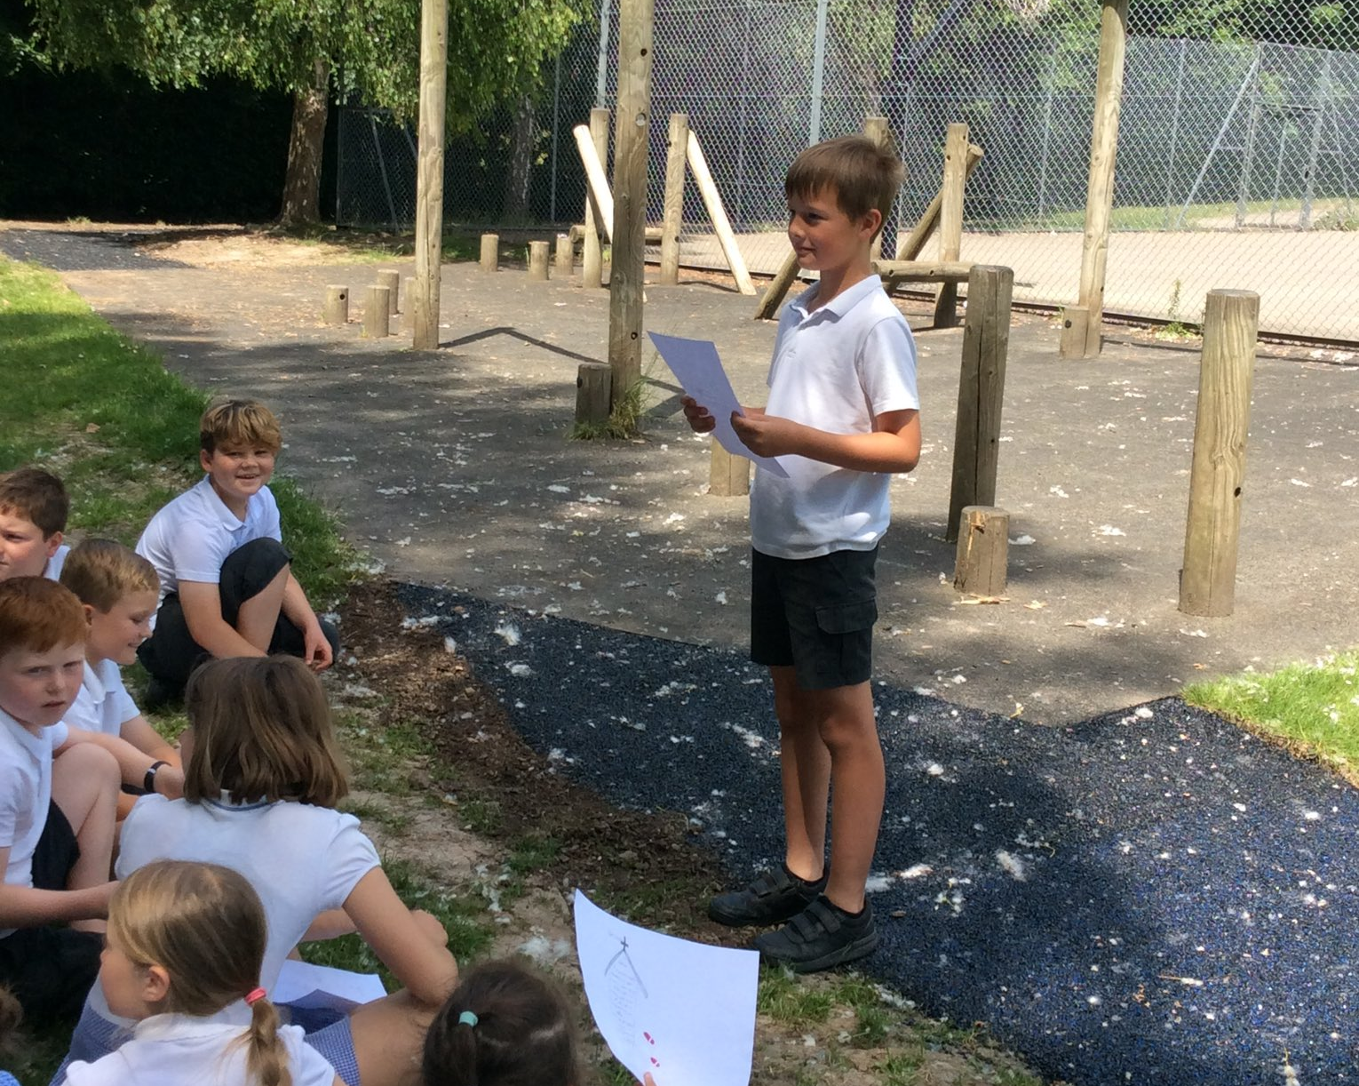
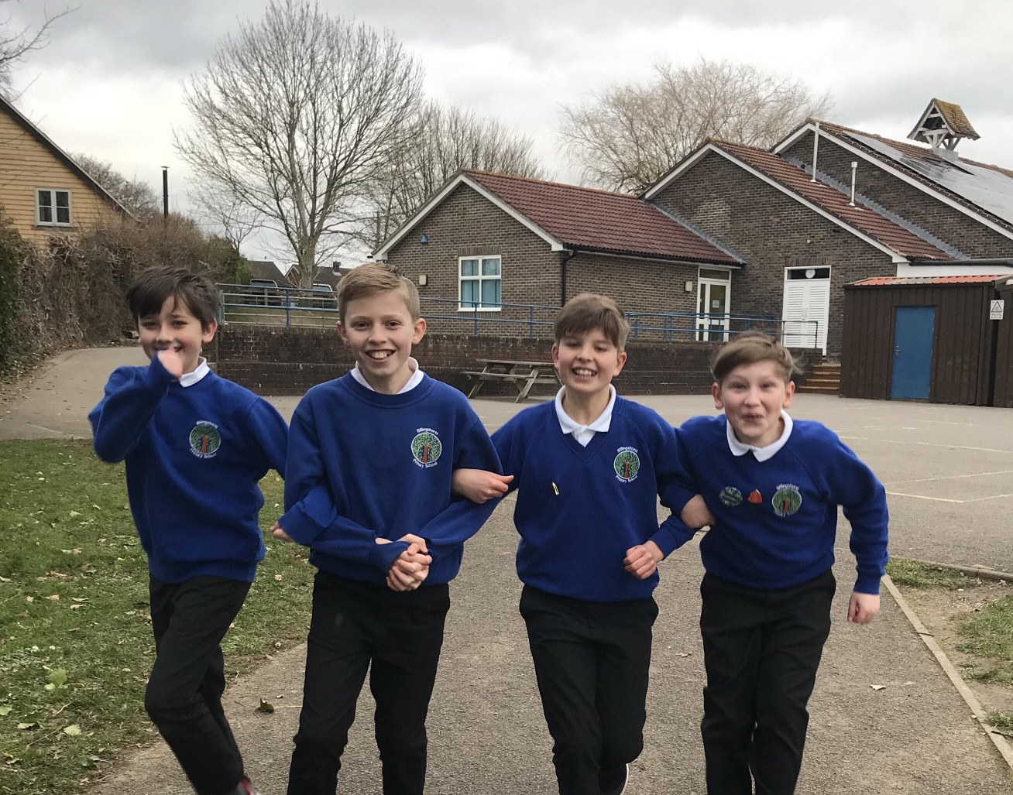
Every child has a voice
Oracy is a key driver for our curriculum, and we teach both the explicit skills of learning to talk and talking to learn through all subject areas. We know this has a huge impact on academic attainment, especially for those children who are disadvantaged.
We take the time to help children to develop their own, unique point of view. Our curriculum offers children the chance to develop and further their own interests in all subject areas, as we know this has a positive impact on their levels of confidence and engagement. Our children are empowered with extra responsibilities, from school councillors, to sports leaders, to artists in residence, making sure they are included in the running of the school and have a meaningful say in its future.

Slide 8
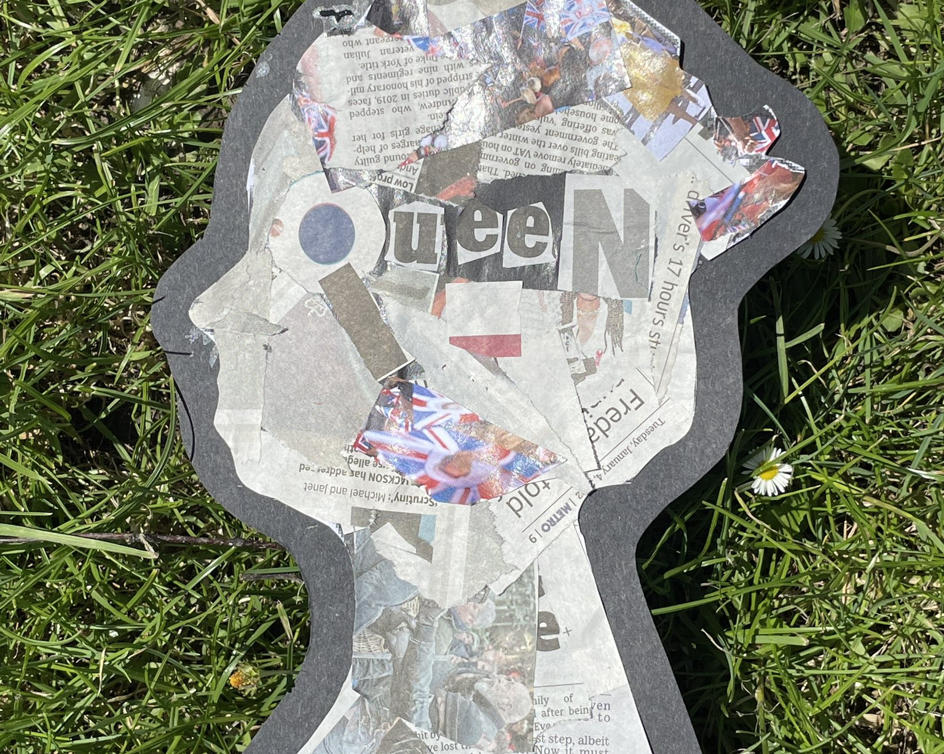
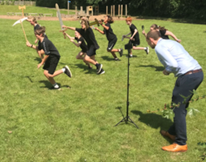
Every child has a voice
Across the whole curriculum, we plan for children to develop their creativity and critical thinking. Problem solving, designing and debating are all vehicles for developing the knowledge and skills to make progress. We also have a passion for high-quality arts provision, and a love of learning outdoors.
Children are given the chance to share their learning through exhibitions, performance, competitions and events, both in-school and within our locality.

Slide 9
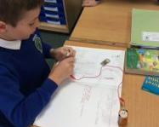
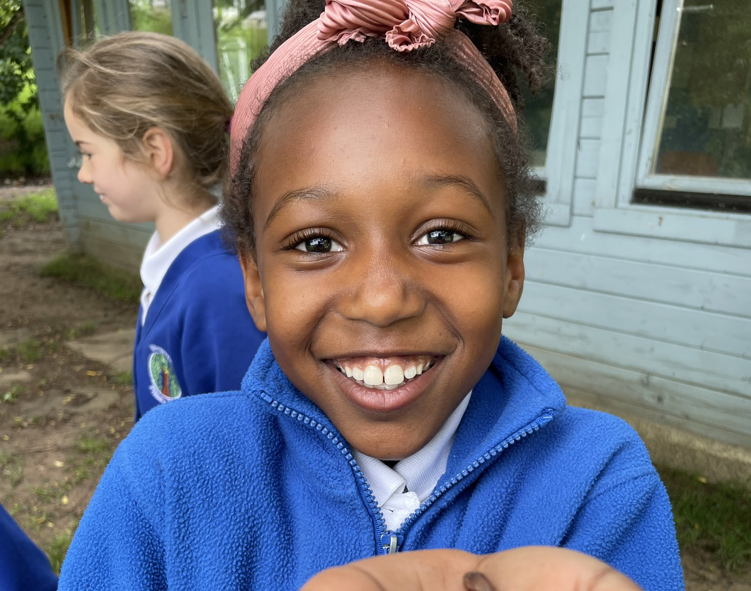
Every child is an active learner
Our learning journeys are centred around provocative questions and challenging statements; our children love to answer them. All learning is planned to teach the key skills and knowledge through enquiry, research, projects and debates, ensuring our children are engaged and motivated through purposeful opportunities. This enables our children to see themselves as mathematicians, scientists, historians, geographers and artists.
This approach begins in Early Years, all the way through to Year 6, ensuring our children are used to the high expectations of involvement in all subject areas across our broad and balanced curriculum.

Slide 10
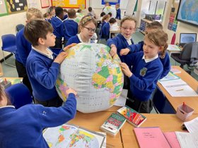
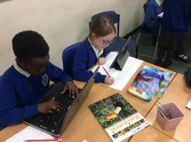
Every child is an active learner
We teach children the skills of metacognition, enabling them to take ownership of their learning and develop the skills of reflective thinking. Our teachers use live feedback to respond to a child’s individual needs and empower them to take the next steps to improve. The timetable gives children the time, space, resources and support to independently practise, develop or explore their learning and put this into action.
We use our Learning Skills to promote positive learning behaviours and reward children for the skills that will serve them as life-long learners. These personal successes are celebrated and rewarded in class and around the school.

Slide 11
Themed weeks, whole school activities and opportunities within and outside school all enrich and develop the children’s learning. Important events in the calendar are marked and celebrated throughout the year. After school clubs and events extend these opportunities further.
Additional whole school programmes and approaches, such as Read Write Inc. and maths mastery supported by the NCETM, support quality teaching and learning and the school is well resourced in terms of learning materials, books and technology.

