Slide 1
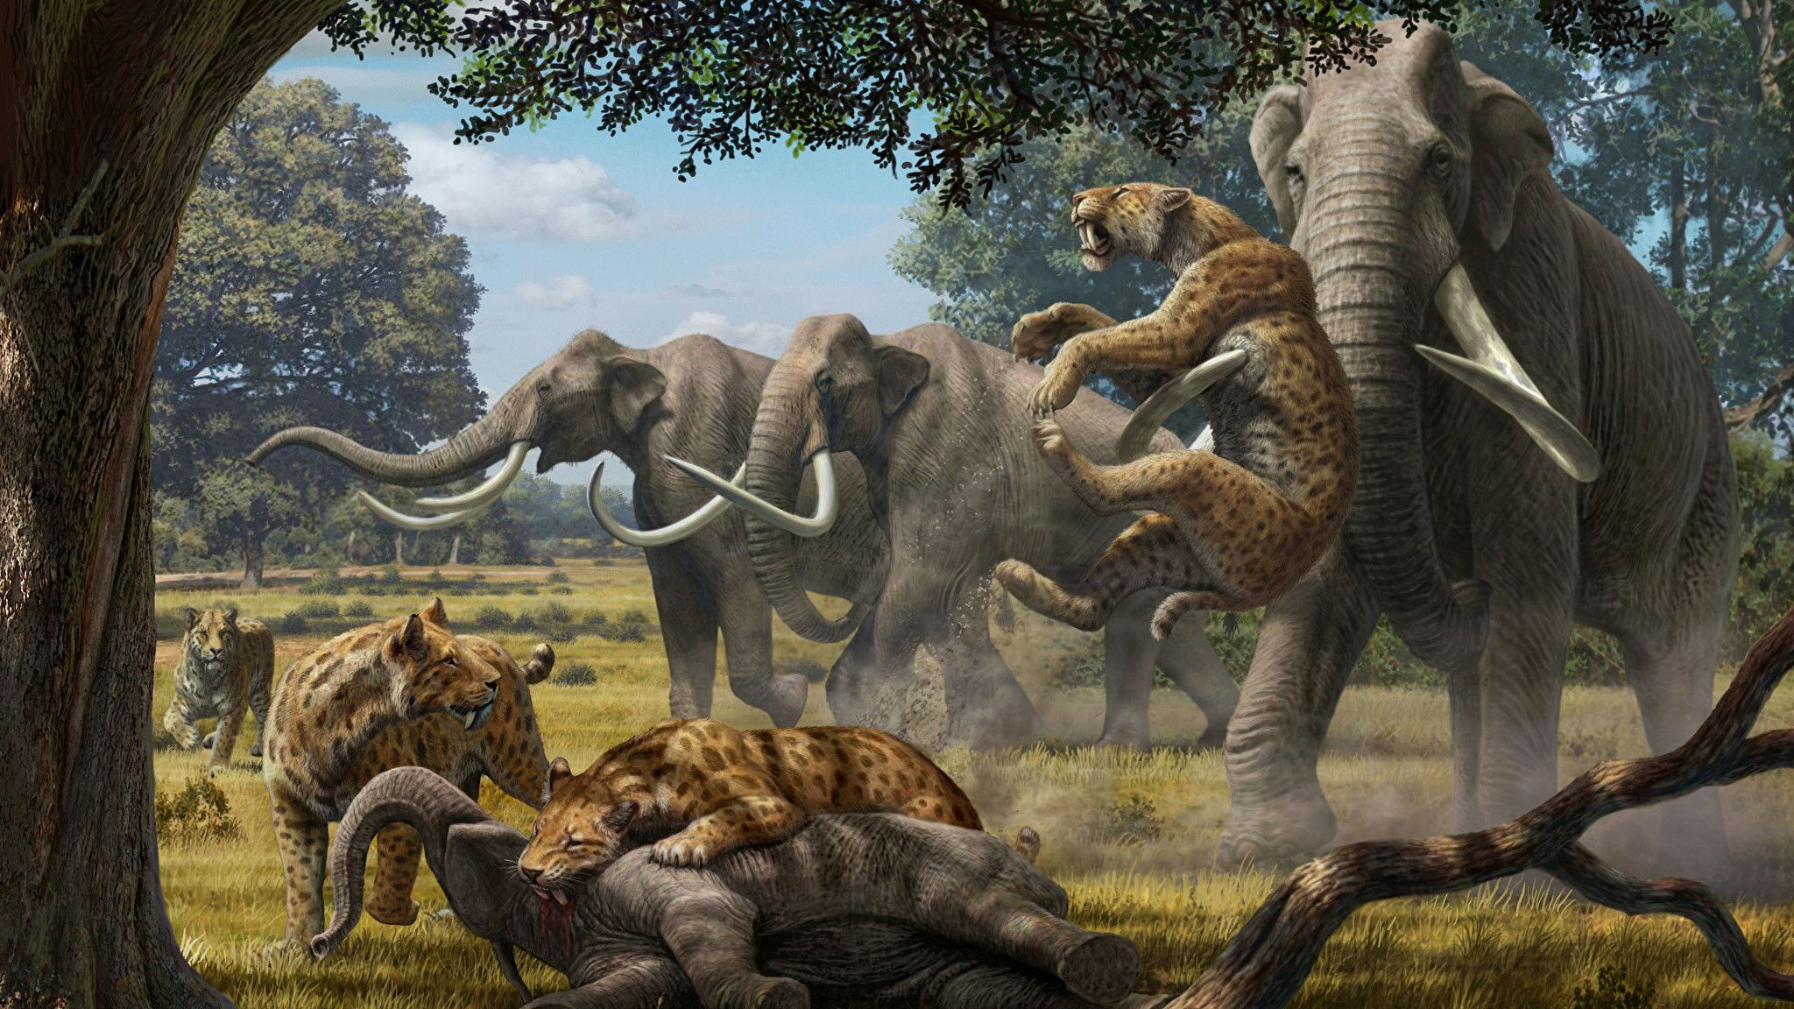
As readers and writers, we will read a range of animal haiku poems and use these to help us write our own haiku about our own Stone Age animal creation. We will then share more information about our animal through non-fiction writing to inform. Finally, we will explore the well-known story of The Grinch. We will be writing to him to persuade him not the ruin Christmas and look forward to sharing our learning in our Christmas production.
As computer scientists, we will develop our computer science coding skills. Using hands on resources, such as BeeBots and Rugged Robots, we will explore input and output programming. We will then move to code.org to learn about sequencing events and loops.
As members of the school community, we will continue to learn about the importance of staying safe online though Digital Literacy lessons. We will also explore the positive attributes of our own personalities that we would like to preserve for the future.
Year 3 – Autumn 2
How did they survive in the Stone Age?
As athletes, we will be learning the skills and rules of handball with an emphasis on moving with pace whilst dribbling. Additionally, we will be developing our dance techniques – imitating animals and expressing mood and emotion through choreographed sequences. This will link to our writing and Stone Age learning.
As mathematicians, we will continue to build on our place value knowledge and understanding of three-digit numbers. We will also explore measure and convert between mm, cm and m. We will start to master the 10 times table, including division facts. Stick and Split should be used daily at home to support this.
As musicians, we will be developing our understanding of musical notations and how to compose our own music. We will sing and play ukulele with increasing control and confidence.
As artists, we will be exploring sketching skills and trying to create different tones with our pencils and mark making skills. We will observe 'The Lion Man' sculpture and create our own version, using clay modelling.
As spiritual learners, we will explore key beliefs in Islam, develop our understanding of key Islamic figures and symbols and make comparisons between Christmas and Eid.
Key texts and complimentary reading:
'Stig of the Dump' – Clive King
'How to Wash a Woolly Mammoth' – Michelle Robinson
'How to Live Like a Stone Age Hunter' –– Anita Ganeri
'Stone Age Boy' - Satoshi Kitamura
'Who are you calling weird?'- Marilyn Singer
Animal awards- Martin Jenkins
As scientists, we will develop our understanding of nutrition, explore skeletons and muscles and their purpose. We will gather, record and classify data, carry out simple enquiries, make predictions and use scientific evidence to answer questions.
As linguists, we will be developing our conversational French. This will include sharing information about our families, asking questions to others and counting to ten.

