Slide 1
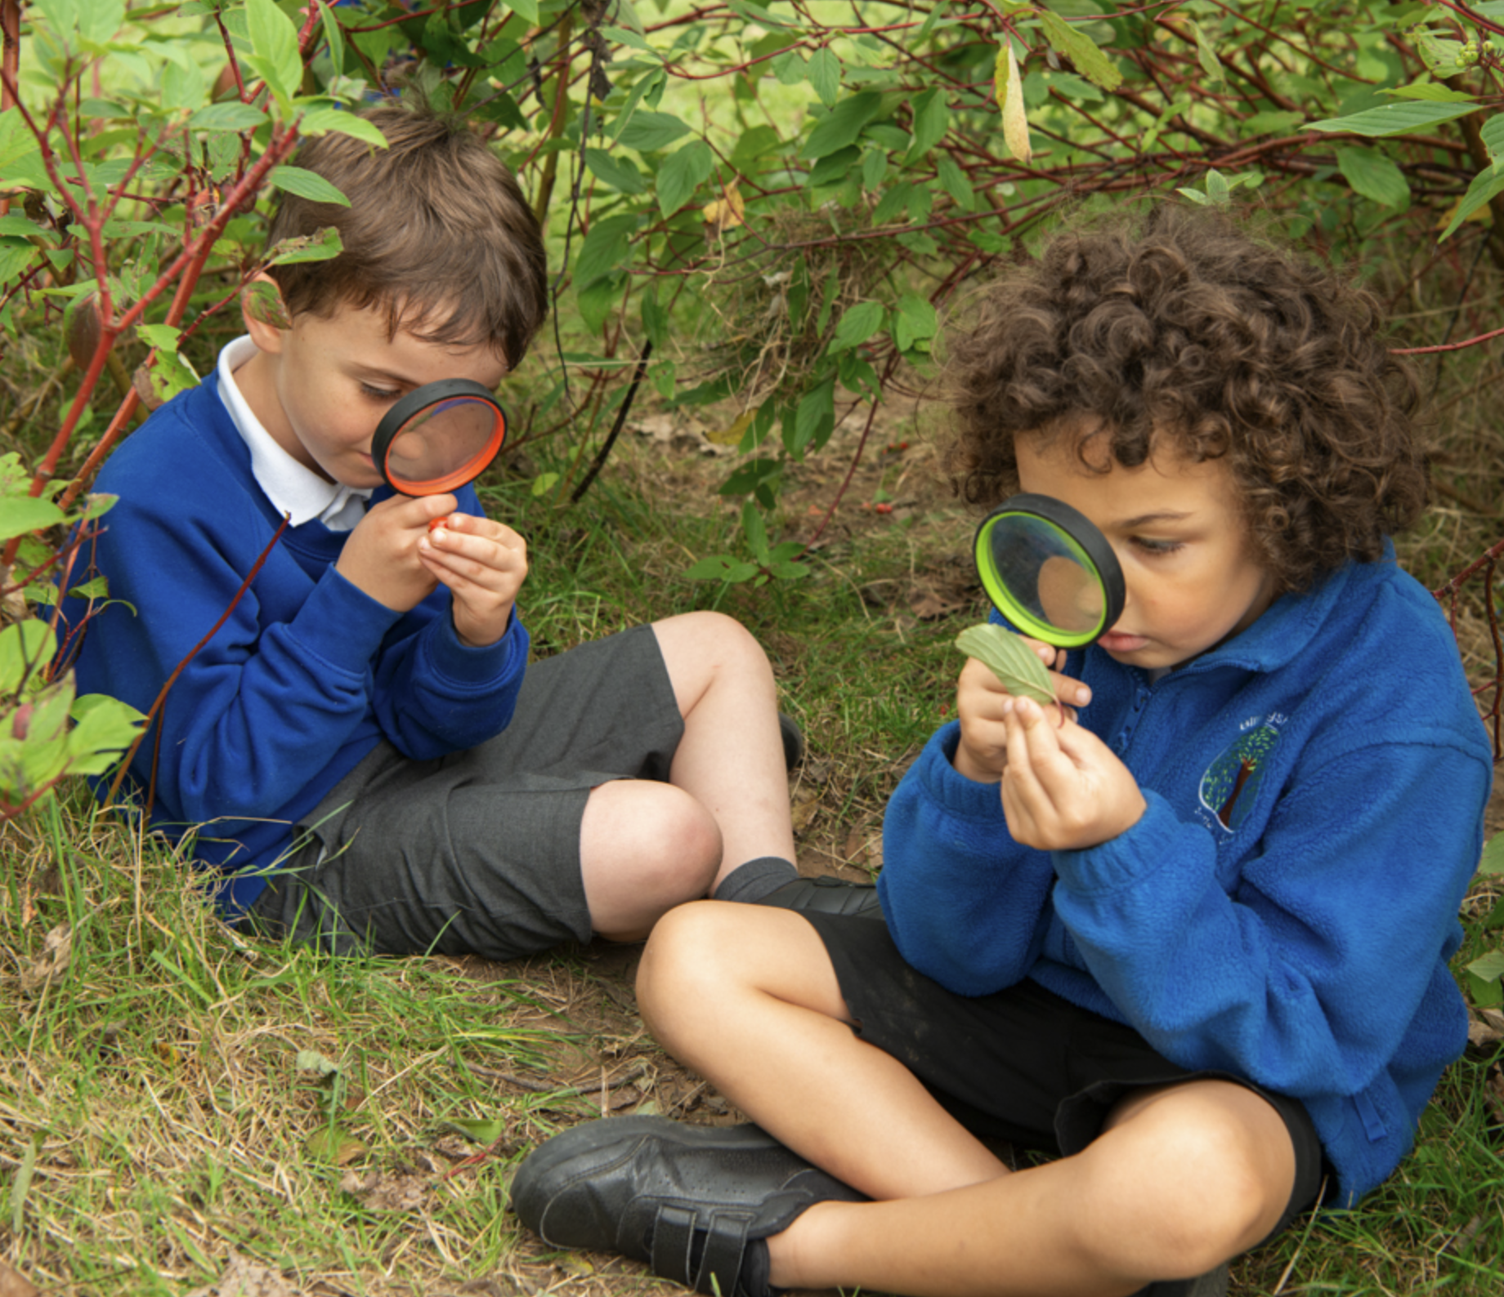
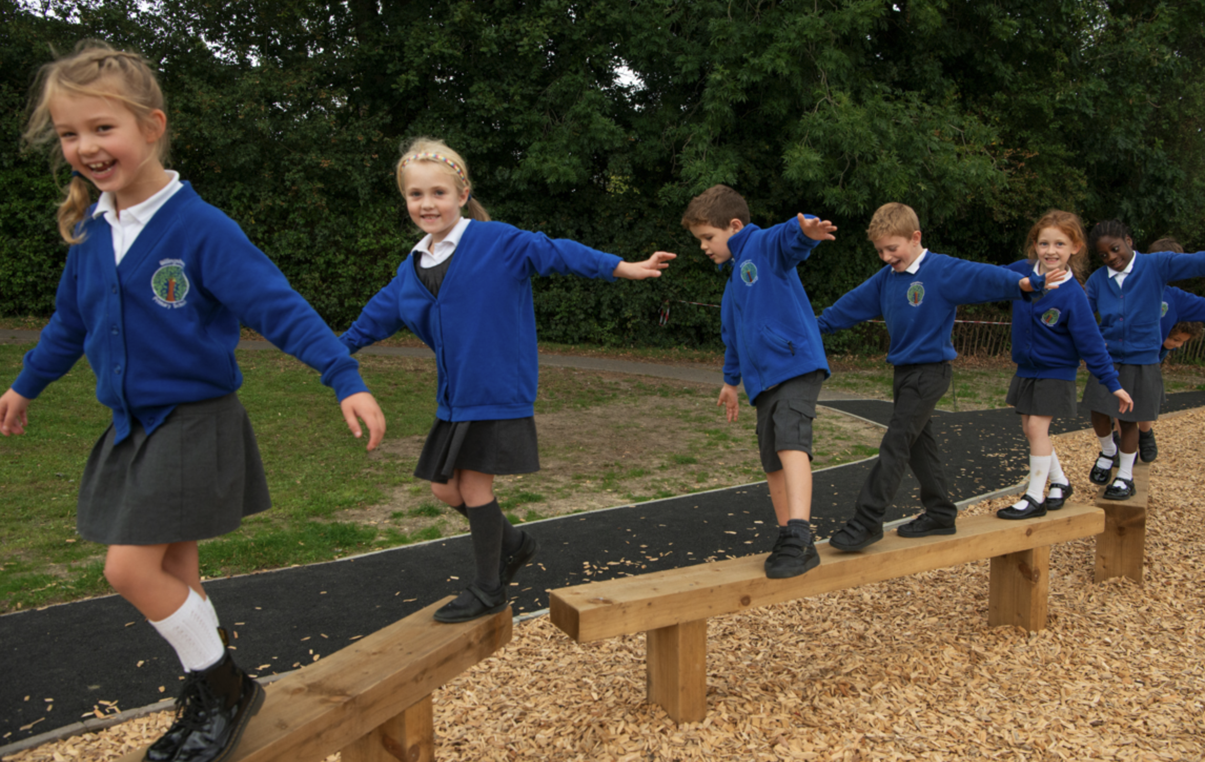
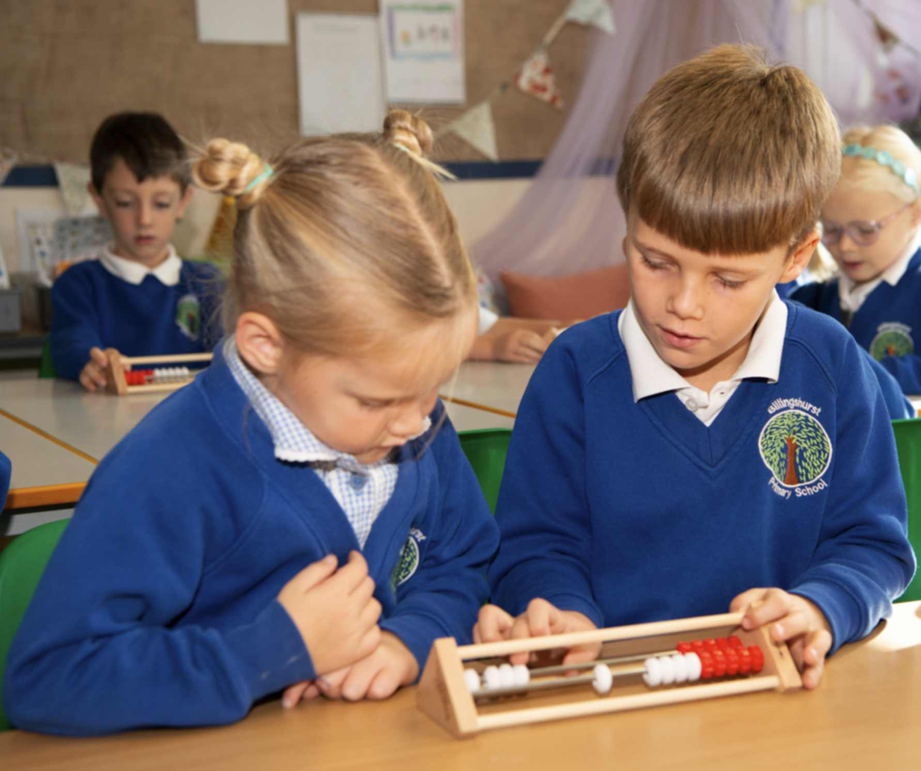
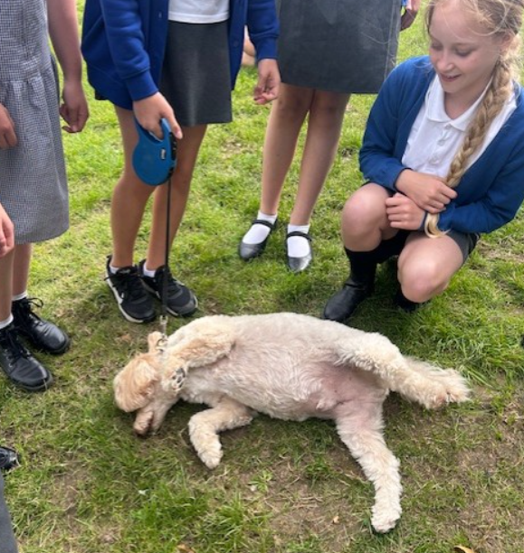
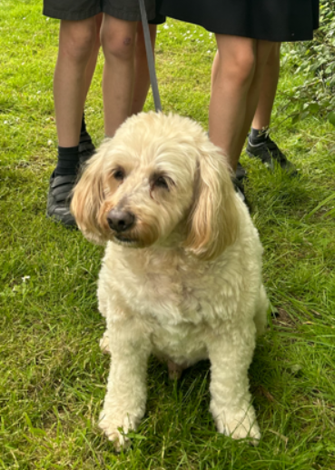
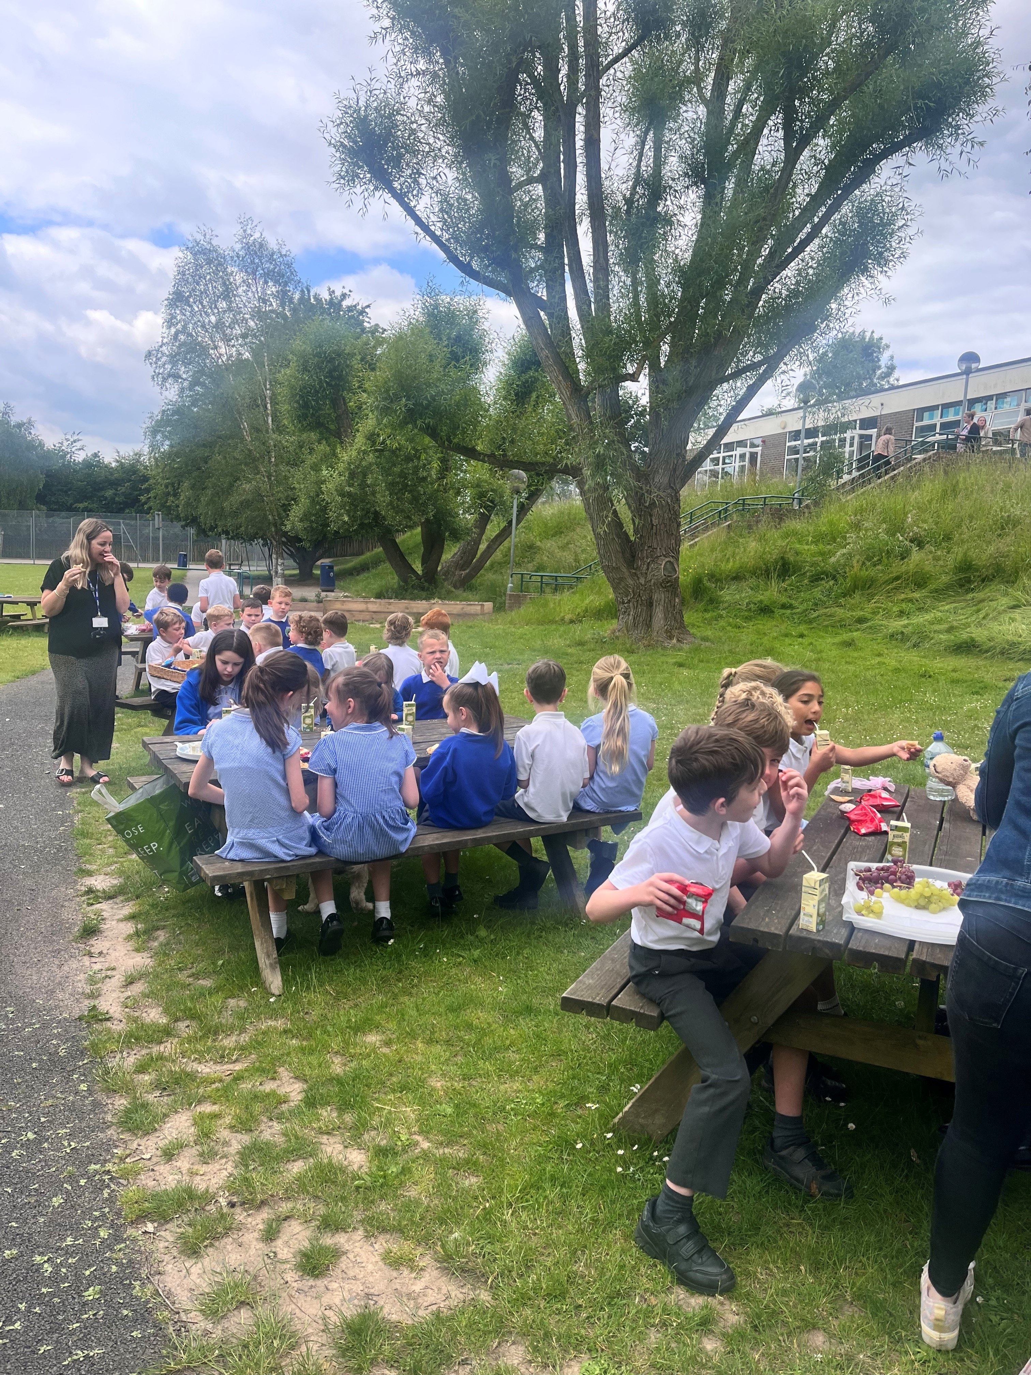
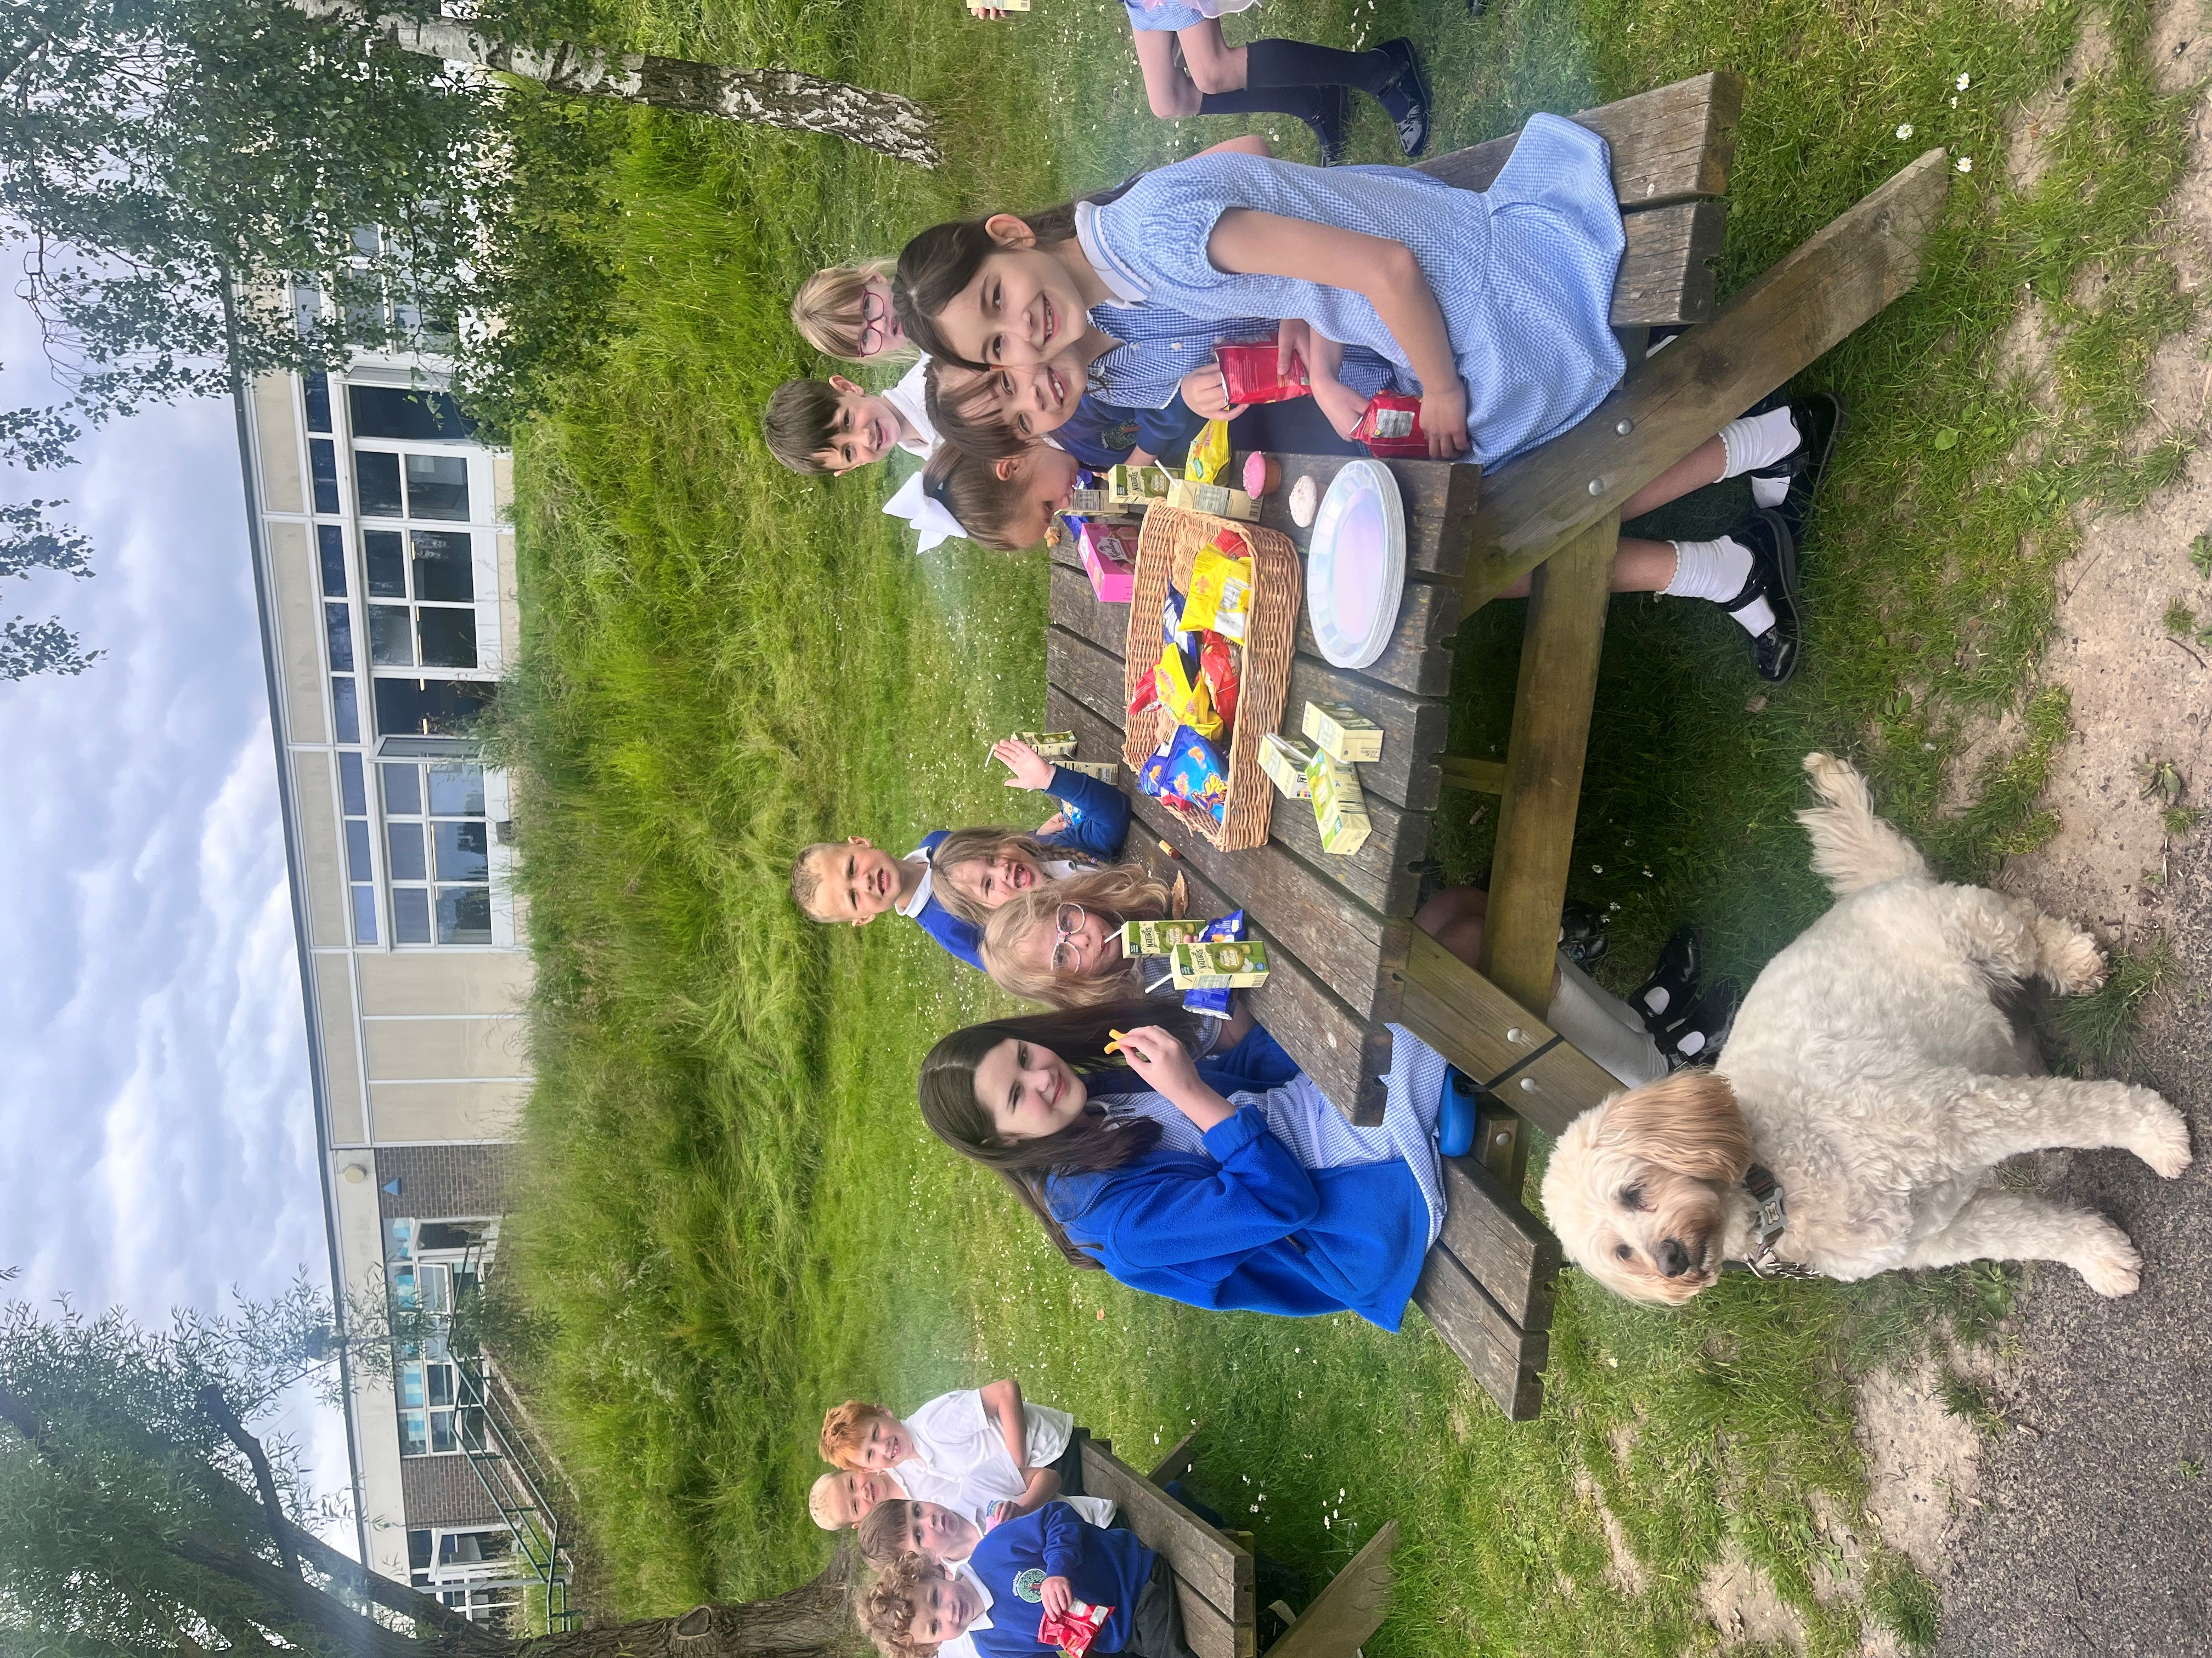
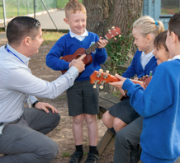
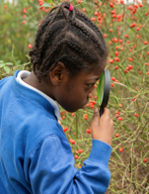
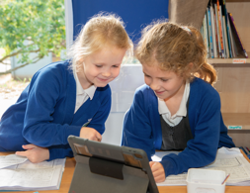
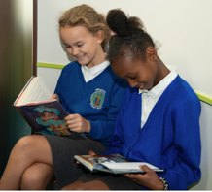
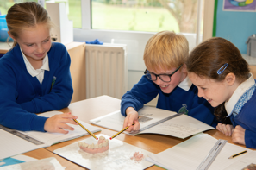
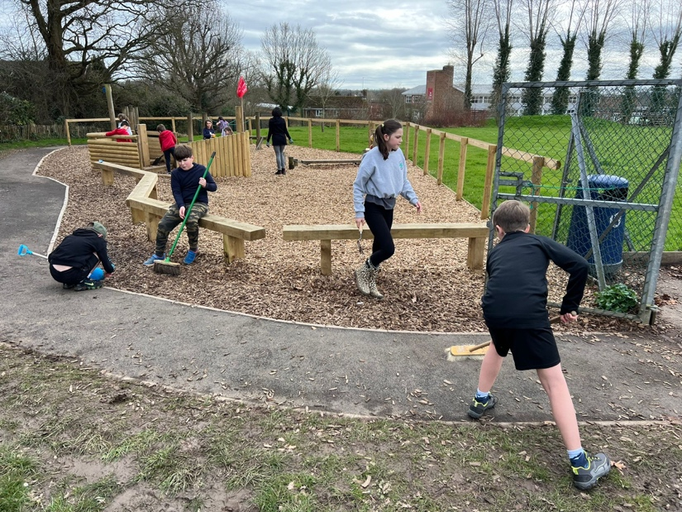
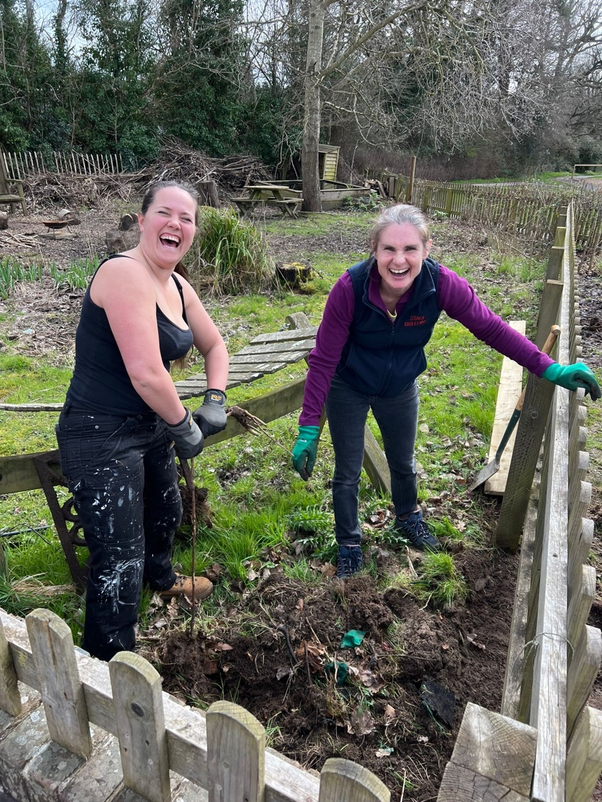
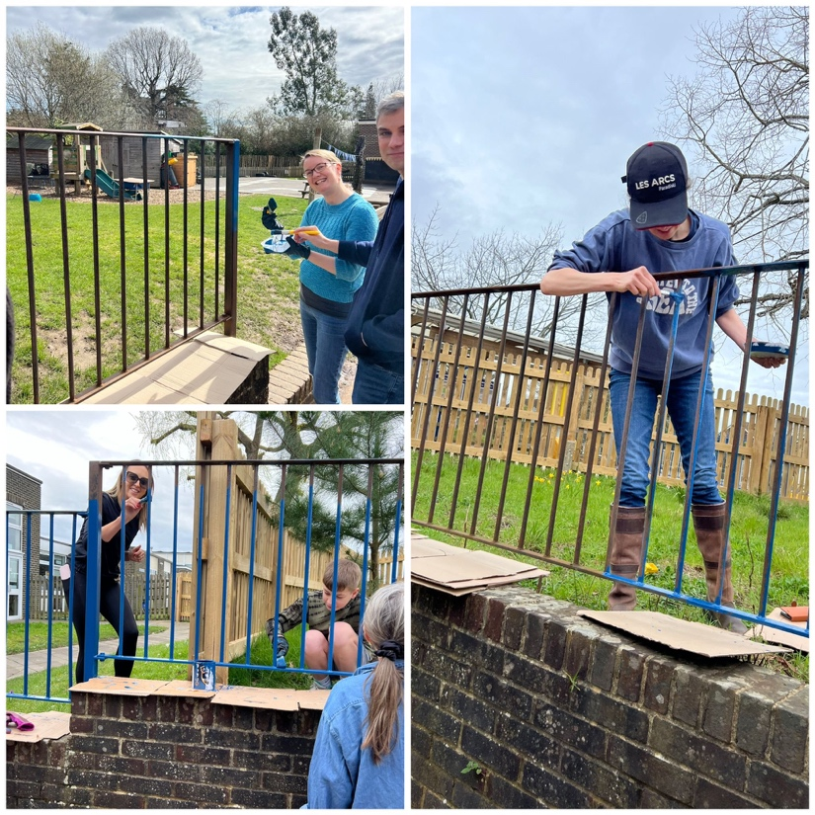
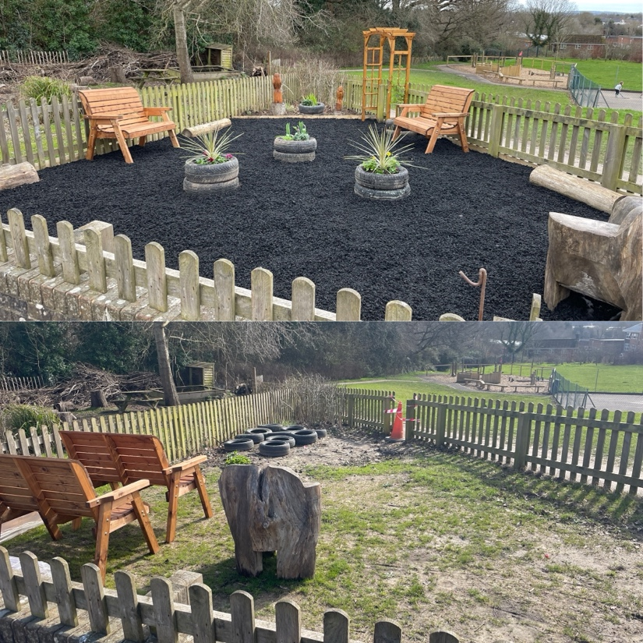
Newsletter 7th June
Learning, growing and achieving excellence together
Dear Parents and Carers,
It has been a fantastic first week back for Billingshurst Primary. Families were greeted with the new sign and logo, designed by Esmee in Year 6, marking the official change to academy status. We are thrilled to now be in part of "The Sussex Learning Trust" and are already seeing the benefits of working with like-minded schools in the Trust. The trust is currently supporting us with buildings project to include, improved safety at the front of the school with higher fences and also developing our EYFS learning environment.
Children were introduced to Teddy, the school dog, this week- he proved a big hit with all. Some of Teddy's work this week included introducing himself in assemblies, caring for some children who were feeling sad, supporting children who needed learning breaks, sitting with children whilst they rehearsed their times-tables and giving general cuddles throughout the school.
Congratulations to all the children who came to the Headteachers Picnic today. It was great fun getting to know the children, finding out more about their achievements and of course eating lots of food.
Please watch this space for news about wrap around care at school. This is something governors and I feel passionately about and will hopefully have some exciting news for you in a couple of weeks.
On a personal note, thank you for all your good wishes, it has been a great to be back with the children after my operation.
Have a wonderful weekend,
Ms Ley

Slide 2
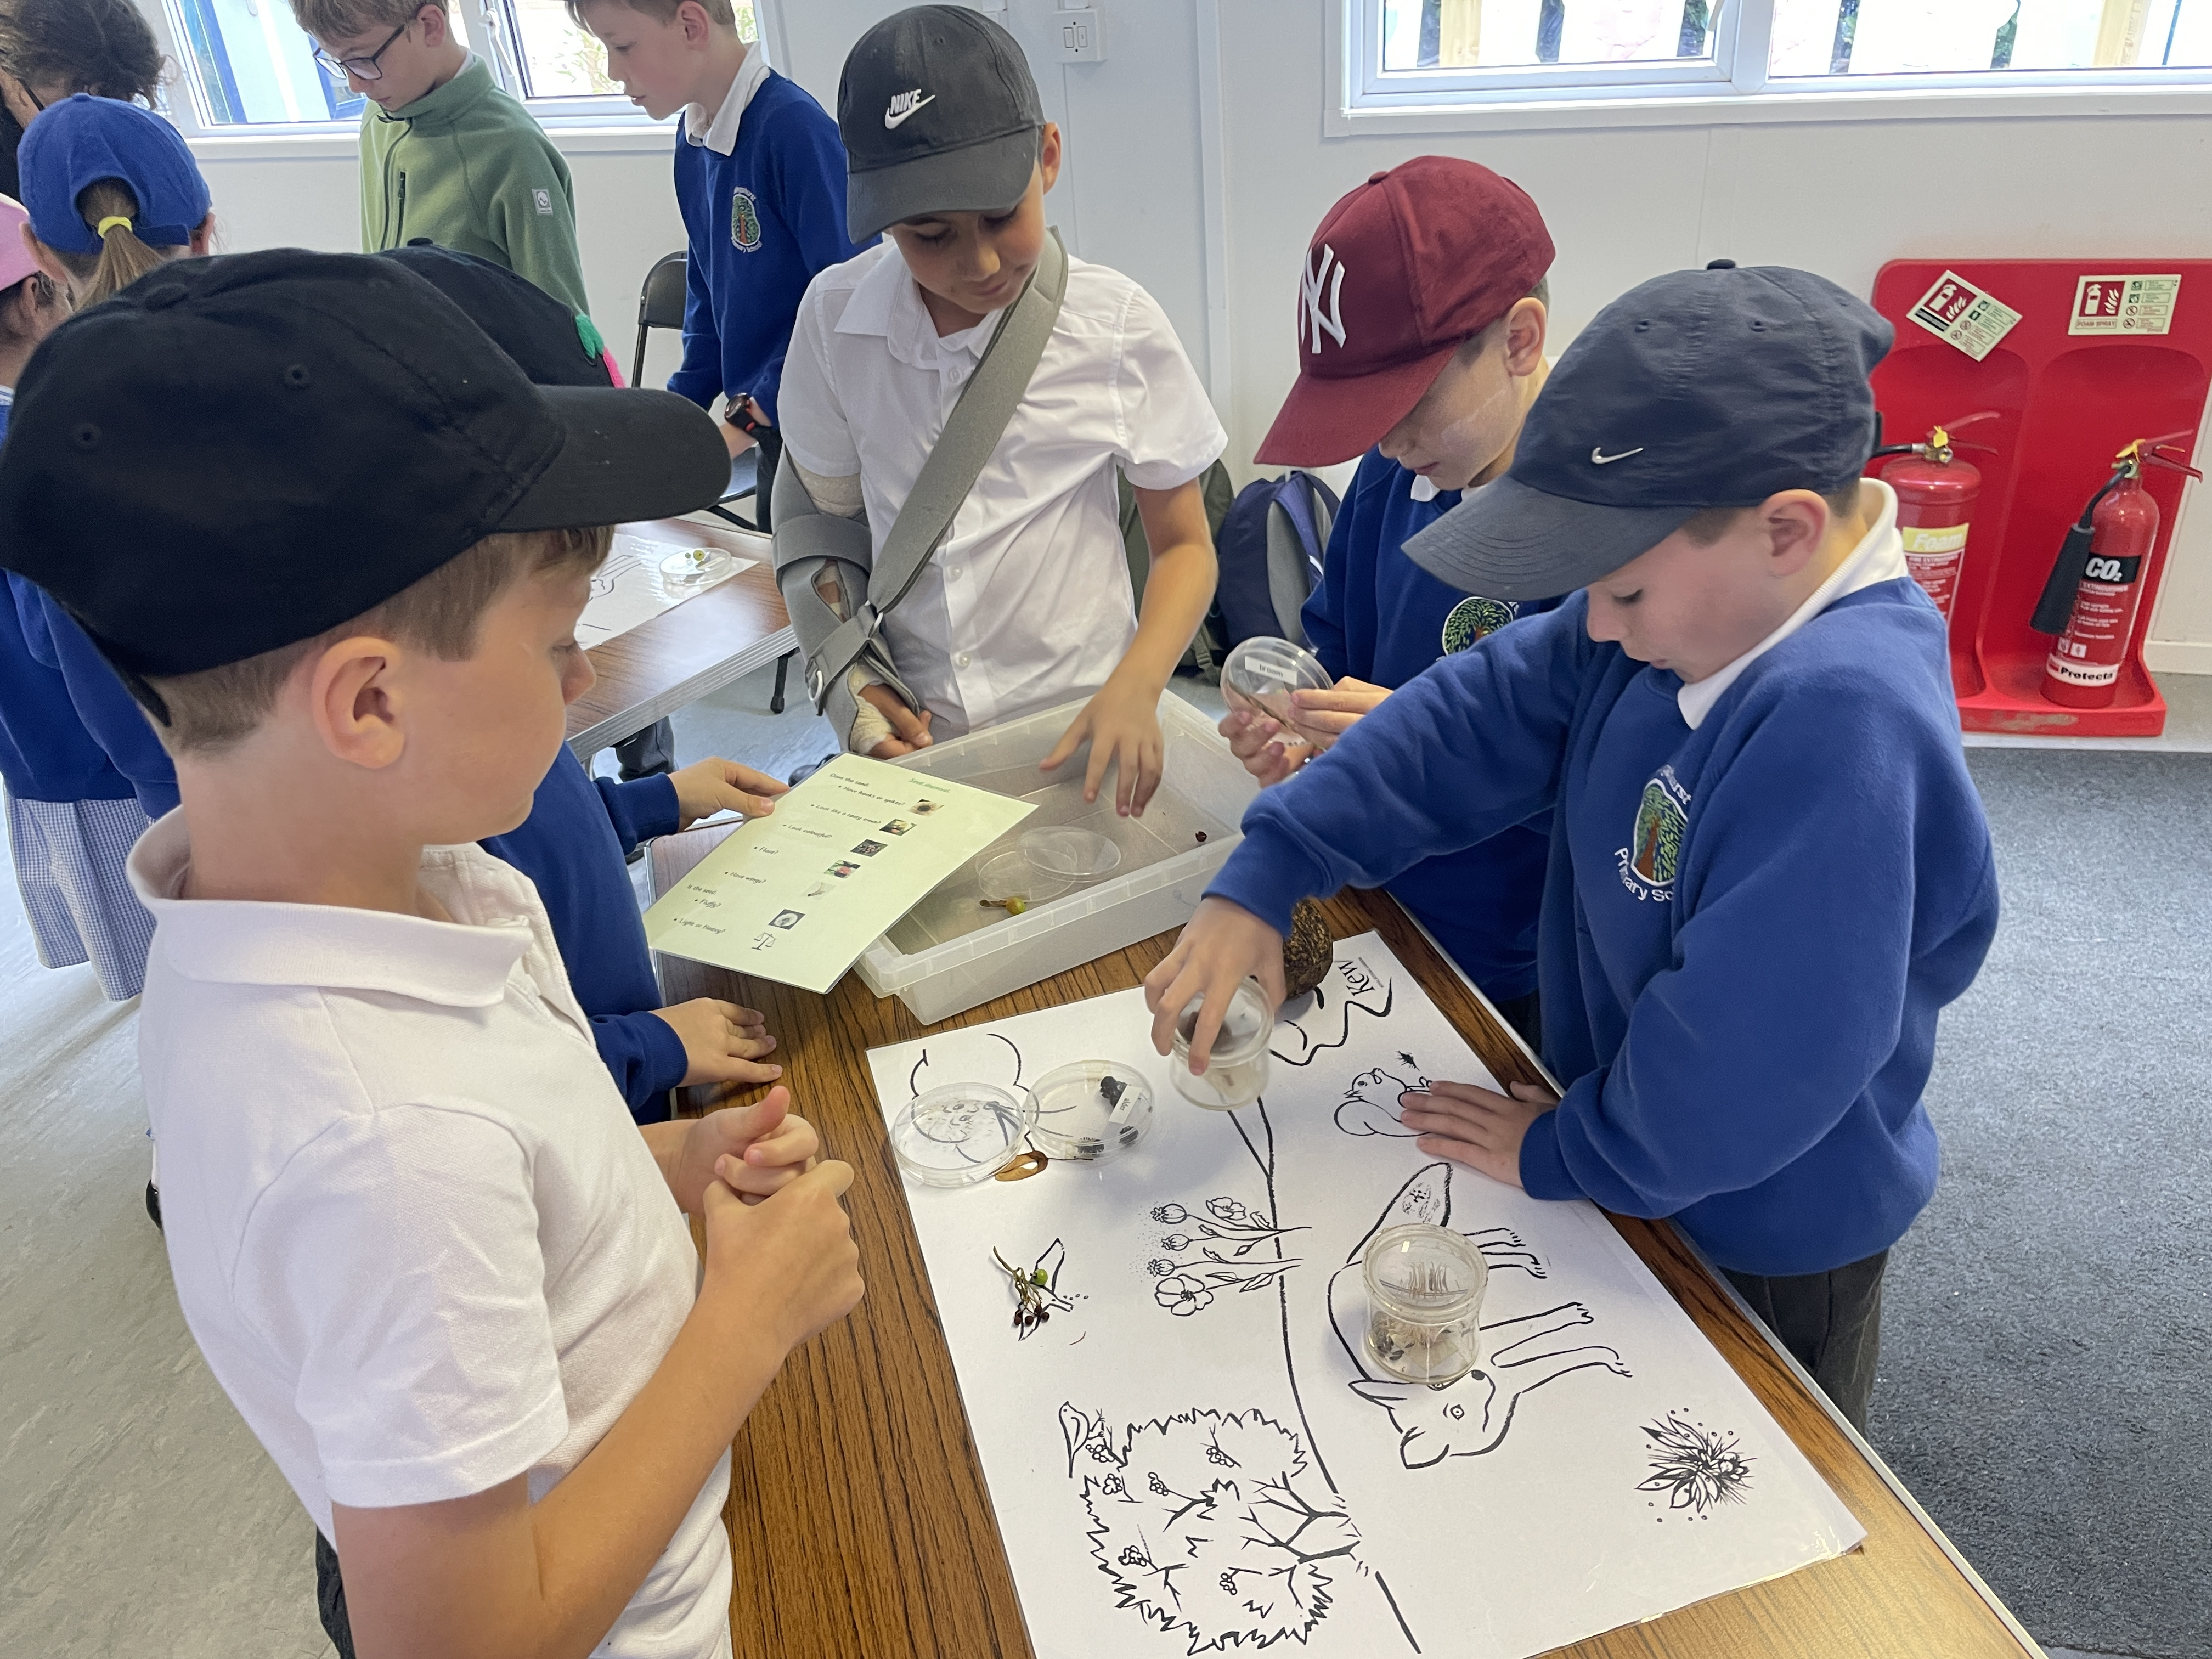
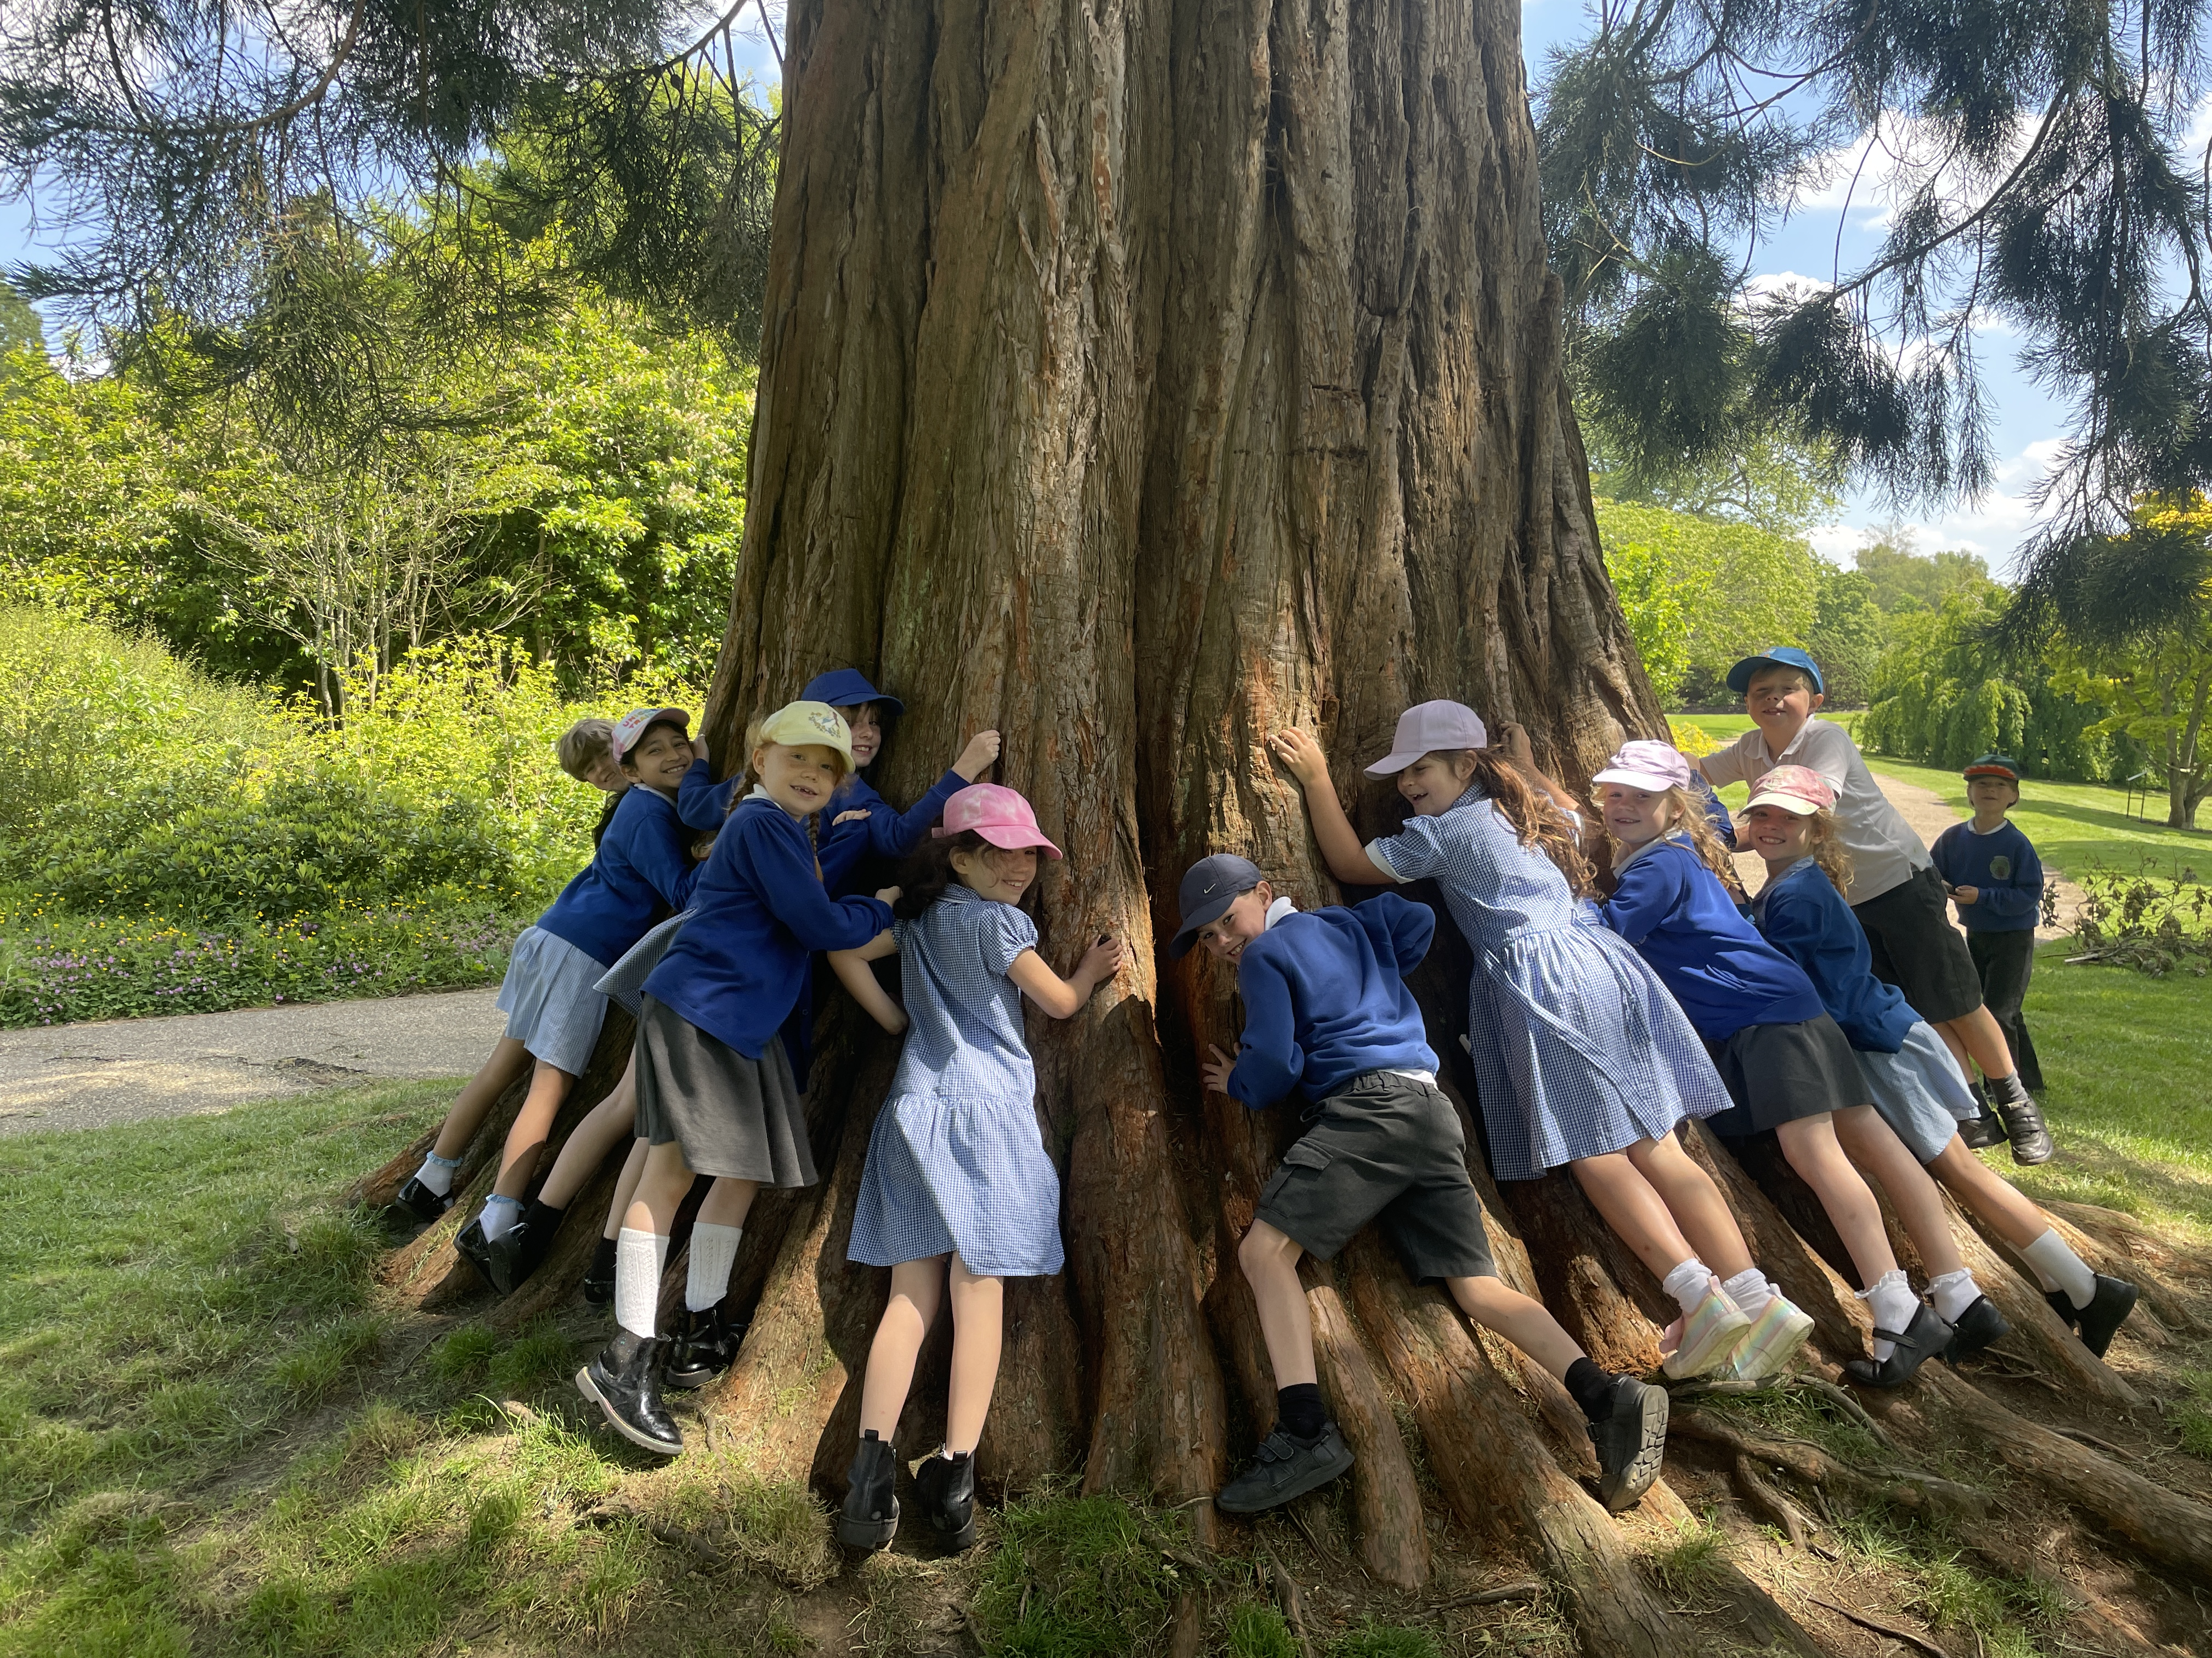
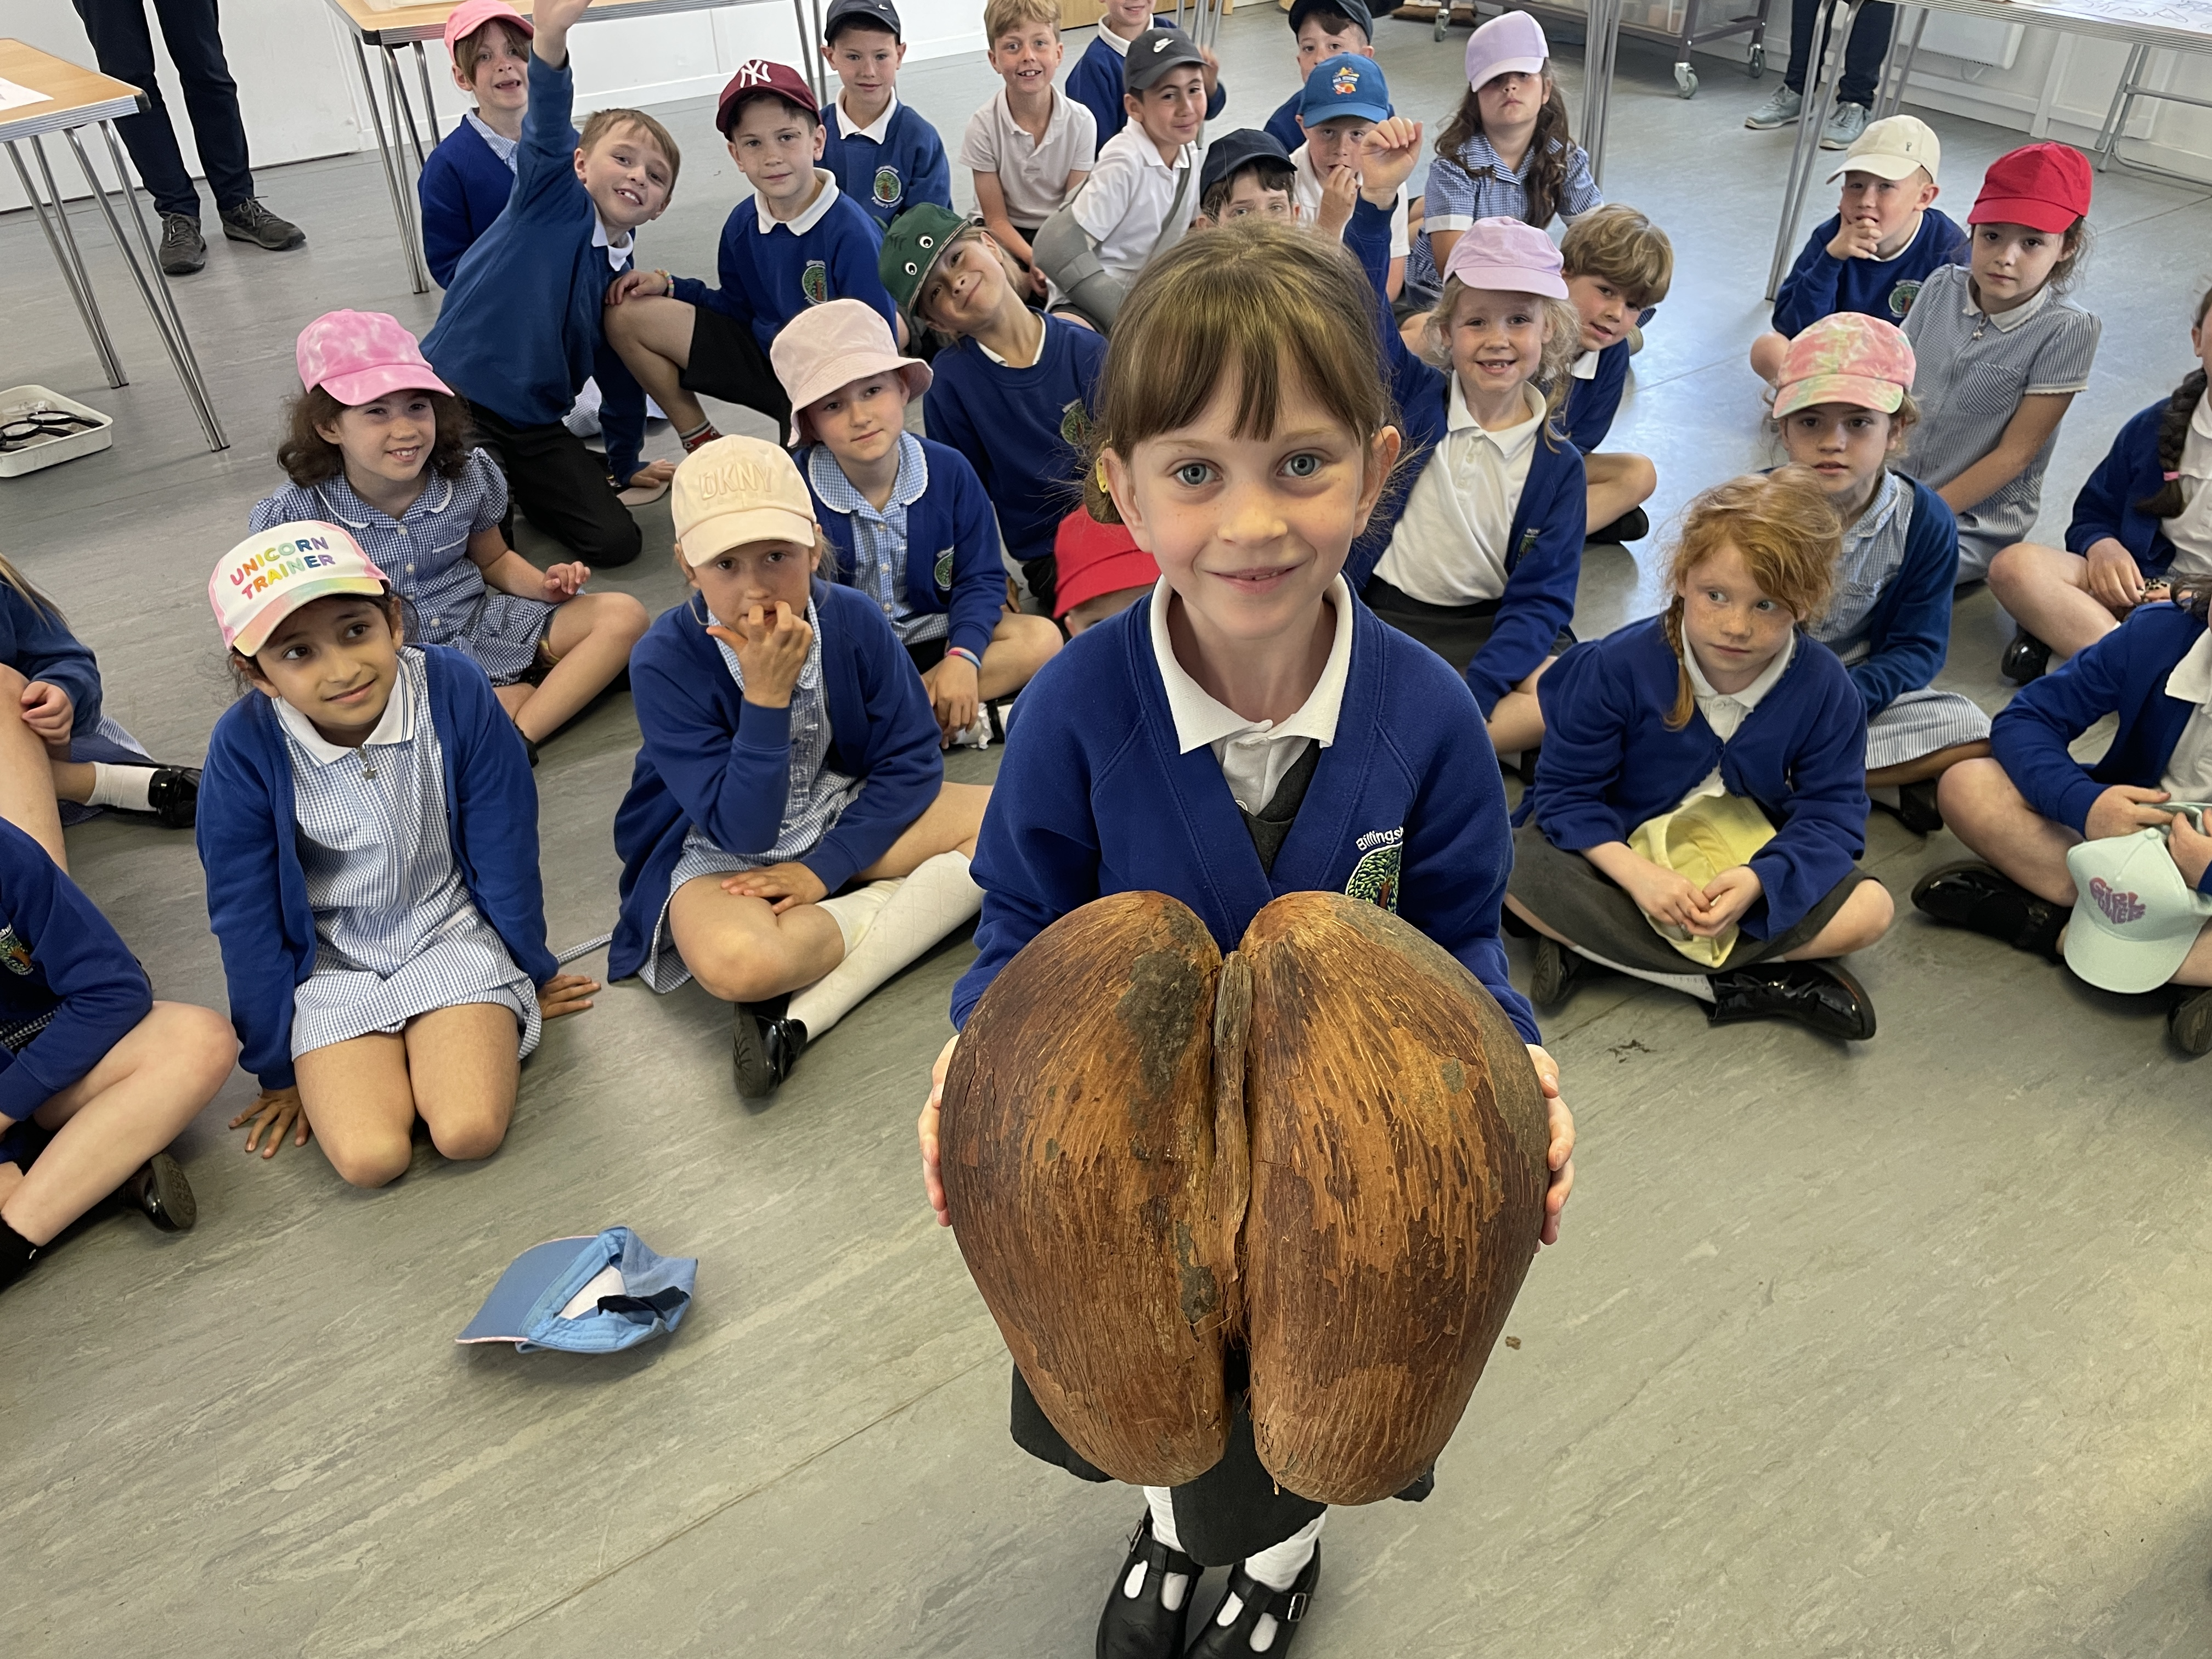
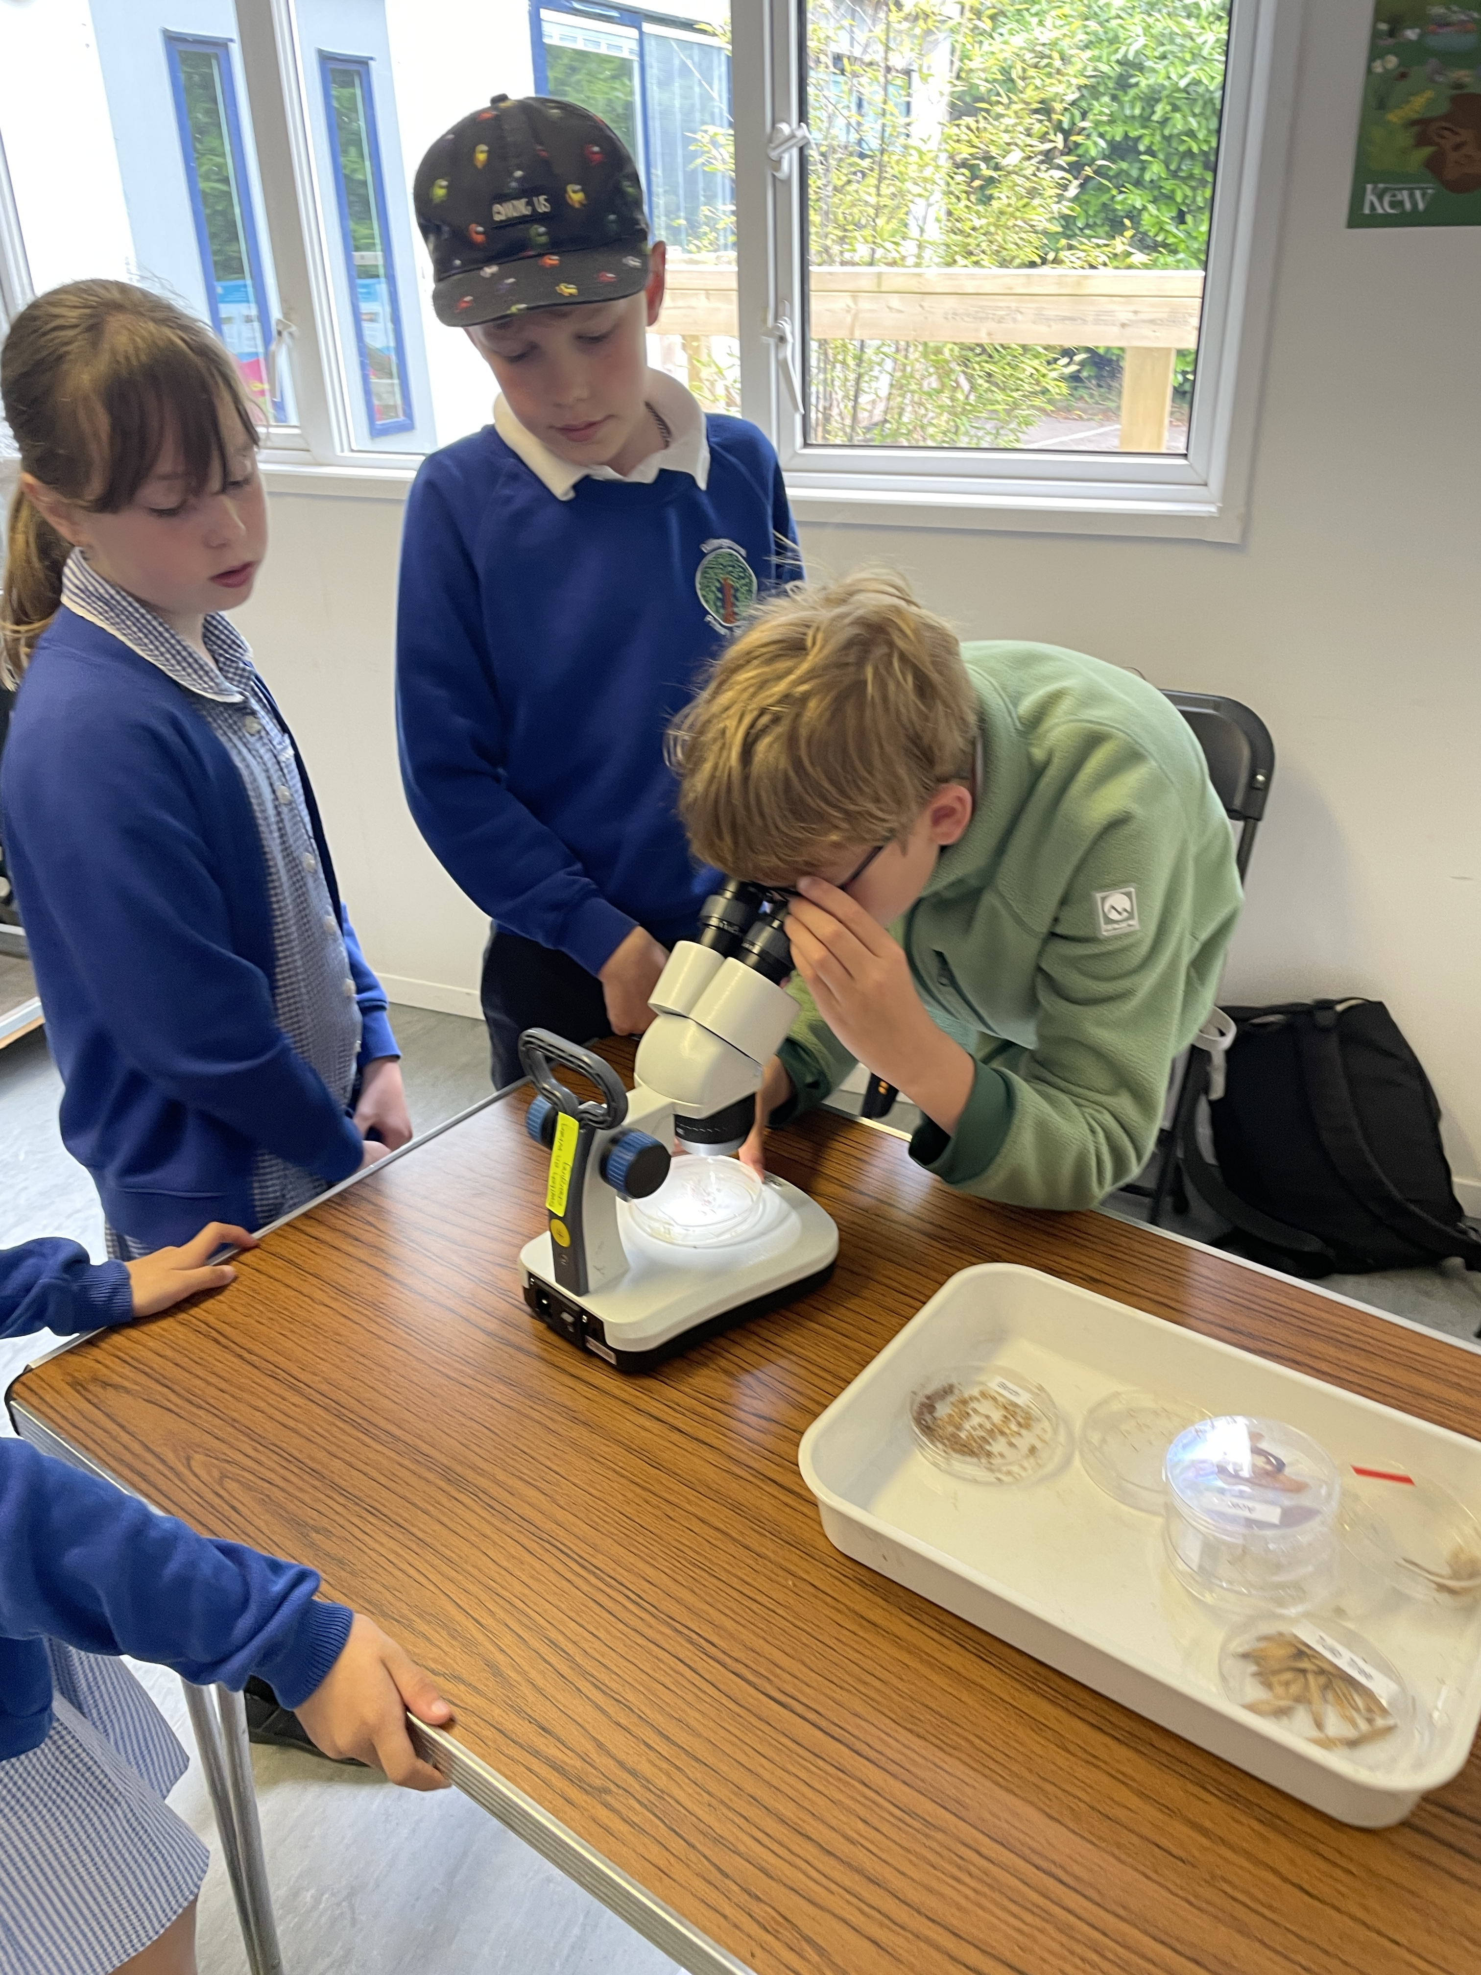
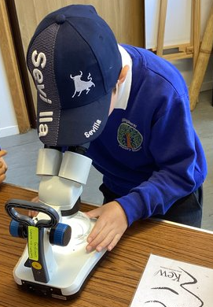
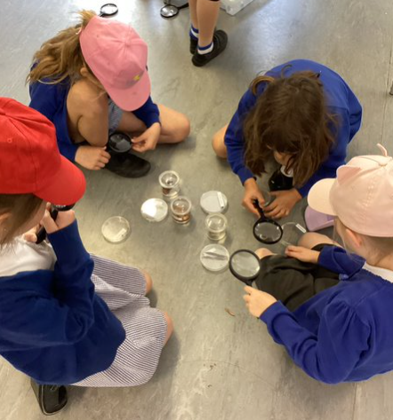
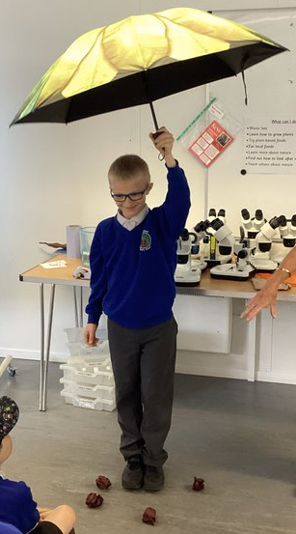
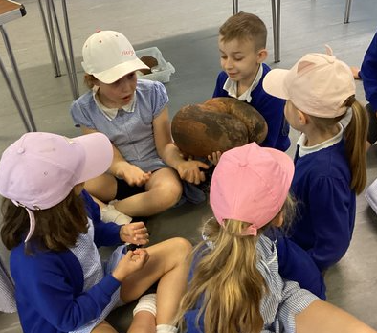
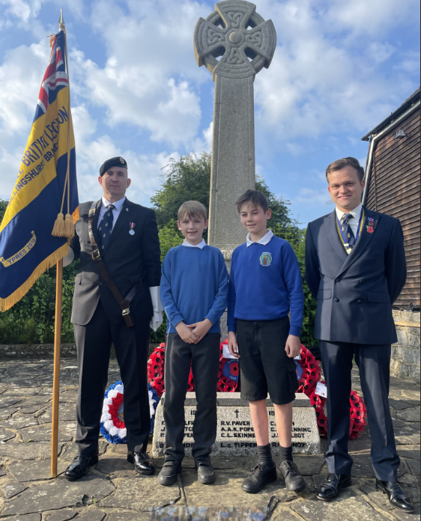
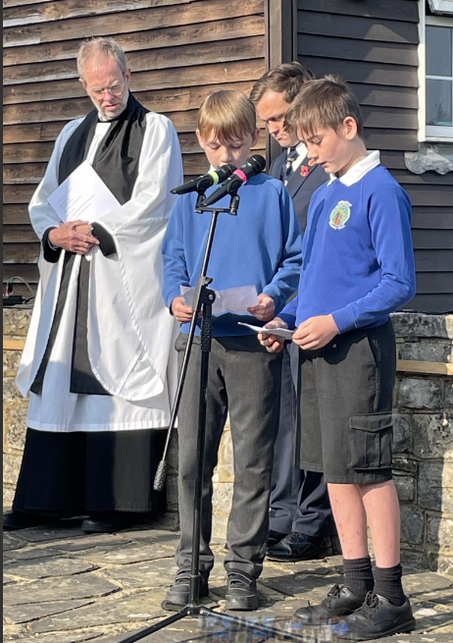
Year 3 Trip to Wakehurst Gardens:
This week, Year 3 enjoyed a fabulous trip to Wakehurst Gardens to enhance their science learning about plants. The children had a great day and learnt lots about seeds, seed dispersal and the parts of a plant. During the day, they were also able to explore the beautiful gardens and look closely at different seeds through microscopes. The children were fantastic throughout and a credit to themselves and our school!
EYFS
This week we had our 'New Parents Evening'. We had a large selection of the children's wonderful work from across the school on show; it was great to see such fabulous work all together in one place. It was also a pleasure to have some of our school council present to talk about how brilliant our school is.
To commemorate the 80th anniversary of D-Day, Billingshurst Royal British Legion led a service of wreath laying early on Thursday morning at the war memorial. Arlo and Freddie (Yr6) read the proclamation at the end of the service. It was a very moving event and both boys read clearly and calmly. We were extremely proud of how they conducted themselves at this very important event.
Year 6 Don't forget to follow us on X (Twitter) to see pictures of our adventures at Tile Barn next week! @BPSYearSix

Slide 3
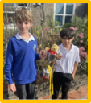
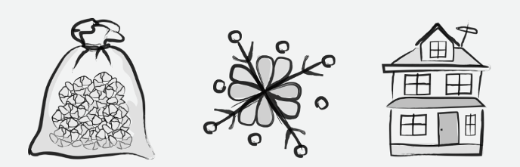
BPACA - Summer Fun Day 6 July 11am-2pm. We need your help! Donations of cuddly toys and tombola prizes for both children and adults can be left in the main office. There will be lots of exciting things going on including, tombola, bouncy castles, raffles and much more!
Note from the Governors - As I am sure you will have seen by now, we completed our transfer to Sussex Learning Trust on 1st June. I had planned to confirm this in the last parent newsletter just before half term but with the election announced, we were advised there was a risk of our transfer being impacted. We are delighted to build on the strong relationships that have been developed over the last year and the opportunities being part of this Trust brings to our school.
House Point Results
Winning House - Goodwood
Thank you to our sponsors for their support!
Cowdray
578
Parham
593
Goodwood
662
Petworth
604
Gil Parham Woodside Sculpture
www.woodlouseindustries.com
Upcoming dates:
10th-14th June – Yr 6 Tile Barn residential & Activity Week
Tuesday 18th June – Yr3 Ukulele Concerts
(Morocco – 9:30am, Egypt - 10:15am, Madagascar – 11:00am)
Tuesday 18th June: Yr 2 trip Arundel Castle
Tuesday 25th June: Transition day
Tuesday 16th July – Year 6 Production (2pm)
Wednesday 17th July – Year 6 Production (2pm and 6pm)
Letters home this week: Dance 2024 letter (Year 4 and 5) Year 6 Disco, Talented athletes (Year 5), Mixing Classes
Best quality Blast-frozen Family run
www.tomthefish.co.uk
@BPSEYFS
@BPSYearOne
@BPSYearTwo
@BPSYearThree
@BPSYearFour
@BPSYearFive
@BPSYearSix
Year groups regularly post photos of children and learning on their X account. Please follow your child’s Year Group using the handles above.
www.professionalrubbersurfaces.com
The Budding Foundation
Follow us on Facebook for all the latest updates:
www.facebook.com/BillingshurstPrimary

