Slide 1
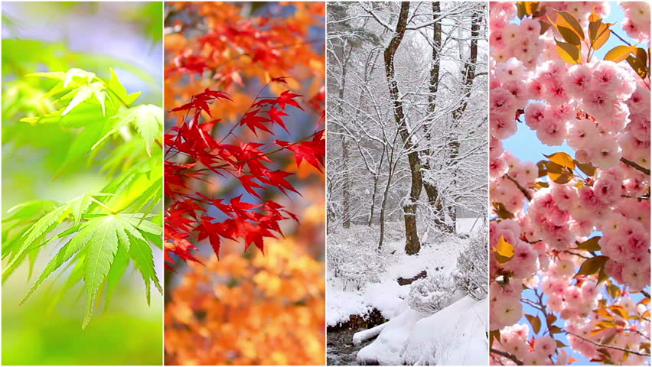
As athletes, we will be learning how to throw a ball underarm in order to pass to team mates. We will be working on our skills of rolling a ball accurately towards a target. Inside, we will be responding to rhythm and pattern through movements in order to express ourselves.
As readers and writers, we will be writing simple sentences to inform what the wind blew. We will be writing an Autumn poem and learning how to sequence sentences to form a short story. We will be learning how to persuade our grown-ups to come to our Christmas production and writing to inform by filming our own weather forecasts.
As members of the school community, we will be exploring how our faces and body language change based on how we are feeling. We will be identifying different emotions and how we can support ourselves and others when they are feeling different emotions.
As artists, we will be exploring the work of Eric Carle to recreate his techniques by learning the skill of colour mixing and printing using both natural and man made objects. The children will the use their paper to create a collage that depicts a season.
As scientists, we will be observing simple changes over time and identifying seasonal changes. We will be performing simple tests and explaining the results we found.
As mathematicians, we will be learning about patterns in order to copy, extend and design our own by creating our own Christmas wrapping paper. We will be identifying and comparing 2D and 3D shapes. We will be using the part whole model to partition numbers one to ten.
As designers, we will design our own Christmas card with a lever to create a moving part. We will learn how to join materials together and then evaluate our product.
As geographers, we will be identifying weather patterns in the United Kingdom and learning about extreme weather conditions. We will think about the potential affects of extreme weather and how these events have affected the UK in the past.
Why is weather wonderful?
As computer scientists, we will be using iPads and cameras to record our weather reports.
Key texts and complimentary reading:
‘The Wind Blew’ by Pat Hutchins
‘The Snowman’ by Raymond Briggs
'After the Storm' by Nick Butterworth
'We're Going on a Leaf Hunt' by Steve Metzger
As faith leaders, we will be learning about why and how Hindus celebrate Diwali and Christians celebrate Christmas. We will be exploring similarities and differences between the two celebrations.
As musicians, we will be exploring the composition of reggae music to learn and perform a song. We will also be learning Christmas songs to perform during our Christmas play.

