Slide 1

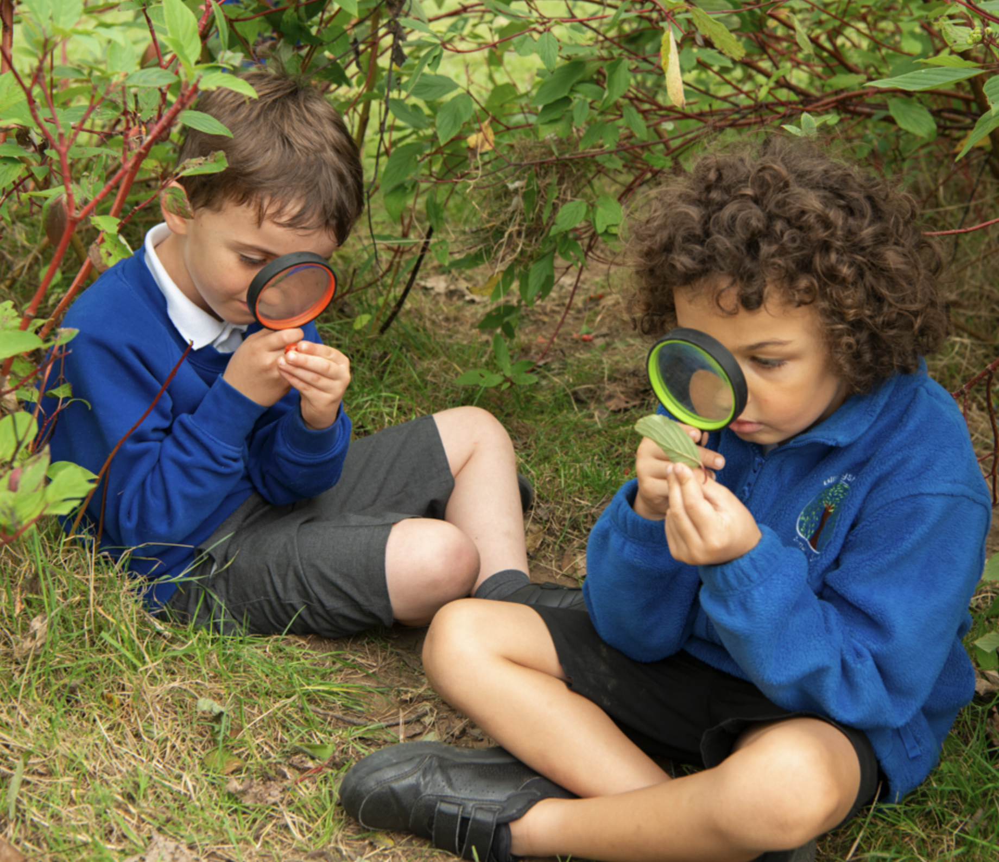
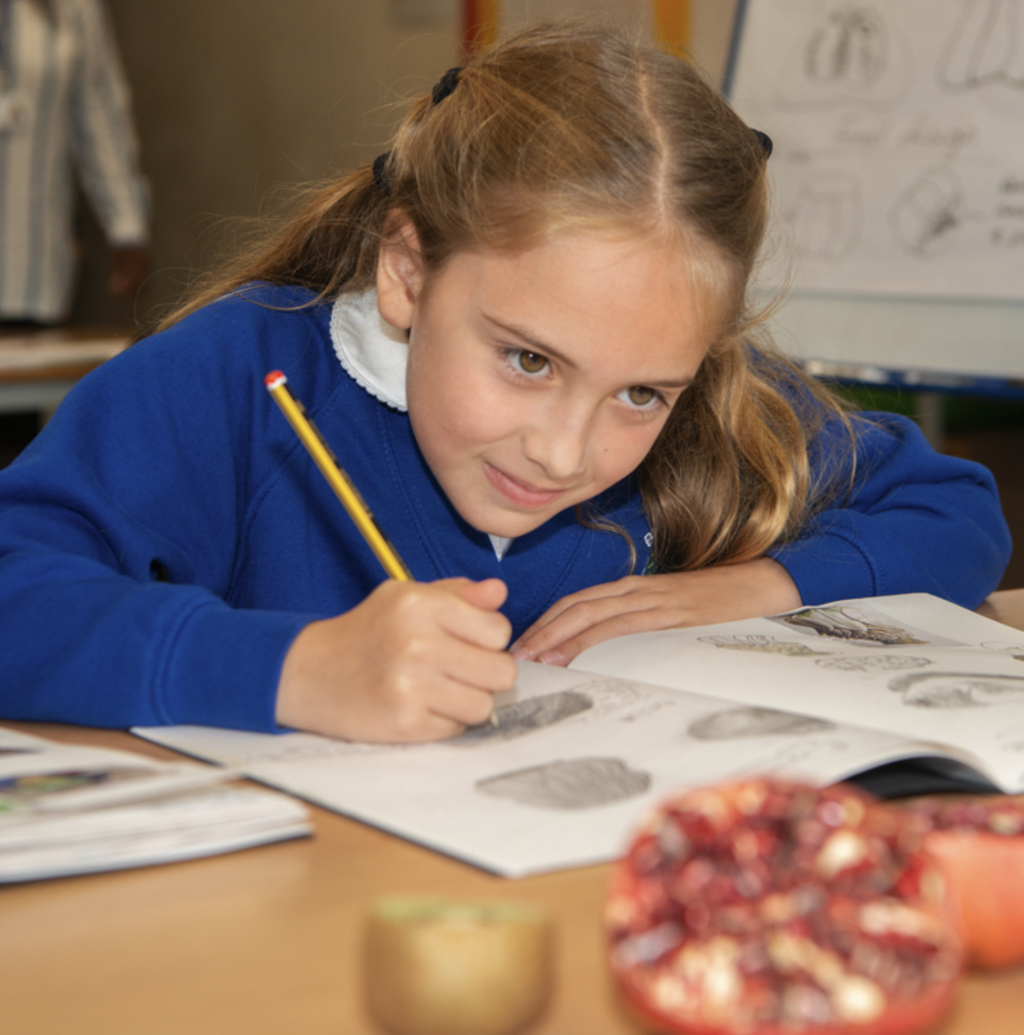
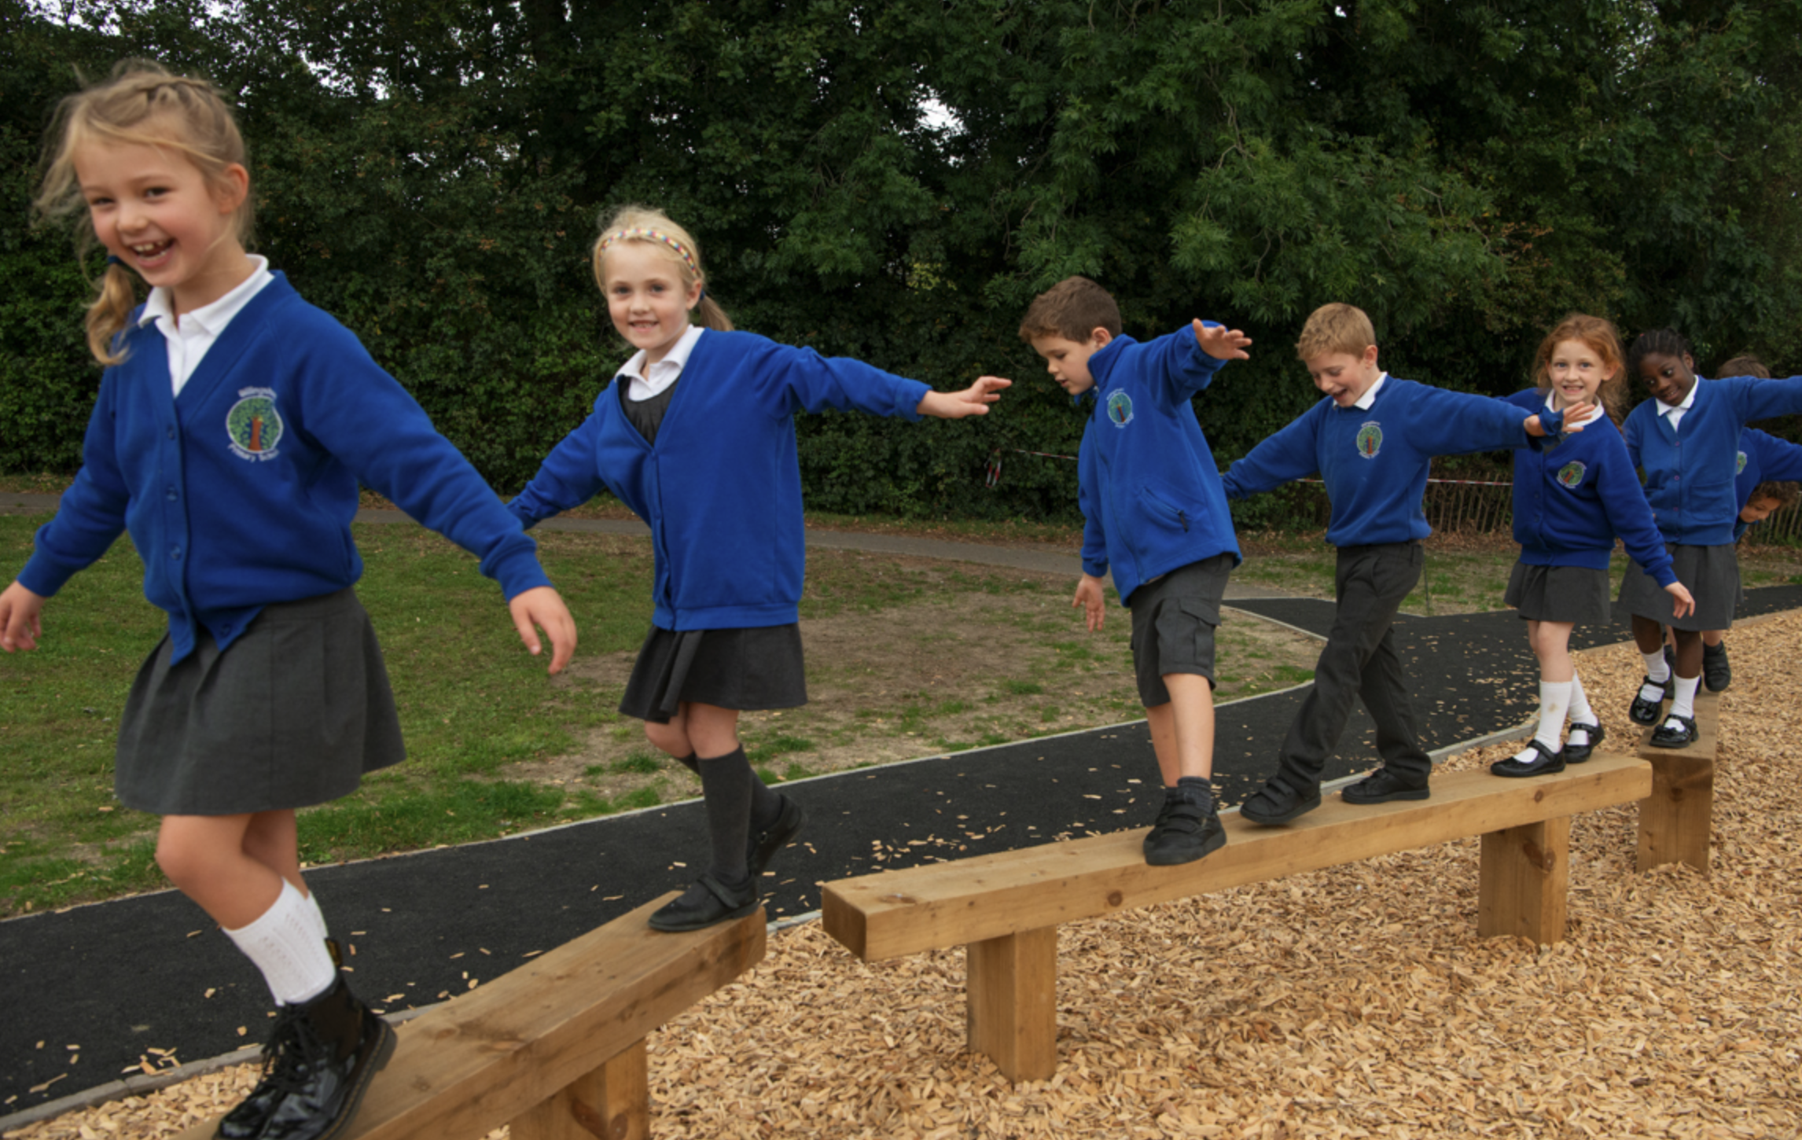
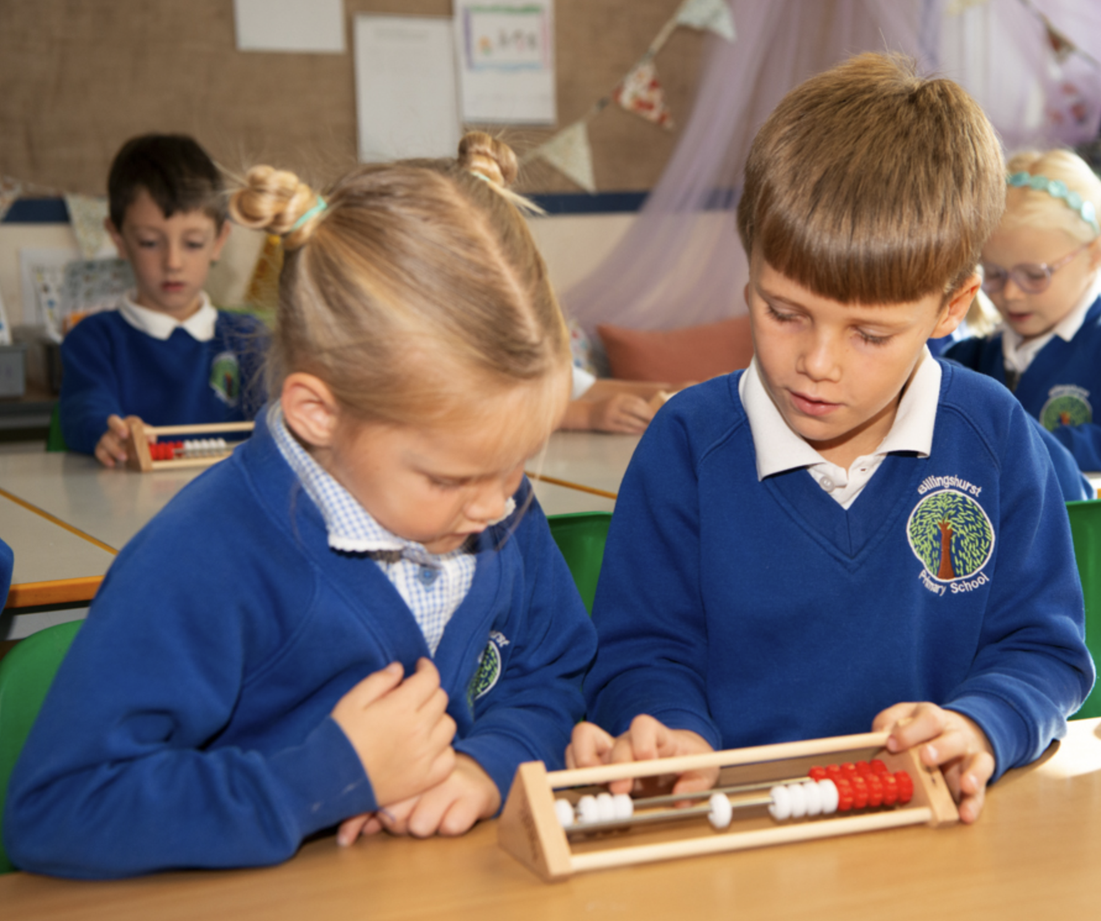
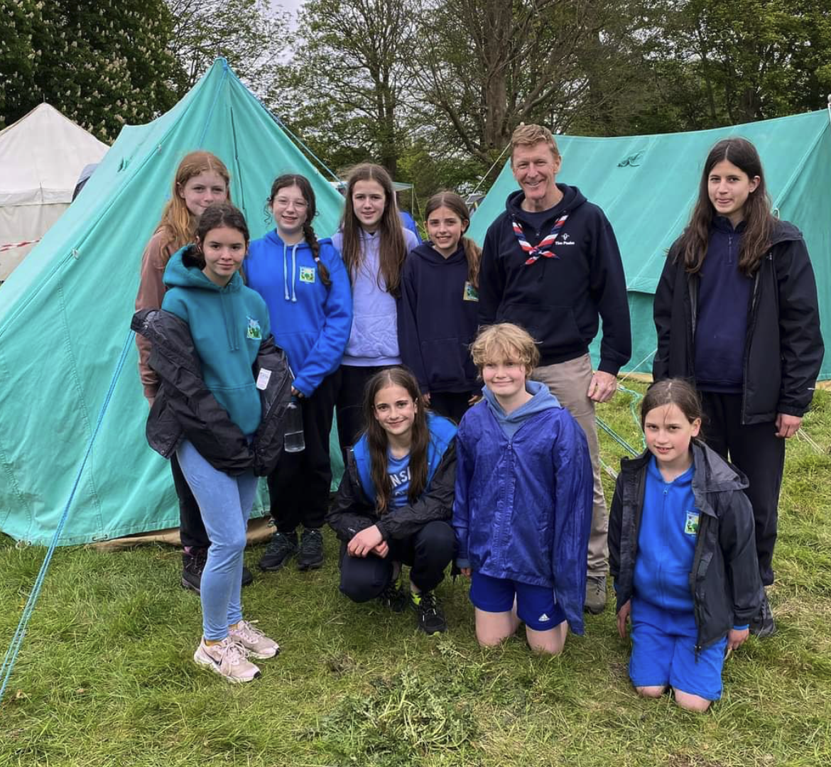
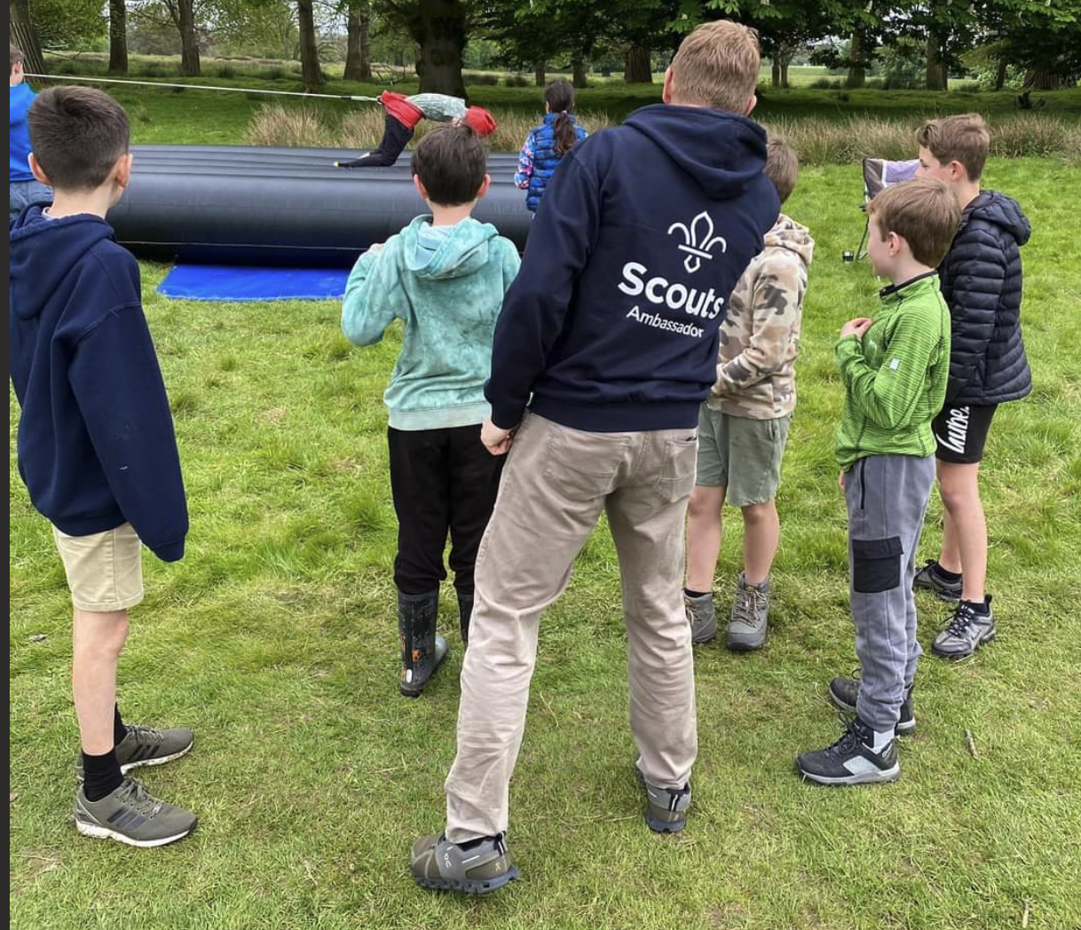
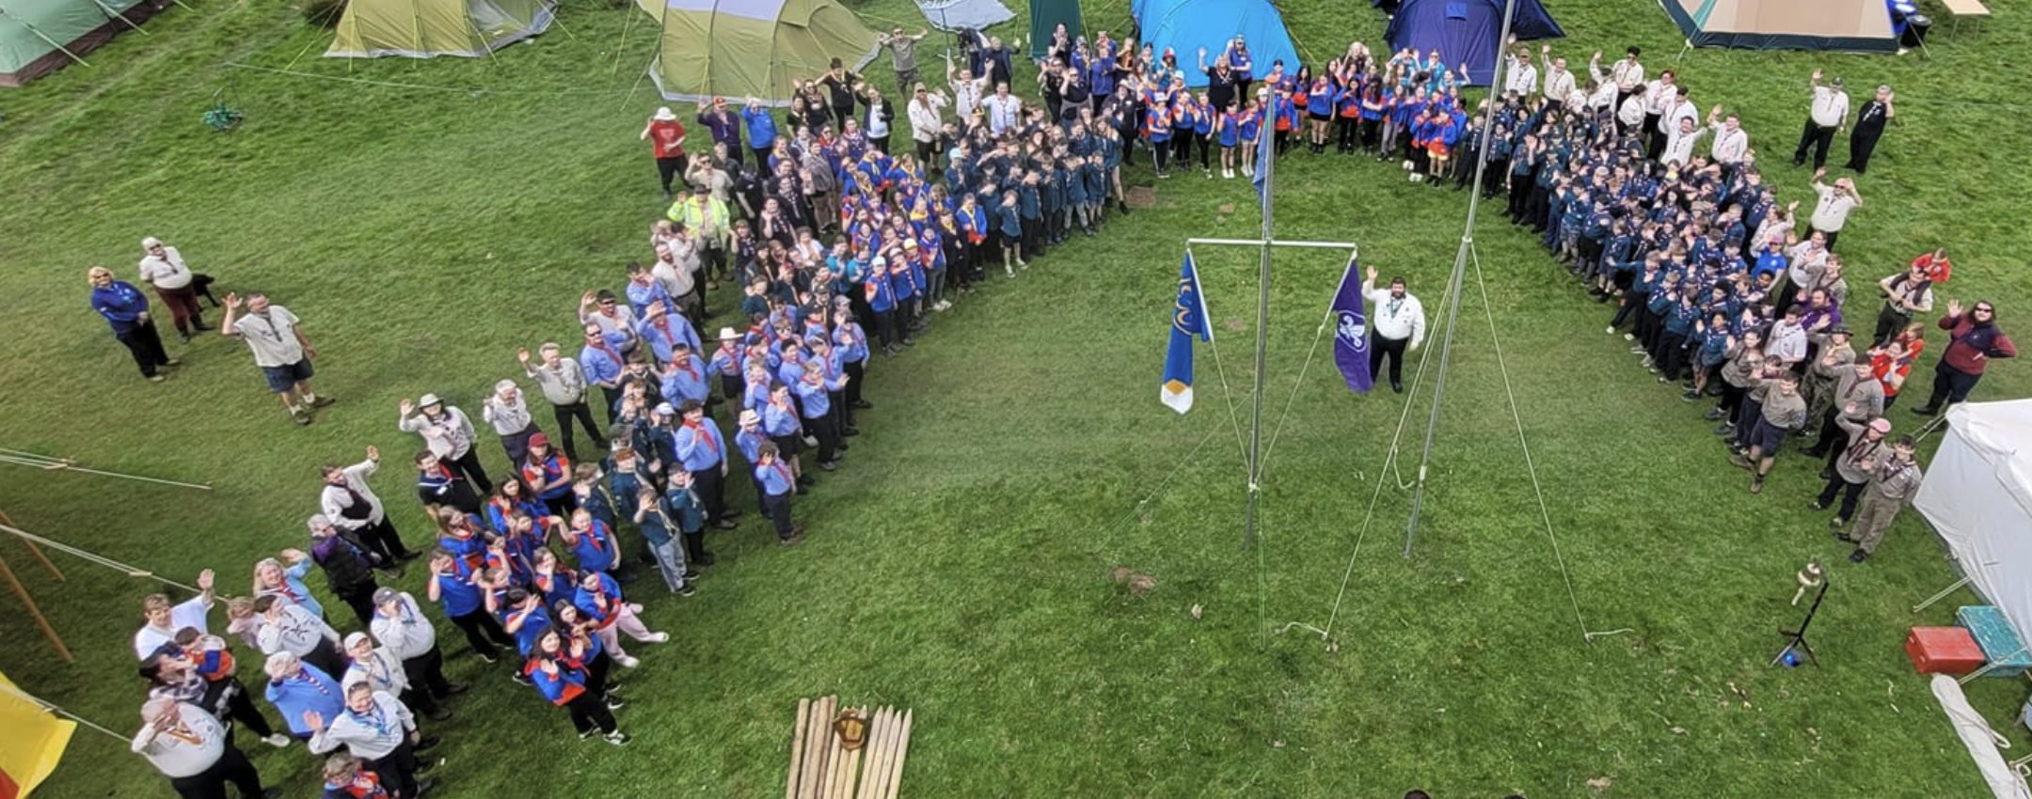
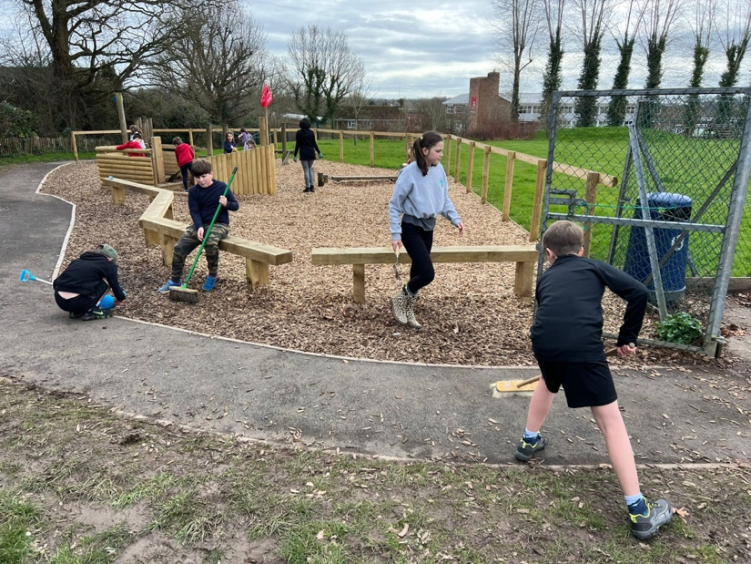
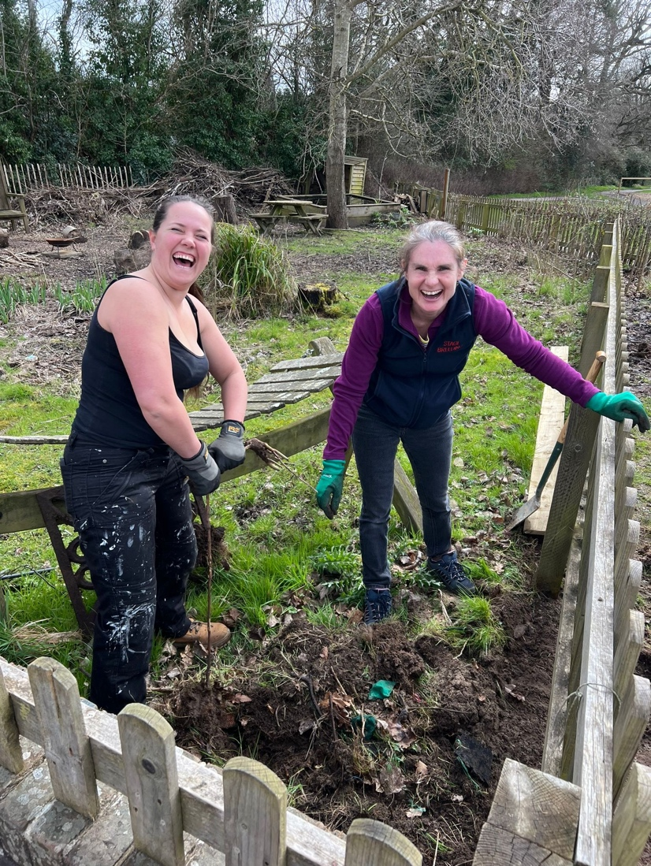
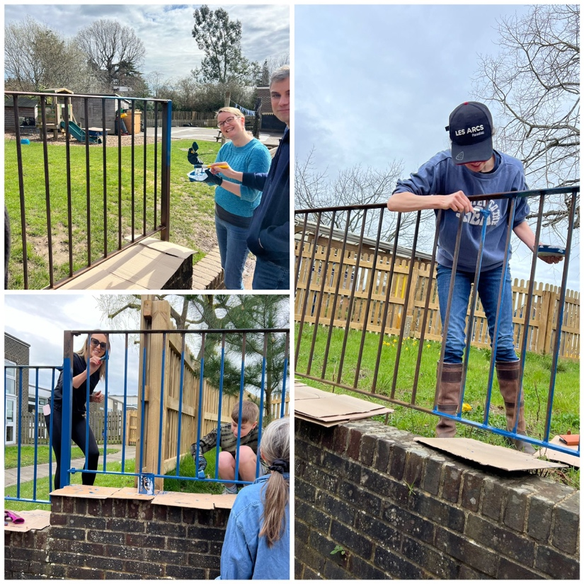
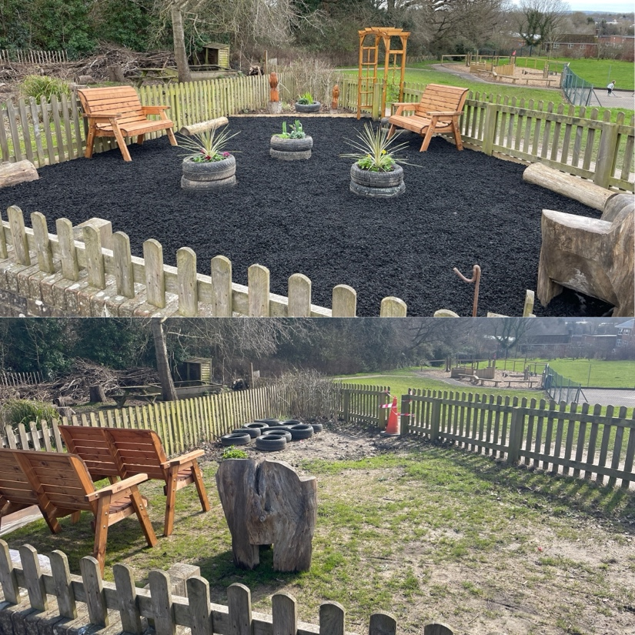
Newsletter 10th May
Learning, growing and achieving excellence together
Dear Parents and Carers,
It has been wonderful being a part of Billingshurst in the sunshine this week; it is truly a wonderful place to be. The children have been enjoying the outdoors and staff have been working hard to plan provision and learning experiences in the sunshine.
We welcomed some of our new reception in-take this week for craft and play after school. Thank you to our Early Years team for making this a fantastic event.
Staff have been working hard planning events where we can welcome you to the school and share learning and fun with your children. I have detailed these opportunities for you below in the newsletter.
Today is my last day at school before my operation on Monday and recovery time. I can honestly say that the last four weeks have joyful, meeting children, parents and staff and working together to lay the foundations for great things. I will still be online whilst I'm away and look forward to seeing you all after half term.
Ms Ley
Billingshurst Scouts and Guides meet Tim Peake
Many of our children, past and present, took part in the Scouts & Guides District Annual camp where they were joined by astronaut Tim Peake, who wrote this message on his Facebook page.
"I had a great time this weekend visiting the Petworth and Pulborough District Annual Scout and Guide camp. It is set in the glorious Petworth Park at the very heart of the South Downs National Park.
There was so much on offer for our Scouts and Guides; climbing, abseiling, target shooting, cooking, crafts, gladiator challenges, axe throwing, archery, paddle boarding and more … It was great to see them embracing the experience of living outdoors and getting to know other young people from the District.
A huge thank you to the volunteers and leaders for giving our young people such a great weekend and huge congratulations to the Scouts, Guides and Explorers for being so awesome."

Slide 2


We are working hard to improve your experiences as parents of Billingshurst Primary School and have organised some extra events to welcome you into school.
Please see below a list of parent events for the rest of the summer term. More information on each event will follow nearer the time.
Open classrooms Wednesday 22nd May
2:45pm EYFS & KS1 parents; 3:05pm KS2 parents
Classrooms will be open for parents to come in and share learning with their children. This will be an informal opportunity for parents to view work, classrooms and the learning environment.
SEN Coffee morning
Wednesday 5TH June 8:45am in the KS2 school hall
A chance for parents and carers of children with additional needs to talk to the Headteacher, SENDCos and other parents.
Summer Fun Day
Saturday 6th July – 11:00am – 2:00pm
Join us for games, raffles, crafts, food, giant inflatables and lots more!
The whole event is to raise funds for our school.
Sports days’ picnics
Tuesday 9th July EYFS & KS1 and Thursday 11th July KS2 - all morning
Bring a picnic lunch to Sports day to share with your children after the events on the school grounds. Children without parents attending will be looked after by staff or join other families and friends to eat.
Headteacher and SLT presentation
Monday 15th July 6:00pm in KS2 school hall
An evening presentation of strategic school improvement work so far this term and plans for next year.

Slide 3
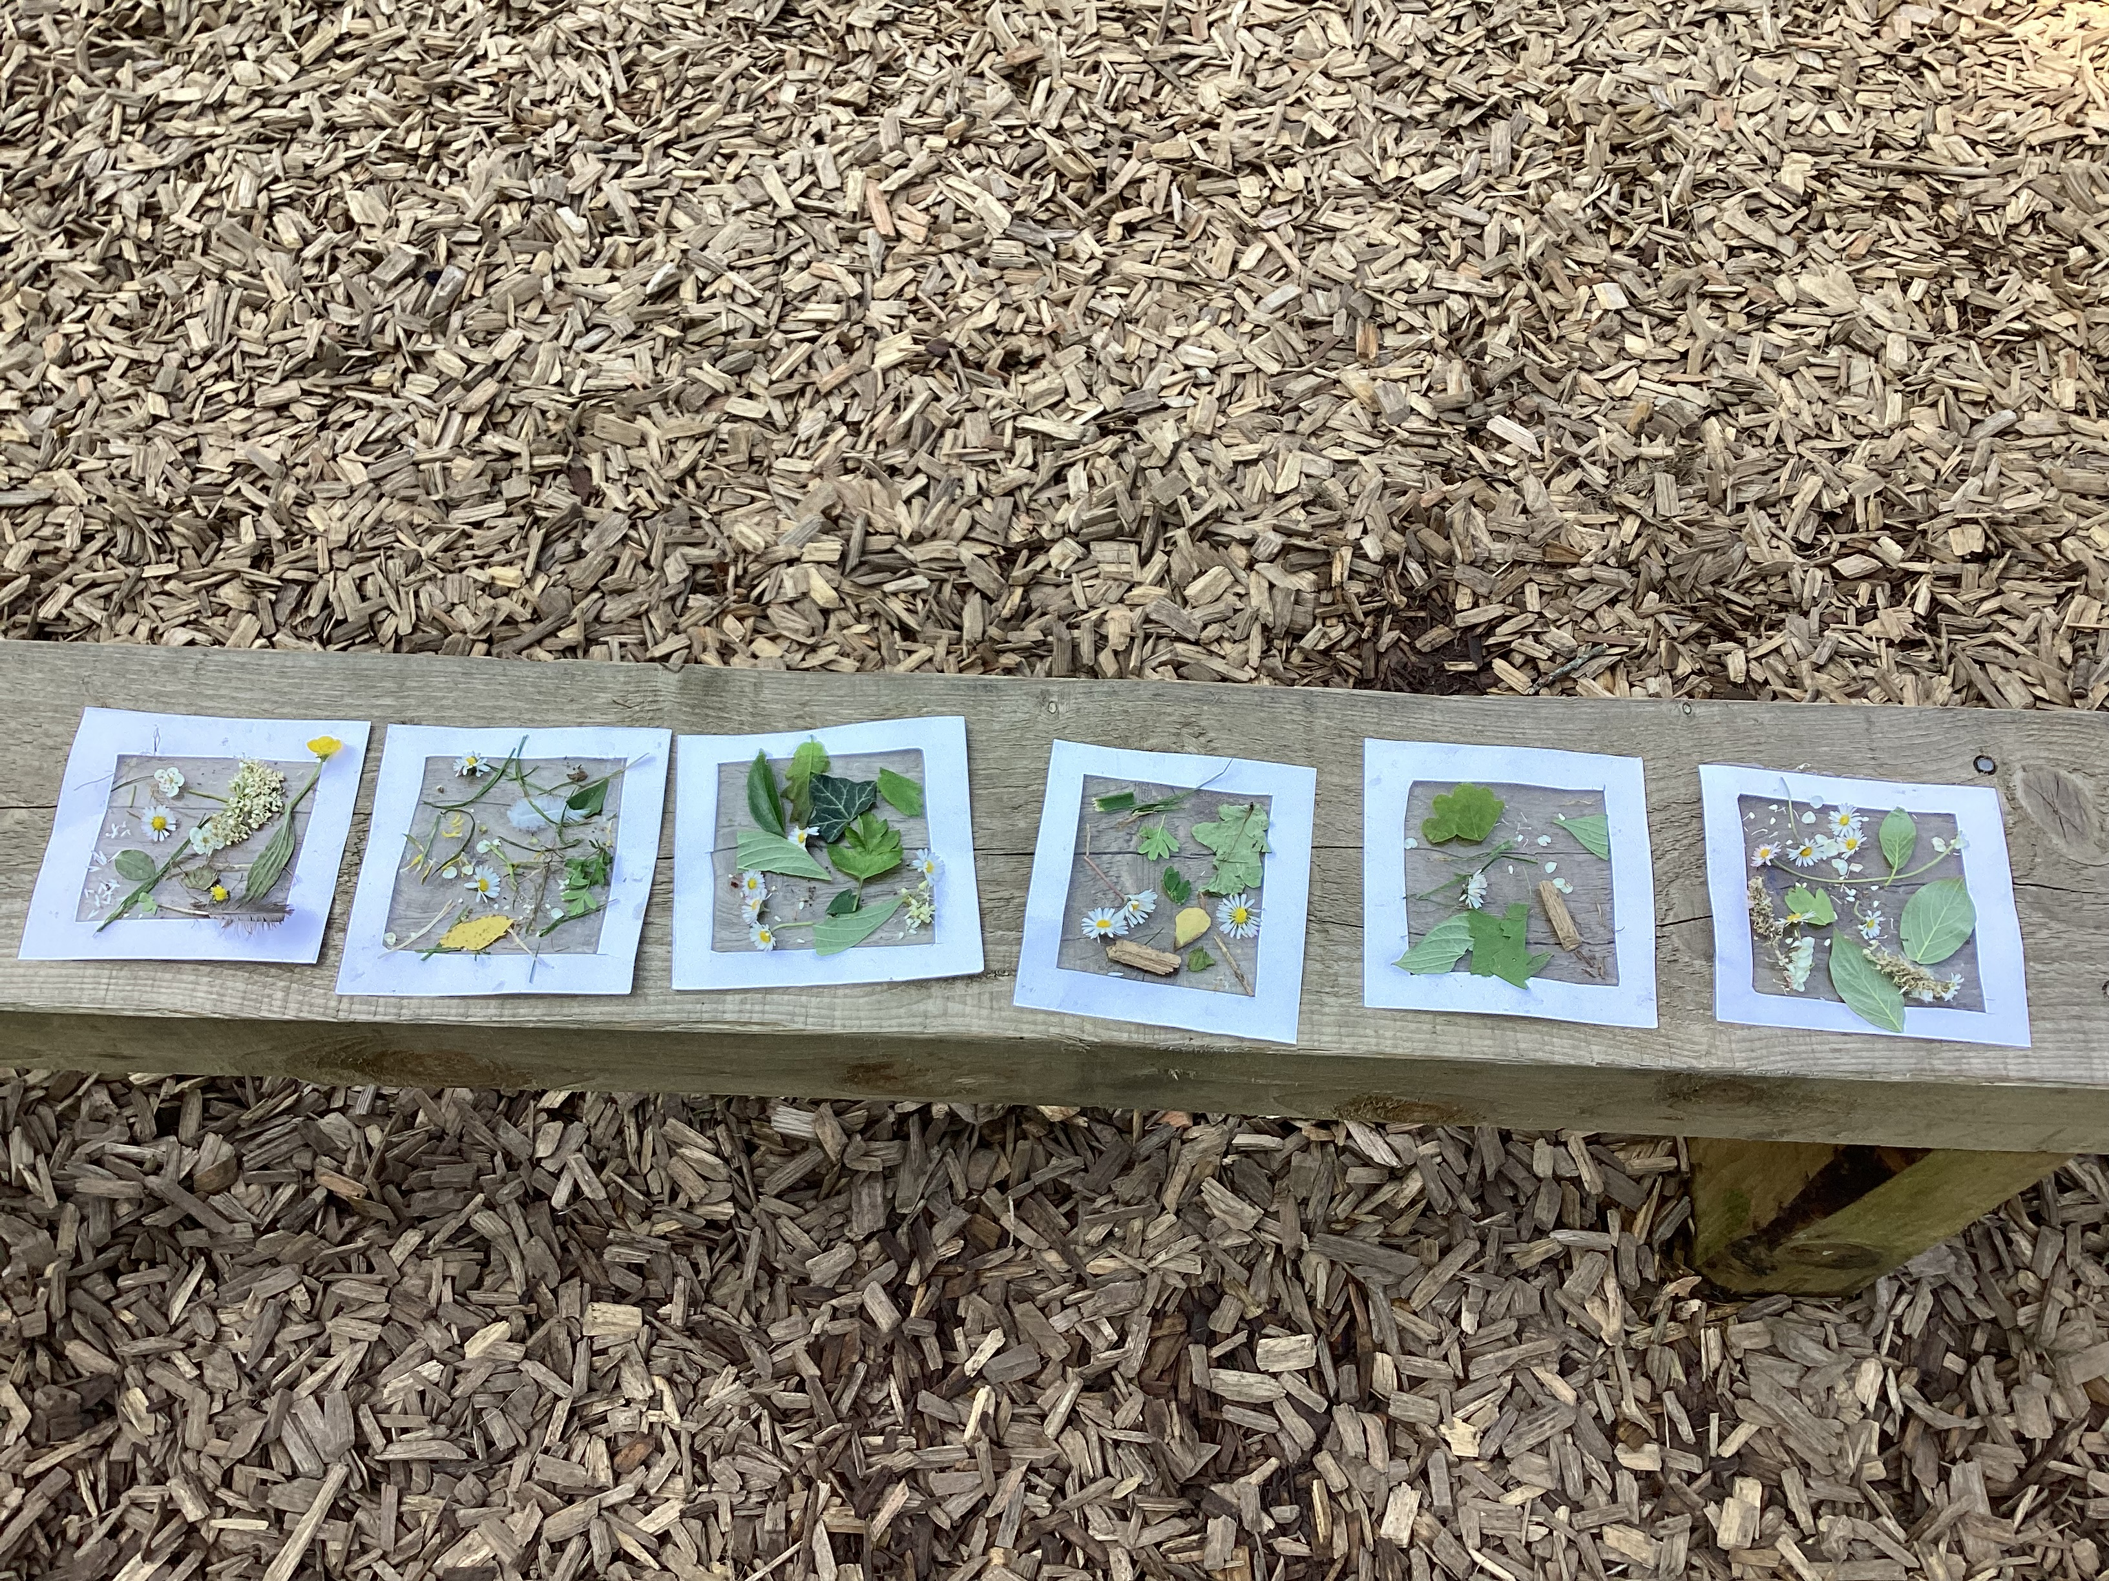
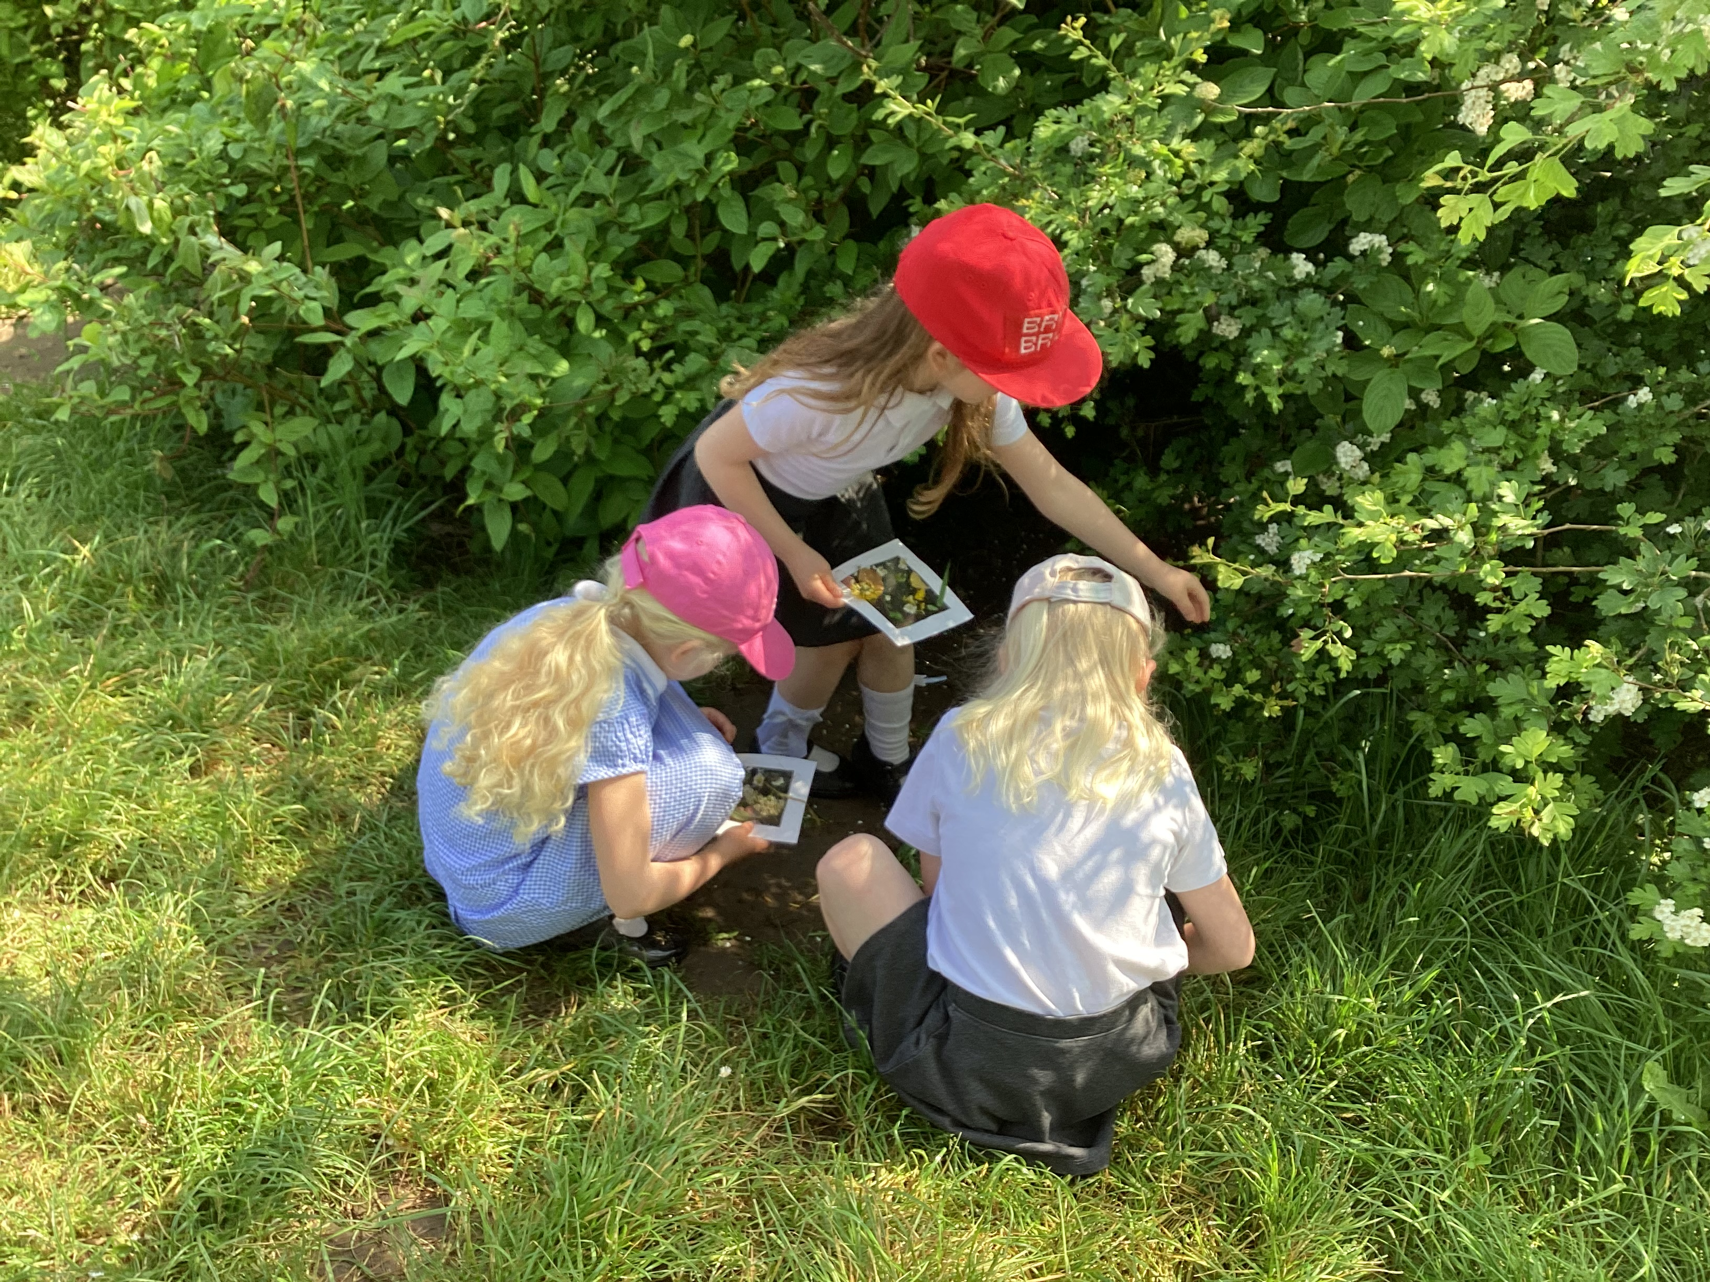
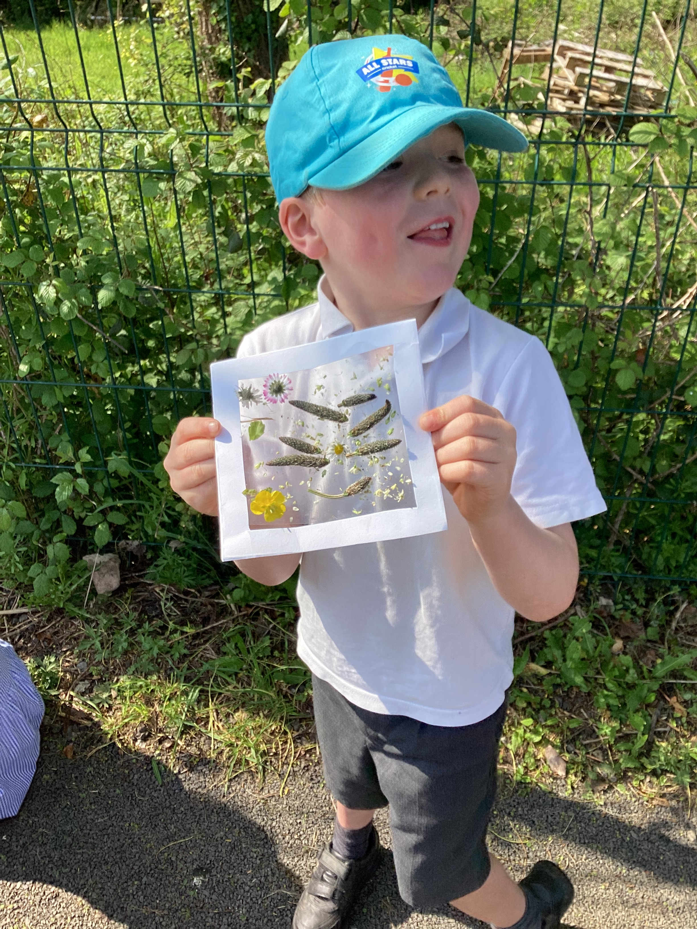
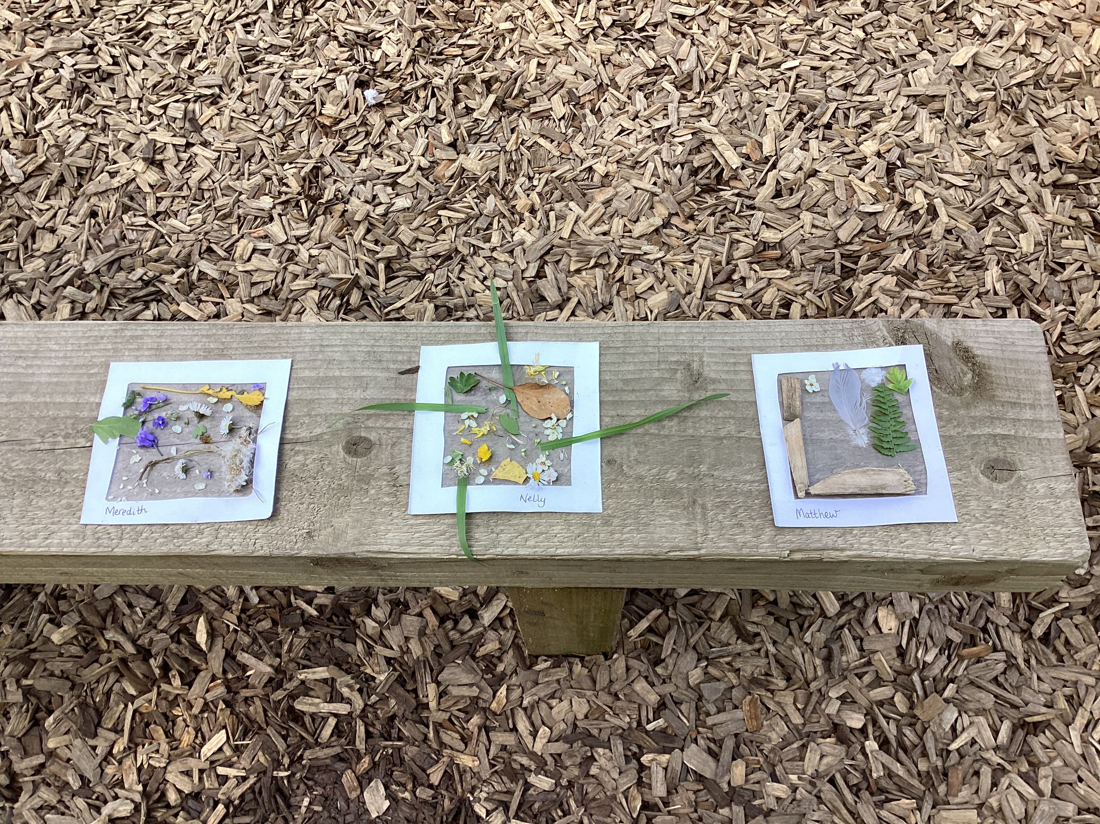
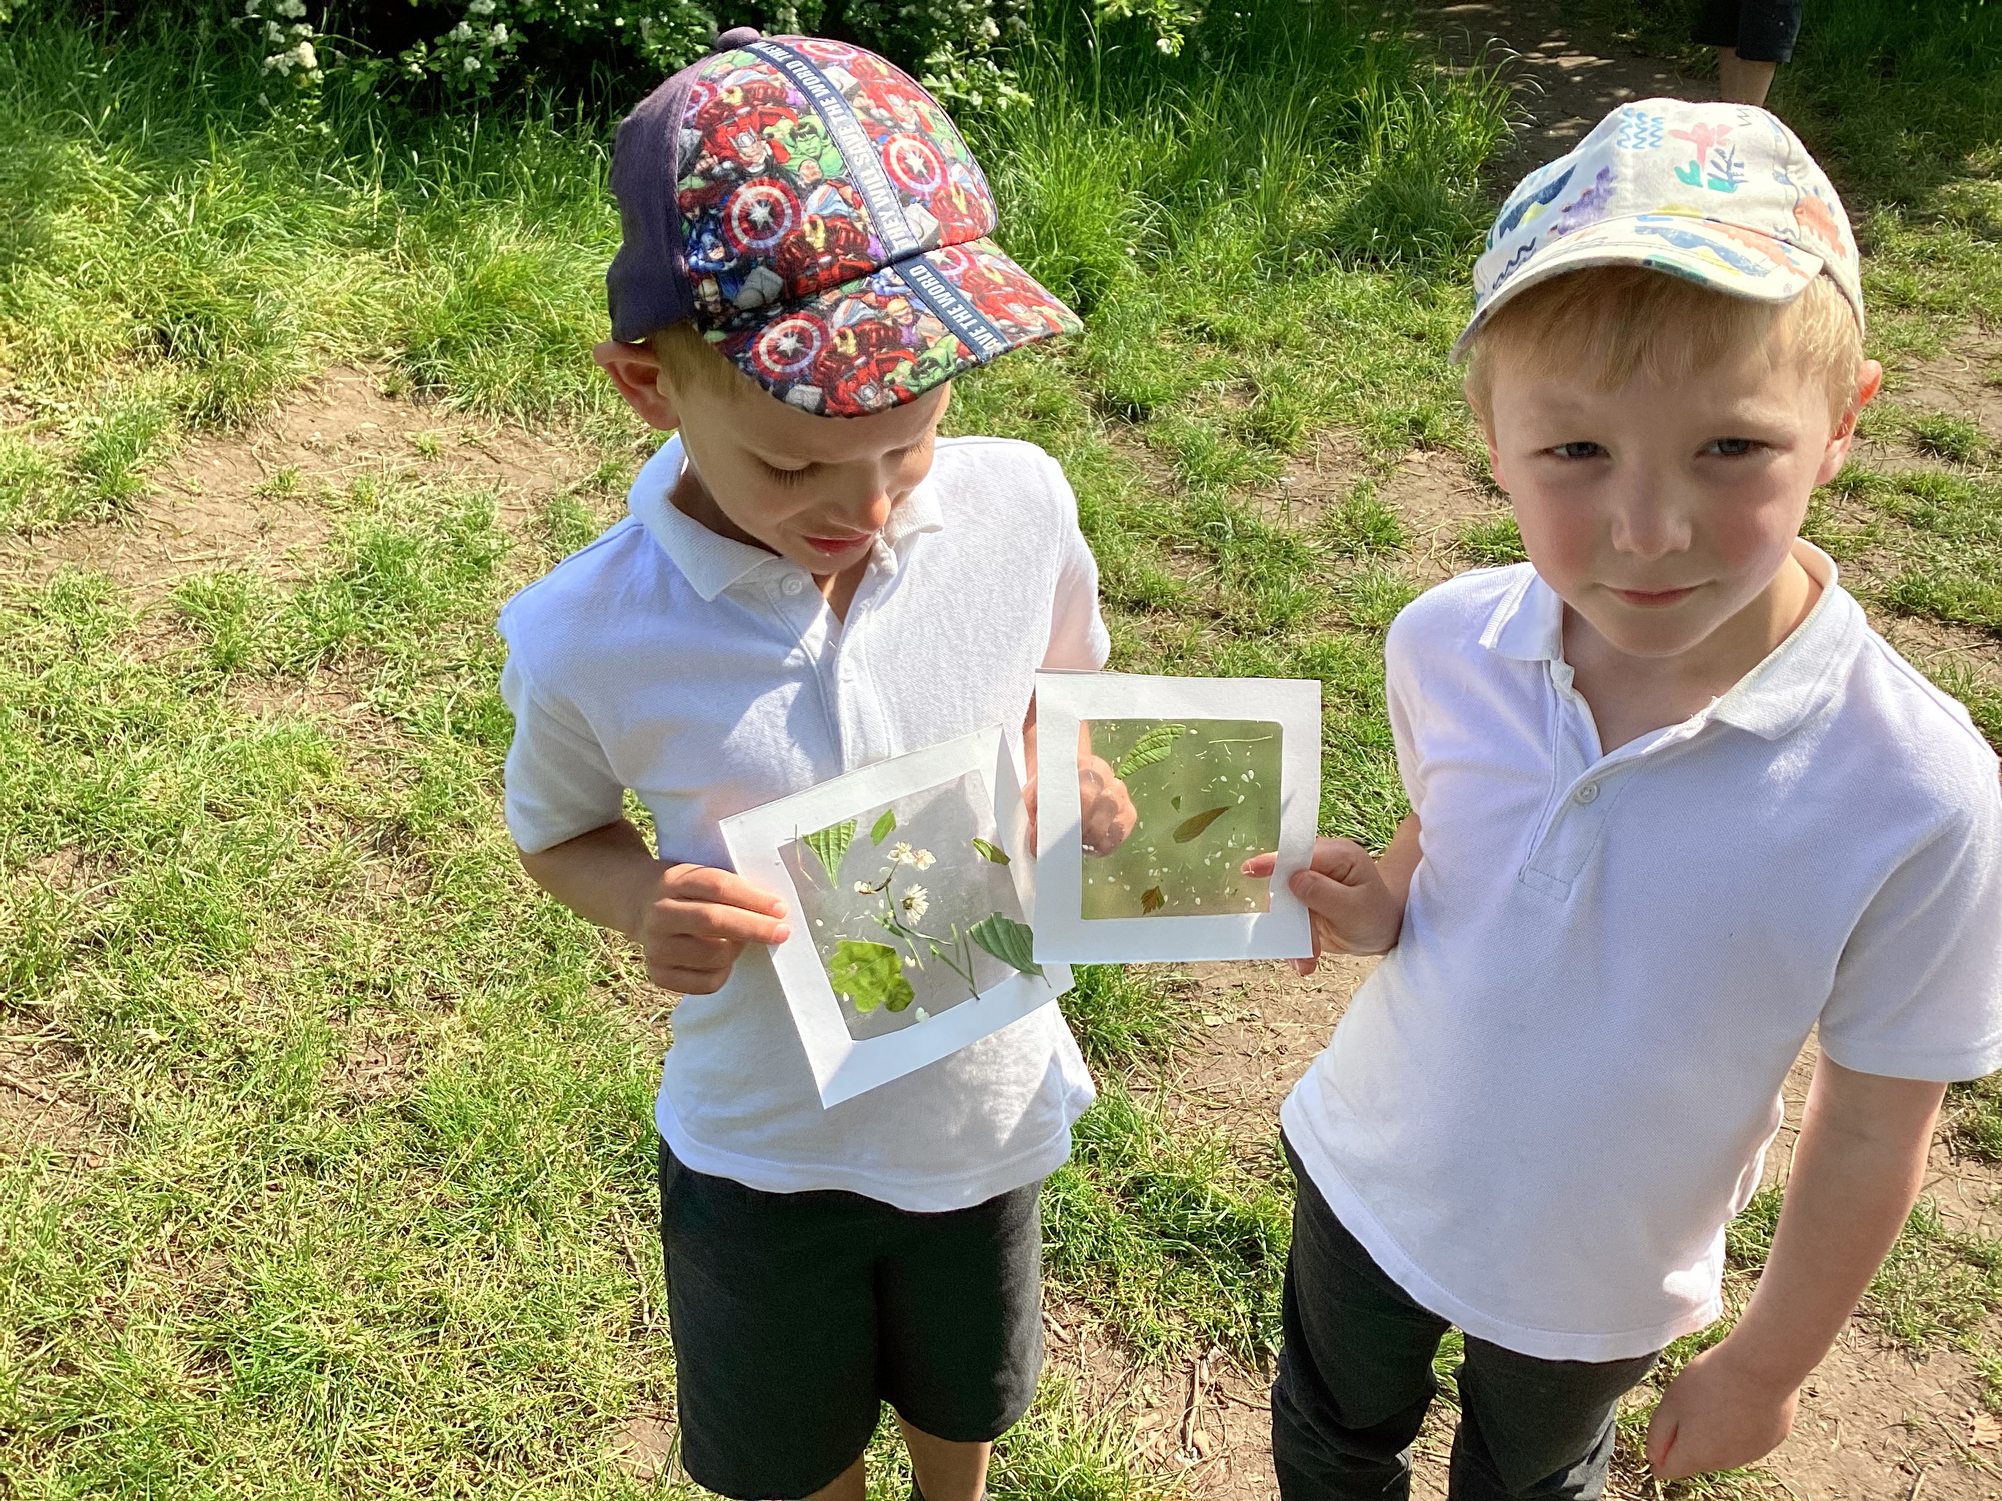
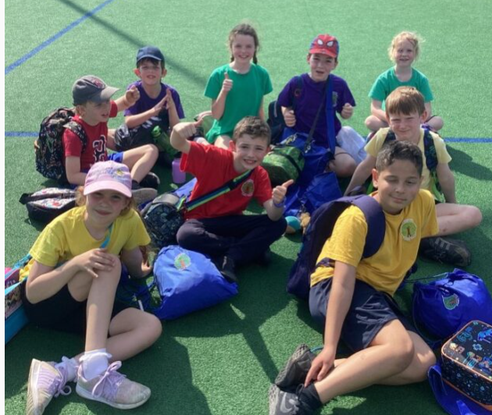
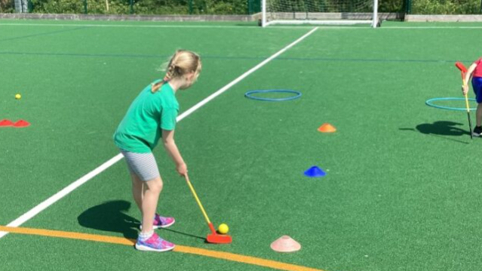
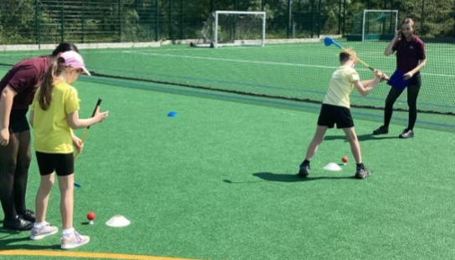
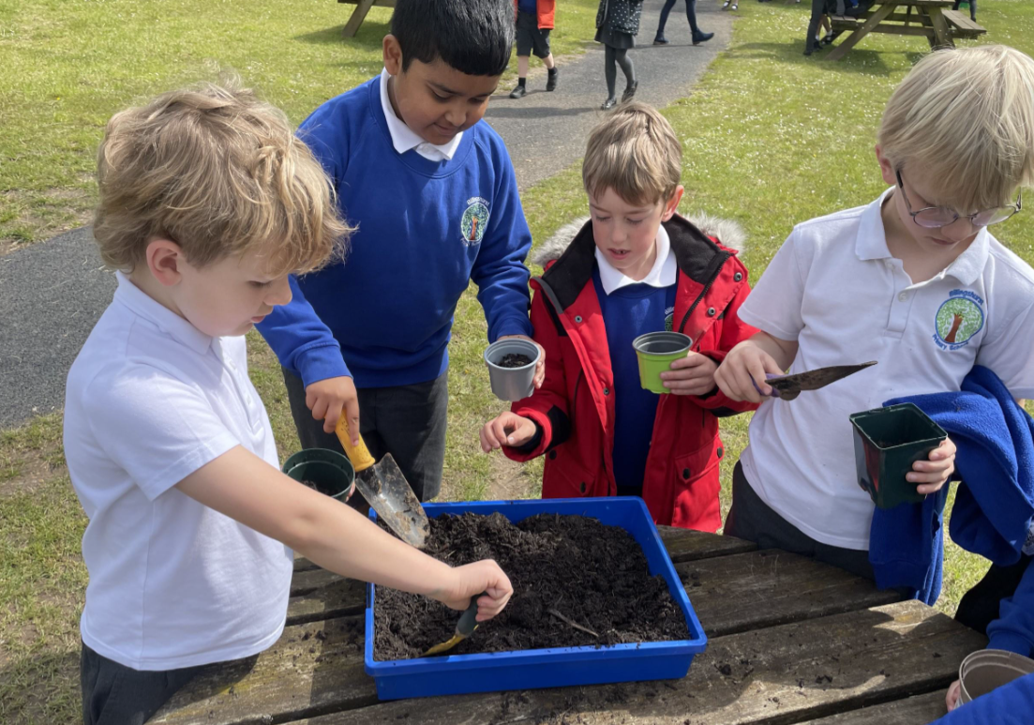
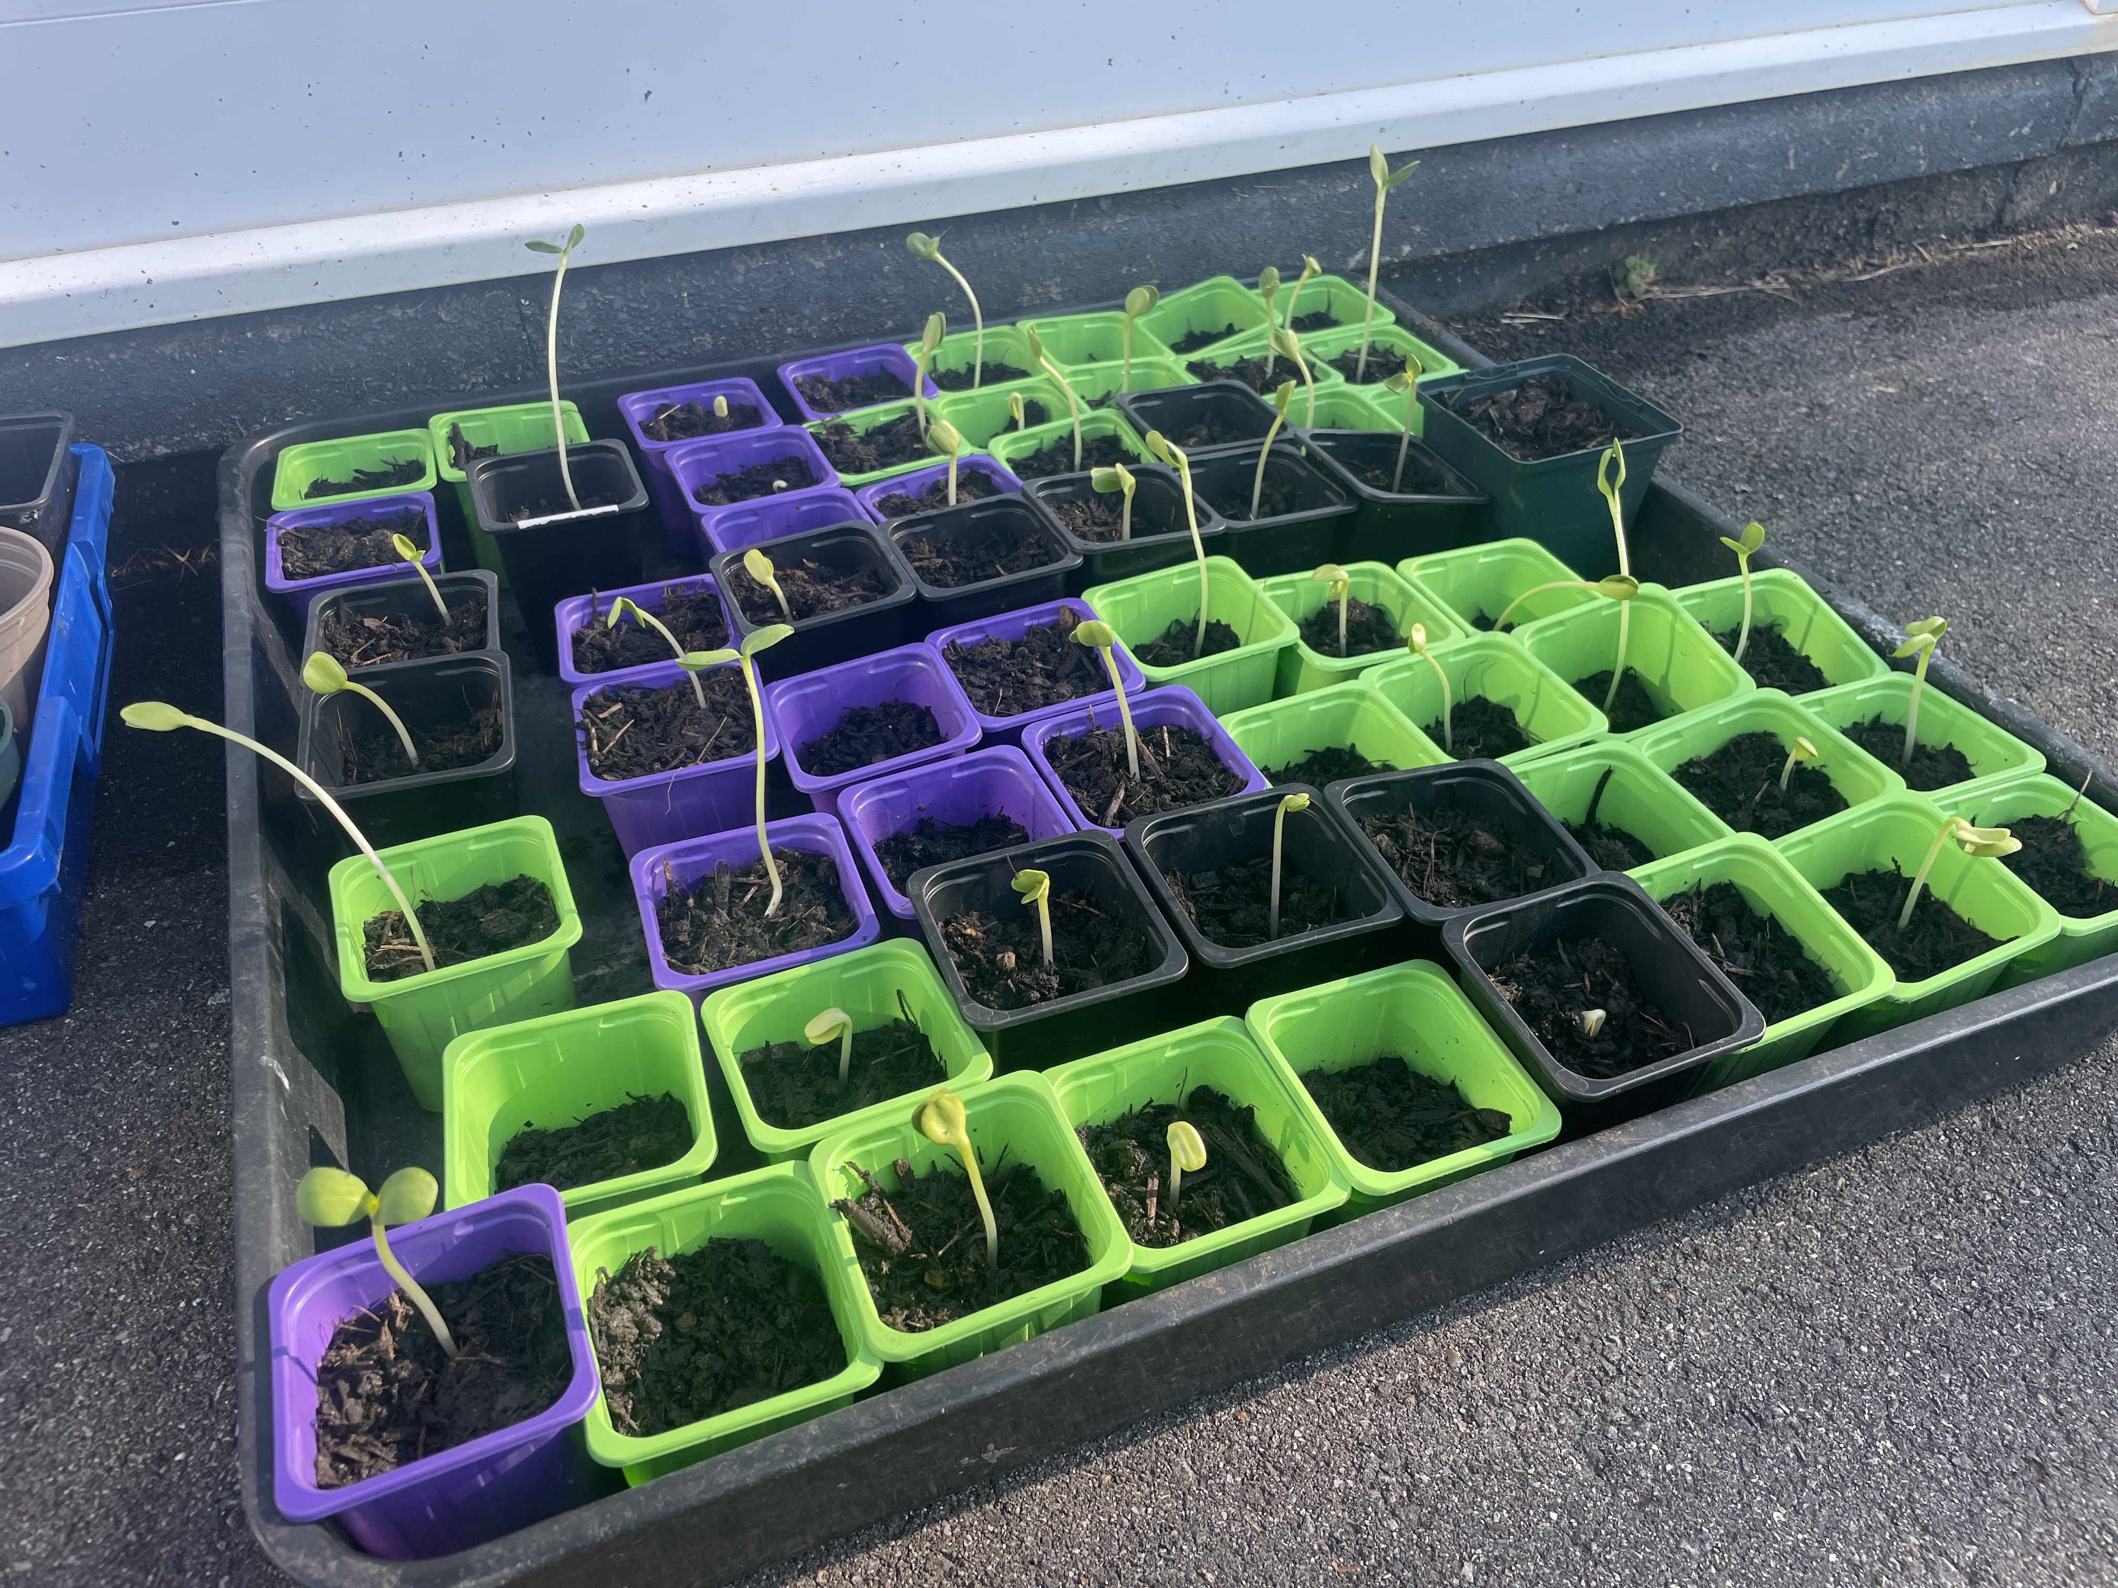
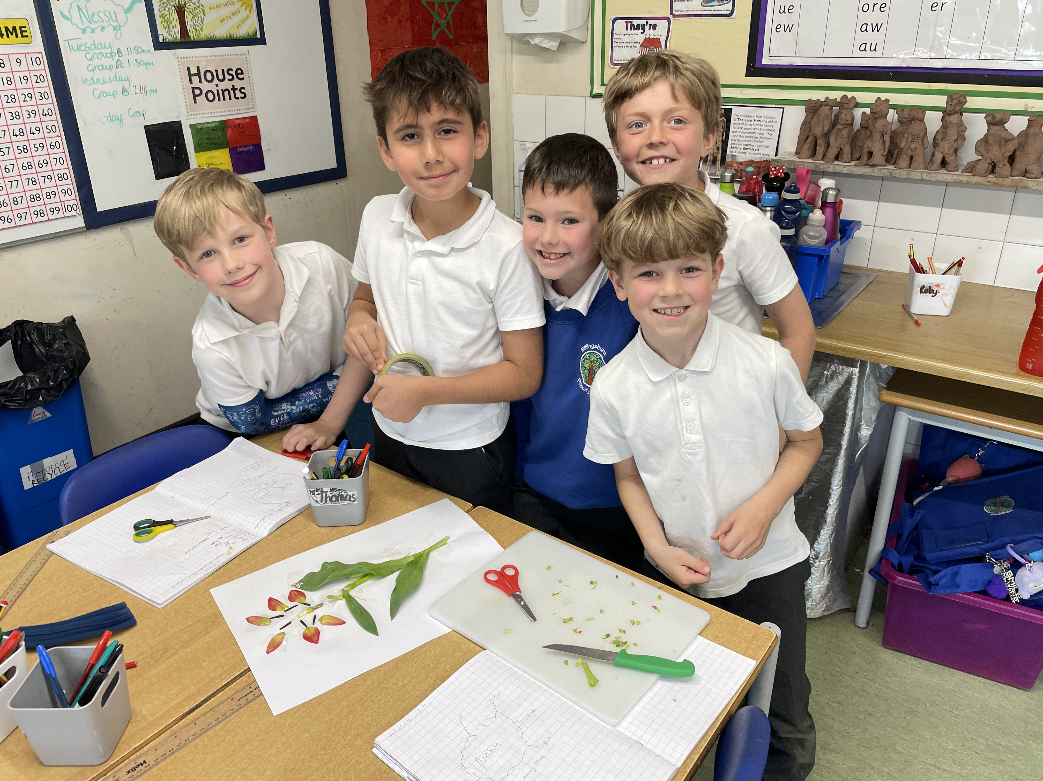
EYFS
This week we have been enjoying the story 'We're going on a bear hunt', so the children have been going on a 'nature hunt' to design and create their own nature windows. We explored the school grounds and found some beautiful leaves and flowers!
Year 3 & 4 Tri Golf event
On Thursday, a group of nine children from Year 3 and 4 went to The Weald to take part in a Tri Golf event. They had an amazing afternoon learning how to use a wedge and a putter. After eight different activities they managed to come fifth. On an unusually warm afternoon they were all amazing and represented the school brilliantly.
Year 3 planted sunflowers
Last week, Year 3 planted sunflowers as part of their learning about plants in science....in just one week, because we've had so much sunshine, they have already started to grow.

Slide 4























BPSCA
Summer Fun Day – Saturday 6th July 11am-2pm.
We need your help! Donations of cuddly toys and tomboys prizes for both children and adults can be left in the main office. Volunteers to set up or run a table for an hour; sign up will be circulated soon!
Having a party?
Hire our eco-friendly party pack of 30 place settings and serving equipment. Email bpsca@billingshurstprimary.org.uk
House Point Results
Winning House - Goodwood
Thank you to our sponsors for their support!
Cowdray
819
Parham
912
Goodwood
1048
Petworth
1002
Gil Parham Woodside Sculpture
www.woodlouseindustries.com
Upcoming dates:
13th – 16th May – KS2 Standard Assessment Tests (SATs)
Monday 13th May - Year 5 & 6 Weald athletics event 3.30-5.15pm
Friday 17th May – Year 6 Tile Barn parent meeting 3.30pm KS2 Hall
Wednesday 22nd May – Open Classrooms 2.45pm EYFS & KS1, 3.05pm KS2
Thursday 23rd May – KS1 Little Big Sing 9:00am-11:30am
Thursday 23rd May – Year 1 trip to Tilgate Park
Letters home this week: No additional letters
Best quality Blast-frozen Family run
www.tomthefish.co.uk
@BPSEYFS
@BPSYearOne
@BPSYearTwo
@BPSYearThree
@BPSYearFour
@BPSYearFive
@BPSYearSix
Year groups regularly post photos of children and learning on their X account. Please follow your child’s Year Group using the handles above.
www.professionalrubbersurfaces.com
The Budding Foundation
Follow us on Facebook for all the latest updates:
www.facebook.com/BillingshurstPrimary

